Slide 1
Methods of spatial field processing for ionospheric
diagnostics problems
M. A. Zverev, S. I. Knizhin, M. V. Tinin

Slide 2
A low-orbit satellite synthesizes a line of sources

Slide 3
Problem definition
A low-orbit satellite synthesizes a line of sources
Inhomogeneous medium
Receivers register a scattered field
Double spatial field processing based on the DWFT method
Phase projections of the scattered field after processing

Slide 4
The model for inhomogeneous medium
The permittivity model for ionospheric plasma:
$ε\left(x,z,t\right)=ε_{chep}\left(z\right)+{\tilde{ε}}_{irr}\left(x,z,t\right)$.
The model of the background ionosphere :
$$ε_{chep}\left(z\right)=1−{\left(\frac{f_{кр}}{f}\right)}^{2}exp\left[1−\frac{z−z_{m}}{H}−exp\left(−\frac{z−z_{m}}{H}\right)\right].$$
The model of plasma irregularities :
$${\tilde{ε}}_{irr}\left(x,z,t\right)=\sum_{i=1}^{5}{{\tilde{ε}}_{mi}\left(t\right)exp\left[−\left(\frac{{\left(x−x_{mi}\left(t\right)\right)}^{2}}{2l_{1i}^{2}(t)}+\frac{{\left(z−z_{mi}(t)\right)}^{2}}{2l_{2i}^{2}(t)}\right)\right]},$$
where cross and longitudinal dimensions of irregularities:
$$l_{1i}\left(t\right)=l_{1i} \left(1+{\left(1+{\left(\frac{τ_{reli}}{t}\right)}^{2}\right)}^{−1/2}\right),$$
$$l_{2i}\left(t\right)=l_{2i} \left(1+{\left(1+{\left(\frac{τ_{reli}}{t}\right)}^{2}\right)}^{−1/2}\right),$$
and maximum value of irregularities permittivity:
$$ε_{mi}\left(t\right)=\frac{ε_{mi} exp\left(−\frac{t}{τ_{reli}}\right)}{\sqrt{l_{1i}^{2}+l_{2i}^{2}}}.$$
Location of ionospheric irregularities center:
$$x_{mi}\left(t\right)=x_{mi}+v_{xi}t,$$
$$z_{mi}\left(t\right)=z_{mi}.$$

Slide 5
The model for inhomogeneous medium

Slide 6
Main formulas
As a model of probing radio wave field, use an expression in the phase screen approximation:
$$U\left(x(t),x_{0}\right)=\frac{ikA_{0}exp\left(ikZ\right)}{8π^{2}\left(z_{t}−z_{s}\right)\left(z_{s}−z_{0}\right)}\int_{−∞}^{∞}{exp\left[ikφ_{s}\left(x_{s},t\right)+\frac{ik}{2}\left(\frac{{\left(x_{s}−x_{0}\right)}^{2}}{\left(z_{s}−z_{0}\right)}+\frac{{\left(x(t)−x_{s}\right)}^{2}}{\left(z_{t}−z_{s}\right)}\right)\right]}dx_{s}.$$
In this case a line of sources is synthesized by a low-orbit satellite:
$$x\left(t\right)=x_{н}+v_{s}t.$$
Partial phase:
$$φ_{s}\left(x_{s},t\right)=\frac{1}{2}\int_{−∞}^{∞}{ε\left(x,z,t\right)}dz^{′}=\frac{1}{2}\int_{z_{0}}^{z_{t}}{\left({\tilde{ε}}_{chep}\left(z^{′}\right)+{\tilde{ε}}_{irr}\left(x,z^{′},t\right)\right)dz^{′}}= \\ =…=\frac{eHf_{кр}^{2}}{2f^{2}}+\frac{\sqrt{2π}}{2}\sum_{i=1}^{5}{{\tilde{ε}}_{mi}\left(t\right){ l}_{2i}(t) exp\left(−\frac{{\left(x_{s}−x_{mi}\left(t\right)\right)}^{2}}{2l_{1i}^{2}(t)}\right).}$$
The wave phase change before spatial field processing can be found from the equation:
$$kФ\left(x\left(t\right),x_{0}\right)=Arg\left[U\left(x(t),x_{0}\right)\right].$$

Slide 7
The wave phase change of the scattered field before spatial field processing

Slide 8
Double spatial field processing based on the DWFT method
Expression for the double spatial field processing based on the DWFT method:
$$U^{∗}\left(x^{∗},x_{0}^{∗},t\right)=\int_{−∞}^{∞}{\int_{−∞}^{∞}{dxdx_{0}U\left(x,x_{0},t\right)exp\left\{−ik\left[Z+\frac{{\left(x+x_{0}\right)}^{2}}{2Z}−\frac{2\left(x^{∗}x_{0}+x_{0}^{∗}x\right)}{Z}\right]\right\}}}$$
The wave phase change after double spatial field processing:
$$kФ^{∗}\left(x^{∗},x_{0}^{∗}\right)=Arg\left[U^{∗}\left(x^{∗},x_{0}^{∗}\right)exp\left(−\frac{2ikx^{∗}x_{0}^{∗}}{Z}\right)\right]$$

Slide 9
The wave phase change of the scattered field after spatial field processing

Slide 11
The model for inhomogeneous medium
The permittivity model for ionospheric plasma:
$ε\left(x,z,t\right)=ε_{chep}\left(z\right)+{\tilde{ε}}_{irr}\left(x,z,t\right)$.
The model of the background ionosphere :
$$ε_{chep}\left(z\right)=1−{\left(\frac{f_{кр}}{f}\right)}^{2}exp\left[1−\frac{z−z_{m}}{H}−exp\left(−\frac{z−z_{m}}{H}\right)\right].$$
The model of plasma irregularities :
$${\tilde{ε}}_{irr}\left(x,z,t\right)=\sum_{i=1}^{2}{{\tilde{ε}}_{mi}exp\left[−\left(\frac{{\left(x−x_{mi}\left(t\right)\right)}^{2}}{2l_{1i}^{2}}+\frac{{\left(z−z_{mi}(t)\right)}^{2}}{2l_{2i}^{2}}\right)\right]},$$
where location of ionospheric irregularities center:
$$x_{mi}\left(t\right)=x_{mi}+v_{xi}t,$$
$$z_{mi}\left(t\right)=z_{mi}.$$

Slide 12
Parameters of the task, when a line of sources is synthesized by a low-orbit satellite
Parameters of the irregularities
№ | $$l_{1i}, km$$ | $$l_{2i},km$$ | $$x_{mi},km$$ | $$z_{mi},km$$ | $$ε_{mi}$$
1 | 0,04 | 0,04 | -0,11 | 400 | 0,002
2 | 0,04 | 0,04 | 0,11 | 400 | 0,002
Parameters of the low-orbit satellite
$$z_{orb},km$$ | $$v_{s}, km/s$$ | $$f, MHz$$
860 | 7,5 | 150
Parameters of the background ionosphere
$$z_{m},km$$ | $$f_{kr}, MHz$$ | $$H,km$$
350 | 5 | 150
Other parameters of the task:
the number of elements in the transmitting and receiving systems $N_{x}=200 и N_{x_{o}}=200$;
the distance between receivers and sources $∆x=40 м$ и $∆x_{0}=40 m$;
satellite takes about 1.1 s to synthesize a line of sources.

Slide 13
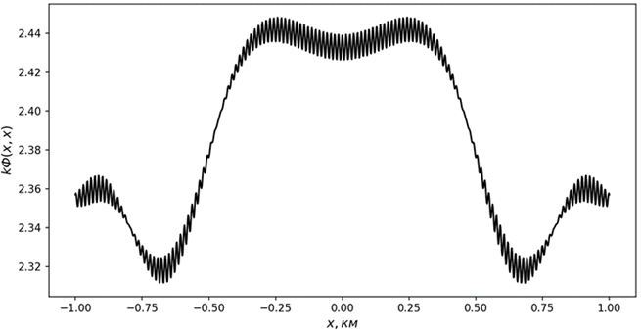
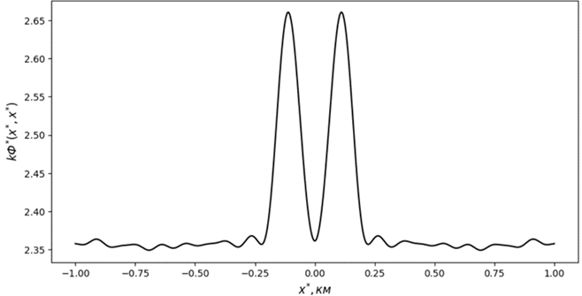
а)
б)
Figure 1 — The wave phase change of the scattered field a) before and b) after the double spatial field processing in case of stationarity the line of sources

Slide 14
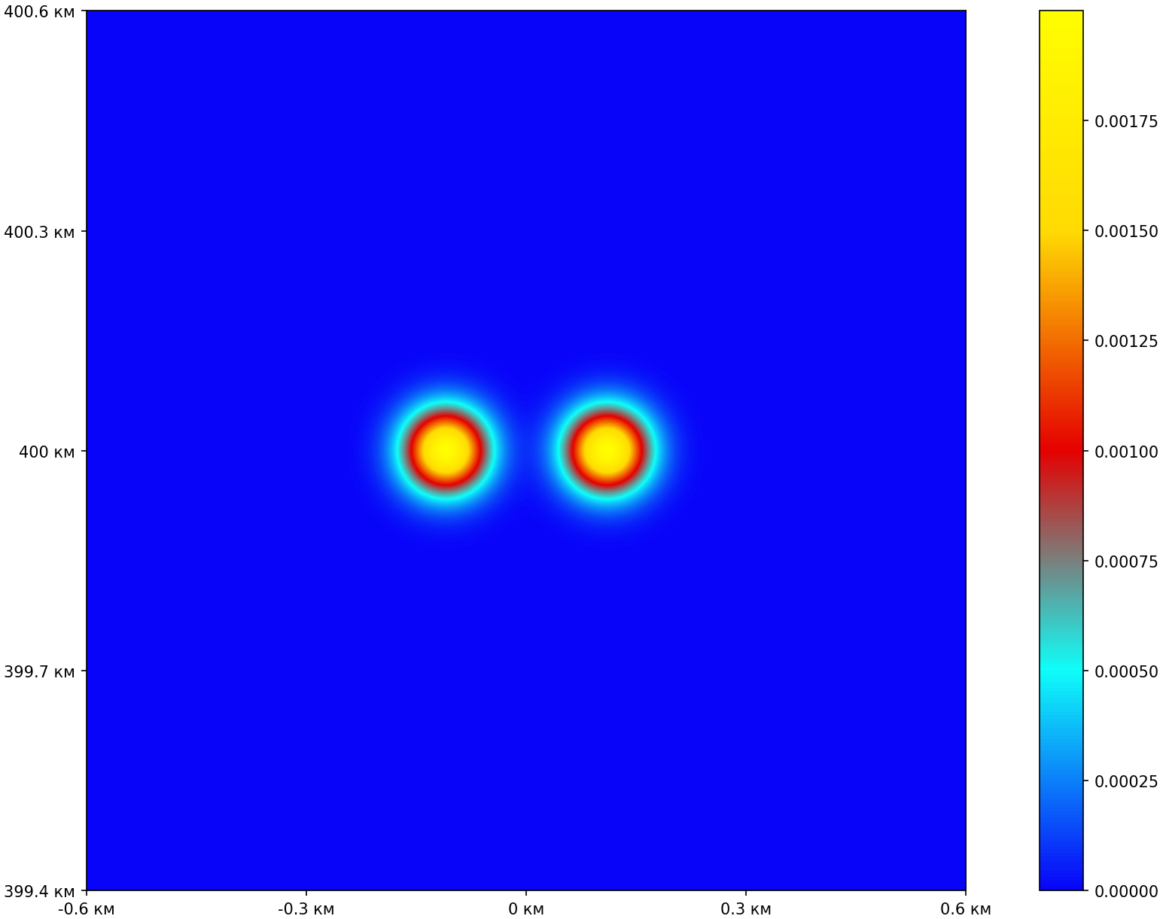
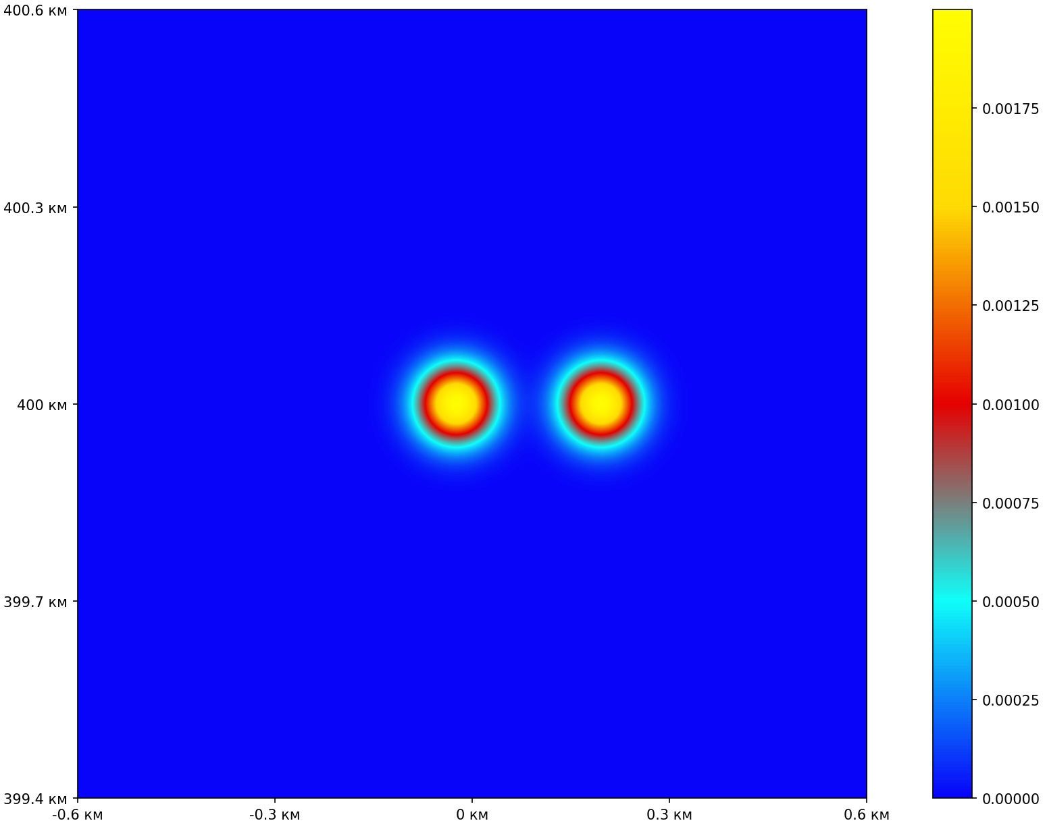
а)
б)
Figure 2 — Moving irregularities at a) the initial and b) the final moment
of time for $v_{x1}=v_{x2}=80 m/s$

Slide 15
а)
б)
Figure 3 — The wave phase change of the scattered field a) before and b) after the double spatial field processing for $v_{x1}=v_{x2}=80 m/s$ with the movement of the satellite

Slide 16
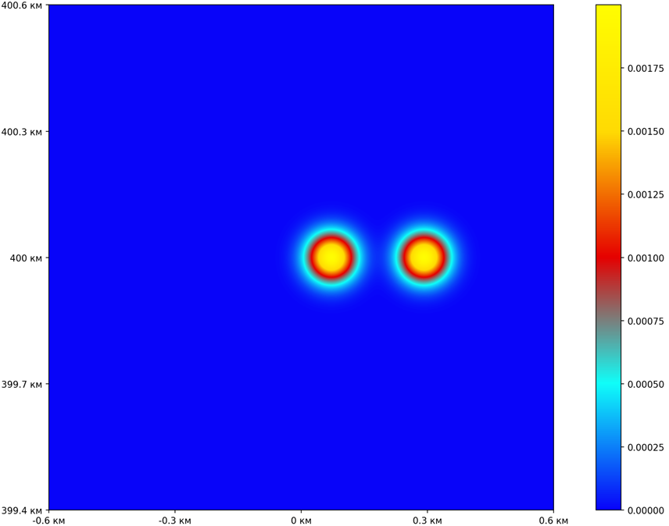
а)
б)
Figure 4 — Moving irregularities at a) the initial and b) the final moment
of time for $v_{x1}=v_{x2}=170 m/s$

Slide 17
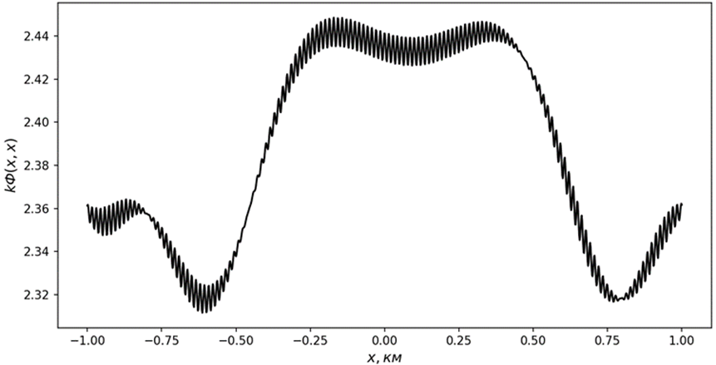
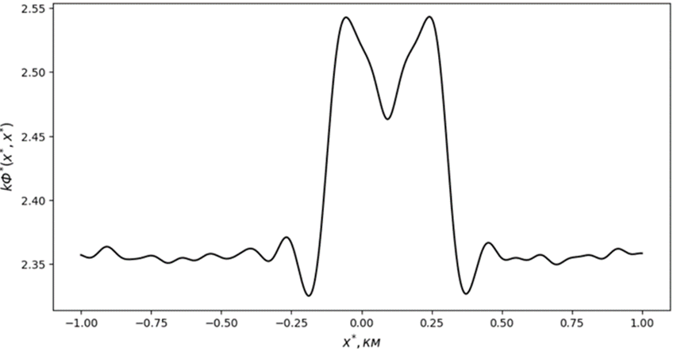
а)
б)
Figure 5 — The wave phase change of the scattered field a) before and b) after the double spatial field processing for $v_{x1}=v_{x2}=170 m/s$ with the movement of the satellite

Slide 18
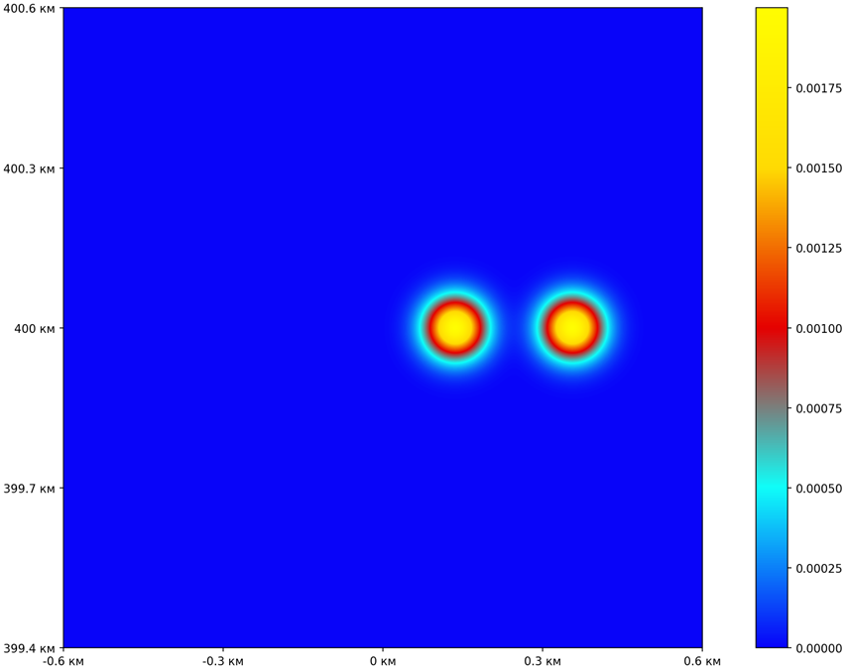
а)
б)
Figure 6 — Moving irregularities at a) the initial and b) the final moment
of time for $v_{x1}=v_{x2}=230 m/s$

Slide 19
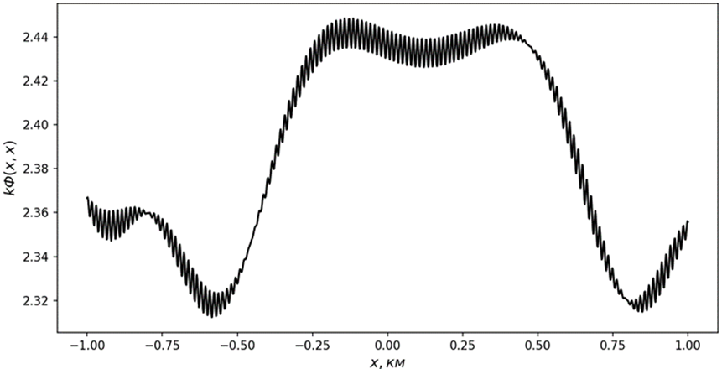
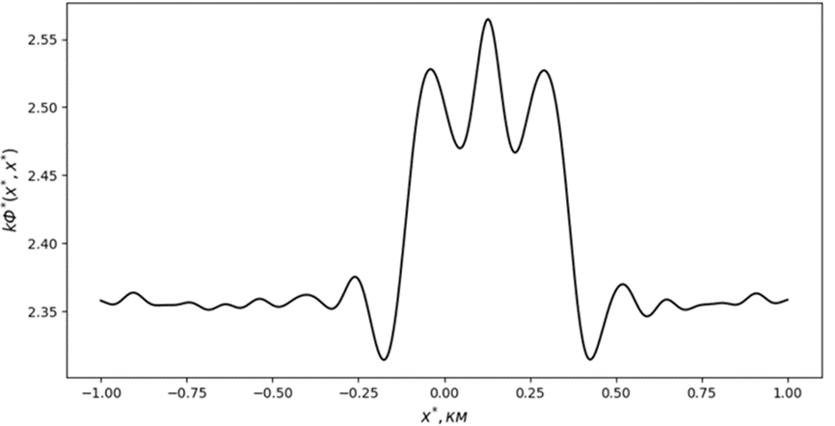
а)
б)
Figure 7 — The wave phase change of the scattered field a) before and b) after the double spatial field processing for $v_{x1}=v_{x2}=230 m/s$ with the movement of the satellite

Slide 20
Results
We explore the possibilities of double spatial field processing based on DWFT to increase the resolution of satellite diagnostics
of inhomogeneous ionospheric plasma The numerical calculation results have shown that the double spatial field processing
based on DWFT allows us to increase the resolution of the fine structure of ionospheric plasma, when the values of the
horizontal drift velocity less then 170 m/s for low-orbit satellite and 70 m/s for GPS satellite. If the velocity of horizontal drift
of plasma irregularities exceeds these values for each of the cases, then the two Gaussian curves in the phase projections
of the processed field will be indistinguishable by the Rayleigh criterion. The values of the diffuse spreading constant should
not exceed the time of synthesizing the satellite the line of sources.

