Slide 1
STUDY OF THE EVOLUTION OF A WEAK PERTURBATION INDUCED AT THE BOUNDARY OF A HOT CORONAL LOOP IN A STRONG MAGNETIC FIELD
D.I. Zavershinskii, A. S. Frolova, D. V. Agapova

Slide 2
What's being observed?

Slide 3
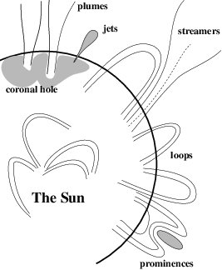
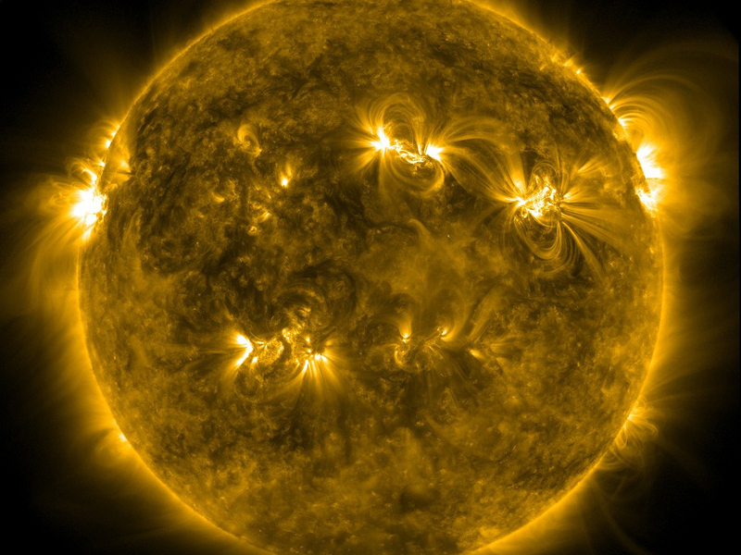
МГД – структуры в солнечной атмосфере
3

Slide 4
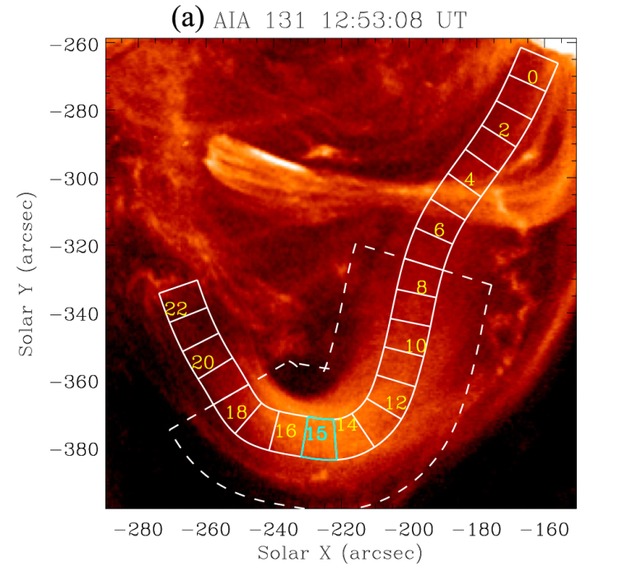
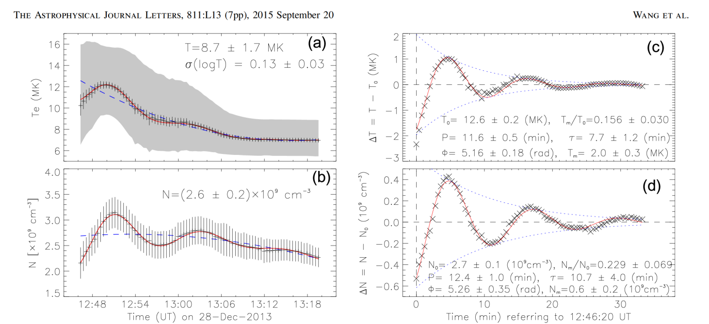

Slide 5
How is it modeled?
5

Slide 6
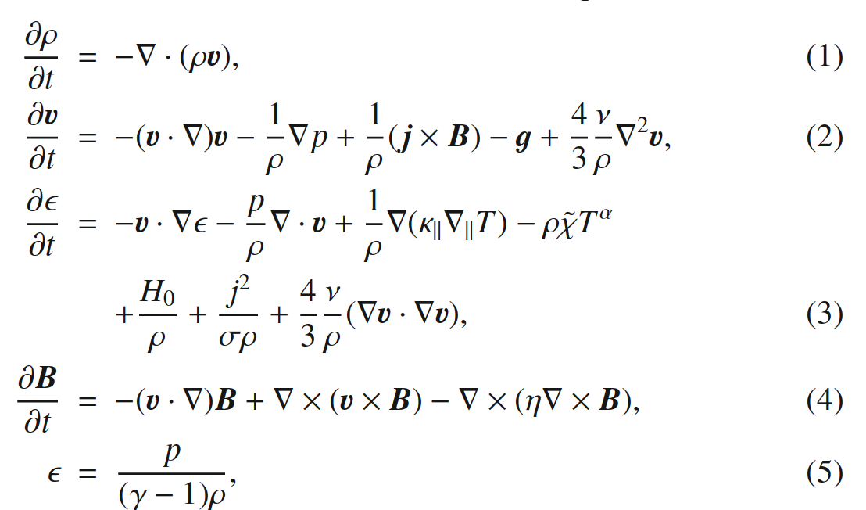
Basic equations
Owen et al., 2009;
6

Slide 7
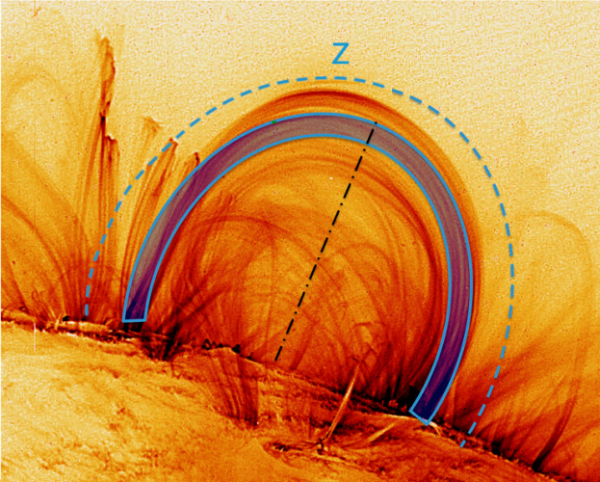
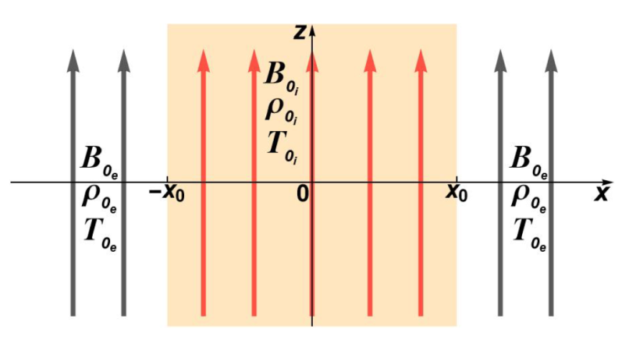
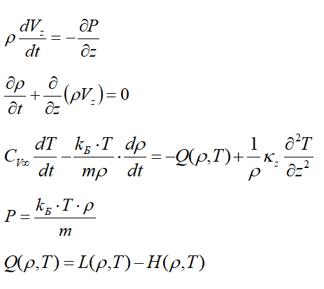
A thin flux tube, in the approximation of an infinite magnetic field
Magnetic slab
Thin flux tube approximation
2022MNRAS.514.5941A
Agapova et. al.
2021PPCF...63l4008K
Kolotkov et al.
2021SoPh..296..122B
Belov et. al

Slide 8
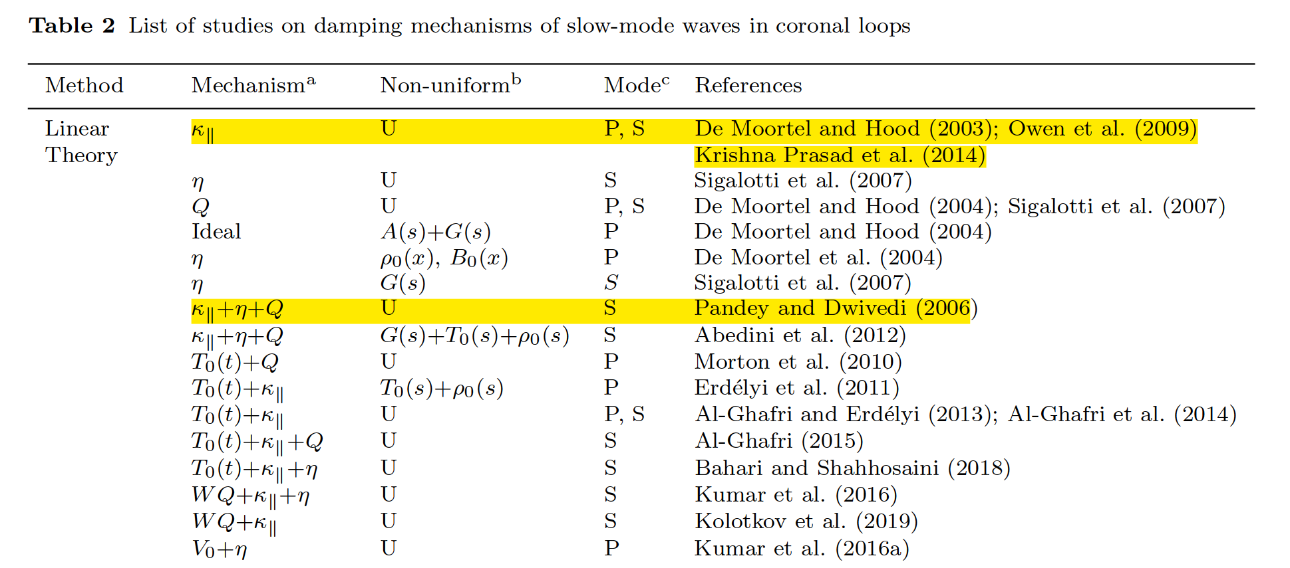
Assumptions
The influence of gravitational stratification is weak($H=\frac{P_{0}}{gρ_{0}}≪L$)
- The effect of waveguide dispersion is weak ($A≪L$)
- The plasma is highly magnetized ($β≪1$)
The effect of viscosity is negligible ($η≪1$)
Plasma homogeneous along the waveguide
8

Slide 9
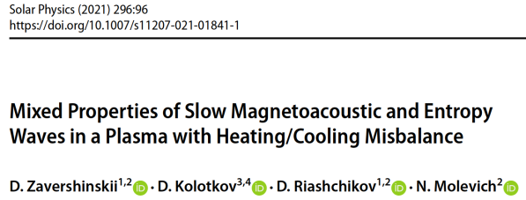
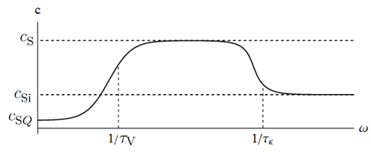
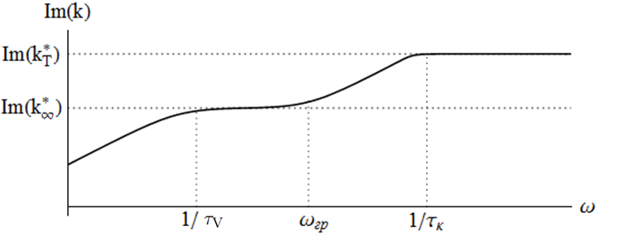

Slide 10
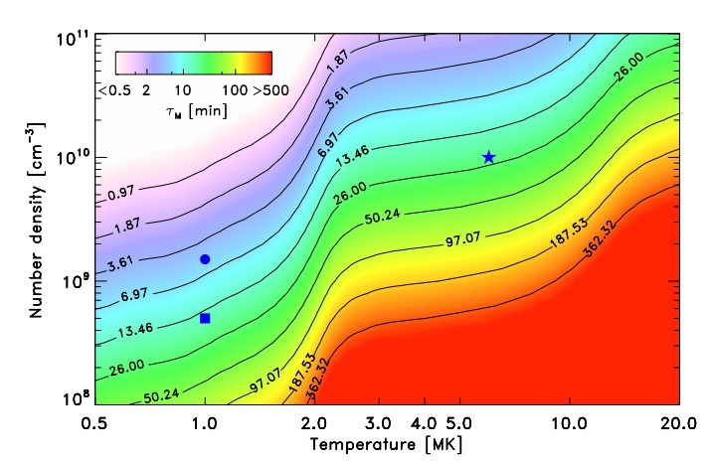
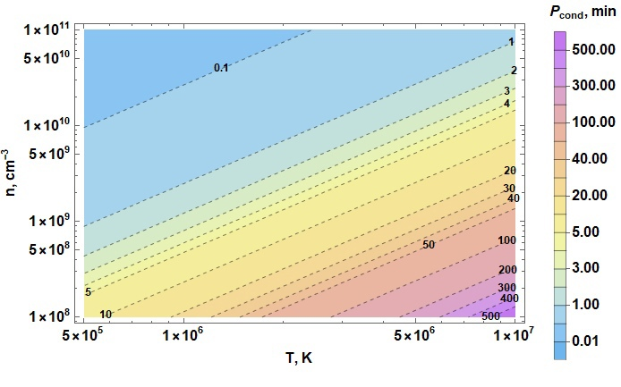
Characteristic temporal scales
Kolotkov et al 2020

Slide 11
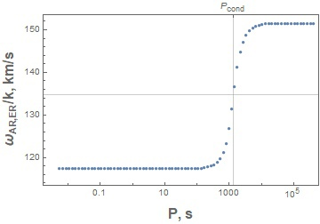
11

Slide 12
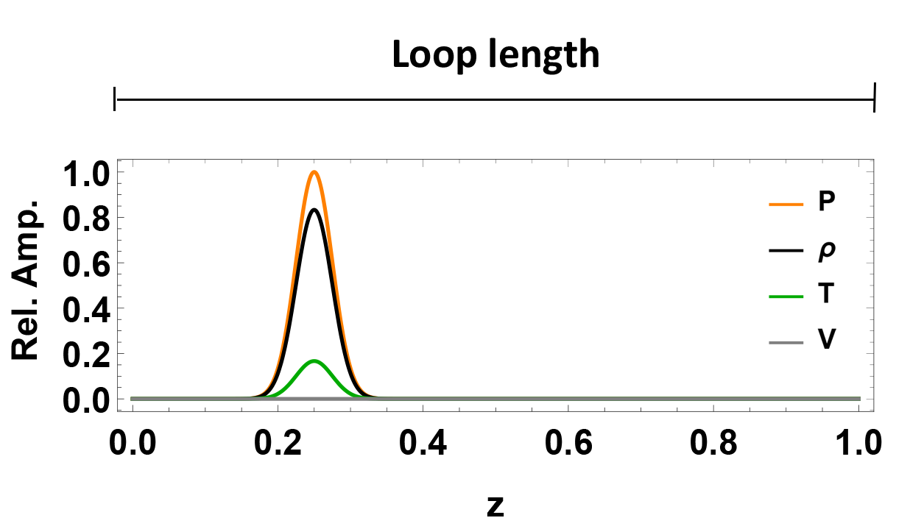
Evolution of some initial conditions
Some initial signal
Of optional type and form
Reflecting boundaries

Slide 13
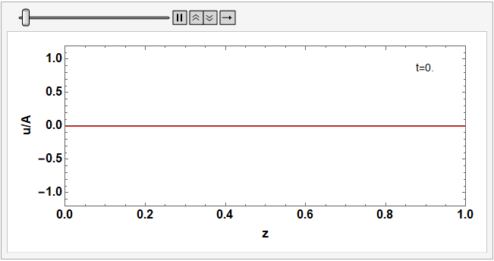
Solution of boundary value problem

Slide 14
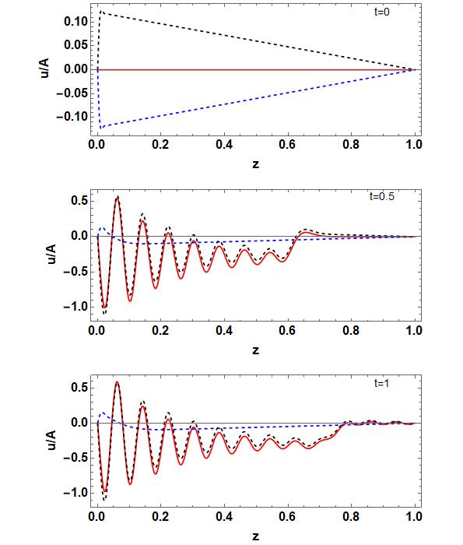
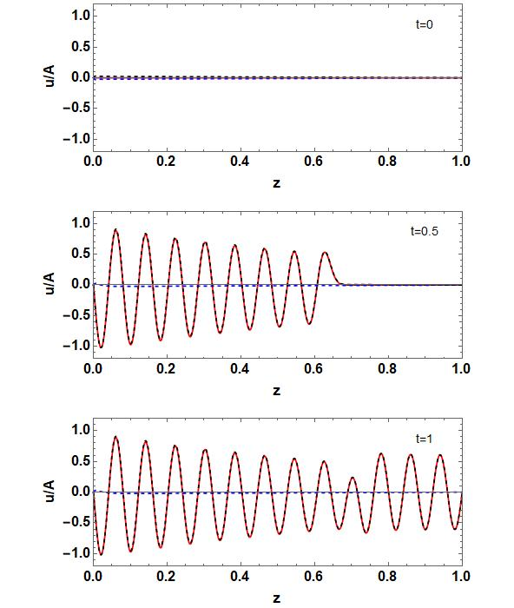

Slide 15
THANK YOU
10

