Slide 1
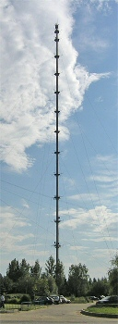
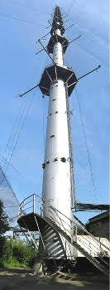
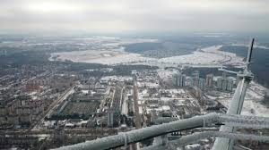
Statistical characteristics of squalls passing through the Obninsk’s high-altitude instrumental tower in 2014-2023
Natalia V. Vazaeva, Otto G. Chkhetiani, Georgy S. Golitsyn, Liudmila K. Kulizhnikova, Mariya K. Matskevich
This work was supported by Russian Science Foundation, project no. 23-17-00273
BSFP 2024
September, 1-7, 2024
Irkutsk region, Russia

Slide 2
Aims and Motivation
The danger of squalls and the complexity of their forecasting is associated with the suddenness of their formation.
Squalls can have great destructive power and often cause significant material damage, in particular, power and communication lines are defected, rural buildings are damaged, and the operation of precision equipment and transport is disrupted.
Diagnostics of the main characteristics of squalls and an approximate assessment of damage should be possible using a large array of data on wind speed and direction obtained with sufficient statistical reliability (i.e. data from the high-altitude instrumental tower of the Institute of Experimental Meteorology of the Federal State Budgetary Institution NPO Typhoon)

Slide 3
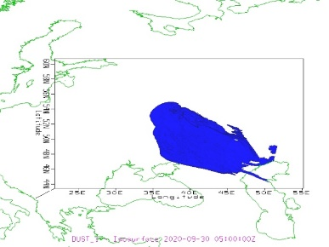
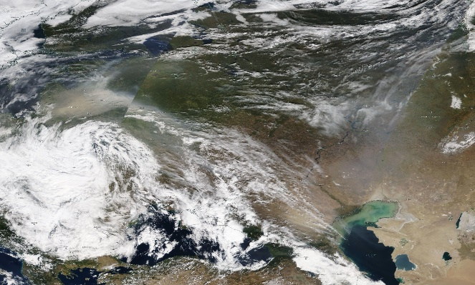
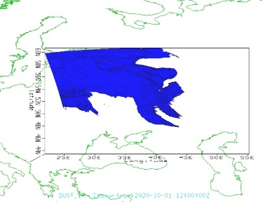
Aims and Motivation
Simulation of specific cases of squalls on an adapted WRF model capable of ⁽¹⁾resolving coherent structures of various scales and orientations, as well as ⁽²⁾taking into account the effect on squall dynamics, at the same time ⁽³⁾made it possible to conclude that aerosol emission (one of the practical inspiring for us) is intensified by coherent structures. In addition, a long-lived squall line can cause a severe dust storm over arid regions.
Satellite image of a dust storm from Kalmykia 2020. Baltic. October 1, 2020
Model findings for September 30 / October 1, 2020

Slide 4
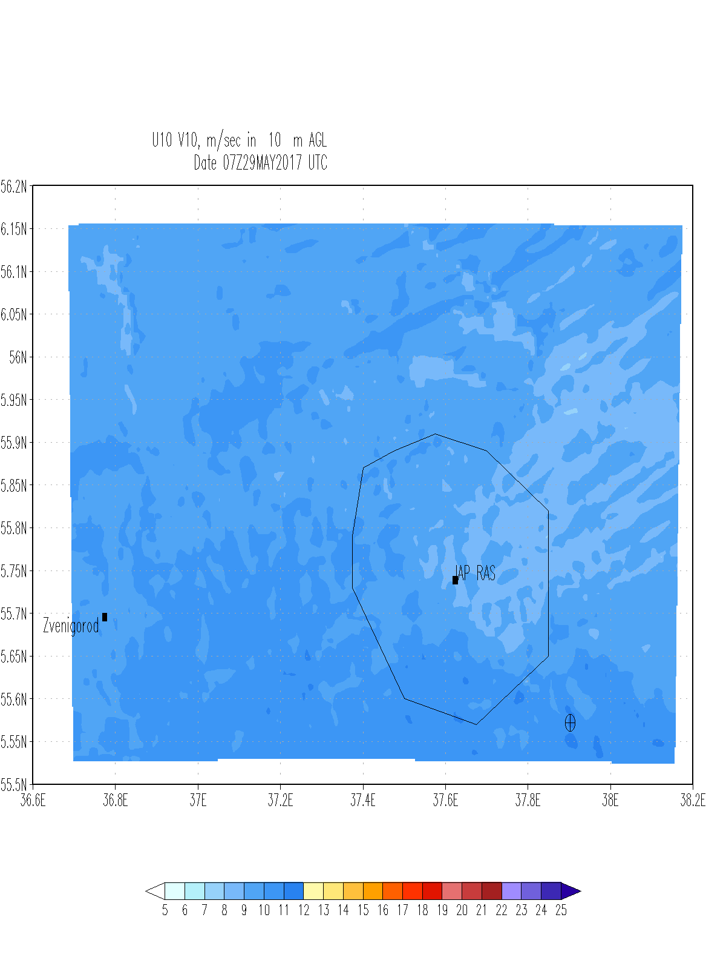
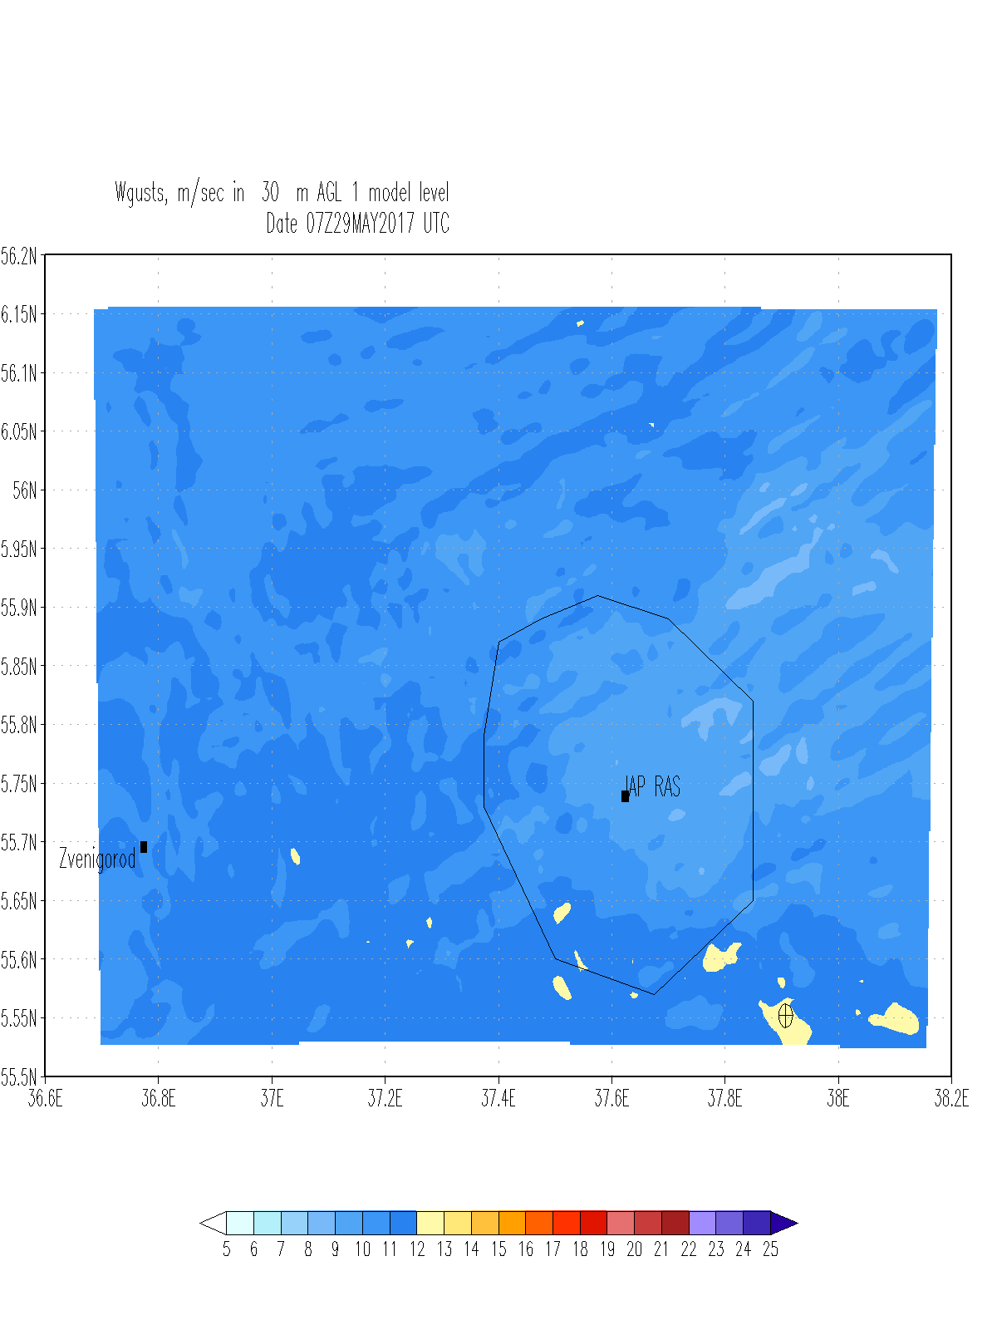
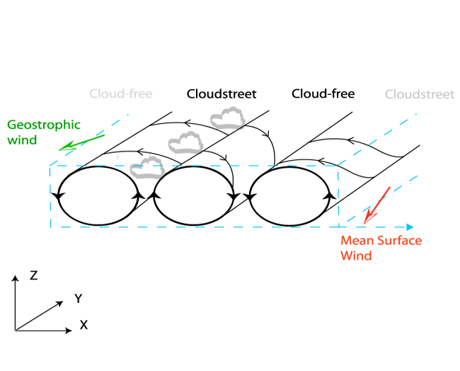
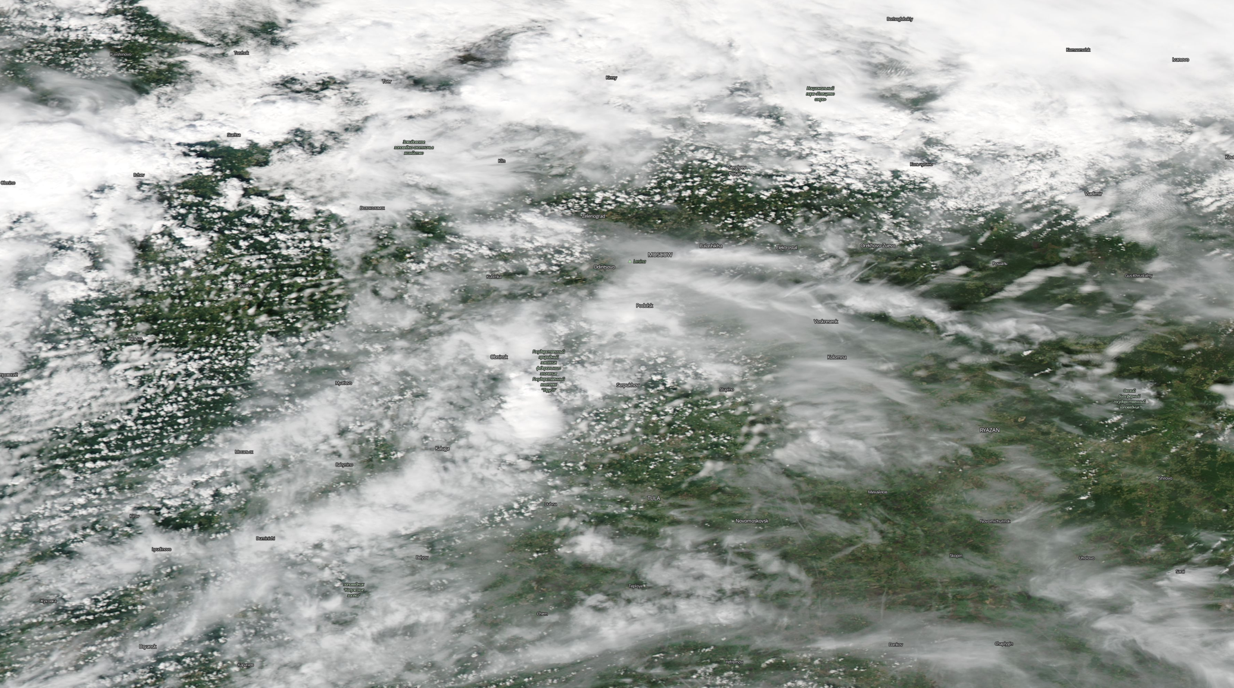
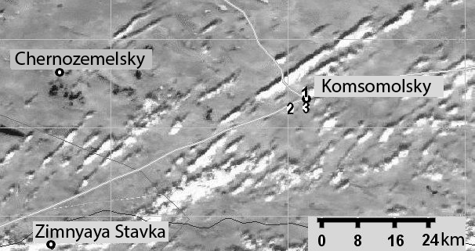
Aims and Motivation
The dynamics and intensity of dust storms are largely determined by circulation structures of various spatial and temporal scales.
Velocity components and wind gusts, 05/29/2017
Rolls
Image above the measurement area taken from the MODIS-AQUA satellite on July 28, 2007 at 14:03 (Moscow time).
Wind gusts in Moscow, MODIS-AQUA image, 05/29/2017

Slide 5
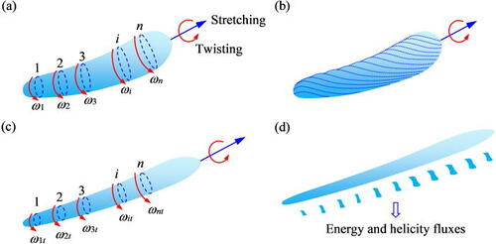
Aims and Motivation
The existence of streaks leads to an intensification of dust emission from the underlying surface
already evidenced by the measurement data of aerosol concentrations in the near-surface layer and concentration profiles obtained during expeditions IAP RAS in the arid territories of southern Russia.
(Sk Zeeshan Ali, Subhasish Dey, 2022)

Slide 6
Aims and Motivation
In the results of numerical simulation: an increase in the mass concentration of dust particles in the calculation area when modeling includes the action of coherent vortex structures –
such structures must be taken into account in the ABL parameterization schemes. Accordingly, data on their scales and dynamic characteristics are of great interest.
The increase in dust removal is associated with an increase in the vertical components of the velocity, as well as in the pressure gradient, leading to the “loosening” of the particles of the upper layer of the underlying surface, partial turbulence of the surface layer, and detachment of a larger amount of aerosol

Slide 7
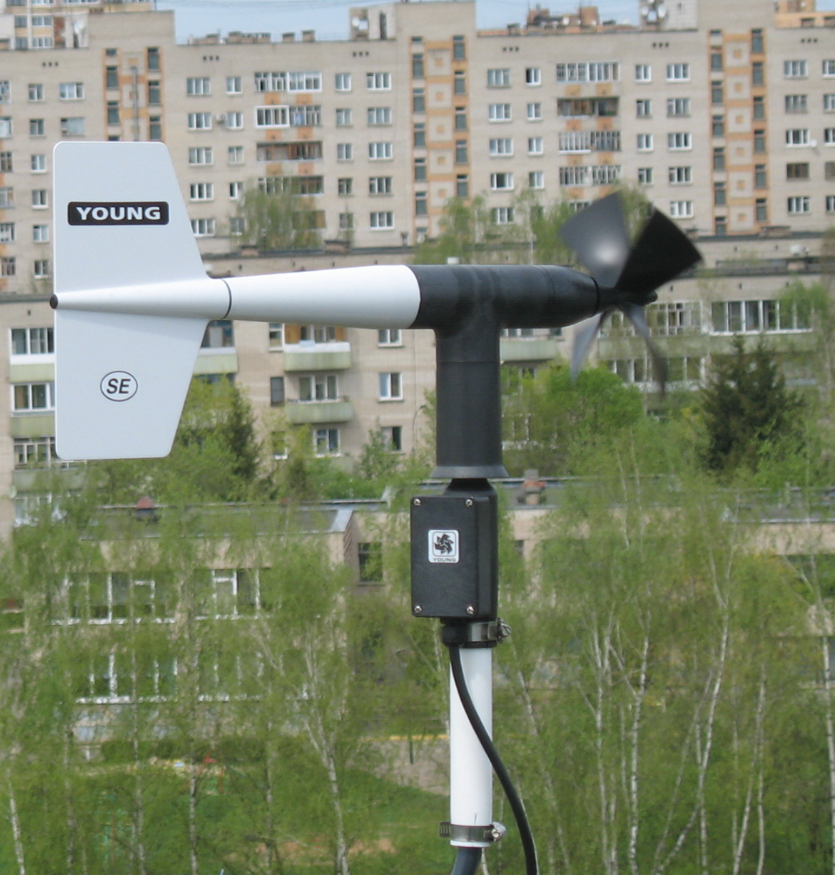
OBNINSK’S HIGH-ALTITUDE INSTRUMENTAL TOWER ("TYPHOON“).
The source of obtaining primary information on the characteristics of squalls for 2014-2023 is the processing of a large array of observational data from a high-altitude meteorological mast (HMM) of the Institute of Experimental Meteorology of the Federal State Budgetary Institution NPO Typhoon.
25, 73, 121, 217 & 301 m
1 Hz – running average 10 min
In addition to propeller wind sensors, acoustic anemometers were also installed at a number of heights of the VMM, measuring three components of wind speed, including the vertical component of speed. Such instruments were the meteorological complex MK-15 developed by FGBU “NPO Typhoon” and acoustic anemometer “Model 81000V” by R. M. YOUNG COMPANY, USA.
Such experimental data on a number of long-term observations on the VMM made it possible, after processing and analyzing the velocity fields, to fix intense squalls passing through the polygon.

Slide 8
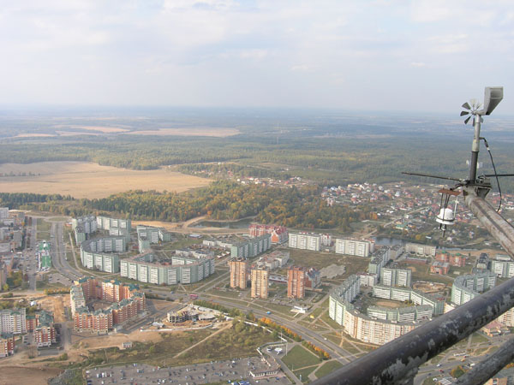
OBNINSK’S HIGH-ALTITUDE INSTRUMENTAL TOWER ("TYPHOON“).
Measured meteorological parameters | Measurement range | Limits of permissible measurement error
Atmospheric pressure with variable origin in the range from 600 to 917, hPa | 150 | ±0,3
Wind velocity, m/s: - Horizontal component V_{r}, - Vertical component V_{B}, | From 0,2 to 60 From -10 to +10 | ± (0,2+0,03V_{r}) ± (0,2+0,03V_{B})
Wind direction, degrees | From 0 to 360 | ±2
Air temperature, ^{о}С | From -60 to +50 | ±0,2
Air relative humidity, % | From 5 to 100 | ± 3 – in the temperature range above 0 °С to +50 °С; ± 5 – in the temperature range from minus 40 °С to 0 °С inc.; in the temperature range from minus 40 °С измерения не проводятся
Meteorological characteristics of MK-15

Slide 9
MEASUREMENT RESULTS. GENERAL ANALYSIS AND CASE STUDIES
In total, in 2014-2023, according to measurements at the VMM, 64 squally increases in wind speed were registered
Characteristics of squally increases in wind speed according to measurements on a high-rise mast for 2014-2023. Vmax is the maximum wind speed during a squall; ΔV is the increase in wind speed during a squall; Δt is the time during which the wind speed increased to its maximum value.
Gradation Vmax, m/s | Hight, m |  | Gradation ΔV,m/s | Hight, m |  | Gradation Δt, min | Hight, m
 | 8 | 301 |  | 8 | 301 |  | 8 | 301
≥ 5.0-9.9 | 32 |  | 2.0÷4.9 | 5 | 1 | ≤ 0.9 | 17 | 11
10.0-14.9 | 27 | 7 | 5.0÷7.9 | 26 | 15 | 1.0÷1.9 | 14 | 13
15.0-19.9 | 5 | 27 | 8.0÷9.9 | 19 | 12 | 2.0÷2.9 | 9 | 10
20.0-24.9 | 1 | 15 | 10.0÷14.9 | 14 | 26 | 3.0÷3.9 | 8 | 9
25.0-29.9 |  | 13 | 15.0÷19.9 | 1 | 8 | 4.0÷4.9 | 10 | 4
≥ 30 |  | 3 | > 20 |  | 3 | ≥ 5,0 | 7 | 18

Slide 10
MEASUREMENT RESULTS. GENERAL ANALYSIS AND CASE STUDIES
Characteristics of squally increases in wind speed according to measurements on a high-rise mast for 2014-2023. Vmax is the maximum wind speed during a squall; ΔV is the increase in wind speed during a squall; Δt is the time during which the wind speed increased to its maximum value.

Slide 11
MEASUREMENT RESULTS. GENERAL ANALYSIS AND CASE STUDIES
A sharp increase in wind speed in a short time was chosen as the criterion for identifying a squall. All selected cases were associated with the passage of cumulonimbus clouds through a high-altitude mast. The clouds were either of intramass origin or associated with a cold front. In the latter case, the wind speed during the squall was higher. Due to the strong shading of the 8 m level by closely located forests and urban development, wind speeds at this height did not reach the value of squalls.
Based on the results of the analysis, the squalls could be divided into 2 groups:
Squalls during the passage of several cumulonimbus clouds during the day, intramass or ahead of a cold front.
Squalls on a cold front.
Within the group, the cases of squalls were subdivided according to the wind speed at a height of 301 m: less or more than 20 m/s.

Slide 12
Actually, 3 groups…
The cases of squalls recorded at the VMM NPO Typhoon in 2014-2023 are analyzed in detail. Based on the results of the analysis, the squalls were divided into 3 groups:
- Group 1. Squalls during the passage of several cumulonimbus clouds during the day, intramass or ahead of a cold front. This includes subgroups:
1.1. Maximum wind speed at squalls less than 20 m/s against a general background of weak or moderate average wind
1.2. The maximum wind speed during one or more squalls is greater than or equal to 20 m/s. The average wind speed is moderate, not exceeding 10-12 m/s
1.3. Against the general background of a strong wind exceeding 10-12 m / s, several wind intensifications during the day during the passage of cumulonimbus clouds.
- Group 2. Squalls on the cold front. This includes subgroups:
2.1. The maximum wind speed during a squall is less than 20 m/s at a height of 301 m
2.2. The maximum wind speed during a squall is greater than or equal to 20 m/s at a height of 301 m
- Group 3. A sharp squalls, when the speed increases from a small amount.

Slide 13
SQUALLS CASE STUDIES
Thus, on March 15, 2014, during the passage of a cold front, the wind speed at a height of 301 m increased sharply from 14 m/s to 31.4 m/s.
On April 16, 2015, three cumulonimbus clouds passed successively through the MMM. Against the background of an average wind speed of 15-20 m/s, the speed at a height of 301 m increased to 32.1 m/s and 31.0 m/s.
On May 29, 2017, before the cold front, the average wind speed at 301 m was 14-20 m/s. Immediately before the squall, the speed decreased to 12 m/s, and during the squall at 16:30, the speed reached its maximum value of 27 m/s at a height of 217 m.
On April 21, 2018, the maximum wind speed during a squall on the cold front was 28 m/s against the background of an average wind speed of about 14 m/s.
On October 18, 2022, a cold atmospheric front passed through the VMM test site in the afternoon. Moderately strong wind was observed from 12:00 to 18:00, caused by a large horizontal pressure gradient. At a height of 301 m, the wind speed was 15-18 m/s. The wind speed in the entire 300-meter layer began to increase after 08:00 and reached its maximum (25.3 m/s at a height of 301 m) at 12:20.

Slide 14
SQUALLS CASE STUDIES
On July 7, 2022, a squall was observed on the cold section of the front with a short-term increase in wind speed. At a height of 8 m, the speed increased from 0.2 m/s to 9.1 m/s from 4:36 pm to 4:48 pm. At a height of 121 m, the wind speed increased at the same time from 4.6 m/s to 23.2 m/s. The passage of the frontal zone was accompanied by a thunderstorm, squally increase in wind speed and heavy rain showers. 18.8 mm of precipitation fell.
On October 30, 2022, the region of Moscow and Obninsk was in the southern part of the cyclone centered over the White Sea. The pressure at the center of the cyclone was 985 hPa. From 09:00 to 15:00, the cold front of this cyclone passed through Obninsk. According to the Maloyaroslavets meteorological station, located 12 km south-west of Obninsk, in front of the front, at 15:00, heavy precipitation was observed in the form of rain, behind the front, at 18:00 - in the form of snow. During the passage of two cumulonimbus clouds, an increase in wind and a drop in air temperature were noted. From 17:00 to 17:10, a cold front zone passed with a temperature drop of 3.8°C. The maximum wind speed on the first cloud was 21.3 m/s at a height of 301 m, and on the cold front - 24.2 m/s.

Slide 15
SQUALLS CASE STUDIES
Case January 2, 2023. On January 1 and 2, the region of Moscow and Obninsk was under the influence of an extensive cyclone centered over the Baltic Sea (shifting to the southeast) and its atmospheric fronts. On January 1, there was a drop in pressure during the day by 8.5 mm. rt. Art. (from 742.8 to 734.2 mm Hg. Art.) At the same time, the temperature increased in the entire layer. The temperature increased by 2 m per day by 6.5 °C (from 0.8 °C to 7.3 °C). Gradually the wind increased from 13.5 m/s to 20 m/s (by 301 m). January 2 at 2:18 was the minimum atmospheric pressure - 732.9 mm Hg. Art. From 02:25 to 02:30 an increase in pressure by 2 mm was observed. rt. Art. Further during the day, the pressure increased by 7.9 mm. rt. Art. From 02:24 to 02:26, the speed for 301 m increased from 16.8 m/s to 31.5 m/s. On 8 m, the maximum speed was 11.3 m/s. At 02:30 a cold front passed and then cold advection began. By 22:00 the temperature dropped by 2 m to -3 °C.

Slide 16
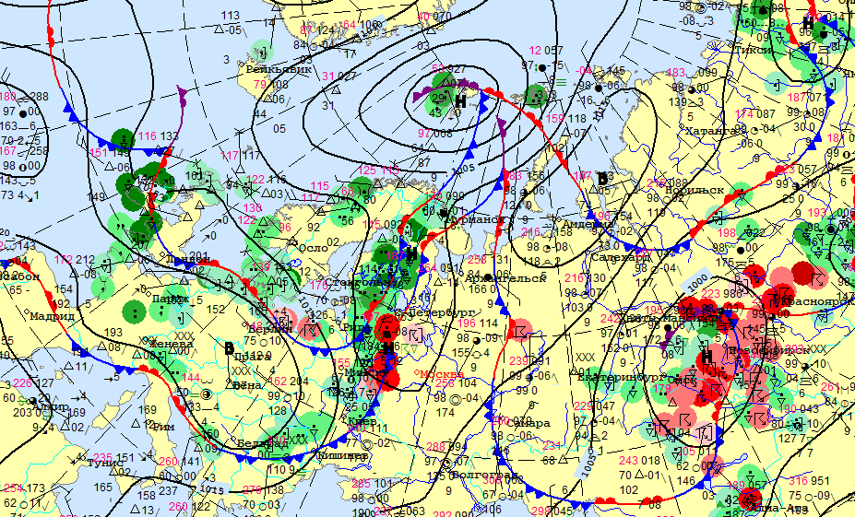
CASE STUDIES 4.07.2016
The region of Moscow and Obninsk was located on the southern periphery of a vast cyclone with its main center in the Svalbard region. The secondary center of the cyclone without a closed isobar was located northwest of Moscow. It was formed on a wave of cold and warm fronts.

Slide 17
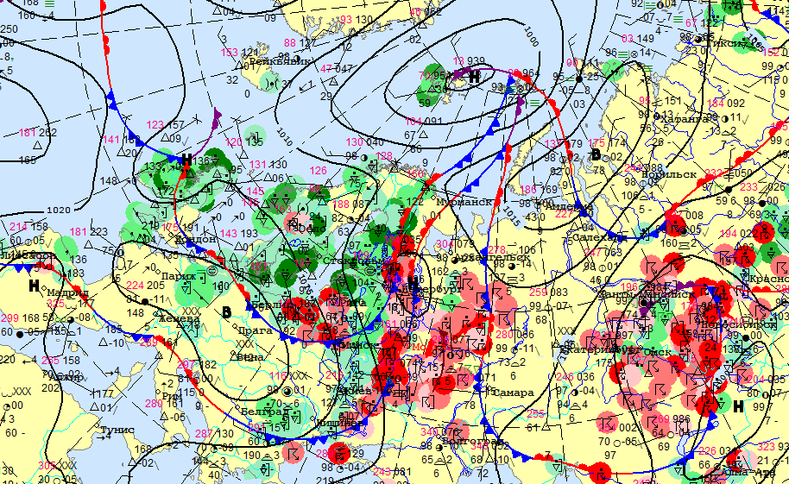
CASE STUDIES 4.07.2016
At about 17:00 in Obninsk, a heavy downpour and a sharp drop in temperature were observed: by 8°C at a height of 2 m. A cold atmospheric front of a cyclone passed with a secondary center in the St. Petersburg region.

Slide 18
CASE STUDIES 4.07.2016
The day before the described particular case, on July 3, 2016, Obninsk is located in the low-gradient baric field of the saddle. Cumulonimbus clouds had an intramass character, i.e. were not associated with fronts, but were caused by convection, which developed in the afternoon due to surface heating. At 13:54 in Obninsk a downpour and a thunderstorm began. At 14:01 the shower was already weak, and at 14:10 it ended.
In total, 2 cold fronts were observed that day. On the first front there is a sharp single squall with a maximum wind velocity of 18.9 m/s. On the second front, at 19:00 local time, a general sharp increase in wind velocity, from 7 to 14 m/s at a height of 301 m.
The time course of 10-second average values of meteorological parameters: ⁽¹⁾ air temperature at six altitudes during the day, ⁽²⁾atmospheric pressure at a height of 2 m, ⁽³⁾ relative air humidity at a height of 2 m, ⁽⁴⁾ wind velocity (m/s) at five heights, ⁽⁵⁾ wind direction in degrees at four heights.
Changes in characteristics are shown for all days and for the time of the first squall, from 15:00 to 19:00 Moscow time.

Slide 19
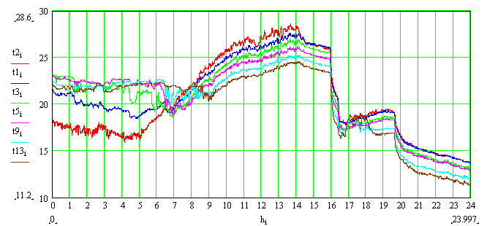
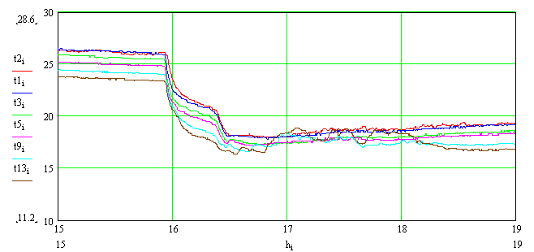
CASE STUDIES 4.07.2016
Air temperature (degrees С) at six altitudes during the day. The x-axis is the hour of the day.
t2 is the temperature at a height of 2 m;
t1 is the temperature at a height of 25 m;
t3 is the temperature at a height of 73 m;
t5 is the temperature at a height of 121 m;
t9 is the temperature at a height of 217 m;
t13 is the temperature at an altitude of 301 m.

Slide 20
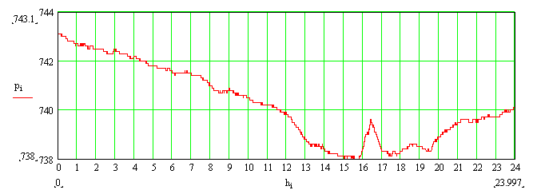
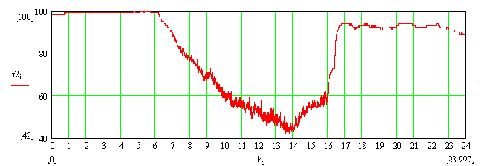
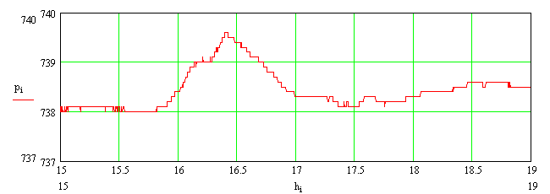
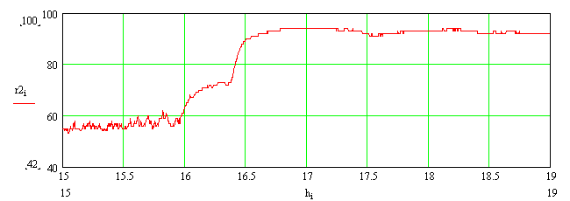
CASE STUDIES 4.07.2016
Pressure 2 m
Relative humidity 2 m

Slide 21
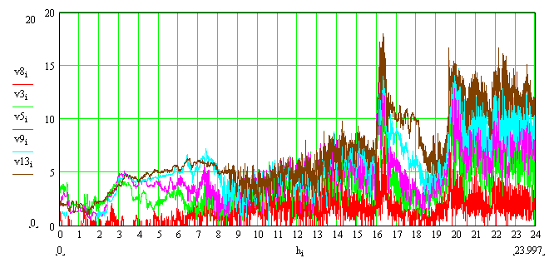
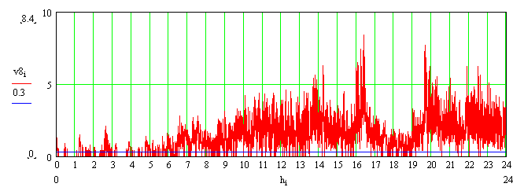
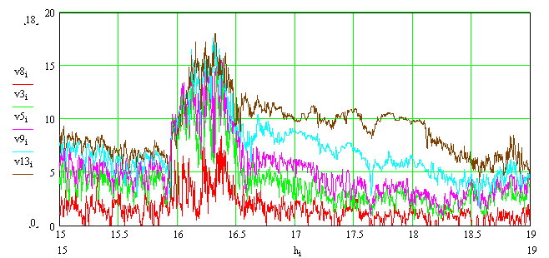
CASE STUDIES 4.07.2016
Wind velocity (m/s) at five altitudes during the day. The x-axis is the hour of the day.
V8 is the velocity at a height of 8 m;
V3 is the velocity at a height of 73 m;
V5 is the velocity at a height of 121 m;
V9 is the velocity at a height of 217 m;
V13 is the velocity at a height of 301 m.

Slide 22
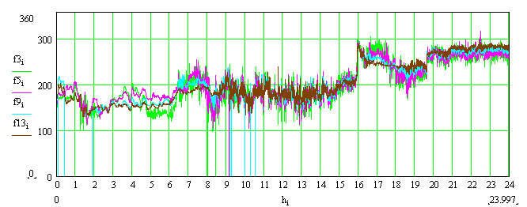
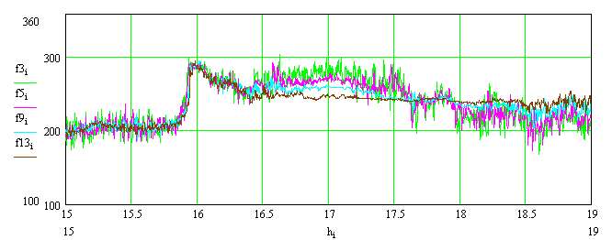
CASE STUDIES 4.07.2016
Precipitation according to an observer at the VMM test site: heavy rain showers 16:25-16:31; heavy rain moderate 16:23-16:25, 16:31-16:33, 16:42-16:48; heavy rain light 16:33-16:42, 16:48-M (continued after the observation period); thunderstorm from 16:15 to 17:05; 16:42-16:50 above us. The sum of precipitation from 16:00 to 17:00 was 6.9 mm.
Wind direction in degrees at four heights

Slide 23
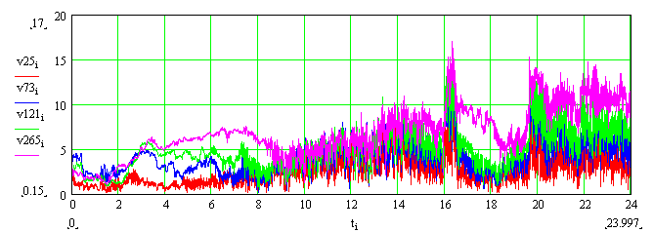
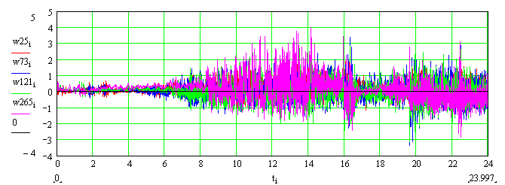
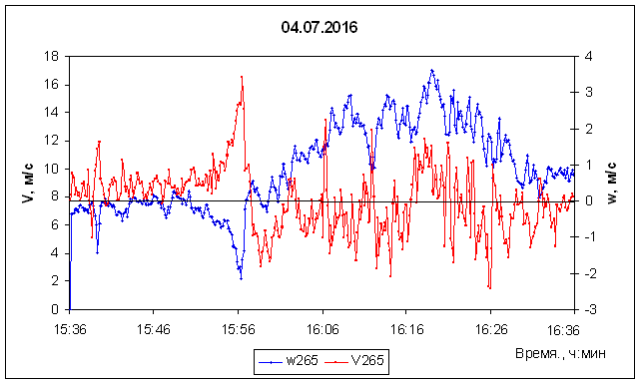
CASE STUDIES 4.07.2016
Vertical velocity measured by acoustic anemometers 81000 from Young. The wind speed values are shown by components; such a sweep is especially interesting for determining the flow structure and estimating the vertical dimensions of squalls. The speed data measured by this device show values close to those measured using the MK-15 complex.
Wind components: module and vertical velocities at four heights (25, 73, 121 and 265 m)
Wind components: module and vertical velocities at the heights of 265 m

Slide 24
Model WRF 4.07.2016
Calculated time | 03.07.2016 12 UTC-05.07.2016 00 UTC
Nested grids | 5
Map projections | Lambert
Grid space | 1620 м / 540 м / 180 м / 60 м / 20 м
Number of grid space, north-south | 210/211/211/211/211
Number of grid space, east-west | 210/211/211/211/211
Number of vertical levels | 40/40/118/118/118
Time step | 9 s
Longwave and Shortwave Radiation | Rapid Radiative Transfer Model и Goddard shortwave (Two-stream multi-band scheme)
Surface Layer | Monin-Obukhov (Zilitinkevitch)
Land Surface | Noah, (Chen et al., 2001)
Turbulence. Diffusion Option. K Option | Full diffusion: Gradients use full metric terms to more accurately compute horizontal gradients in sloped coordinates with K is diagnosed from 3d deformation and stability following a Smagorinsky approach For LES – Simple diffusion: Gradients are simply taken along coordinate surfaces with K for horizontal diffusion is diagnosed from just horizontal deformation. The vertical diffusion is assumed to be done by the PBL scheme
Microphysics | Morrison double-Momentum scheme
Planetary Boundary layer (PBL) | Mellor-Jamada-Janjic scheme (Janjic, 1994, MWR), LES scheme
Saltation emission | Shao (2011)
Non-saltation emission | proposed by the authors

Slide 25
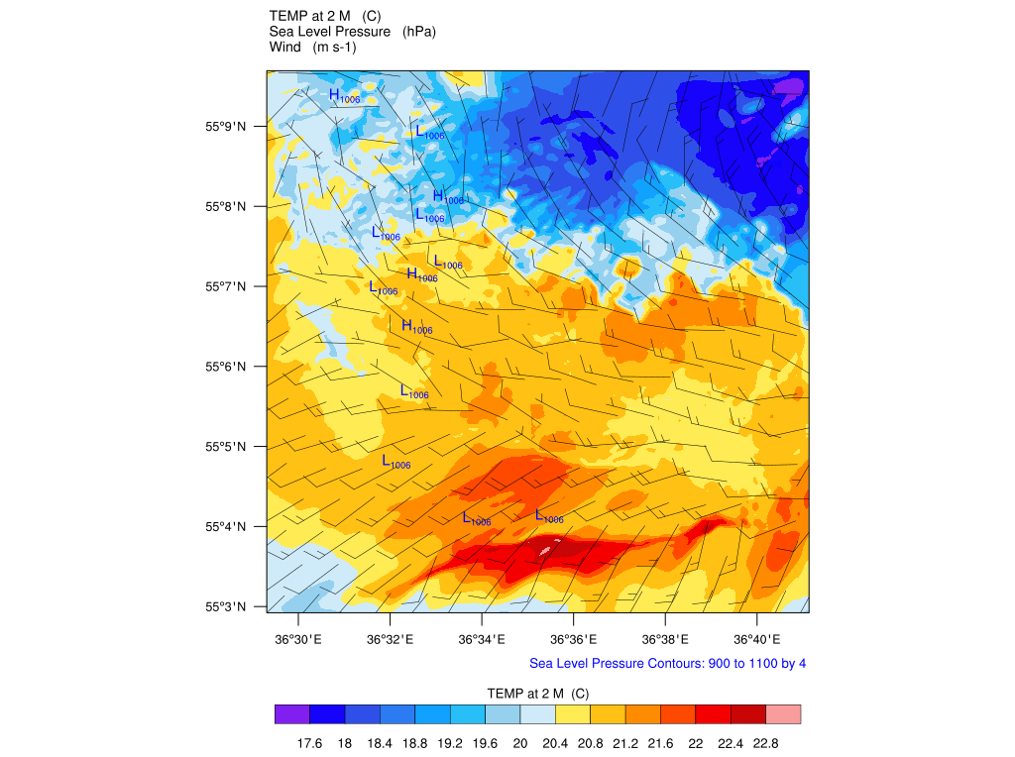
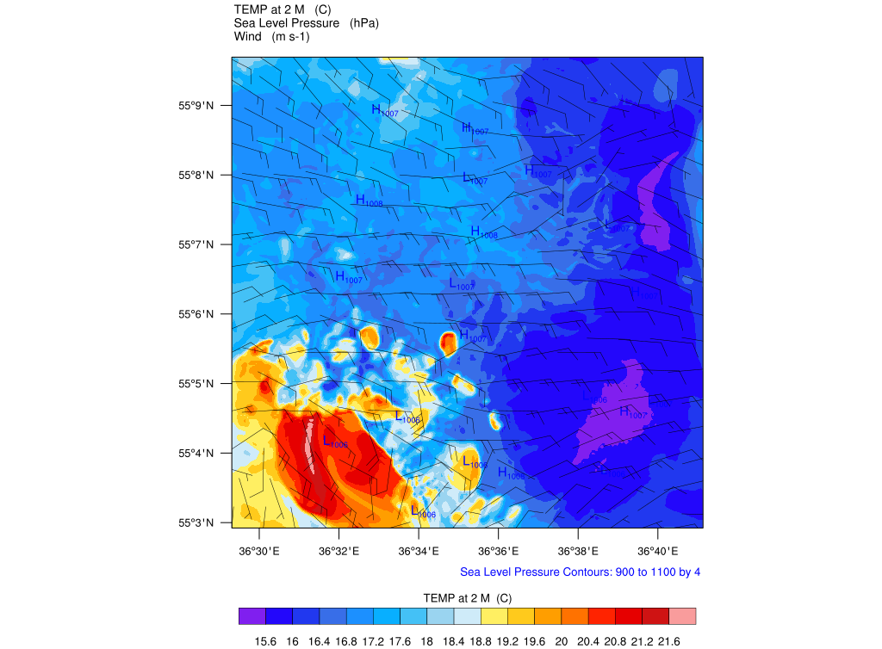
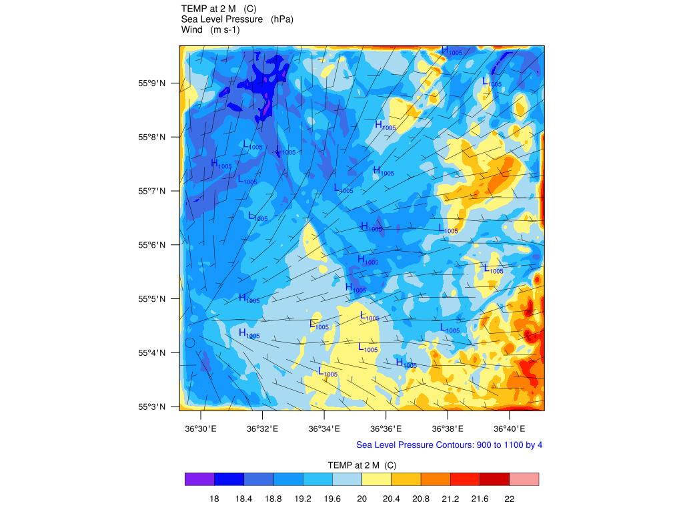
Model results 4.07.2016
The first squall was observed at 12-14 UTC.
Temperature
Wind velocity
Sea level pressure
13 UTC
12 UTC
14 UTC
The maximum speed is 19 m/s, which is close to the observed value (according to observations, 18.9 m/s).

Slide 26
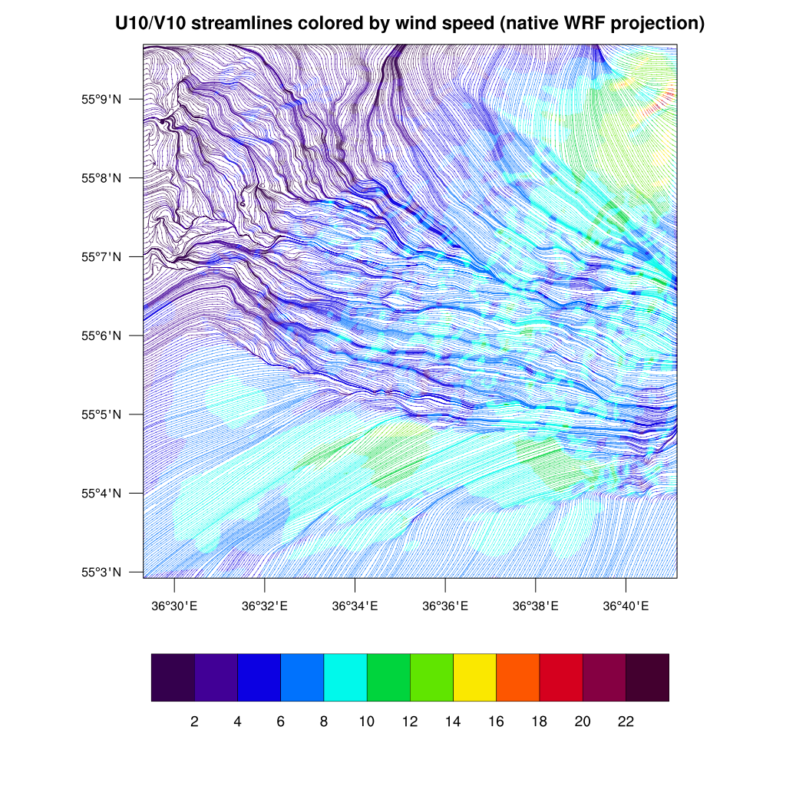
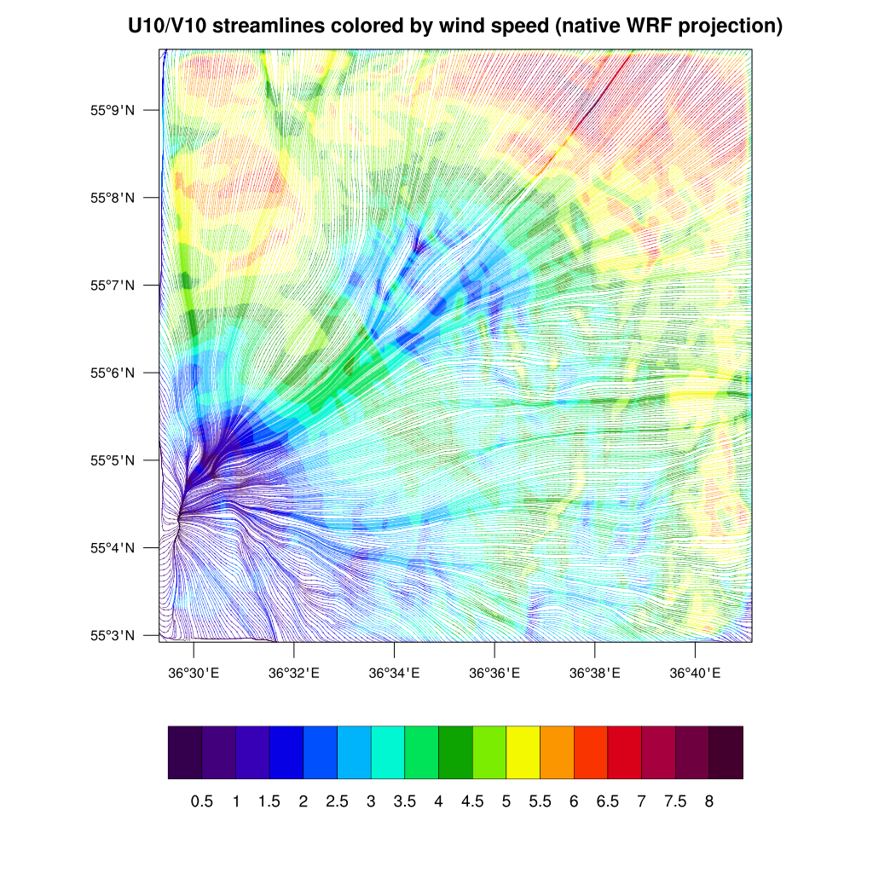
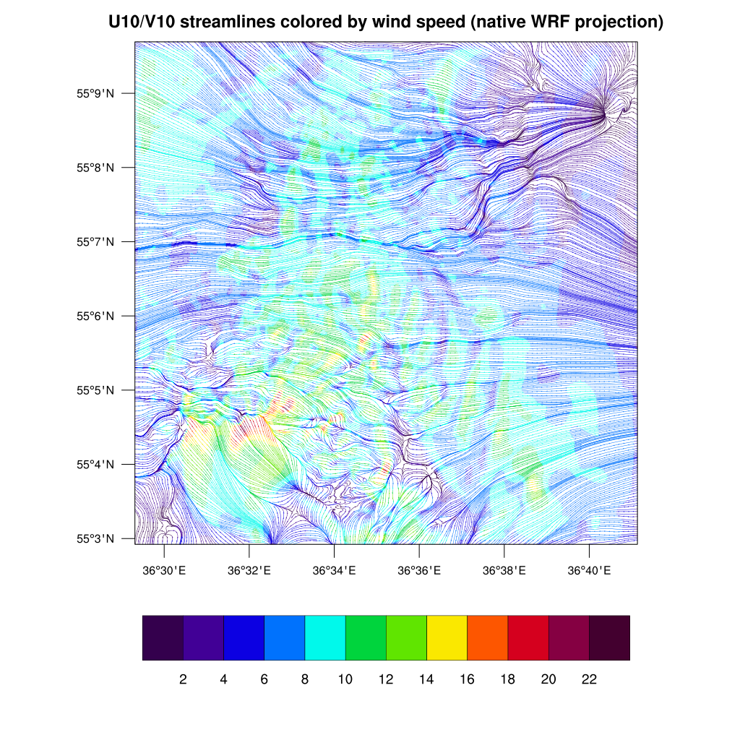
Model results 4.07.2016
13 UTC
12 UTC
14 UTC

Slide 27
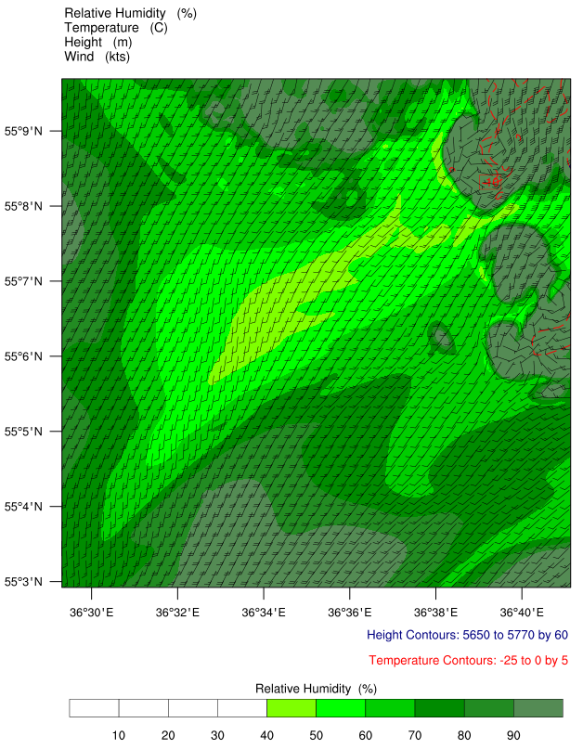
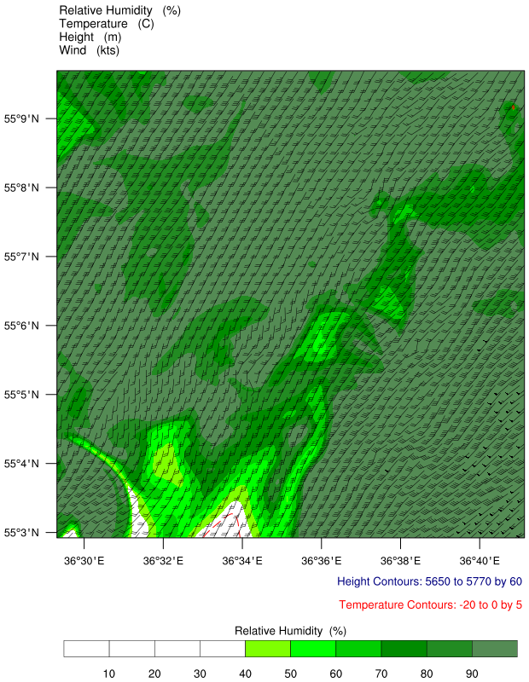
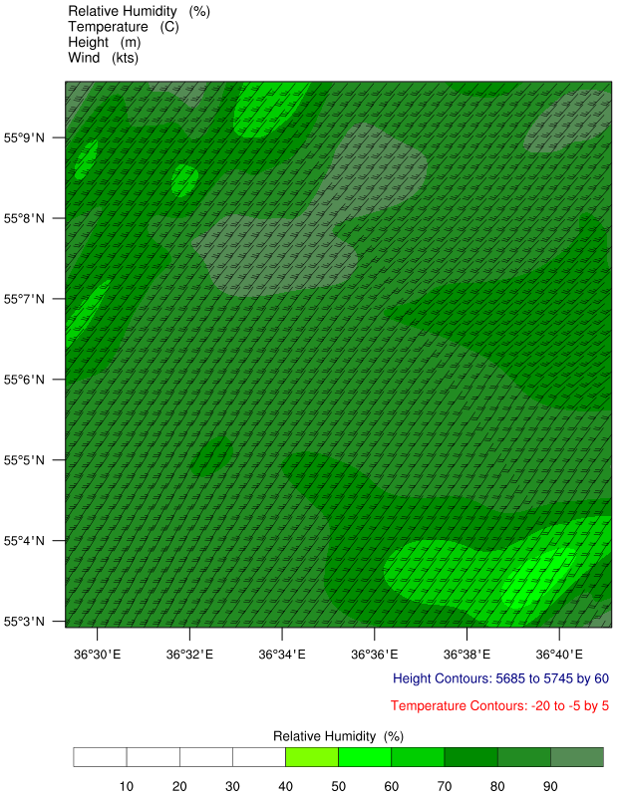
Model results 4.07.2016
Humidity
Wind velocity
Temperature
950 hPa
The temperature at a height of 2 m at the location of the VMM, according to calculations, varied from 23 to 18 °C over the indicated time interval from 12 to 14 UTC, and correlates well with the measured values, however, the initial temperature value by 2 m is slightly underestimated according to calculations (according to observational data 26 to 18 °C).
12 UTC
13 UTC
14 UTC

Slide 28
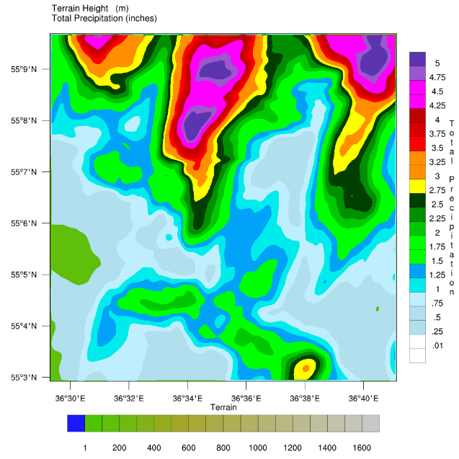
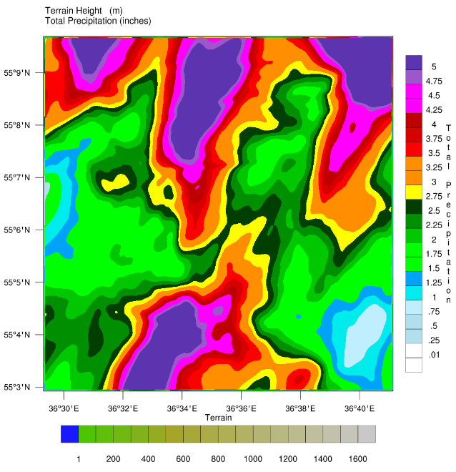
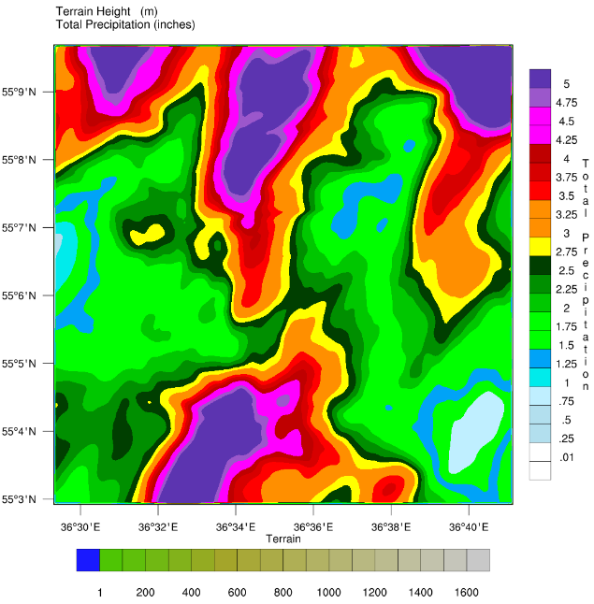
Model results 4.07.2016
Humidity rises by the time of the first squall. It can be seen that the humidity and wind speed at two pressure levels and the humidity and temperature over the entire height make it possible to restore a complete picture of the geometric characteristics of squalls and clouds.
12 UTC
13 UTC
14 UTC

Slide 29
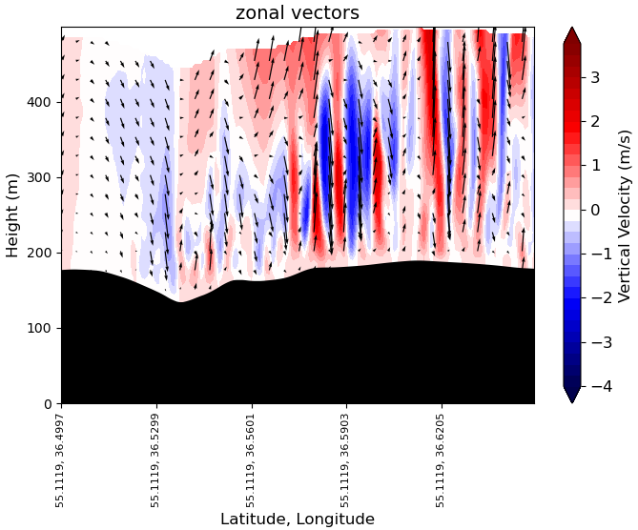
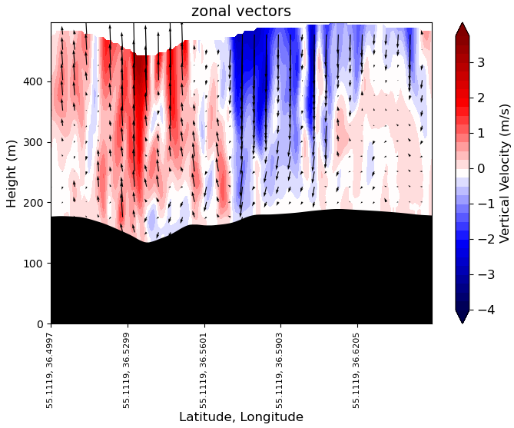
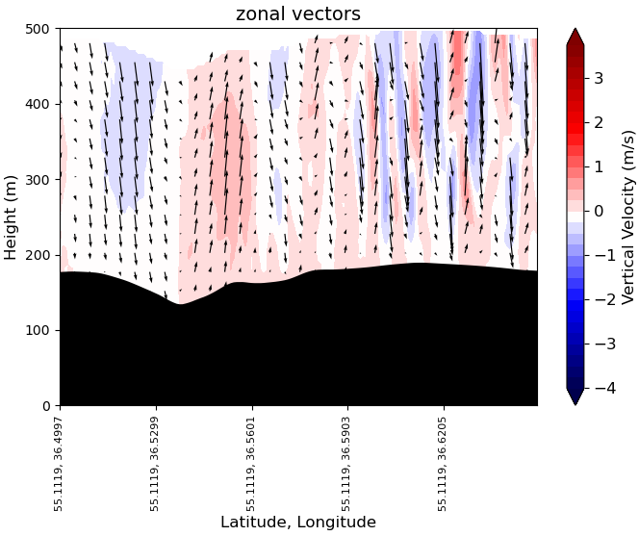
Model results 4.07.2016
Of great interest is the modeling of vertical velocity, which is an indicator of convective movements associated with the formation of squalls. One can see the correspondence with the HMM data. Intense convective motions are clearly observed during the considered time interval of the formation of the first squall.
12 UTC
13 UTC
14 UTC

Slide 30
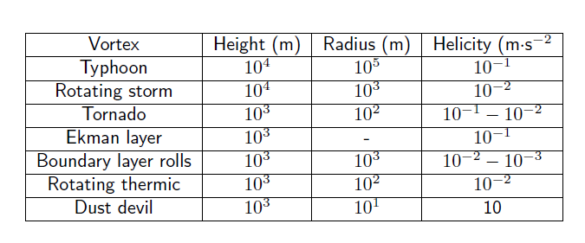
Helicity in the atmosphere
R. Cieszelski, “Studies on Turbulence Parametrizations for Flows with Helicity,” Izv., Atmos. Ocean. Phys. 35, 157–170 (1999).

Slide 31
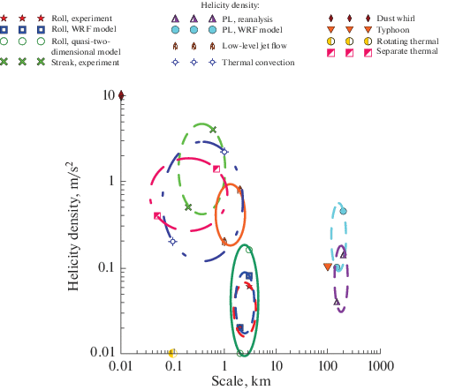
Helicity in the atmosphere
The ranges of the helicity estimations
Rolls experiment: 0.02-0.12 m/s²
Rolls 2-scale model: 0.01-0.16 m/s²
Rolls WRF model: 0.02-0.08 m/s²
Streaks experiment: 0.5-3.0 m/s²
Polar Lows reanalysis: 0.04-0.14 m/s²
Polar Lows WRF model: 0.1-0.45 m/s²
Dust devil: 10 m/s²
Typhoon: 0.1 m/s²
Rotating thermal: 0.01 m/s²

Slide 32








Helicity in the atmosphere
The ranges of the helicity estimations
Rolls experiment: 0.02-0.12 m/s²
Rolls 2-scale model: 0.01-0.16 m/s²
Rolls WRF model: 0.02-0.08 m/s²
Streaks experiment: 0.5-3.0 m/s²
Polar Lows reanalysis: 0.04-0.14 m/s²
Polar Lows WRF model: 0.1-0.45 m/s²
Dust devil: 10 m/s²
Typhoon: 0.1 m/s²
Rotating thermal: 0.01 m/s²

Slide 33
Helicity is inherent in many circulation movements and structures in the ABL, in which it is continuously reproduced due to the combined action of the Earth's rotation and friction, which is also closely related to the reverse cascade and large-scale restructuring of currents.
The helicity density could help identify and visualize streaks – as an accompanied structures to squalls.
Helicity in the atmosphere. Accompanying coherent structures to squalls

Slide 34
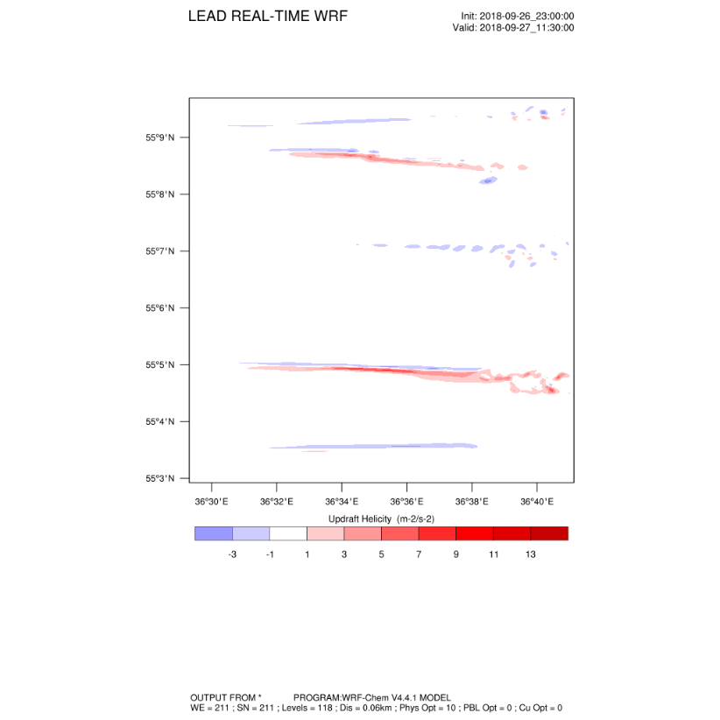
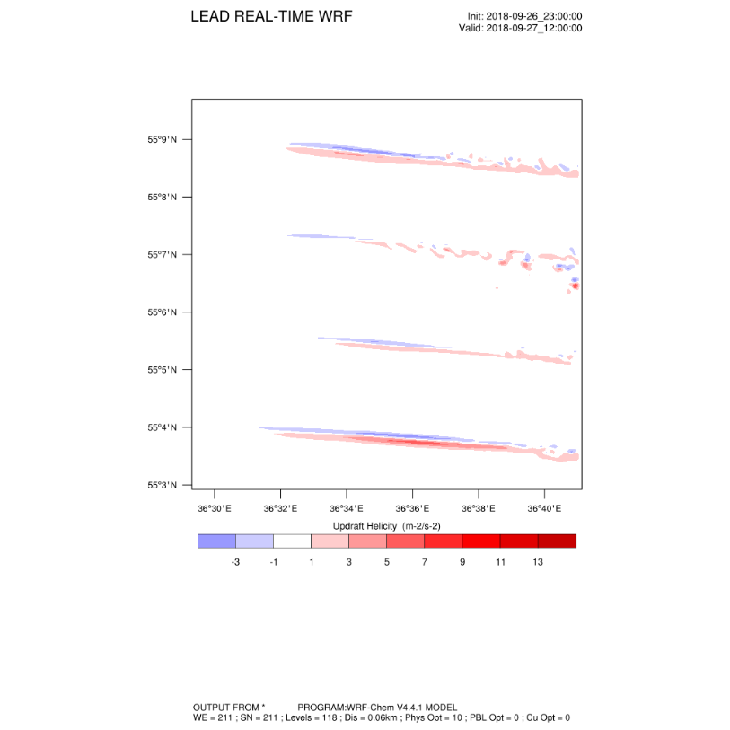
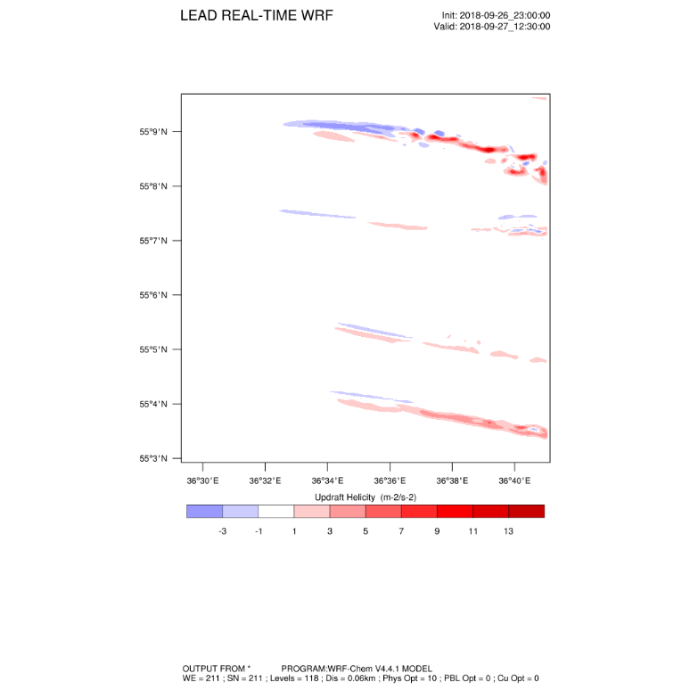
An interesting result was obtained for the helicity index, the increase of which is an indicator of vortex motions. Observed just at the time of the passage of squalls. 27.09.2018

Slide 35
Model results. Summary for 4.07.2016
A map of the main surface meteorological parameters: temperature and wind at a height of 2 m, atmospheric pressure at sea level,
time period from 12 to 14 UTC.
The maximum velocity is 19 m/s, which is close to the observed value (according to observations, 18.9 m/s).
The temperature at a height of 2 m at the location of the VMM, according to calculations, varied from 23 to 18 °C over the indicated time interval from 12 to 14 UTC, and correlates well with the measured values, however, the initial temperature value by 2 m is slightly underestimated according to calculations (according to observational data 26 to 18 °C).
Good agreement was also noted for atmospheric pressure and humidity.
Humidity rises by the time of the first squall. It can be seen that the humidity and wind velocity at two pressure levels and the humidity and temperature over the entire height make it possible to restore a complete picture of the geometric characteristics of squalls and clouds.

Slide 36
Statistics
The first results were obtained on the statistical distributions of the main diagnostic characteristics - wind velocity, energy and power - which may be associated with the reasons for the formation of squalls and the coherent structures accompanying them; and the scale and destruction energy of such extreme events associated with a sharp increase in wind were assessed.

Slide 37
Statistics
Using the above data, a statistical analysis was performed, the sizes and energy of the squalls were estimated.
For all cases, the following were calculated: ⁽¹⁾squall time, ⁽²⁾wind intensification time, ⁽³⁾squall scale, ⁽⁴⁾maximum velocity, ⁽⁵⁾average velocity, ⁽⁶⁾scale factors, ⁽⁷⁾energy, ⁽⁸⁾power and ⁽⁹⁾other related parameters.
The degrees of velocity, including those for obtaining energy and power, were estimated as integral values ​​calculated taking into account the step of the values ​​already averaged over 10 sec., using the trapezoid method.

Slide 38
Statistics
The most interesting results are shown in figures below, in which the values ​​of velocity, maximum and average, energy, power, scale for different and in no way related (!) squalls, even without taking into account the division into groups, fall on one curve with a probability of approximately 95-98% (!!!).
The authors assume a connection with turbulence and submesoscale coherent structures here.

Slide 39
Dependence curves on the scale of the squall
Dependence of the square of the velocity (energy) on the scale of the squall
Dependence of the cube of velocity on the scale of the squall

Slide 40
Dependence curves on the average velocity throughout the entire squall
Dependence of the average values ​​of the square of the velocity (energy) on the average velocity throughout the entire squall
Dependence of the average values ​​of the cube of speed (power) on the average speed throughout the entire squall

Slide 41

Energy spectrum

Slide 42
Estimation of squall sizes
According to the theory [Kolmogorov, 1934], the square of the velocity can be obtained v² = c₁*eps*t₁, where c₁<1, whence eps = v² / c₁*t₁, where the average velocity is used, and the area can be expressed as s = c₃*eps*t³, where c₃ is in the range of 10-14, whence we can obtain an estimate of the transverse scale, which we cannot measure with just one mast, l = (c₃/c₁)^{1/2} * v * t, and the ratio (c₃/c₁)^{1/2} = ((10-14) / 1)^{1/2} is approximately equal to 3-4. That is, the transverse dimensions of squalls can be on average 3-4 times larger.
To draw the final relation, one can use the results of numerical simulation, for example, done in [Vazaeva et al., 2024], where the spatial dimensions actually differ by several times, but to obtain more statistically sound information, it is proposed to use a larger number of particular cases. Based on the size of the squalls, one can estimate the energy of destruction through their characteristic times and forcings.

Slide 43
Conclusions
The cases of squalls recorded at the VMM NPO Typhoon in 2014-2023 are analyzed in detail. Based on the results of the analysis, the squalls were divided into 3 groups:
- Group 1. Squalls during the passage of several cumulonimbus clouds during the day, intramass or ahead of a cold front. This includes subgroups:
1.1. Maximum wind speed at squalls less than 20 m/s against a general background of weak or moderate average wind
1.2. The maximum wind speed during one or more squalls is greater than or equal to 20 m/s. The average wind speed is moderate, not exceeding 10-12 m/s
1.3. Against the general background of a strong wind exceeding 10-12 m / s, several wind intensifications during the day during the passage of cumulonimbus clouds.
- Group 2. Squalls on the cold front. This includes subgroups:
2.1. The maximum wind speed during a squall is less than 20 m/s at a height of 301 m
2.2. The maximum wind speed during a squall is greater than or equal to 20 m/s at a height of 301 m
- Group 3. A sharp squalls, when the speed increases from a small amount.

Slide 44
Conclusions
Detailed diagnostics of a particular case of a squall on July 4, 2016,and dust storm on July 2021, the former based on the results of observations at the VMM and numerical simulation on the WRF model modified for the given area and synoptic situation, is considered. Air temperature at different heights, atmospheric pressure, relative air humidity, and wind speed components were simulated. The simulation results are in good agreement with the observational data. The maximum wind speed in a squall at the first single cold front was 18.9 m/s according to observations and 19 m/s according to simulation results. The model will increase the accuracy of the operational forecast of squalls, as well as, together with the measured EMM data, analyze the causes of squalls, taking into account the convective mechanisms observed in the 300-meter layer.
The dynamics of squalls are largely determined by circulation structures of different spatial and temporal scales.
An adapted WRF model capable of ⁽¹⁾resolving coherent structures of various scales and orientations, ⁽²⁾taking into account the effect on squall dynamics, ⁽³⁾made it possible to conclude that aerosol emission is intensified by coherent structures

Slide 45
Conclusions
Of particular interest due to its sudden universality is the analysis corresponding to statistical distributions of the main diagnostic characteristics – wind velocity, energy and power – which may be associated with the reasons for the formation of squalls and the coherent structures accompanying them.
Also of interest is the assessment of the scale and energies of destruction of extreme events associated with a sharp increase in wind. The first results of such an analysis are shown in this study.
Statistical processing of cases with squalls and tornadoes (with wind velocities of 25 m/s and more) previously allowed us to identify some patterns of their occurrence [Grishchenko, 2009], such as the frequency of occurrence and areas most susceptible to the threat of these dangerous phenomena. But the accuracy and lead time of the forecast remained insufficient and still require further study.
An estimate of the scale and energies of destruction of the studied extreme events was obtained. Using Kolmogorov's theory of 1934 [Kolmogorov, 1934], the estimate of the transverse scale of a squall, which we cannot measure with just one mast, is on average 3-4 times greater than the longitudinal scale.

Slide 46
Thank You for Your attention!

Slide 47



Slide 48

Helicity estimation. Main equations for the Ekman flow
The helicity is deﬁned as the scalar product of velocity and vorticity–
$H=v∙rot\left(v\right)$.
The Ekman flow is:
$U=U_{G}\left(1−\exp\left(−\frac{z}{h}\right)\cos{\frac{z}{h}}\right)−V_{G}\exp\left(−\frac{z}{h}\right)\sin{\frac{z}{h}}$;
$V=V_{G}\left(1−\exp\left(−\frac{z}{h}\right)\cos{\frac{z}{h}}\right)+U_{G}\exp\left(−\frac{z}{h}\right)\sin{\frac{z}{h}}$.
Here $h=\sqrt{ν/Ω}$ - the Ekman scale,
$V_{G}$, $U_{G}$ - the geostrophic wind velocity components in a free atmosphere. The vertical components of the vorticity in these cases can be neglected (not for large scale structures).
In that case the helicity (Ekman flow helicity (Hide, Kurgansky)) is:
$H=−U\frac{∂V}{∂z}+V\frac{∂U}{∂z}$. (1)
And the integral helicity (Kurgansky, 1989) is:
$H_{int}$=$\int_{0}^{∞}{Hdz}=\frac{1}{2}\left({U_{G}}^{2}+{V_{G}}^{2}\right)$. (2)

Slide 49


Расчетная область модели с учетом аэрозоля
1. Расчетные области для района экспедиционный измерений.
Калмыкия, июль 2020 г.
2. Расчетная область для моделирования дальнего трансграничного переноса, Калмыкия, Европейская территория России, Прибалтика, сентябрь-октябрь 2020 г.

Slide 50
2. Параметры сетки и выбранные схемы параметризации в модели WRF-ARW для моделирования дальнего переноса (в частности, для случая пыльной бури 2020 г.)

Slide 51
Условия эмиссии аэрозоля
Частицы отрываются от поверхности в момент когда скорость трения
u* ∼ ⟨-u′v′⟩^{1/2} достигает критического значения, примерно
30 см/с.
Толщина 𝛿* вязкого пограничного слоя
𝛿* ∼ 5𝜈/u*.
где u* ∼ 0.5 м/с, 𝛿* ∼100 𝜇м.
Когда u* > u_{crit}, частицы диаметром d > 𝛿* могут подниматься.
Частицы с размером d ≪ 𝛿* (D ∼ 0.1 − 10 𝜇м) не выходят из вязклго пограничного слоя.

Slide 52
Механизмы эмиссии
Наиболее распространенные...
Сальтация и ее модификации – для скорости ветра ≥ 10 m/s.
Конвекция
Однако, количество тонкого атмосферного аэрозоля и условия, и условия его эмиссии с подстилающей поверхности предполагают, что при слабом ветре существует эмиссия. the number of atmospheric fine particles and the conditions for their occurrence suggest that they can also be lifted in calm weather, when the wind force is insufficient to form strong shear turbulence over the underlying surface (несальтационная эмиссия).

Slide 53
Несальтационная эмиссия
Рассмотрена возможность для мелких частиц подниматься с подстилающей поверхности в случае сильных тепловых потоков
(f ∼ 200 ÷ 500 В/м²).
В воздушном слое толщиной ∼ 0.5–1 м, температура падает на 10-30∘C; основное «падение» приходится на первый сантиметр.
Воздух над песком вступает в конвективное движение из-за нагрева приповерхностного слоя T_{S}∼ 40 − 70 ∘C
Средний ветер ∼ 4 м/с

Slide 54

The frequency of dust storms in Kalmykia
the number of 3-hour periods when the dust storm was observed
[Chernokulsky A., Kozlov F.]

Slide 55
Modified WRF-Chem MODEL taking into account surface temperature gap and non-saltation emission
I Modified model WRF-Chem. Domains and parameterizations
Calculated time | changeable
Nested grids | changeable (we tryed up to 5)
Map projections | Lambert/Mercator/Polar
Grid space | changeable (better from 9 or 3 km down to 500 m or finer, depend on the scale of problem. We tryed 20 m – grid space in the inner domain)
Number of grid space, north-south | changeable
Number of grid space, east-west | changeable
Number of vertical levels | 35 (for CFSR reanalysis. You can use the others)
Time step | 5-6 of the horizontal grid space (in km) or smaller
Longwave and Shortwave Radiation | Rapid Radiative Transfer Model и Goddard shortwave (Two-stream multi-band scheme)
Surface Layer | Monin-Obukhov (Zilitinkevitch)
Land Surface | Noah, (Chen et al., 2001)
Turbulence. Diffusion Option. K Option | Full diffusion: Gradients use full metric terms to more accurately compute horizontal gradients in sloped coordinates with K is diagnosed from 3d deformation and stability following a Smagorinsky approach For LES – Simple diffusion: Gradients are simply taken along coordinate surfaces with K for horizontal diffusion is diagnosed from just horizontal deformation. The vertical diffusion is assumed to be done by the PBL scheme
Microphysics | Morrison double-Momentum scheme
Planetary Boundary layer (PBL) | Mellor-Jamada-Janjic scheme (Janjic, 1994, MWR)
Saltation emission | Shao (2011)
Non-saltation emission | proposed by the authors

Slide 56


Modified WRF-Chem MODEL taking into account surface temperature gap and non-saltation emission
II Surface temperature correction (7 minute’s gap )
Example: Surface temperature from the data of observations, model WRF-Chem and deviation of these 2 parameters for different point in daytime 28 July, 2007 (7 minute’s gap not only for 2007)
III Non-saltation emission
The confirmed and applied parameterization of additional non-saltation emission (the number of atmospheric fine particles and the conditions for their occurrence suggest that they can also be lifted in calm weather, when the wind force is insufficient to form strong shear turbulence over the underlying surface, [**] for details):
1. Under strong wind (u* > 0,3 m/s)
$$∆c=4{(0,64T_{sur}−20)}^{−1/3}$$
2. Under weak wind (u* < 0,3 m/s)
$$∆c=0,12{(0,64T_{sur}−20)}^{0,5}$$
[**] Chkhetiani, O. G., Gledzer, E.B., Artamonova, M.S., Iordanskii, M.A. (2012). Dust resuspension under weak wind conditions: direct observations and model. Atmos. Chem. Phys., 12(11), 5147-5162.
Emissions of the aerosols and its transport by circulation structures
The intensification of the processes of emission, trapping and carrying out of submicron aerosol from the underlying surfaces of arid zones by rolls with further transfer and formation of aerosol layers according to the results of numerical simulation in our MODEL has been noted already
Future plans/possibilities for Model’s upgrade
The correction of underlying surface (for topography and soil type)
7:30 – 11 UTC, 28.07.2007
Komsomolsky

Slide 57


Wind velocity and temperature
expedition 2021

Slide 58

High temperature
Dry underlying surface
No precipitation, low humidity
Wind
Dust storm

Slide 59
Dust cloud transport. Aerosol layers.
Kalmykia, July 28, 2007 Model WRF-Chem V.3.9.1.1
7:30 – 11 UTC
UoC dust scheme (dust_opt=4)
Комсомольский
The intensification of the processes of emission and removal of submicron aerosol from the underlying surfaces of arid zones by coherent structures with further transfer and formation of aerosol layers
24/43

Slide 60

Case study modeling. Aerosol mass concentration for particles with a median size of up to 0.5 µm in a cross section perpendicular to the axis of the rolls. Model WRF-ARW V.3.9.1 (WRF-LES, WRF-Chem), 8 UTC
L, км
From blue to red - an increase in the mass content of aerosol in the layer from 10-12 to 0.5 µg/kg.
Chem module: GOCART, the module uses dust modeling only

Slide 61



Model results. Summary for 23.07.2021
Results of calculation of the dust content, in which its sharp increase is observed at the time of the passage of a squall. (up to 800 µg/kg dry air) for 0,5 µm size bin, 100 times less than for October 2020
12:30 UTC
13 UTC
13:30 UTC

Slide 62

Возможное совершенствование модели
Расстояние между пунктами размещения и ЦАО
53,1 км
21,5 км
53,5 км
7,2 км
47,5 км
Такое расположение позволяет рассмотреть и принять во внимание широкий диапазон метеорологических условий и параметров

Slide 63
a) Относительная ошибка прогноза скорости. 19 октября, 2011 00 UTC
Без усвоения
Сравнение прогноза с данными аэрологического зондирования в ЦАО для 3х нижних уровней аэрологии
С усвоением
Относительная ошибка прогноза скорости стремится к минимуму при более краткосрочных прогнозах: 6 и 3 часа; особенно в случае с усвоением данных содаров

Slide 64



b) Рассчетные профили скорости с усвоением и без усвоения данных. Сравнение с содаром ИФА
Результаты показывают корреляцию рассчитанных и наблюдаемых профилей. Наилучшее согласие – для краткосрочных прогнозов – до 3 часов.
Усвоение данных с 30 мин усреднением.
Профиль скорости в ИФА. 19.10.2011. 00 UTC
Профиль скорости в ИФА. 19.10.2011. 12 UTC
Больше того, в ряде случаев даже 24-часовой прогноз профилей показывает достаточно хорошую корреляцию с наблюдаемыми профилями
Профиль скорости в ИФА. 25.05.2011. 00 UTC

Slide 65

b) Временной ход скорости. ИФА.
18-19 октября 2011
Расчёты с усвоением, обновляемые каждые 30 минут, в целом лучше показывают ход скорости ветра по амплитуде и по характеру временного хода и его колебаниям

Slide 66
Профили скорости в ЦАО, данные зонда и результаты расчета с и без усвоения. 14.07.2014. 00 UTC
Усвоения данных профилемера в дополнение к усвоению скорости и направления ветра приводит к заметному улучшению точности прогноза поля ветра в нижней части атмосферного пограничного слоя, особенно для краткосрочного прогноза. В дальнейшем рекомендуется располагать профилемеры в каждой точке, где функционирует содар..
Модель с усвоением данных содаров и температурного профилемера обеспечивают нас наилучшими результатами.

Slide 67
Результаты прогноза и измеренные вертикальные профили скорости ветра и температуры
В качестве упрощенного критерия сравнения выбрана относительная ошибка прогноза скорости и температуры на разных уровнях, определяемая как разность между вычисленными и наблюдаемыми значениями величины, деленная на наблюдаемую величину:
$dV=\frac{V_{выч}−V_{набл}}{V_{набл}}$, $dT=\frac{T_{выч}−T_{набл}}{T_{набл}}$.
Проведено 2 серии экспериментов:
a) в качестве сравниваемых данных использовались данные аэрологического зондирования в ЦАО. Усваивались данные акустического зондирования от всех трех пунктов. В данных испытаниях не проводилось усвоение данных по температуре.
b) в качестве наблюдаемого профиля скорости ветра использовались данные акустического зондирования в ИФА. Проводилось усвоение данных 2-х содаров: на ЗНС и в МГУ.
Результаты усвоения данных по температуре показаны отдельно.

Slide 68

Содарные эхограммы и профили скорости
ЗНС, 17.04.2012. Инверсия, вертикальная скорость случайна, струйное течение >16м/с

Slide 69




Температурный профилемер МТ-5
Частота - 60 ГГц ( = 5 мм)
Высотный диапазон - от 0 до 600 м
Разрешение по вертикали - 50 м Разрешение по времени - 120 сек

Slide 70
Эксперименты в Москве.
Частные случаи:
18-19 Октября, 2011
25-26 Мая, 2012
14-16 Июля, 2014
1 – ИФА РАН. Акустический локатор (содар) расположен на крыше Института физики атмосферы им. А.М. Обухова РАН в центральном административном округе Москвы. Координаты: 55.7391° с.ш., 37.6232° в.д.
2 – МГУ. Содар расположен на крыше физического факультета Московского Государственного Университета, в западном административном округе Москвы. Координаты: 55.701° с.ш., 37.531° в.д.
3 – Пункт ЗНС (Звенигородская научная станция). Содар и температурный профилемер расположен на Звенигородской научной станции ИФА им. А.М. Обухова в 40 километрах к западу от Москвы в сельской местности. Координаты: 55.6969° с.ш., 36.775° в.д.
Расстояние между пунктами размещения и ЦАО:
Мы благодарны Каллистратовой М.А., Кузнецову Р.Д., Люлюкину В.С., Крамару В.Ф., Зайцевой Д.А., Кузнецову Д.Д. за существенный вклад в полготовке и проведении экспериментов
 | ЗНС | МГУ | ИФА | ЦАО
ЗНС |  | 47.5 км | 53.5 км | 53.1 км
МГУ | 47.5 км |  | 7.2 км | 24.9 км
ИФА | 53.5 км | 7.2 км |  | 21.5 км
ЦАО | 53.1 км | 24.9 км | 21.5 км

Slide 71
a) Относительная ошибка прогноза температуры. 19 октября, 2011 00 UTC
Без усвоения
Относительная ошибка прогноза температуры стремится к минимуму также при более краткосрочном прогнозе в случае с усвоением данных, особенно это заметно для 3х-часового прогноза
С усвоением
Процесс расчета в модели непрерывный и 3-часовой прогноз есть следствие предшествующей работы модели, который начался за 24 ч
Расчет без усвоения в большей степени увеличивает прогноз амплитуды скорости ветра в АПС.

Slide 72
Усвоение данных содара и температурного профилемера. 14.07.2014. 00 UTC
Относительная ошибка прогноза скорости vs время прогноза
без усвоения
Относительная ошибка прогноза температуры vs время прогноза
без усвоения

Slide 73
Усвоение данных содара и температурного профилемера. 14.07.2014. 00 UTC
Относительная ошибка прогноза скорости vs время прогноза
с усвоением
Относительная ошибка прогноза температуры vs время прогноза
с усвоением

