Slide 1
Detection of two mesospheric bores in the nightglow over Yakutia
BAIKAL YOUNG SCIENTISTS’ INTERNATIONAL SCHOOL ON FUNDAMENTAL PHYSICS
“PHYSICAL PROCESSES IN OUTER AND NEAR-EARTH SPACE”
XVIII Young Scientists’ Conference
“Interaction of fields and radiation with matter"
Irkutsk, September 1-7, 2024
Tyshchuk Olesya Vladimirovna
Junior Researcher, Laboratory of Atmospheric Optics
Yu.G. Shafer Institute of Cosmophysical Research
and Aeronomy of SB RAS, Yakutsk, Russia
Co-authors: Koltovskoy I.I., Nikolashkin S.V.

Slide 2
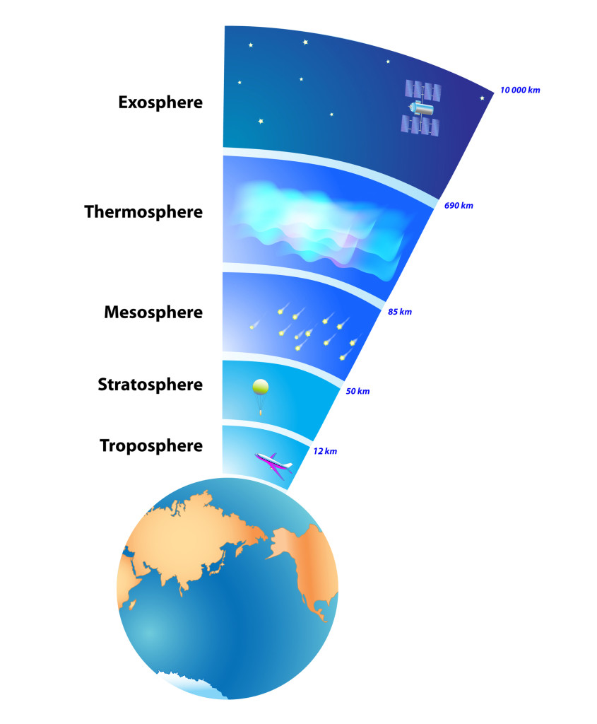
The mesospheric bore is a bright front of a single wave, beyond which internal gravity waves (IGW) most often spread consistently. The name of this phenomenon came from the Old Norse “bara”, which translates as “wave, swell”.
Exosphere
Understanding the mechanisms of the movement of air masses is very important and remains an urgent task in the era of global climate change. The mesospheric bore, which is an increase in atmospheric gravitational waves, can affect the flows of impulse and energy, and thereby affect the composition and thermal regime at all levels of the atmosphere.
The purpose of the work is to study the features of the spread and mechanism of the formation of a mesospheric bore based on images from all-sky camera in the geographical conditions of the territory of Yakutia.
10 000 km
Thermosphere
690 km
Mesosphere
85 km
Stratosphere
50 km
Troposphere
12 km

Slide 3
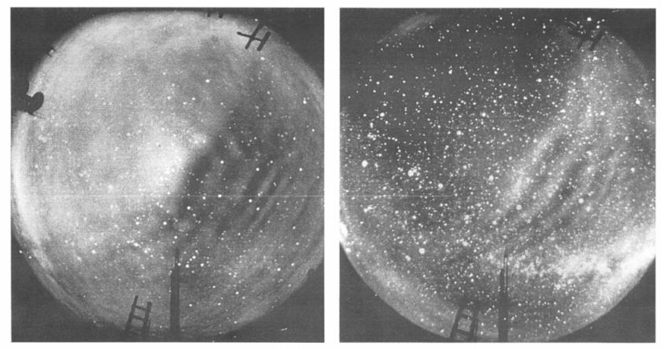
The bore in the night sky glow was first reported by Taylor et al. in 1995 and described as a «spectacular gravitational wave event». This phenomenon is a clear wave front that separates the part of space already involved in the wave process from the region in which the oscillations have not yet occurred.
Bore was observed in four layers of atmospheric glow:
OH at an altitude of ~87 km;
Na at an altitude of ~90 km (resonant doublet);
O₂ at an altitude of ~94 km (atmospheric bands);
OI at an altitude of ~96 km (green line).
OI
OH
All-sky images taken on October 10, 1993, over the crater of the Haleakala volcano (USA) during the Airbome Lidar and Observations of Hawaiian Airglow (ALOHA-93) campaign in the emission of hydroxyl OH (right) and atomic oxygen OI (left)
[Taylor M.J., Turnbull D.N., Lowe R.P. Spectrometric and imaging measurements of a spectacular gravity wave event observed during the ALOHA-93 campaign // Geophys. Res. Lett. 1995. V. 20, P. 2849–2852.]

Slide 4
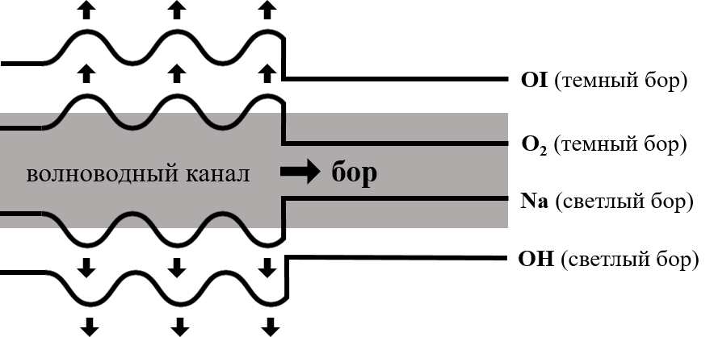
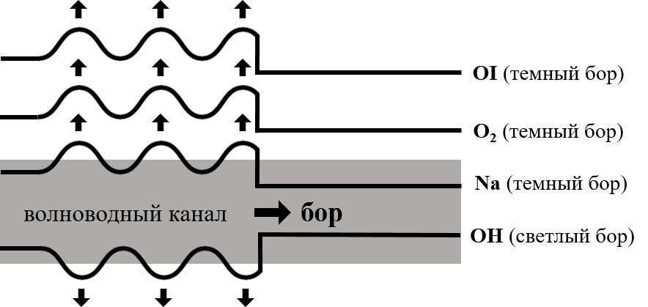
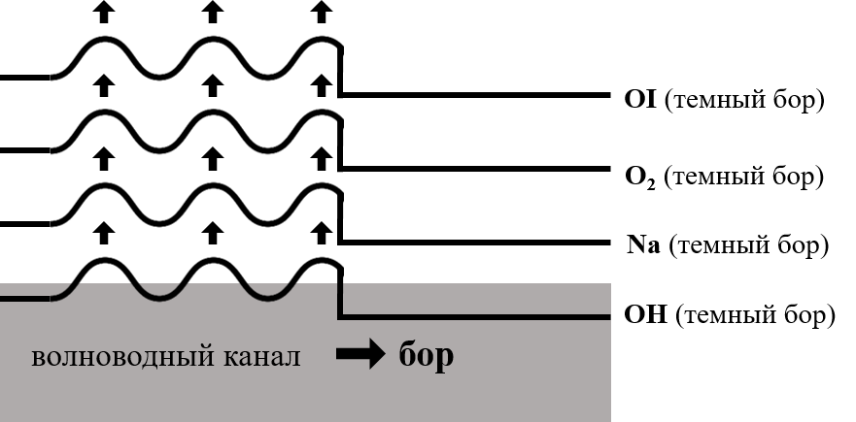
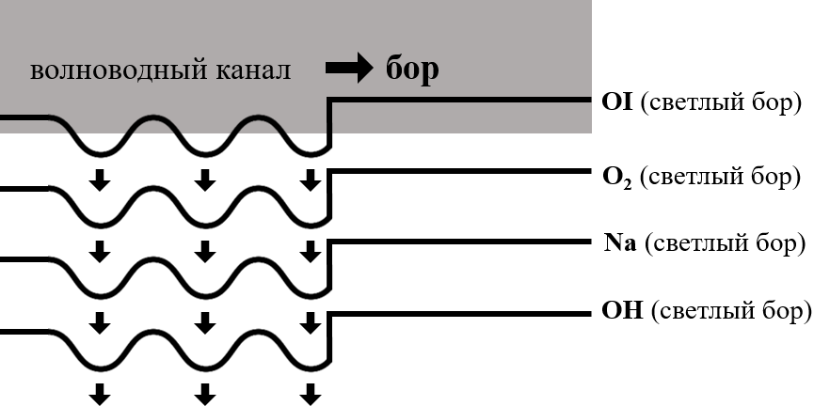
MIL structure – mesospheric inversion layers
(dark bore)
(dark bore)
(dark bore)
(dark bore)
waveguide channel
bore
(light bore)
(dark bore)
waveguide channel
bore
(light bore)
(light bore)
(dark bore)
waveguide channel
bore
(light bore)
(dark bore)
(light bore)
(dark bore)
(light bore)
(dark bore)
(light bore)
waveguide channel
bore

Slide 5
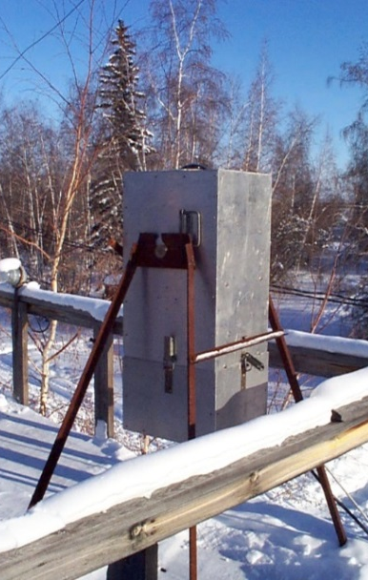
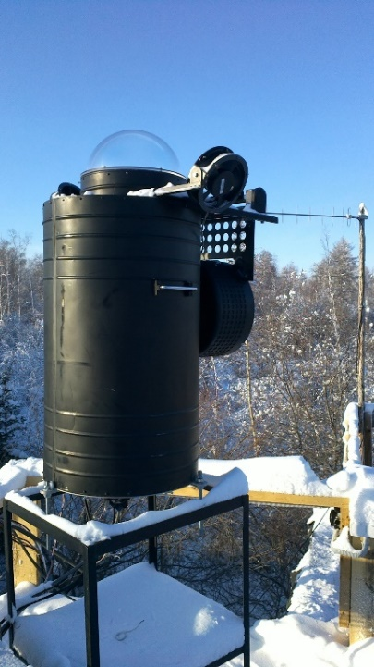
Registration of wave processes in the glow of the night sky was carried out using digital all-sky cameras located at the Maimaga station (63.04°N, 129.51°E), north of the city of Yakutsk at a distance of about 140 km.
1) All-Sky Camera «ST-6»
2) All-Sky Camera «ST-9»
3) All-Sky Camera «Keo Sentry»
Spatial resolution 241x250.
Spectral region
660-1000 nm,
where hydroxyl OH is emitted at an altitude of ~87 km.
The shooting interval between frames is 3 minutes.
Spatial resolution 512x512.
Spectral region 660-1000 nm, where hydroxyl OH is emitted at an altitude of ~87 km.
The shooting interval between frames is 1 minute.
Spatial resolution 1024x1024.
In this work, a filter centered on the horizontal wavelength of 557.7 nm [OI] was used.
The exposure duration is 10 s.

Slide 6
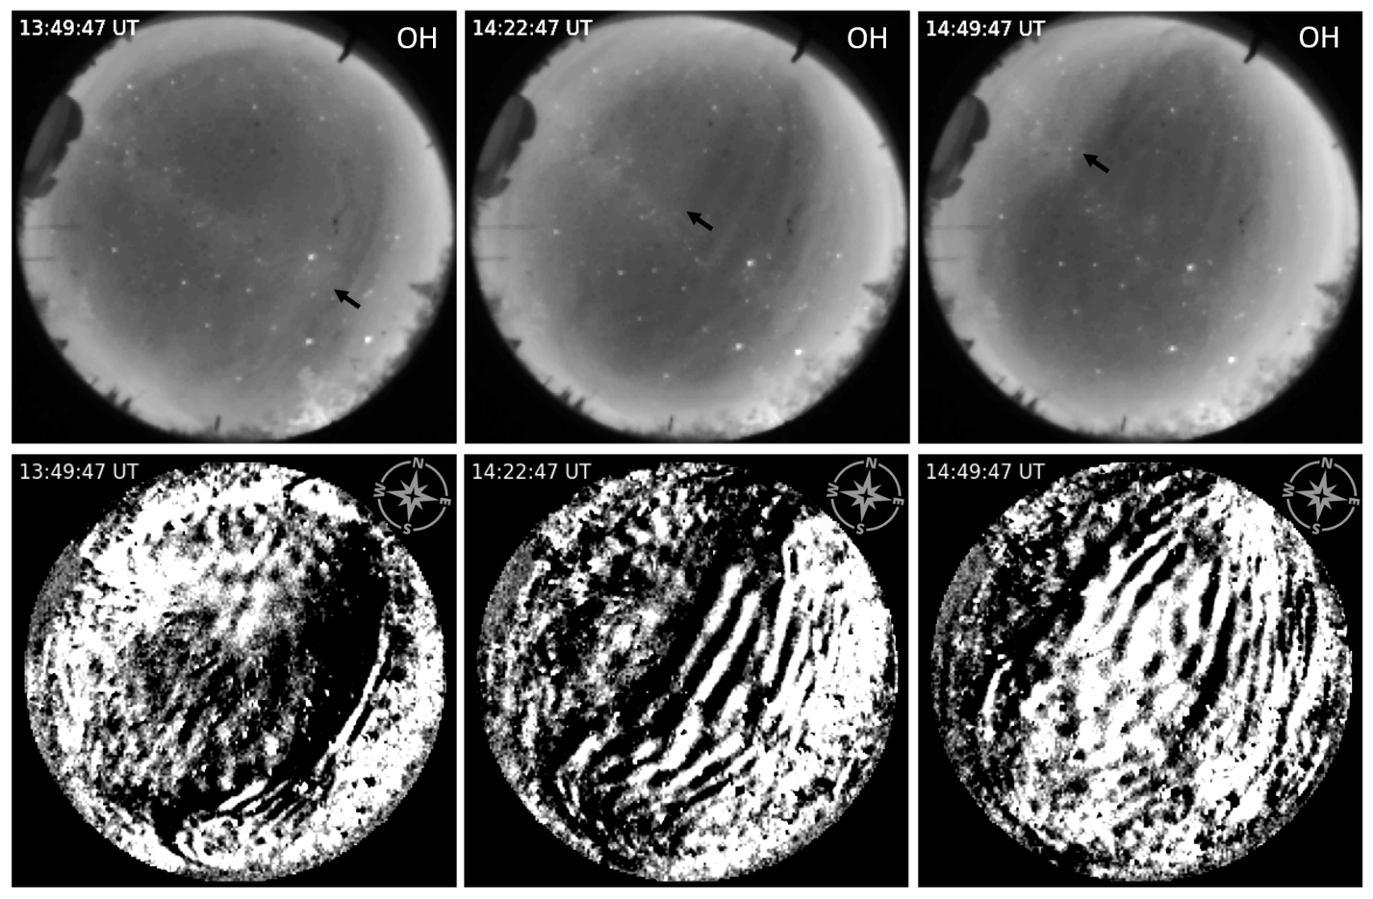
The first mesospheric bore event was recorded by all-sky cameras on November 19, 2017

Slide 7
Dark mesospheric bore November 19, 2017
The mesospheric bore propagated along an azimuth of ~ 290° (northwest).
The horizontal phase velocity of the mesospheric bore was ~ 66 m/s.
The observation time was 1 hour 18 minutes.
The waves sequentially propagating behind the mesospheric bore were observed until 16:10 UT. Their wavelength was ~ 27 km.
The event of the dark bore phenomenon suggests that its channel is located below the OH layer, respectively, the height of the mesospheric bore propagation is less than ~ 87 km.
OH
OH

Slide 8
An interesting effect was observed in the 557.7 nm [OI] line of the all-sky camera «Keo Sentry», where no clear wave front was visible, but after the passage of the mesospheric bore in the OH line through the camera's zenith (northwest), successive wave disturbances appeared in a limited area. These disturbances were separated on both sides by a smaller group of waves propagating in the opposite direction (southeast).

Slide 9
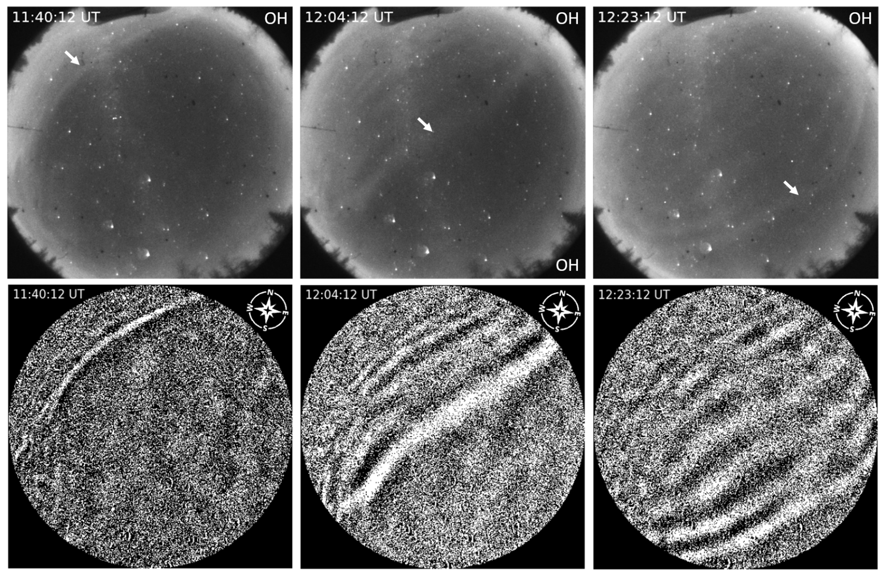
Second mesospheric bore event recorded by all-sky camera on January 30, 2022

Slide 10
Light mesospheric bore January 30, 2022
The mesospheric bore was propagating at an azimuth of ~ 140° (southeast).
The horizontal phase velocity of the mesospheric bore is ~ 86 m/s.
The observation time is 1 hour 23 minutes.
After the bore went beyond the horizon, successively propagating waves ceased to be displayed in the glow emission at about ~ 12:53 UT. The length of successive IGW is ~ 34 km.
The light bore implies that its channel is located above the OH layer. From this, it can be assumed that the bore was propagating at altitudes between the OH and OI layers (87 and 96 km.)
OH
OH

Slide 11
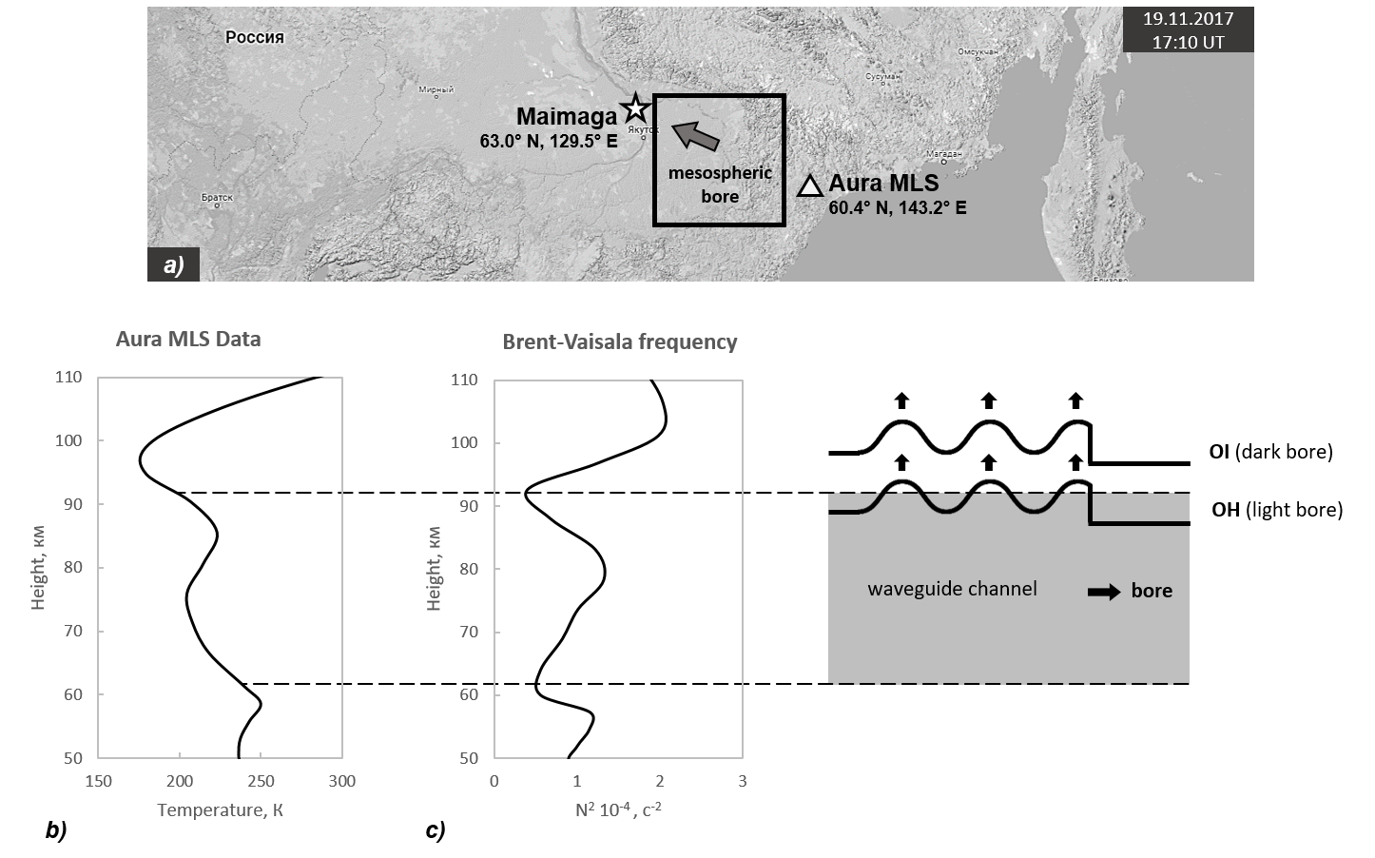
Upper Atmosphere Temperature Profile from Aura MLS (Microwave Limb Sounder) Satellite Data on November 19, 2017
Vertical profile of the square of the Brent-Väisälä frequency:
$$N^{2}=\frac{g}{T}(∆T_{z}+\frac{g}{C_{p}})$$
T = (T(z₁) + T(z₂)) / 2
ΔT_{z} = (T(z₂) – T(z₁)) / (z₂ – z₁)
z = (z₁ + z₂) / 2
At an altitude of 60–92 km, a region with the highest N² value (stable layer) is distinguished, surrounded by regions with low N² (unstable layers). This structure suggests that a MIL existed on this day, which is a favorable condition for the propagation of mesospheric bore.

Slide 12
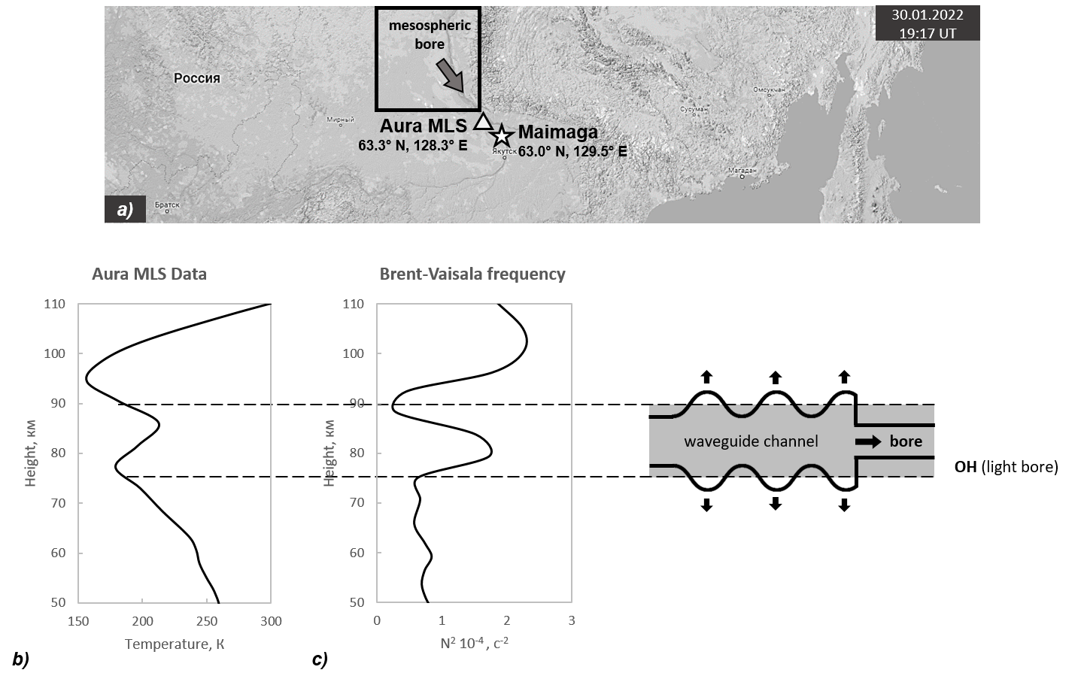
Upper Atmosphere Temperature Profile from Aura MLS (Microwave Limb Sounder) Satellite Data on January 30, 2022
Vertical profile of the square of the Brent-Väisälä frequency:
$$N^{2}=\frac{g}{T}(∆T_{z}+\frac{g}{C_{p}})$$
T = (T(z₁) + T(z₂)) / 2
ΔT_{z} = (T(z₂) – T(z₁)) / (z₂ – z₁)
z = (z₁ + z₂) / 2
At an altitude of 75–88 km, a region with the highest N² value (stable layer) is distinguished, surrounded by regions with low N² (unstable layers). This structure suggests that a MIL existed on this day, which is a favorable condition for the propagation of mesospheric bore.

Slide 13
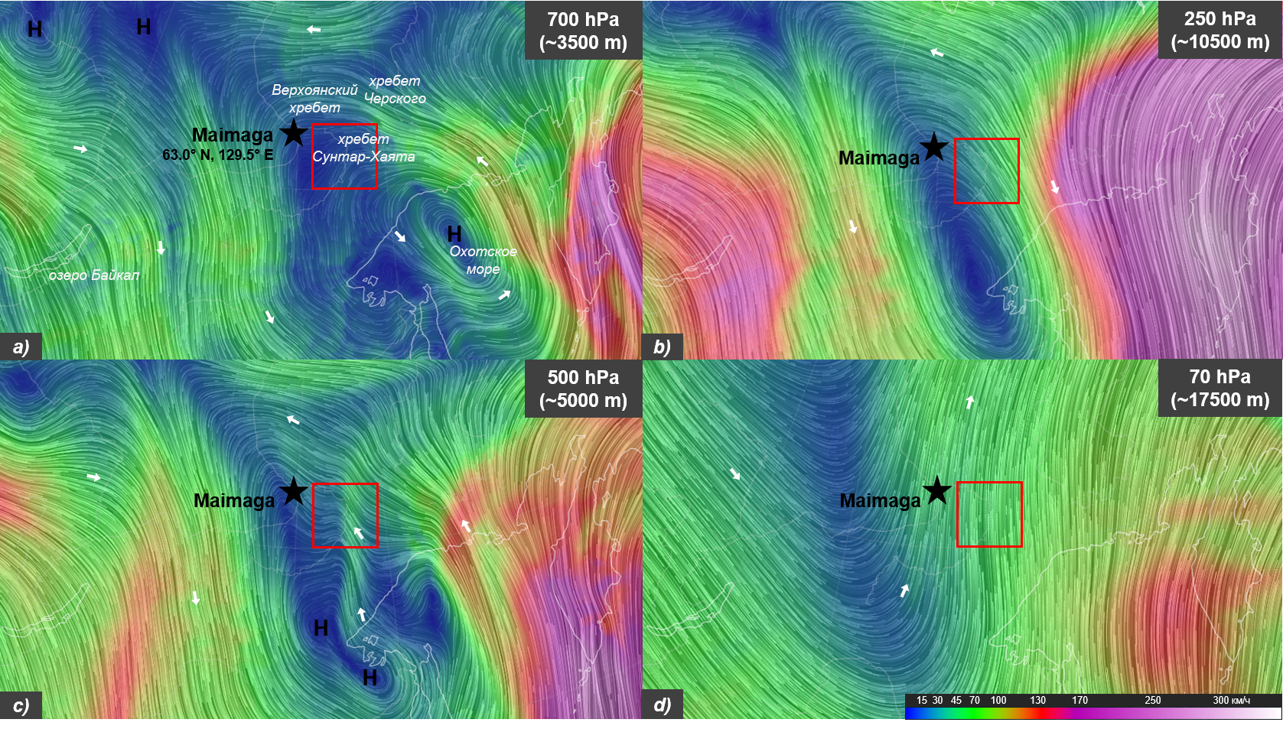
Global wind and weather map from NCEP (National Centers for Environmental Prediction) on November 19, 2017 at 12:00 UT
[Иванов В.В., Алексеенков Г.А. Приземные и высотные метеорологические карты. ОДМП ААНИИ [Электронный ресурс]. URL: https://www.aari.ru/data/realtime]
[Cameron Beccario. Earth: a visualization of global weather conditions [Электронный ресурс]. URL: https://earth.nullschool.net]

Slide 14
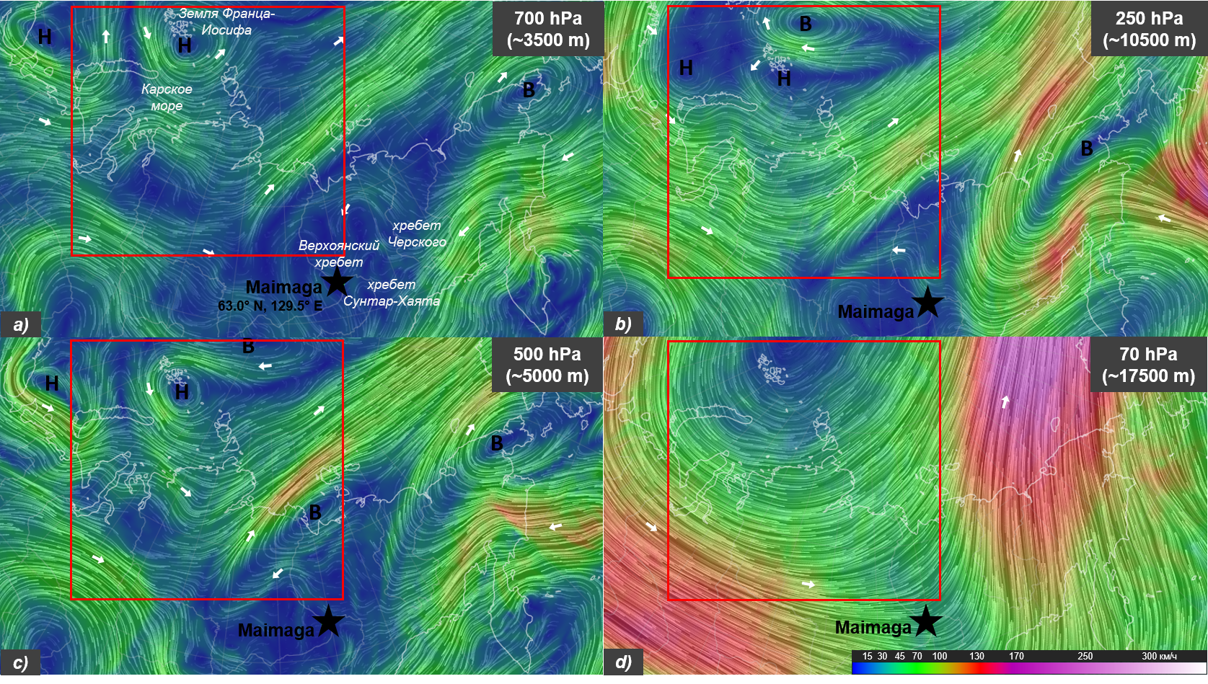
Global wind and weather map from NCEP (National Centers for Environmental Prediction) on January 30, 2022 at 11:00 UT
[Иванов В.В., Алексеенков Г.А. Приземные и высотные метеорологические карты. ОДМП ААНИИ [Электронный ресурс]. URL: https://www.aari.ru/data/realtime]
[Cameron Beccario. Earth: a visualization of global weather conditions [Электронный ресурс]. URL: https://earth.nullschool.net]

Slide 15
Conclusion
In this paper, the mechanisms and features of the mesospheric bore phenomenon were studied. Two events observed in northern latitudes over central Yakutia were identified.
The first event was recorded by two all-sky cameras in the night sky glow emissions on November 19, 2017. The light mesospheric bore extended from the southeast to the northwest (azimuth 300º). The wave front in the OH glow emission divided the sky into light and dark areas. The observation time was 1 h 18 min. The horizontal phase velocity of the mesospheric bore was ~66 m/s. The length of successive IGW was ~27 km. IGW were also observed in the atomic oxygen [OI] glow emission, including in the opposite direction relative to the successive waves behind the bore. The supposed source of the mesospheric bore generation was the wind shear between the tropospheric jet stream and the stratospheric polar vortex, formed by the orographic features of the terrain.
The second event was recorded by the all-sky camera on January 30, 2022 in the OH hydroxyl glow emission. The wave front, as in the first case, divided the sky into light and dark areas. The dark mesospheric bore propagated from the northwest to the southeast (azimuth 130º). The horizontal phase velocity of the mesospheric bore was ~86 m/s. The observation time was 1 h 23 min. The length of successive IGW was ~34 km. After the bore went beyond the horizon, successively propagating waves ceased to be displayed in the glow emission. The generation of the mesospheric bore may have been caused by shear instability from small-scale turbulent motions, or by shear instability of the circulation dipole.

Slide 16
Thank you for your attention!
The research was supported by Scientific and Educational Foundation for Young Scientists of Republic of Sakha (Yakutia) SEFYS http://nofmu.ru
Исследования поддержаны Научно-образовательным фондом поддержки молодых ученых Республики Саха (Якутия) НОФМУ http://nofmu.ru

