Slide 1
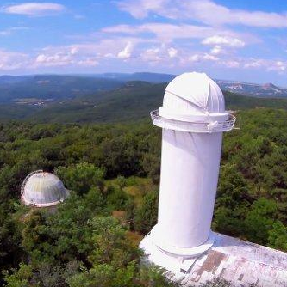
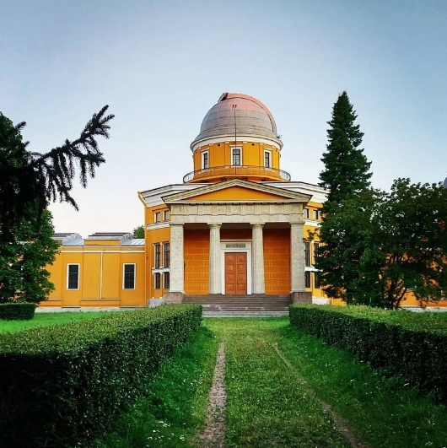
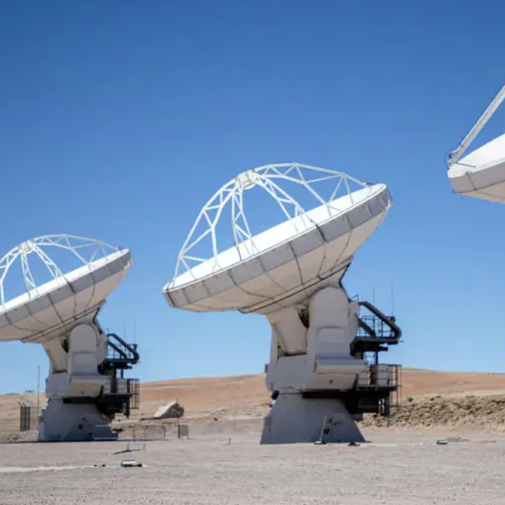
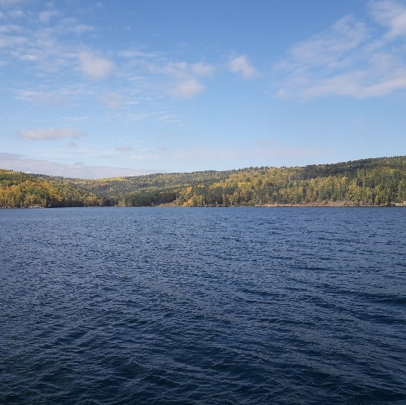
Исследование структуры и параметров факельных образований на Солнце STUDY OF THE STRUCTURE AND PARAMETERS OF FACULAR FORMATIONS ON THE SUN
¹П.В. Стрекалова, ²В.В. Смирнова, ¹Ю.А. Наговицын
¹ Главная (Пулковская) астрономическая обсерватория РАН, Санкт-Петербург, Россия
²Крымская астрофизическая обсерватория РАН, пгт. Научный

Slide 2
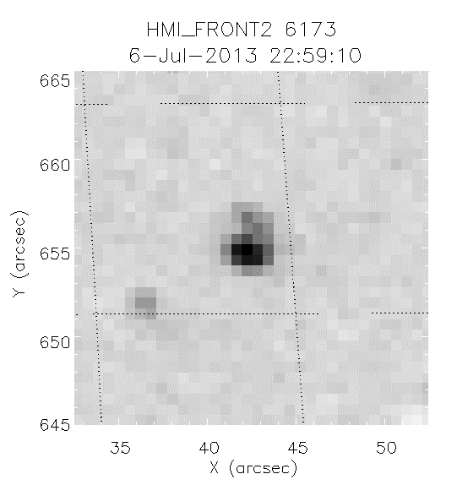
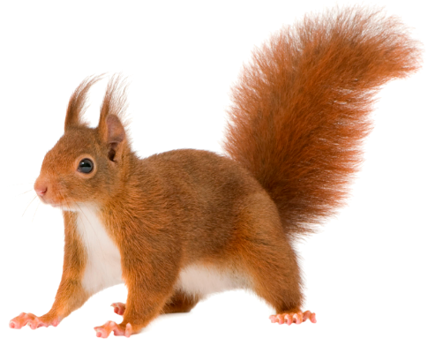
What are facular formations?
Факельные образования (ФО)/Facular formations (FF)
are a superclass that unites small-scale, long-lived, stable photospheric-chromospheric formations that do not belong to active regions of the Sun
D: 1,5 – 4 Mm
T_{life} ~ 10^{h} (9-33^{h}по магнитному полю)
|B_{max}| : 400-1100 G
↑
absolute value of the maximum achievable magnetogram signal
The figure shows an example of a FF magnetogram according to SDO/HMI data. The magnetic field value was
B=-315G at the moment
WTFF?

Slide 3
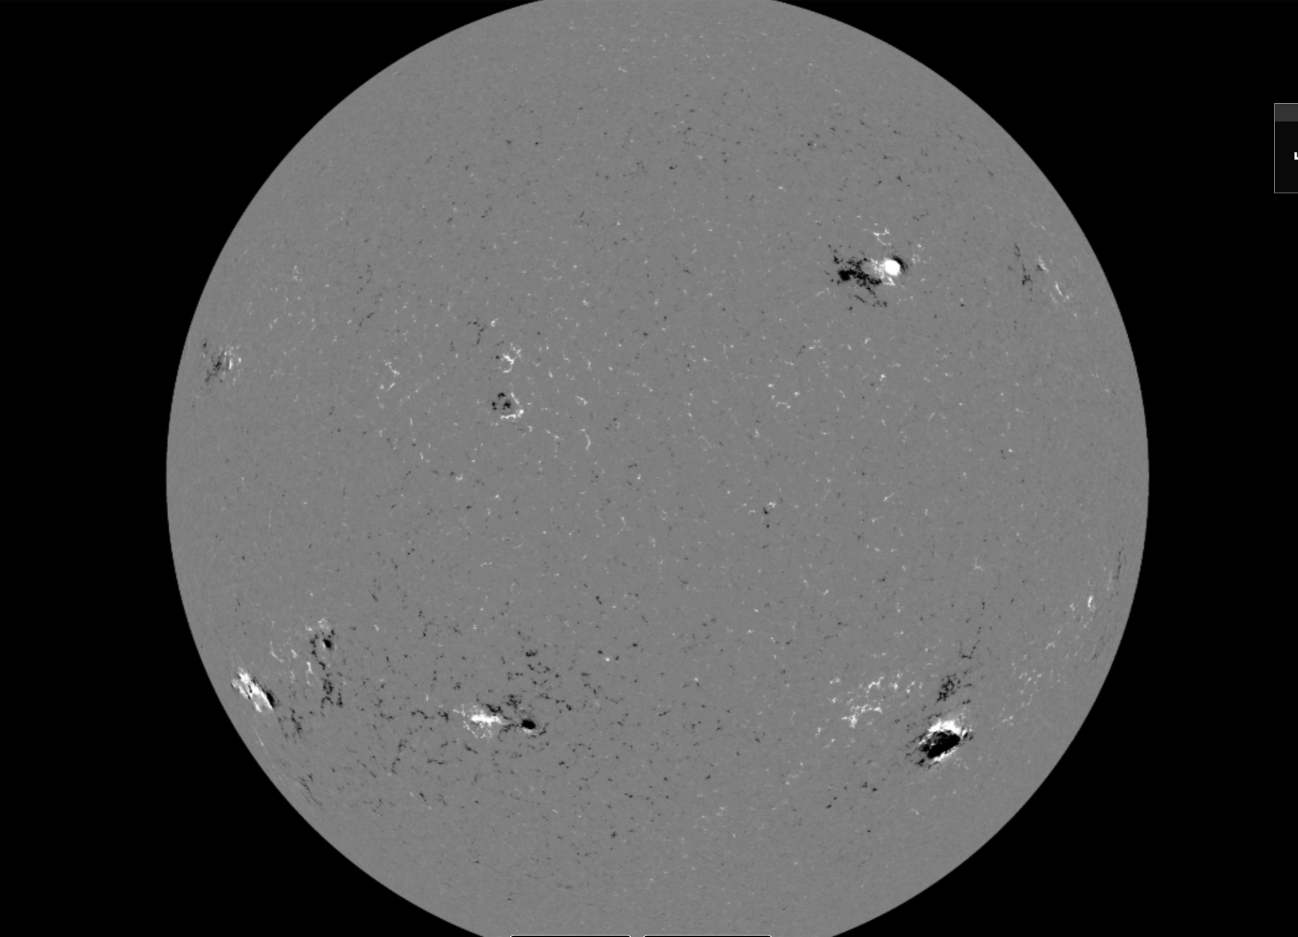
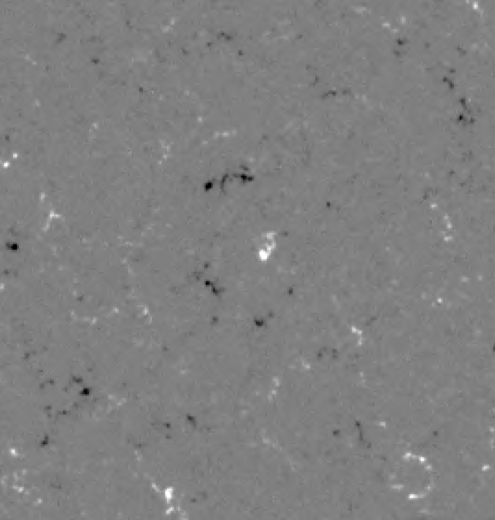
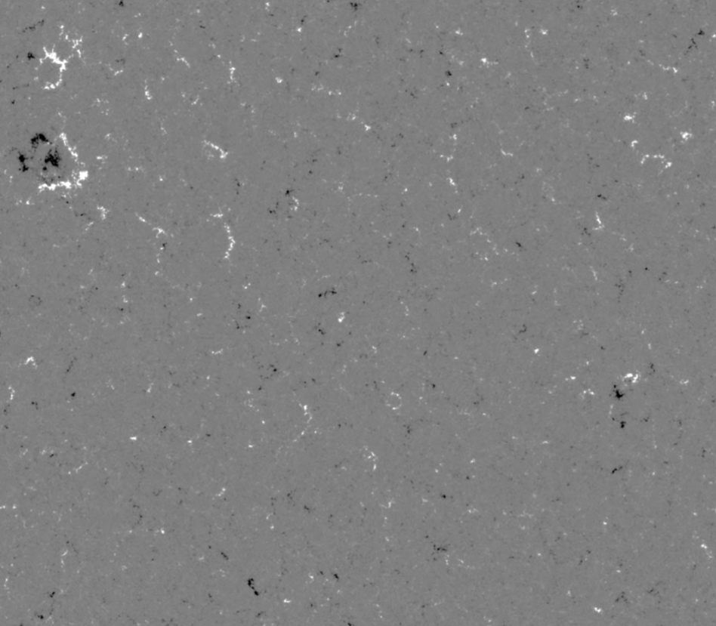
Where are the facular formations?
but not here
yesssss
pores
it’s a sunspot group
Everywhere
NO!
and not here
nope
this is it

Slide 4
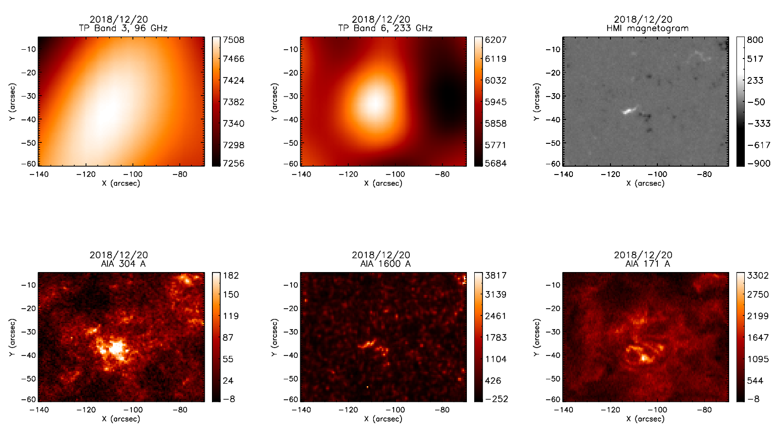
Аnd what about other ranges?
blurry source
localized radio source
(low resolution)
405G
T=7508°
T=6207°
-188G
low chromospheric loop
higher loop
bright source

Slide 5
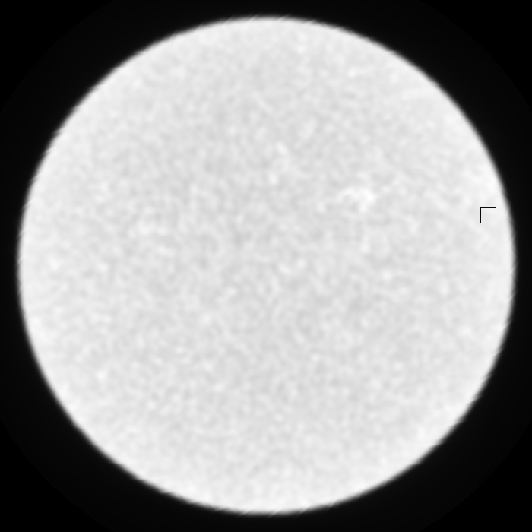
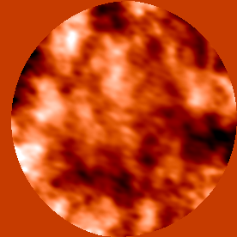
Temperature measurement
ALMA bands 96 GHz (3mm) 233 GHz (1,2mm)
Average height of radiation formation 1,8 Mm ± 1,0 Mm 0,9 Mm ± 0,7 Mm
Project 2018.1.01763.S
ΔH = 0,92 ±0,85 Mm
low resolution
no objects
Atacama Large Millimeter/submillimeter Array

Slide 6
Temperature measurement results
Bipolar structures →
Clear source
configuration of the magnetic field lines of the FF forms low loops that are visible in the chromosphere
Unipolar structures →
Weak/shifted source
(in chromosphere)
 | B_{extr}, G | T_{b} 1.2mm, K | T_{b} 3mm, K | ΔT_{b} 1.2mm, K | ΔT_{b} 3mm, K
1 | -869 | 6294 | 7240 | 594 | 140
2 | 736 | 6086 | 7321 | 386 | 221
3 | 509 | 6167 | 7467 | 467 | 367
4 | 407 | 6000 | 7511 | 300 | 411
5 | -420 | 6073 | 7419 | 373 | 319
6 | -610|259 | 6248 | 7574 | 548 | 474
7 | 405|-188 | 6207 | 7508 | 507 | 408
The background values ​​on the 1.2mm and 3mm maps were calculated by the method proposed in [Nagnibeda, Piotrovich, 1987]. In our case, they were 5700K and 7100K, respectively.

Slide 7
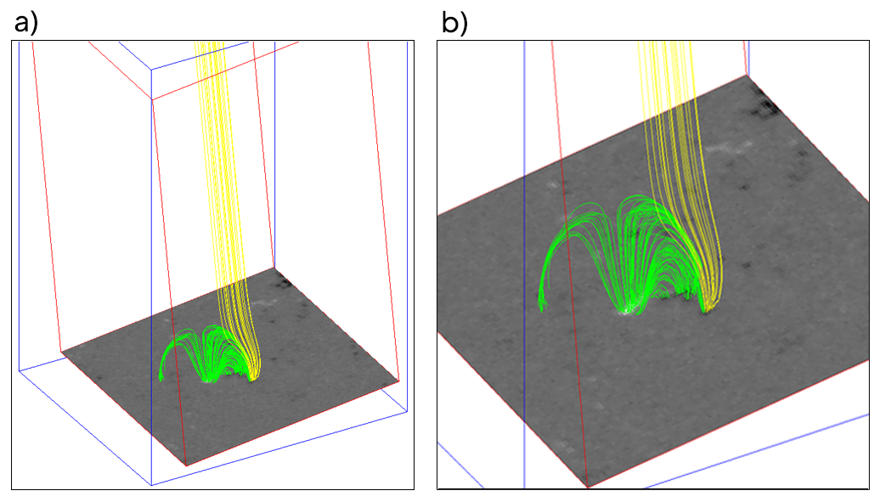
GX simulation results
GX simulator [Nita, 2009] allows to reconstruct the potential magnetic field up to coronal heights based on magnetograms obtained at the photosphere level based on observations at SDO/HMI
Magnetic field partially forms an open configuration
Some magnetic field lines close in areas of opposite polarity, forming loops

Slide 8
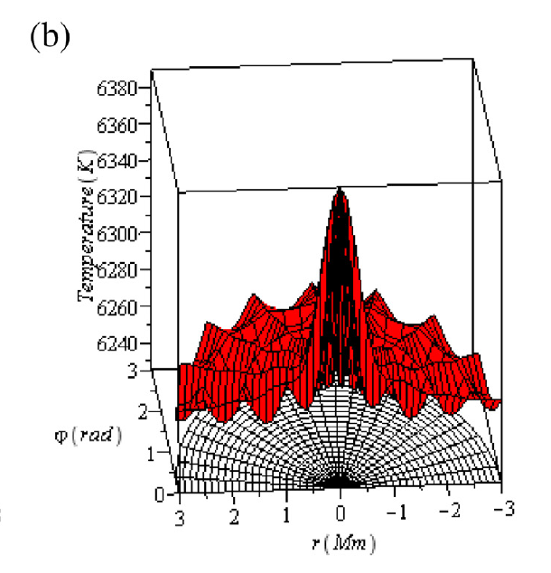
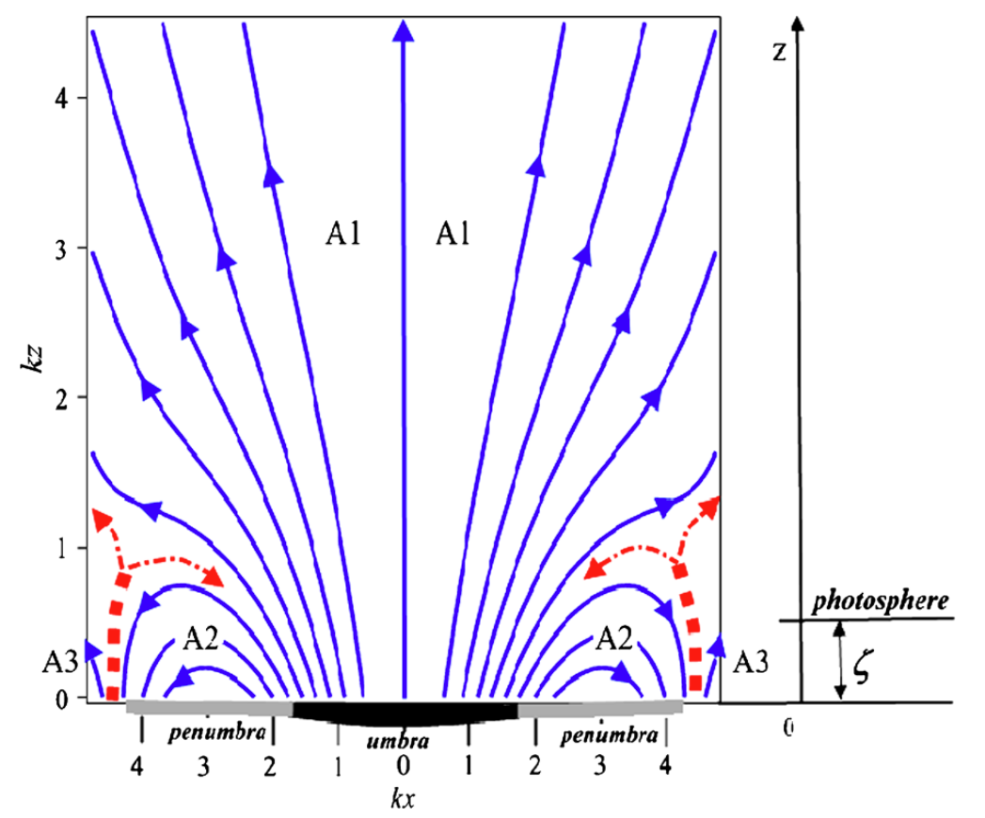
Discussion and conclusions
Three-flux model of the sunspot magnetic structure
[Solov’ev A.A., Kirichek E.A., 2016] [Smirnova et al.,2016]
heating
reconnection
Temperature field of the facula at the level z = 1003 km for a magnetic field twice smaller than the previous: B0 = 500 G
(Structure of solar faculae, [Solov’ev A.A., Kirichek E.A., 2018])

Slide 9
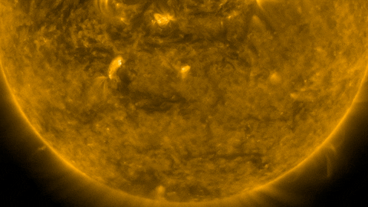
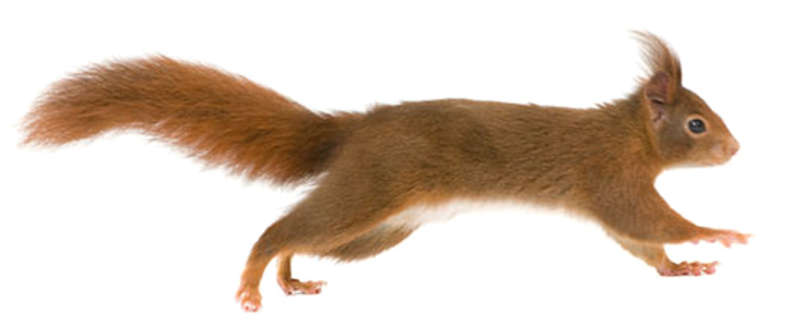
Thanks for watching!

Slide 10
Where are the facular formations?

Slide 11
Where are the facular formations?
Everywhere

Slide 12
Where are the facular formations?
But not here
It’s a sunspot group

Slide 13
Where are the facular formations?
but not here
it’s a sunspot group
and not here

Slide 14
Where are the facular formations?
but not here
it’s a sunspot group
and not here
nope

Slide 15
Where are the facular formations?
but not here
it’s a sunspot group
NO!
and not here
nope

Slide 16
Where are the facular formations?
but not here
pores
it’s a sunspot group
NO!
and not here
nope

Slide 17
Where are the facular formations?
but not here
pores
it’s a sunspot group
NO!
and not here
nope

Slide 18
Where are the facular formations?
but not here
pores
it’s a sunspot group
NO!
and not here
nope

