Slide 1
STUDY OF THE INFLUENCE OF CHANNEL MODEL PARAMETERS
ON THE CHARACTERISTICS OF THE PCM SIGNAL
FOR IONOSPHERIC HF COMMUNICATIONS
Authors: Dr. (Phys.-Math.), Professor Natalya V. Ryabova;
Ph.D. (Eng.), Associate Professor Alexey A. Elsukov;
Postgraduate student Sofya S. Stankevich
Volga State University of Technology
The purpose: development, software and hardware implementation and verification of an algorithm for assessing the influence of channel model parameters on the characteristics of a complex signal using the example of FCM for HF radio links
Tasks:
Synthesis of a complex PCM signal in the GNU Radio software environment;
Modeling the influence of channel parameters on a complex PCM signal based on a simulator implemented using the Waterson model;
Creation of an algorithm and its implementation in the GNU Radio software environment for compression of a distorted complex PCM signal;
Verification of the developed algorithm and assessment of the influence of channel model parameters on the distortion of the characteristics of a complex PCM signal

Slide 2
There is a problem in the temporal variability of the characteristics of communication lines due to the variability of the ionosphere and a number of other factors (solar flares, geomagnetic storms, spacecraft launches, ground explosions, heating of the ionospheric plasma by powerful radio emission .)
Diagnostics of the ionosphere allows taking into account this variability. It is necessary for a qualitative assessment of engineering solutions of created radio equipment in real communication channels at the design stage; it is necessary to reduce the development cycle
Over the years, a great contribution to the development of ground-based and space-based ionospheric sounding systems was made by: N.A. Armand, E.L. Afraimovich, V.D. Gusev, N.P. Danilkin, V.A. Ivanov, V.E. Kunitsyn, V.I. Kurkin, L.A. Lobachevsky, D.S. Lukin, R.G. Minullin, A.P. Potekhin, V.P. Uryadov, Yu.N. Cherkashin.
The following works are devoted to research in the field of creating ionosphere diagnostic systems and HF communication channels: N.P. Danilkin, V.A. Ivanov, D.V. Ivanov, V.I. Kurkin, A.P. Potekhin, N.V. Ryabova, O.N. Sherstyukov, A.D. Akchurin, S.A. Kolesnik, Yu.A. Chernov, G.H. Barry, S. Salous, A.W. Pool, P.S. Cannon, J. Vierinen., B.D. Perry, R. Rifkin, D.J. Belknap.

Slide 3
MODELS OF HF RADIO CHANNELS
1. Watterson model. By equivalently replacing the HF path with a low-frequency equivalent, the channel is modeled as a delay line with taps, each corresponding to a discrete beam and modulating the signal in amplitude and phase by multiplying by a complex time-dependent factor. The signals taken from the taps of the delay line simulate signal modes arriving along different trajectories to the receiving antenna. Each of these signals is multiplied by the corresponding complex transmission coefficient of the given beam. The disadvantages of the model are that it is suitable for a channel frequency band of no more than 10–12 kHz; does not take into account signal blurring in the time domain due to frequency dispersion and scattering on ionospheric irregularities; as well as correlation of signal propagation modes reflected from the same layer. The mutual delays between multipath components have fixed values. The model assumes the channel to be stationary in time. Therefore, its use is possible at time intervals of about 10 minutes.
2. The Vogler-Hofmeier model takes into account the existence of time scattering, which allows it to be used in calculating the characteristics of HF modems operating at speeds above 9600 bps in the voice channel band, and in calculating low-bandwidth modems with a bandwidth of up to 1 MHz. When constructing the model, it is assumed that the impulse response of a multipath channel is the sum of the impulse responses of its constituent single-beam channels. The advantage of the model is to expand the frequency band and take into account the Doppler frequency shift. Disadvantages include the need to enter a large number of parameters for each propagation mode, which cannot be determined from ionospheric and propagation path models. This model, like the previous one, considers the channel as stationary in time.
3. Model of Zernova N.N. and Germa V.E. involves two stages. The first is analytical ray tracing for a basic model of the ionosphere, which is represented by a layered isotropic medium. In the ionosphere, anisotropy and the concentration gradient of charged particles can be taken into account. As a result, trajectories of oblique signal propagation are constructed. At the second stage, it is assumed that the pulse signal passing through the excited ionosphere is described by the Fourier integral in the frequency domain. The disadvantage of the model is the need to perform complex calculations of voluminous mathematical expressions. However, this makes it possible to statistically take into account the effects of scattering of a propagating electromagnetic field on ionospheric irregularities
4. The Yau model is designed specifically to simulate fading of a broadband signal propagating in the ionosphere. The advantage of the model is the presence of analytical expressions that take into account the nonstationarity of the ionosphere in time, which describe signal distortions. These expressions are also related to the physical parameters of the propagation medium. The disadvantage of this method is the need to perform ray tracing for application.

Slide 4
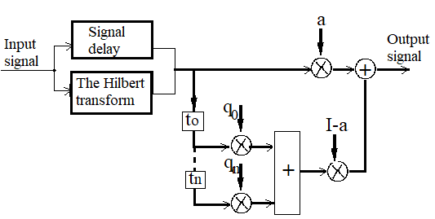
WATTERSON MODEL
Narrowband model for ionospheric HF radio channels
The radio channel is modulated as a multi-section delay line with one tap for each signal path. The delayed signal is modeled in amplitude and phase by random complex gain at each tap.
Advantages of the Waterson model:
Training for Researchers: The Watterson model provides scientists with an optimal platform for studying and modeling the ionosphere, allowing them to better understand the processes that occur in this medium.
Ionospheric Disturbance Prediction: Using an ionospheric simulator using the Waterson model, potential disturbances and deviations in radio communications and navigation systems can be predicted, which helps facilitate planning and optimization.
System Testing: The Waterson model can be used to test and validate new radiocommunication and navigation technologies and systems to evaluate their performance and effectiveness under different conditions.
Figure 1 - Scheme of the Watterson model algorithm
To describe the N-beam channel using the Waterson model, taking into account magneto-ion splitting and the values ​​of constant Doppler shifts, it is required:
set of (N-1)+6 parameters; (N-1) mutual delays between beams and six parameters for each beam:

Slide 5
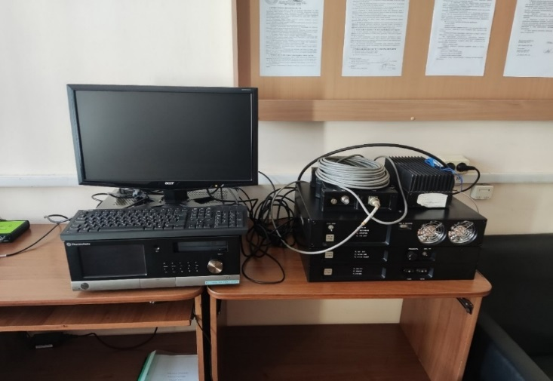
Simulator of HF-VHF channels
The product VIRD .464971.001 RE is certified and standardized
The HF-VHF channel simulator is designed to:
for testing data
exchange systems
to study the characteristics of modems, modulation and coding methods, channel data transmission protocols and methods of their technical implementation for HF and VHF radio communication systems.
During the modeling process in the HF channel simulator, you can set the following parameters of the Waterson model:
number of rays (from 1 to 4);
ray levels (amplitudes) (from 0 to 10);
relative ray delays (from 0 to 15 ms);
phase shift of the first beam (from -5 to 5 rad);
Doppler frequency shift of the signal of each beam (from -2500 to 2500 Hz);
Doppler scattering of the signal frequency of each beam (from 0 to 30 Hz);
coefficients of the ratio of specular components of rays to scattered ones (from 0 to 10);
ray_asymmetry coefficients (from 0 to 10).
Figure 2 – Simulator of HF-VHF channels (Volgatech)

Slide 6
Hardware-software algorithm for assessing the influence of the parameters of the Waterson channel model on the characteristics of a complex signal
1. Synthesis of a complex input signal using the example of a phase-code-manipulated signal. The synthesized FCM signal is written to a file in .wav format
2. Simulation of signal passage through an HF channel using the Waterson model
3. The signal from the output of the simulator is fed to the input of the receiver. There is no binding to a specific receiver, i.e. there is no filtering or frequency conversion). In the GNU Radio software environment, the PCM pulse is compressed when calculating the correlation of the received signal with a known transmitted pulse. The output signal of a matched filter can be mathematically described by the convolution between its input signal and the impulse Response
where s(t) is the input signal, h(t) is the impulse response of the matched filter.
4.Verification of the developed algorithm and assessment of the influence of channel model parameters on the distortion of the characteristics of a complex PCM signal
From the properties of the Fourier transform
Algorithm verification and estimation of PCM signal parameters

Slide 7
Stage 1. Synthesis of a PCM signal in a software environment GNU Radio
In the GNU Radio software environment, a phase-codo manipulated pulse was created and saved in a wav file. A Barker sequence with a length of 13 chips was taken (this is the maximum possible number of chips, which gives the largest ratio of the main lobe to the side lobes in the CF correlation function). Chip duration is 83.3 μs, duration is 1.08 ms, period is 10.6 ms. wav file parameters: sampling frequency 48 kHz, bit depth 16 bits, mono.
Figure 3 - Scheme for creating a FCM pulse

Slide 8
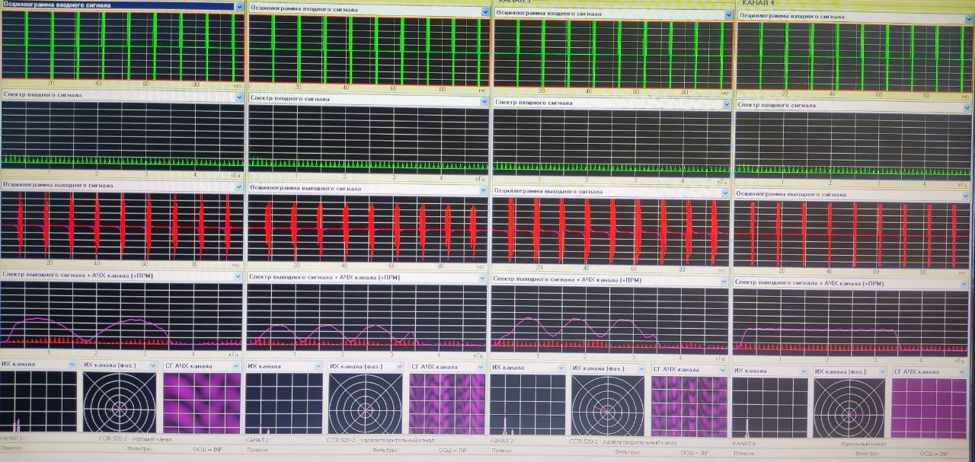
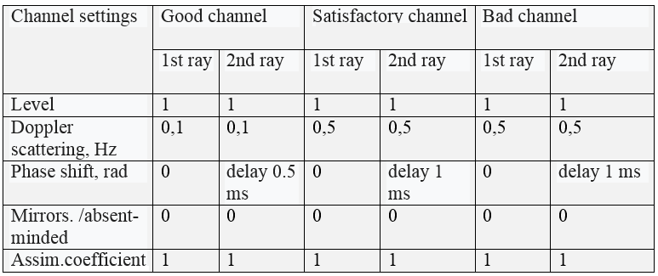
Stage 2. Modeling the influence of channel parameters on a complex PCM signal based on a simulator implemented using the Watterson model
Figure 4 - graphs of the FCM pulse passed through the HF channel simulator
for 3 channels and ideal passage without using a model
Table 1. Setting the parameters of HF channels in the simulator in accordance
with the CCIR Recommendation

Slide 9
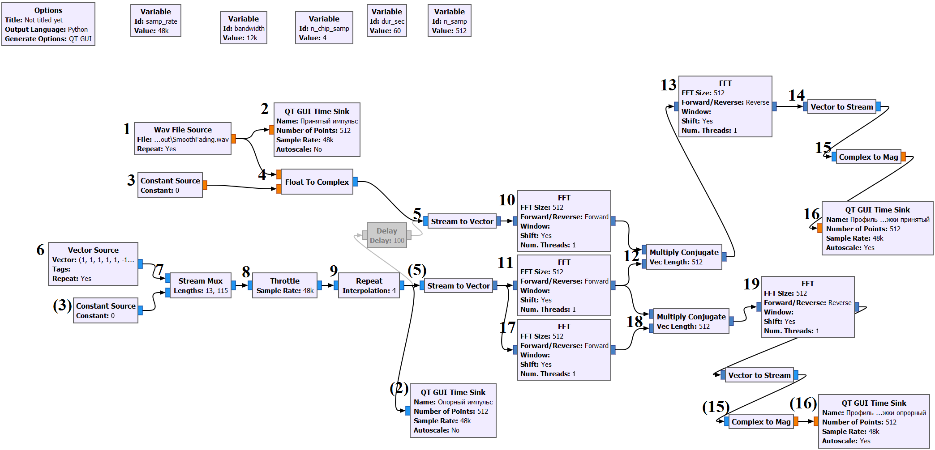
Stage 3. Creation of an algorithm and its implementation in the GNU Radio software environment for compression of a distorted complex PCM signal
The signal, after passing through all the channels of the simulator, was recorded in a wav file for subsequent analysis in GNU Radio.
An algorithm and a circuit that implements it in the GNU Radio software environment have been developed for compressing a complex PCM signal transmitted through a HF radio channel.
Figure 5 - Compression scheme for a pulse passed through IR FCM in the frequency domain

Slide 10
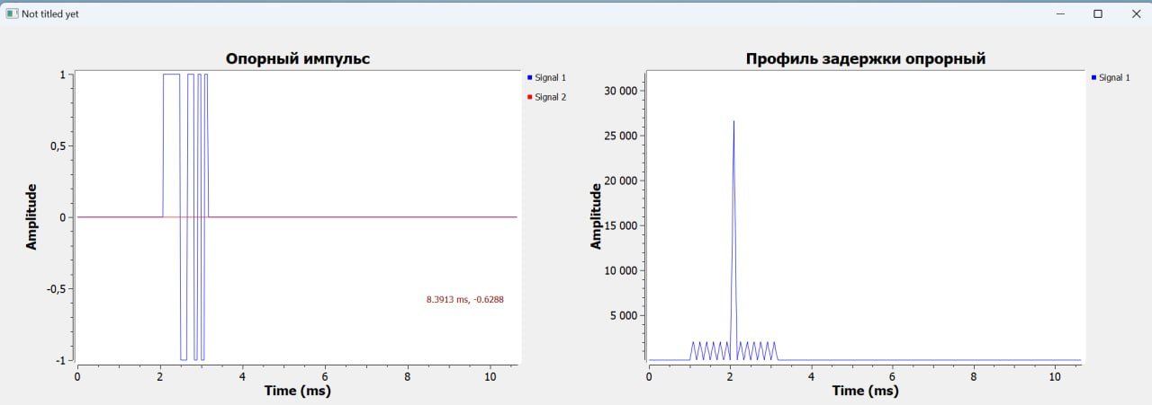
Stage 4. Verification of the developed algorithm and assessment of the influence of channel model parameters on the distortion of the characteristics of a complex PCM signal
Fig. 6 - Graphs of the original pulse (left) and its correlation function (right) Fig. 7 - Graphs of the FCM pulse received after the channel simulator with good …. passage of the channel (left) and its correlation function (right)
Fig. 8 - Graphs of the FCM pulse received after the channel simulator with
satisfactory passage of the channel (left) and its correlation function (right)
Fig. 9 - Graphs of the FCM pulse received after the channel simulator with poor channel passage (left) and its correlation function (right)

Slide 11
Estimates of distortion of the characteristics of a complex signal using the example of PCM depending on the parameters of the Watterson channel model
(derived from graphs 6-9)
The original pulse and its correlation function show an ideal channel without distortion.
The results obtained allow us to conclude that depending on the state of the radio channel, which is specified by its parameters, the received signal is distorted. As a result, its correlation function changes compared to the original one.
In a “good” channel, multipath practically does not appear and delay scattering is minimal.
In a satisfactory and poor channel, a 2-path signal propagation is observed.
The ratio of the main lobe of the correlation function to the side lobes of the original signal is 13, which corresponds to the Barker code length.
A good channel has a ratio of the main lobe of the correlation function to the side lobes of ~8; for satisfactory ~7; the bad one has ~5.1.

Slide 12
Conclusion
An algorithm for assessing the influence of channel model parameters on the characteristics of a complex signal for ionospheric HF radio links has been developed and implemented in software and hardware.
A radio channel was simulated using the Watterson model on a HF-VHF channel simulator device VIRD .464971.001 RE
To synthesize the emitted complex signal and process the received signal, algorithms have been developed, implemented in the GNU Radio software environment
Estimates of the distortion of the characteristics of a complex signal are obtained using the example of PCM, depending on the parameters of the Watterson channel model
The work was supported by a grant from the Russian Science Foundation, project № 23-19-00145.

