Slide 1
St. Petersburg University
Department of Atmospheric Physics
Estimation of the relation between the mesospheric dynamic regime and the stratospheric circulation from reanalysis and microwave radiometry data
Arseniy V. Sokolov, Andrey V. Koval, Elena N. Savenkova

Slide 2
Agenda
remote sensing
MW radiometry
PW activity analysis
NLC onset date
MLT temperature & water vapor
stratosphere circulation

Slide 3
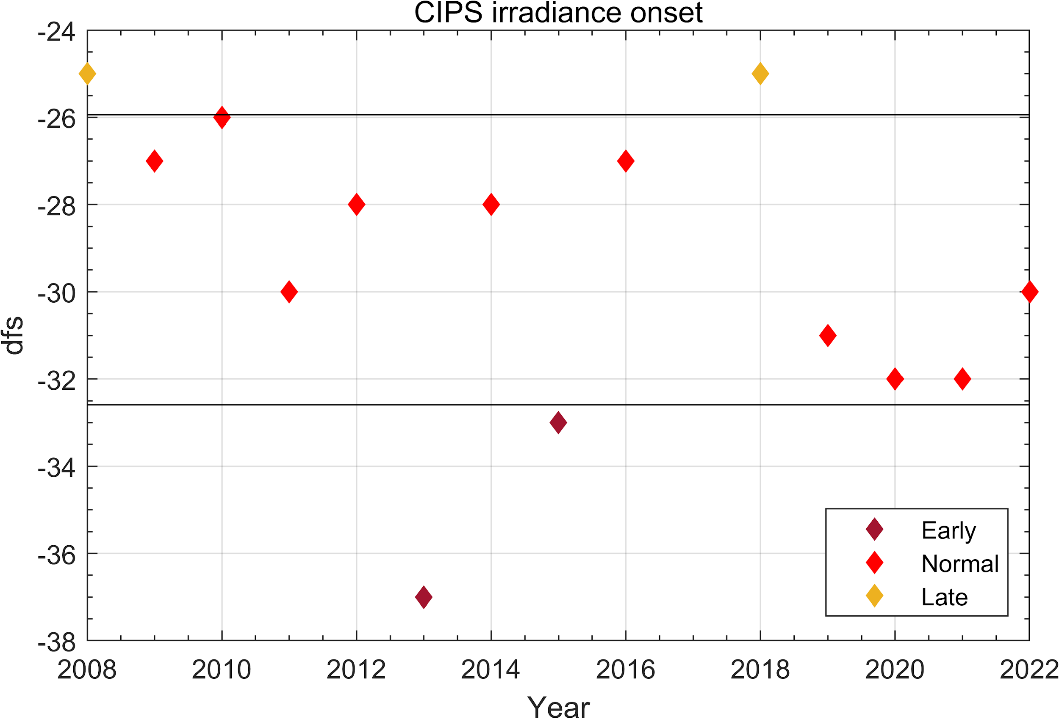
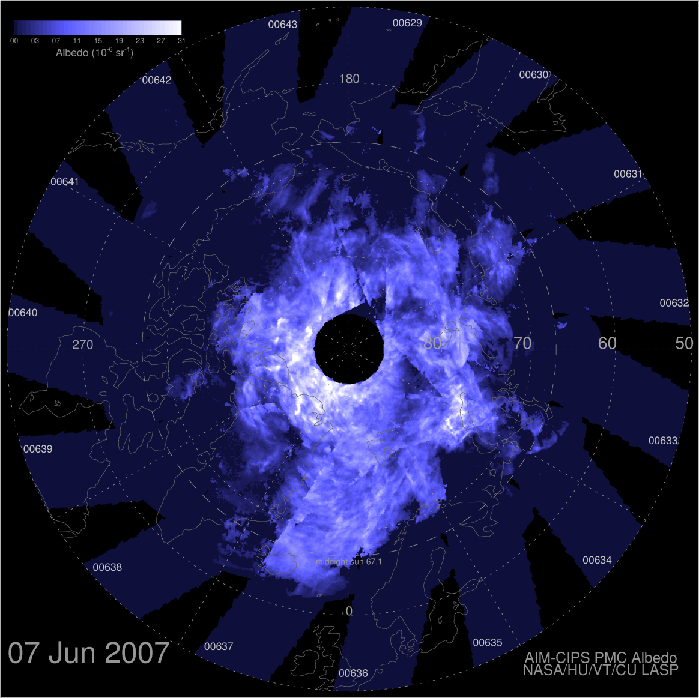
Remote sensing

Slide 4
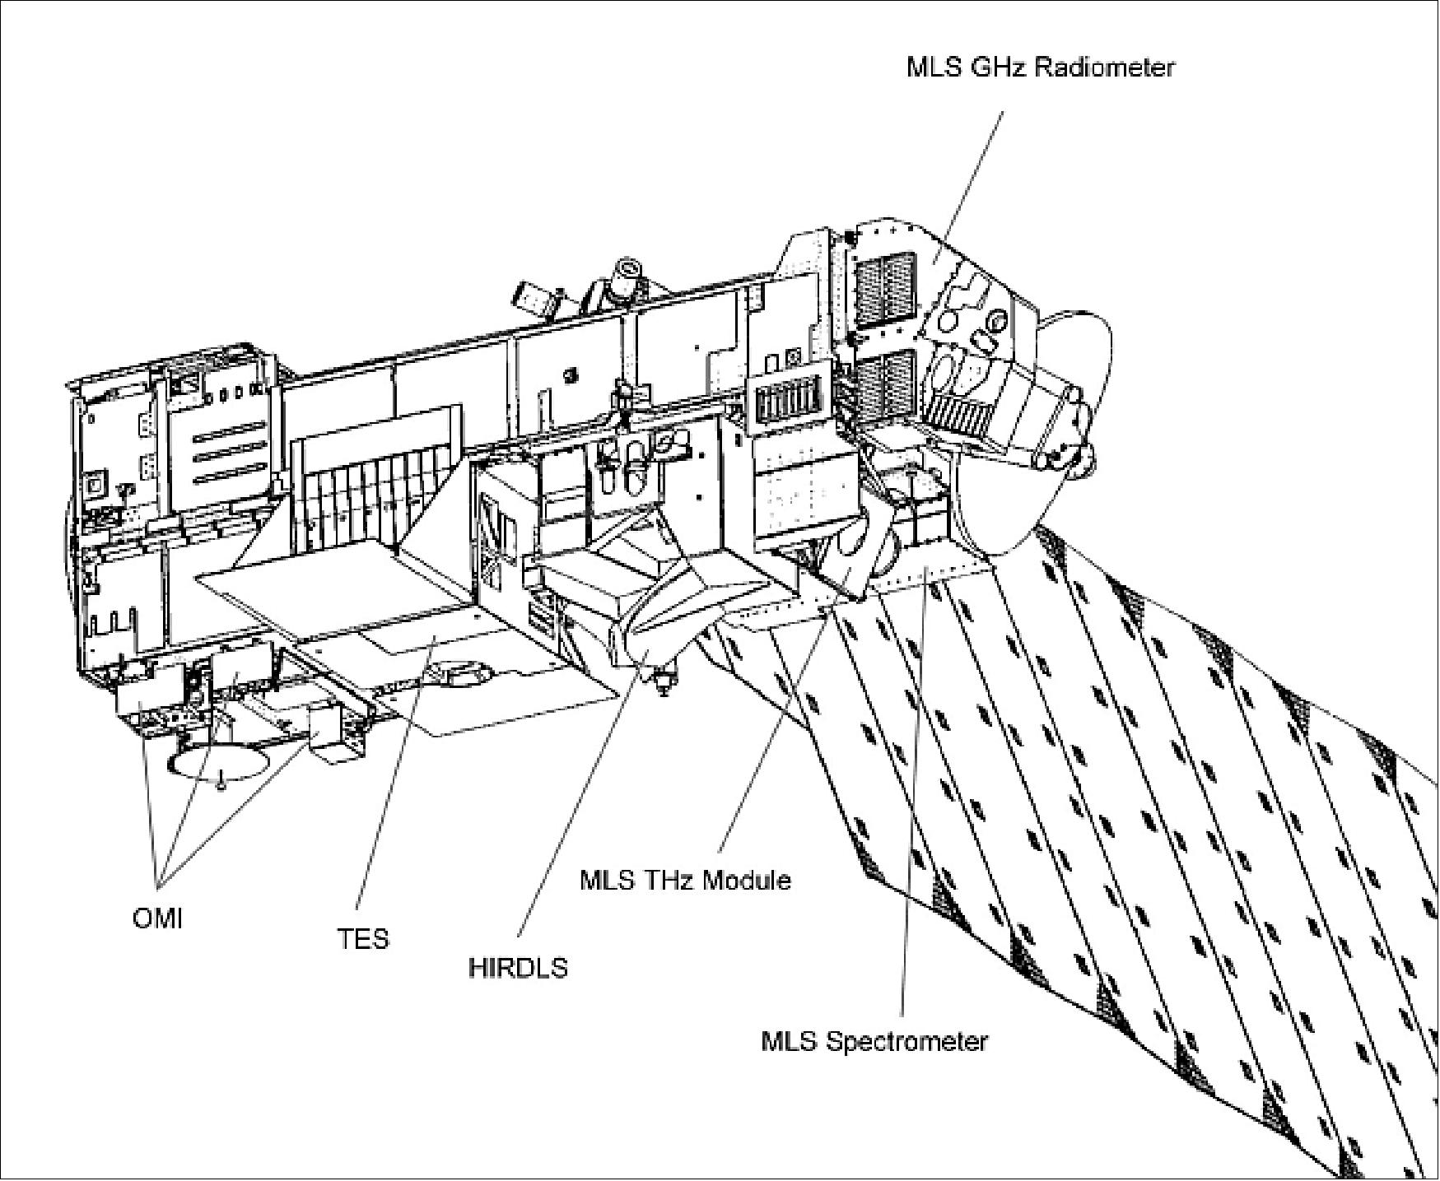
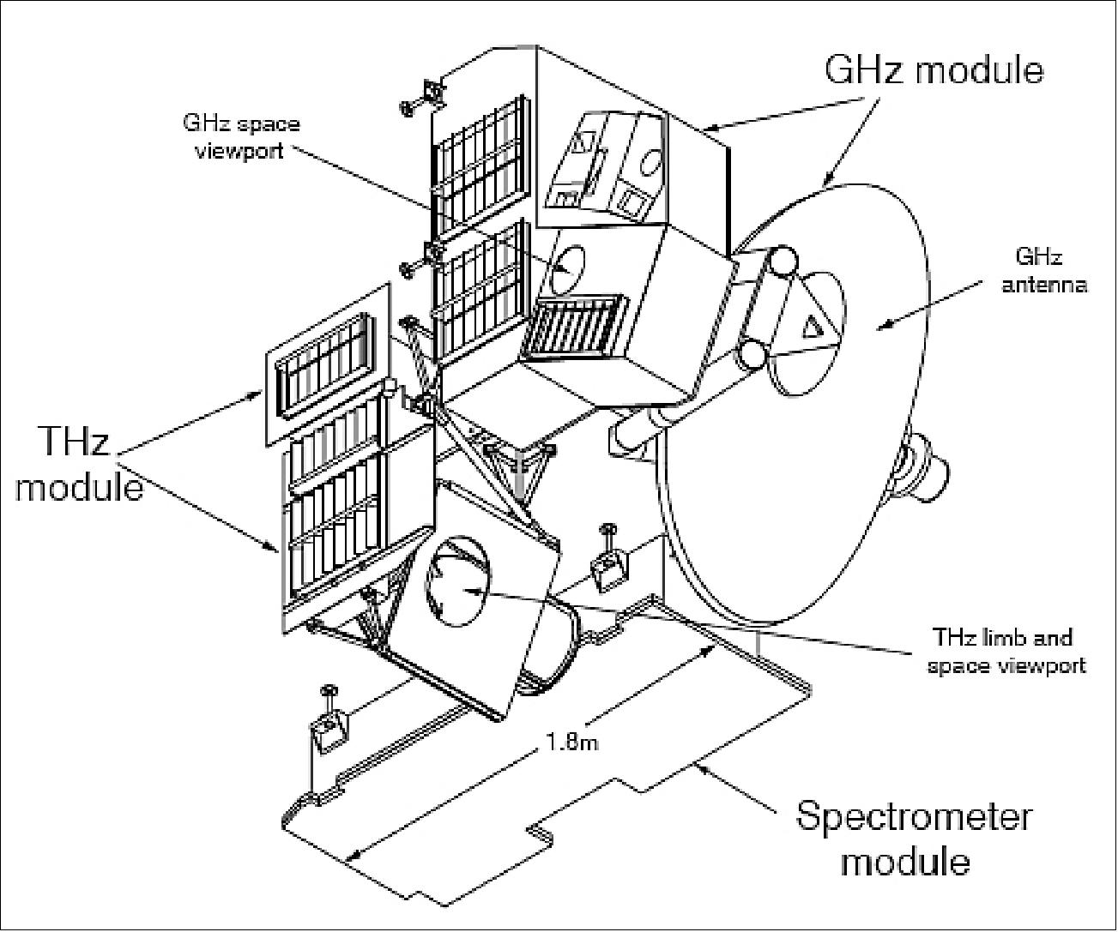
a. MLS/Aura
EOS MLS
Aura
«Aura» spacecraft. Equator crossing time 01:45 LT & 13:45 LT.
Microwave Limb Sounder (MLS) onboard «Aura» spacecraft.

Slide 5
b. Wavelet transform

Slide 6
b. Wavelet transform
Amplitude
Phase
Morlet Wavelet

Slide 7
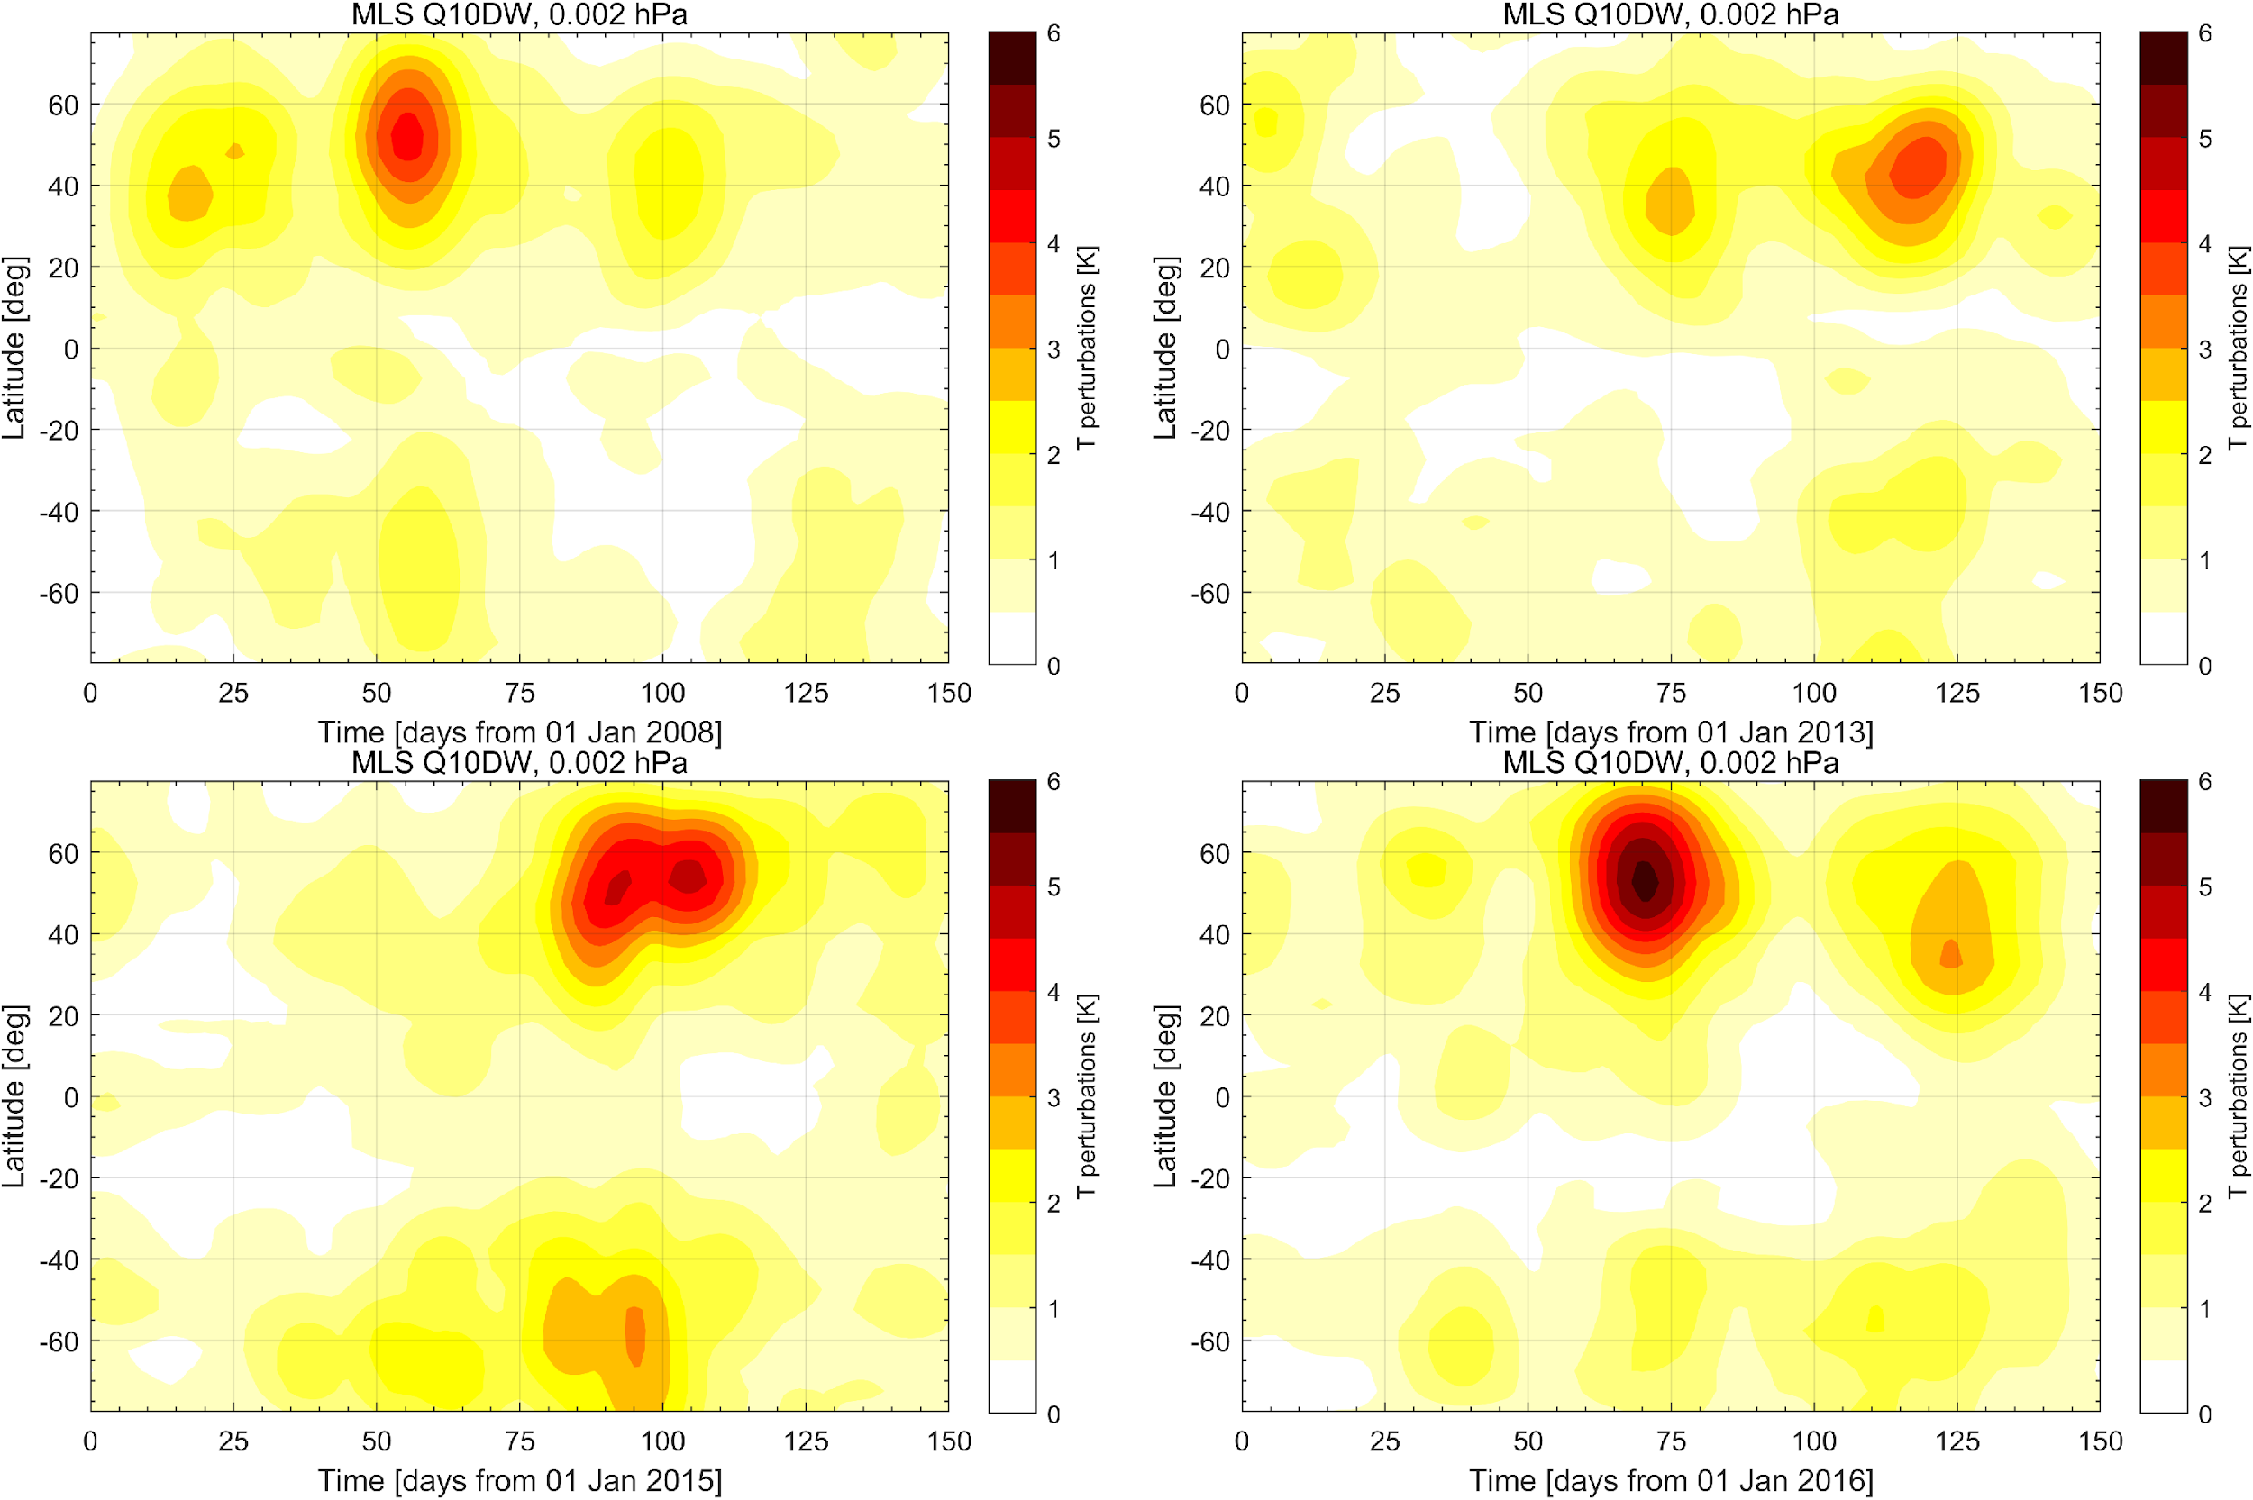
Q10DW (90 km) 2008-2022

Slide 8
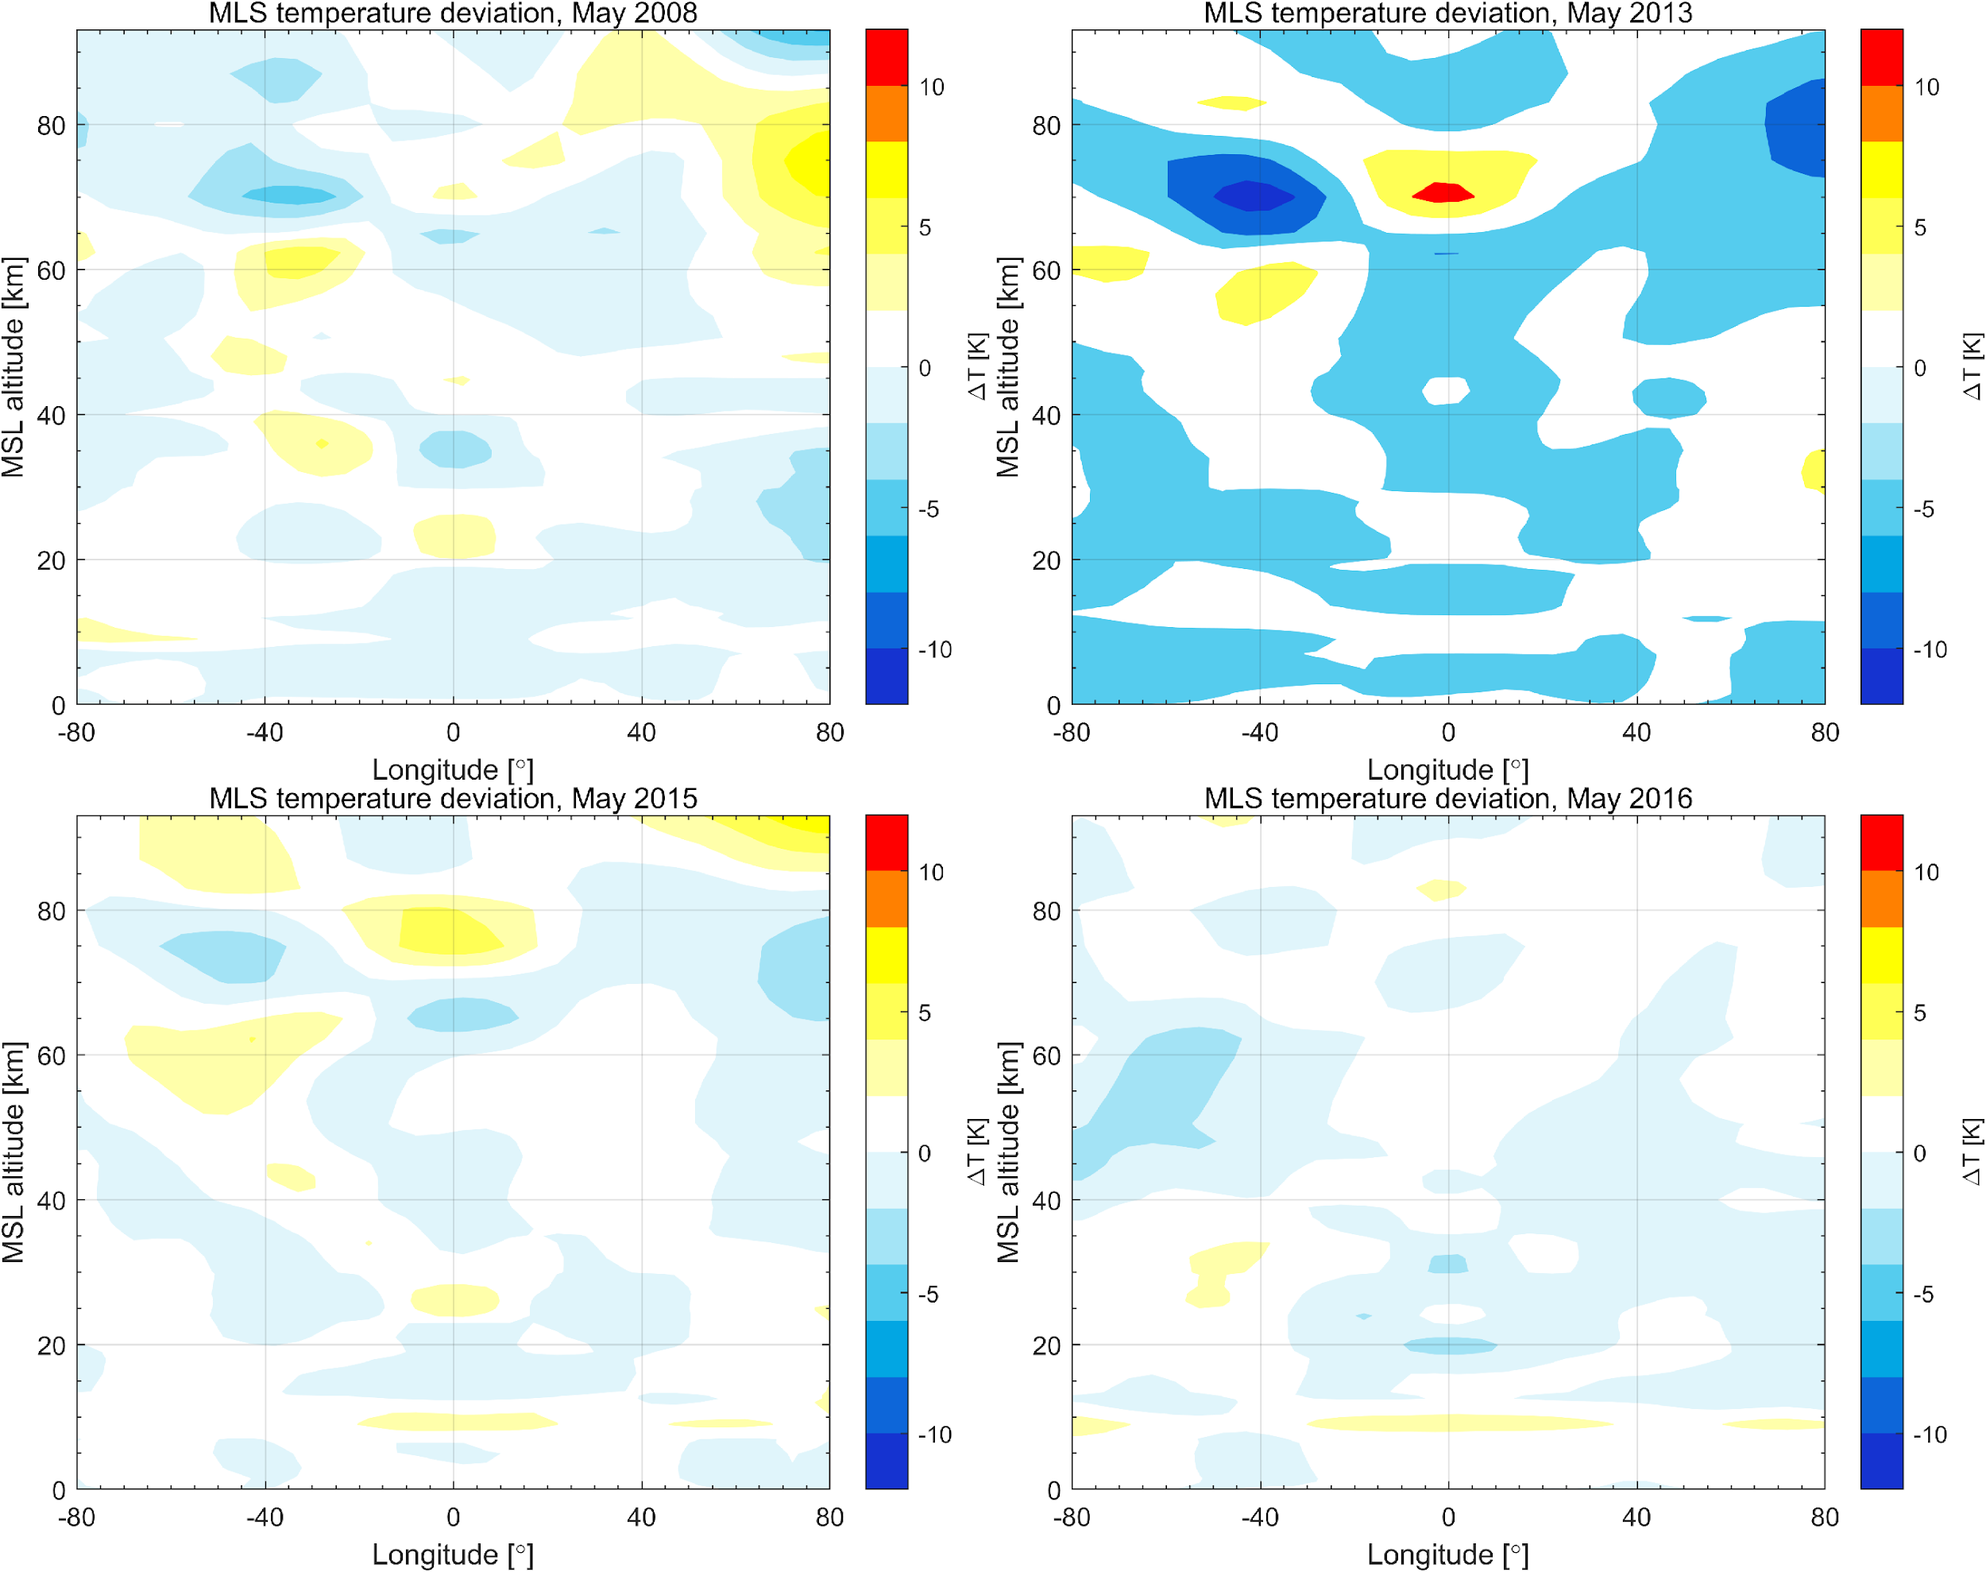
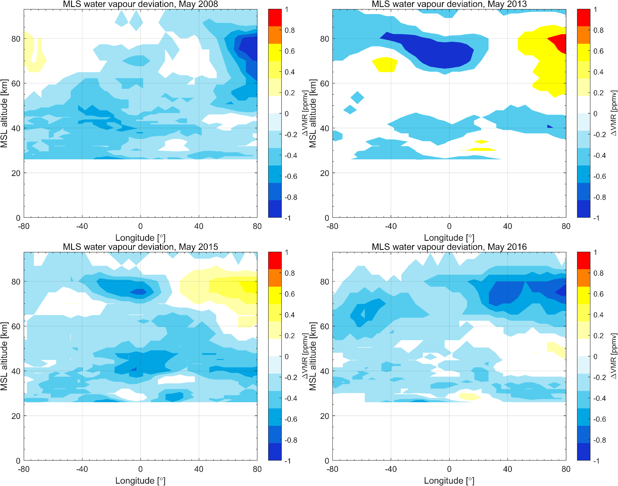
Zonal mean T & H2O Anomaly
a)
b)
monthly mean temperature (a) и water vapor (b) anomaly in may, MLS/Aura

Slide 9
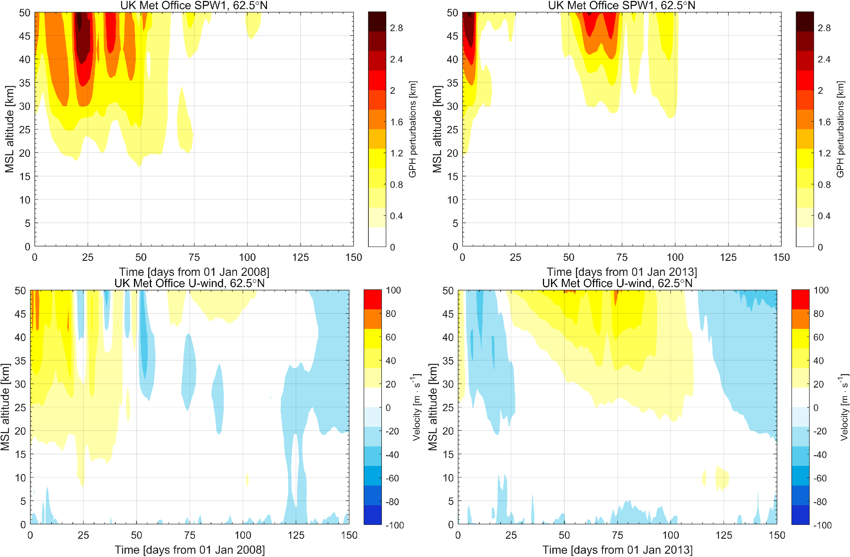
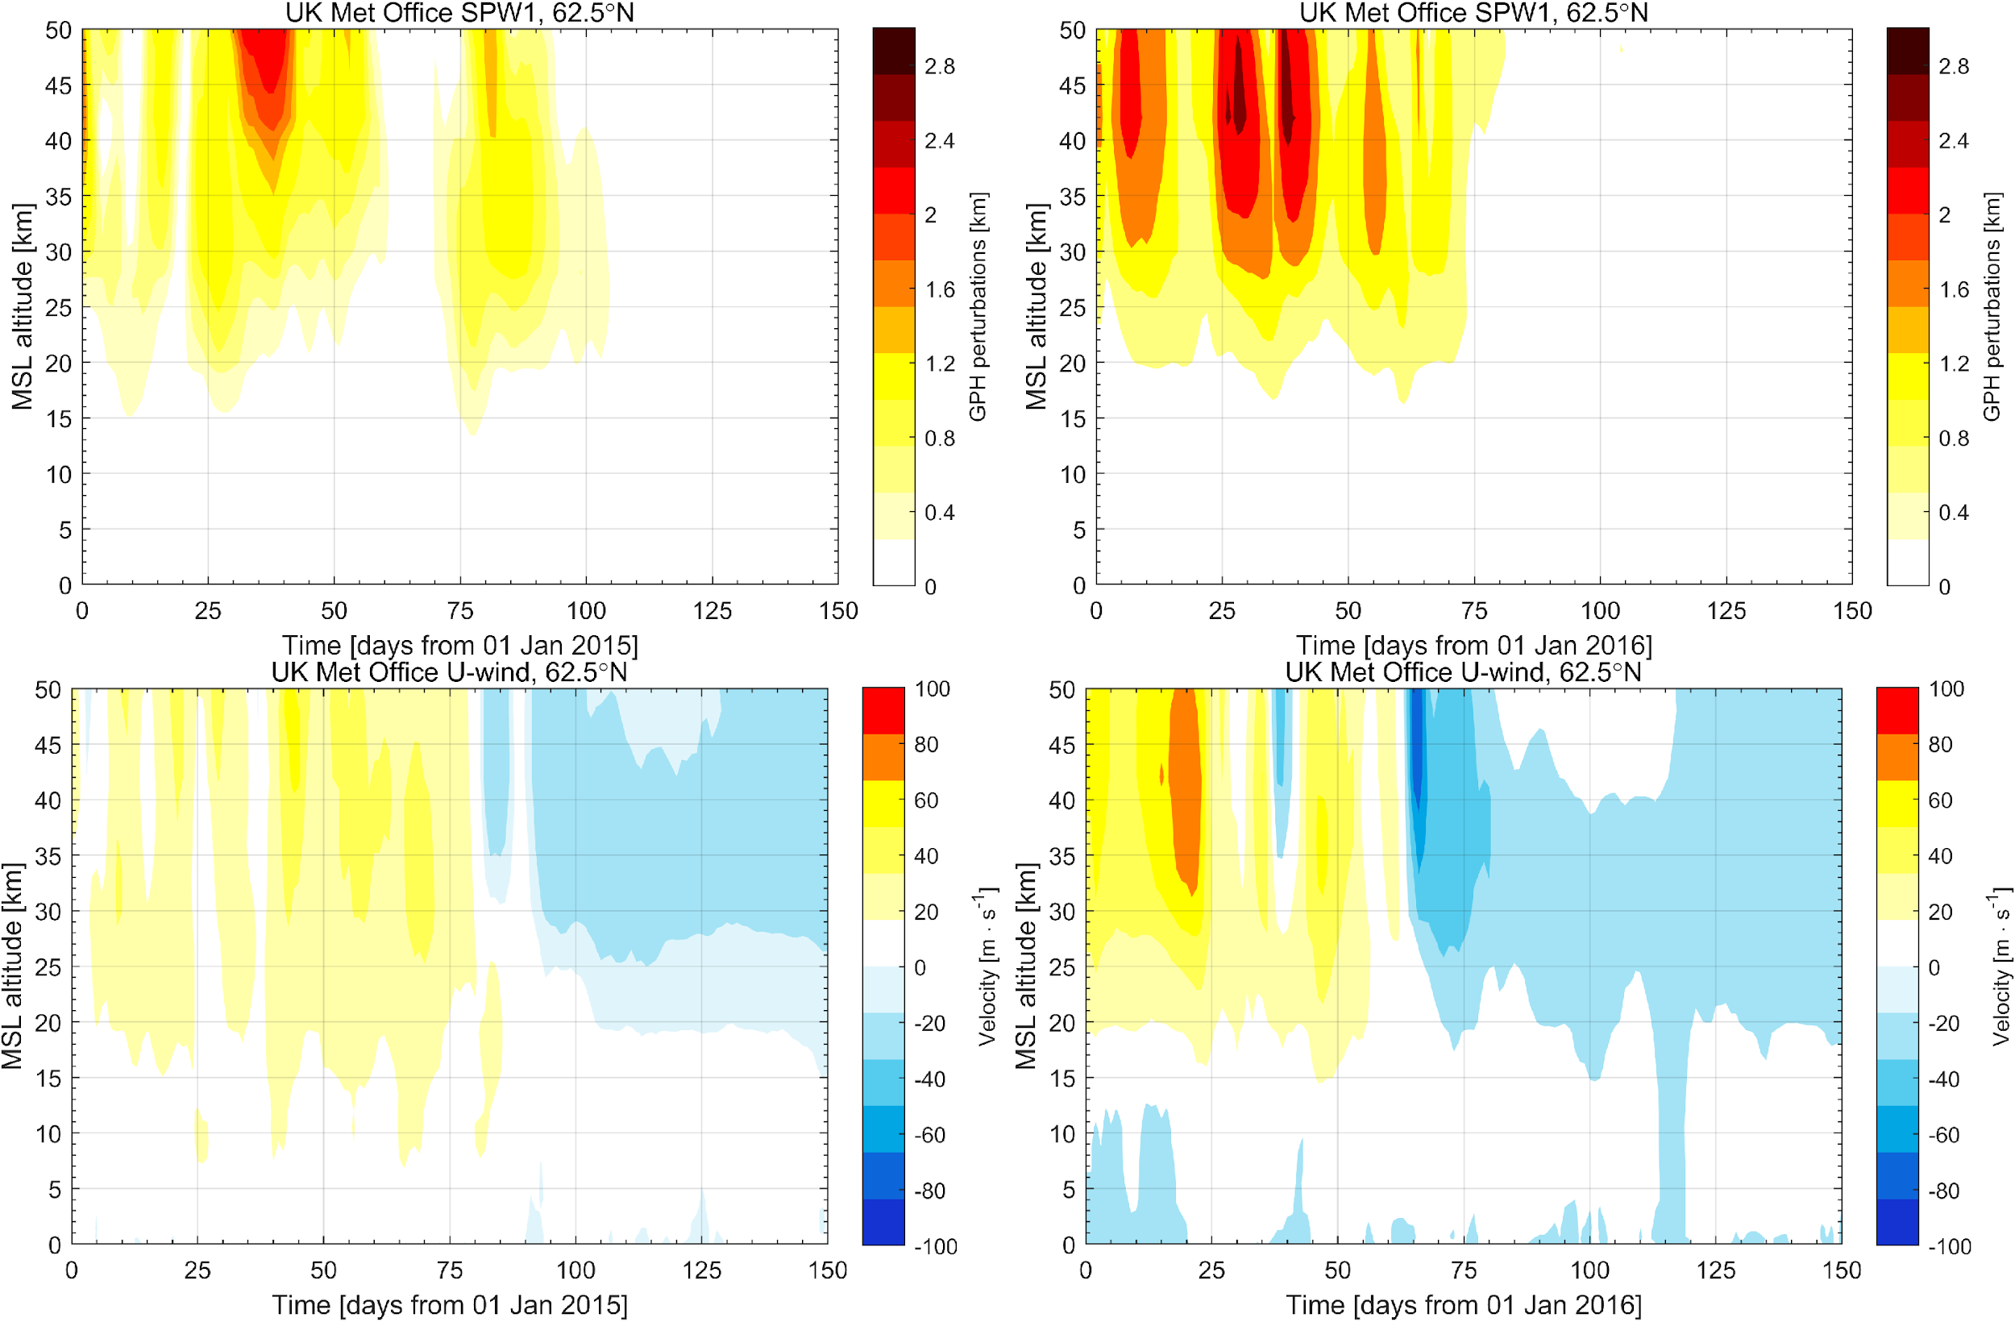
Stratospheric Transitions & SSW
SPW1 amplitude (GPH, top) & zonal mean zonal wind (bottom), 62.5°N, UK Met Office

Slide 10
Stratospheric Transitions & SSW
Zonal mean zonal wind anomaly (m/s), 62.5°N, MERRA2

Slide 11
Conclusion
MLS measurements
NLS onset date
Т & Н₂О anomaly
MLT conditions
Q10DW (m=1 & t=10 day)
stratosphere circulation

Slide 12
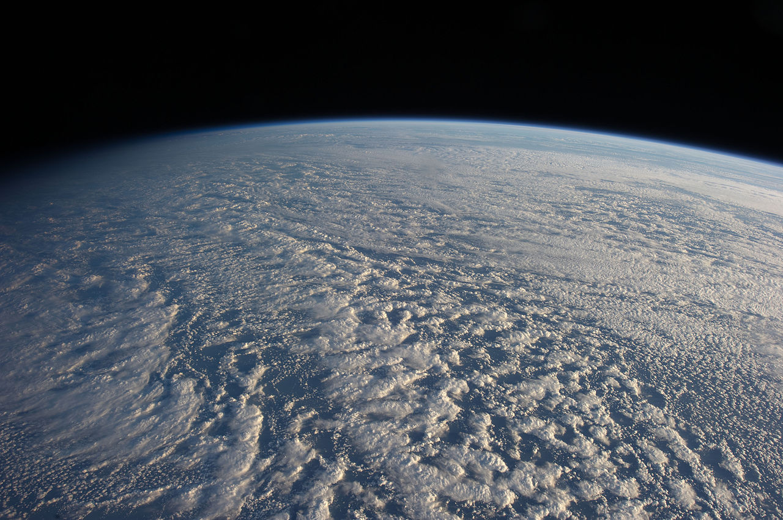
Thanks for your attention!

