Slide 1
X-ray flares, CMEs, AND PROTON EVENT FORECASTING
Shlyk N.S., Belov A.V.,
Abunina M.A., Abunin A.A.

Slide 2
Event selection (1996-2023)
X-ray flare
CME
SEP
GOES data on X-ray and proton fluxes
LASCO CME catalog
Daily SDO + LASCO movies
IZMIRAN database of X-ray flares and proton enhancements
P10 – 308 SEPs (>10 MeV, >0.15 pfu)
P100 – 167 SEPs (>100 MeV, >0.01 pfu)
GLE – 18 events
No SEP - 599 events
http://spaceweather.izmiran.ru/papers/2024/SEPs_1996_2023.pdf

Slide 3
Mean values of main parameters
X-ray flux, Wt/m²
Initial CME speed, km/s
Heliolongitude, °
Heliolongitude, °
 | No SEP (599) | P10 (308) | P100 (167)
Xm*10⁶, Wt/m² | 40 ± 2.8 | 93 ± 8.3 | 122 ± 13.4
t, min | 25 ± 1.1 | 33 ± 1.9 | 31 ± 2.7
φ, ° | -1 ± 2.1 | 28 ± 2.3 | 33 ± 2.8
V0, km/s | 653 ± 16 | 1161 ± 33 | 1320 ± 49
P10, pfu | 0 | 380 ± 128 | 690 ± 235
P100, pfu | 0 | 10 ± 3.5 | 19 ± 6.5

Slide 4
SEP model
Probability
Maximum flux
Time delay
Energy spectrum

Slide 5
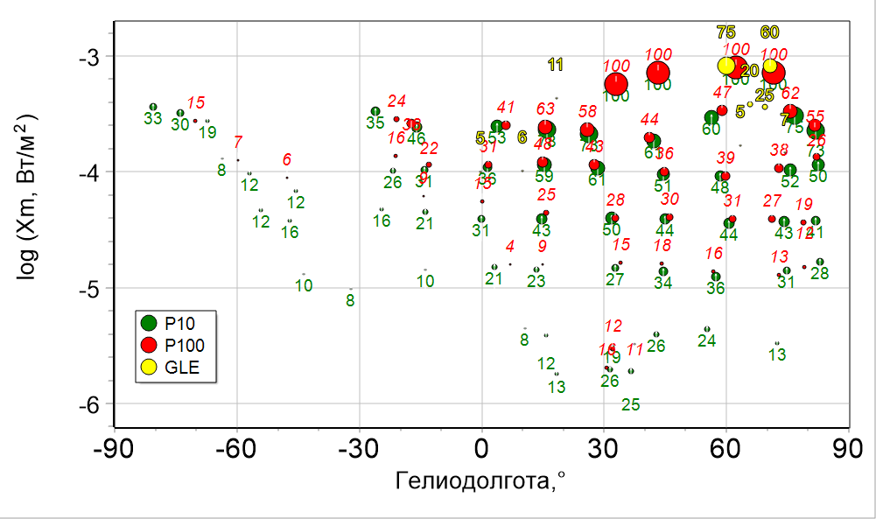
Probability of SEPs (Belov, J. Adv. Space Res., 2008)
X
log (Xm, Wt/m²)
M
C
Heliolongitude, °

Slide 6
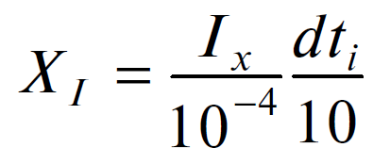
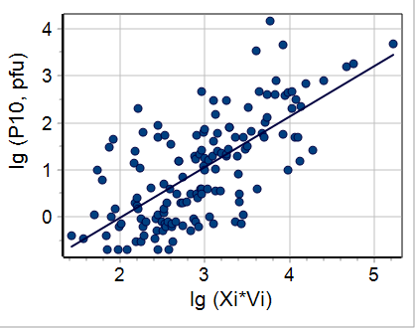
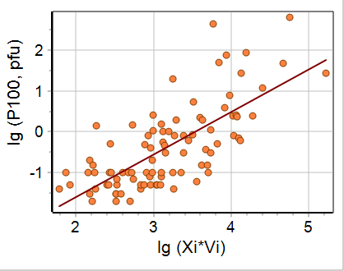
Relationship of maximum proton flux and solar source parameters
Flare index
Speed index
Belov, G&A, 2017
CC= 0.7±0.04,
146 events
CC= 0.73±0.05,
91 events
W19_W83

Slide 7
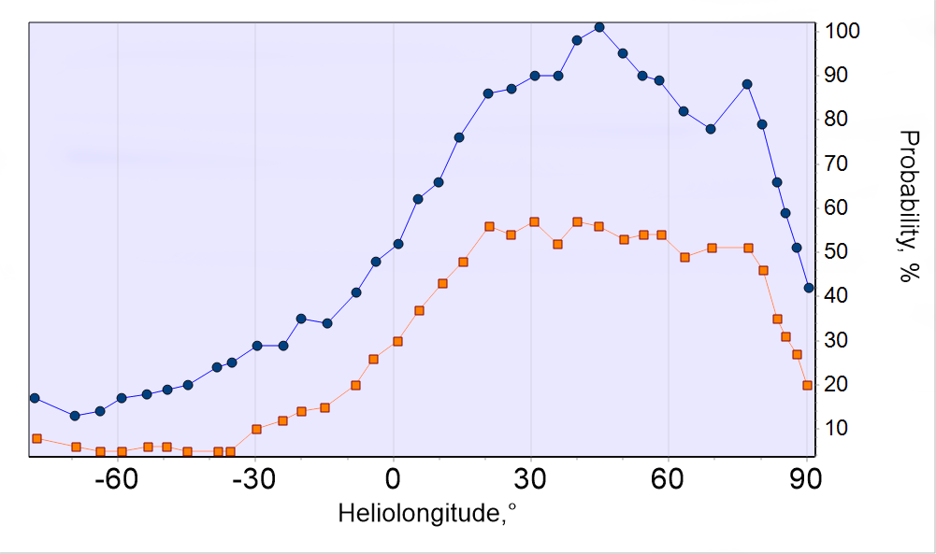
”Proton index” and SEP probability
E>10 MeV
E>100 MeV

Slide 8
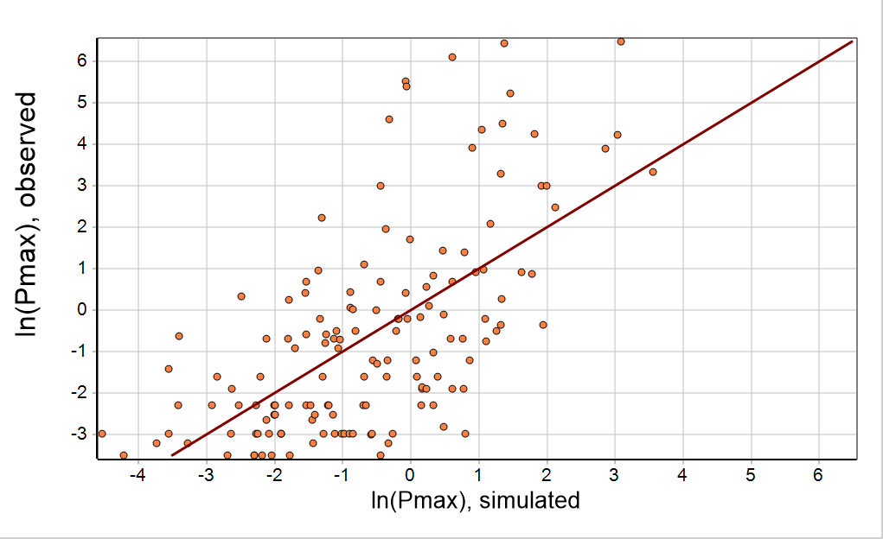
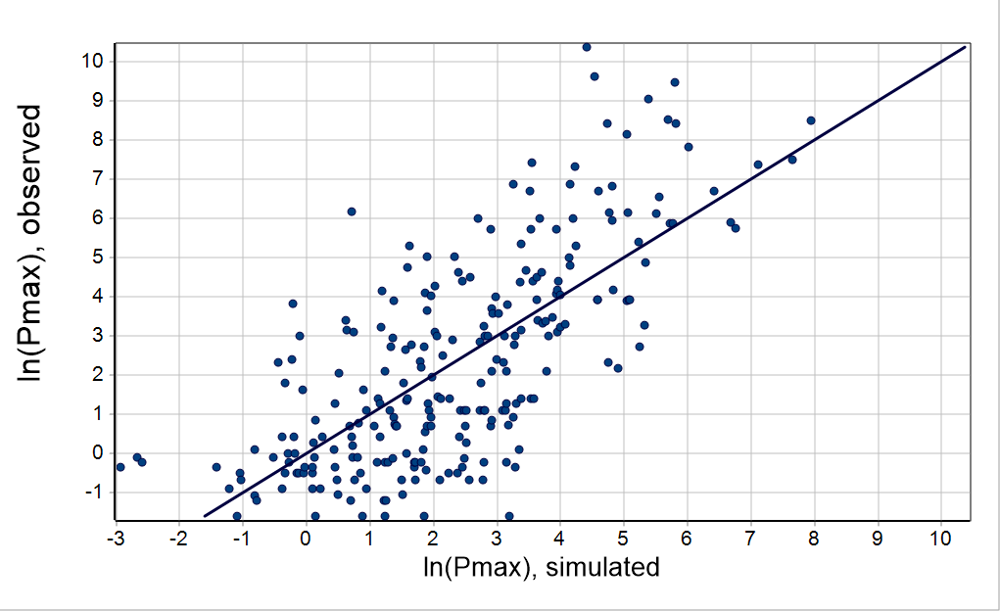
Model for estimation of maximum flux of particles with different energies
CC= 0.64±0.05,
144 events
CC= 0.73±0.04,
247 events
E>100 MeV
Confident solar sources!
E>10 MeV

Slide 9
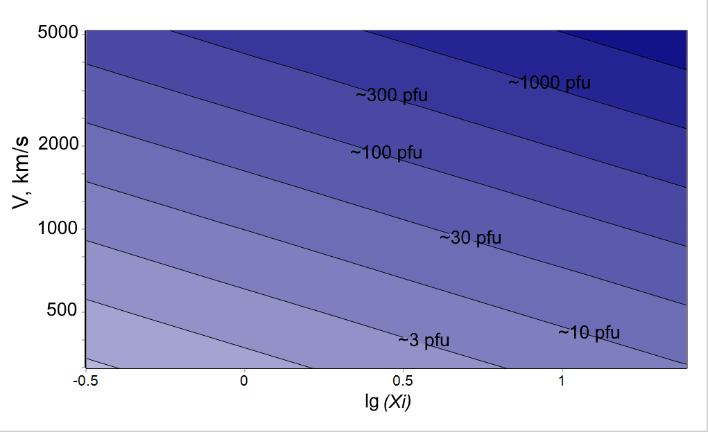
Contours: expected proton flux
X1 flare,
Dt = 10 min
X10 flare,
Dt = 10 min

Slide 10
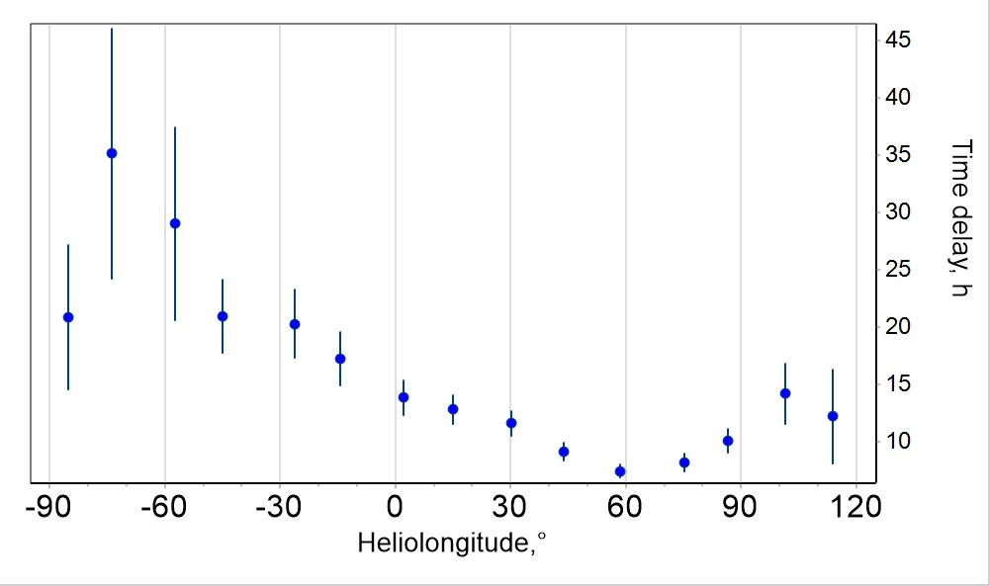
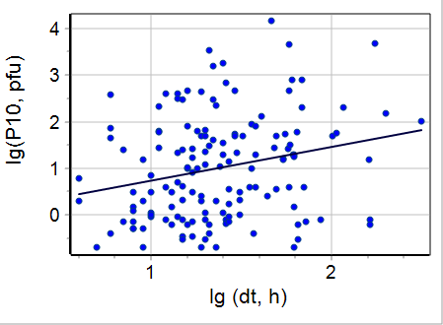
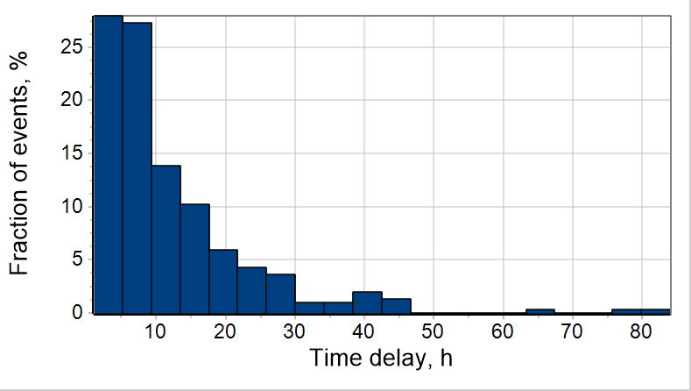
Time delay
Longitudinal dependence of time delay in hours
Time to registration of maximum P10 flux in hours

Slide 11
Conclusions
A catalog of SEPs (>10 and >100 MeV) was compiled for 1996–2023 http://spaceweather.izmiran.ru/papers/2024/SEPs_1996_2023.pdf
The characteristics of SEPs were compared with the parameters of parent CMEs and solar flares
The average values ​​of various parameters were calculated
Regularities were established to estimate both the probability of SEP event, the values ​​of expected proton fluxes and time delay
The basis for an empirical prognostic model of SEPs was created

Slide 12
Thanks for attention!
nshlyk@izmiran.ru

