Slide 1
Comparison of nocturnal variations of the neutral atmospheric parameters to electron densities in the upper atmosphere
A.D. Shelkov¹, R.V. Vasilyev¹, M.F. Artamonov¹, K.G. Ratovsky¹
¹Institute of Solar-Terrestrial Physics SB RAS

Slide 2
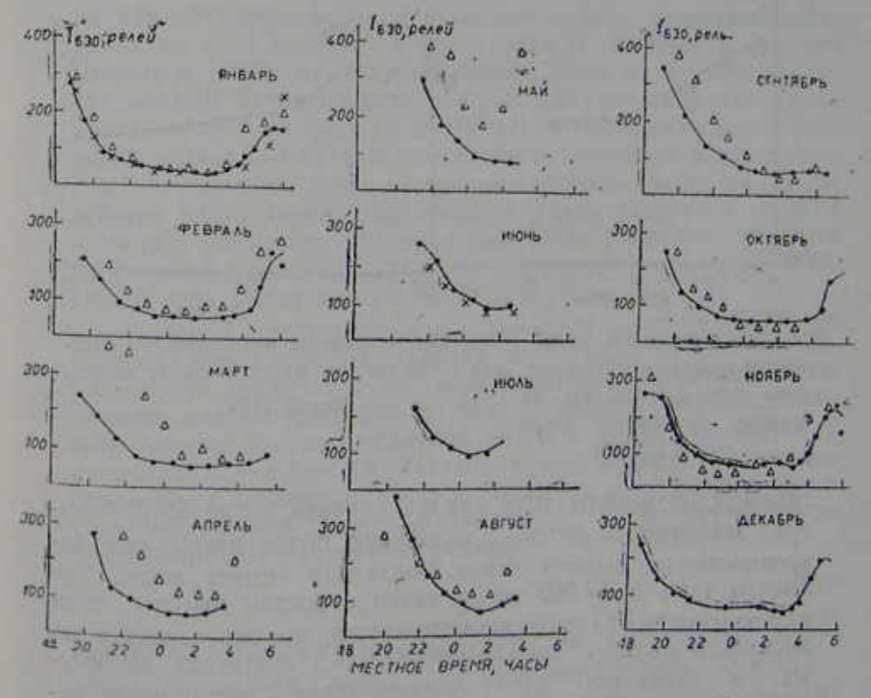
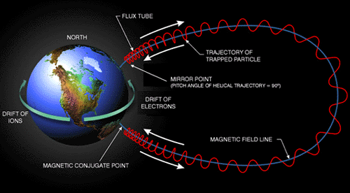
Background. Airglow predawn enhancement
BSFP-2024
Predawn enhancement of the atomic oxygen 630 nm line was first discovered and analyzed in 1959 by D. Barbier. In mid-latitudes this phenomenon is observed regularly during autumn, winter and spring several hours before local sunrise.
It is a result of electrons gaining energy from the emerging Sun in conjugated ionosphere. These electrons then move along a magnetic line exciting atoms in the local atmosphere.

Slide 3
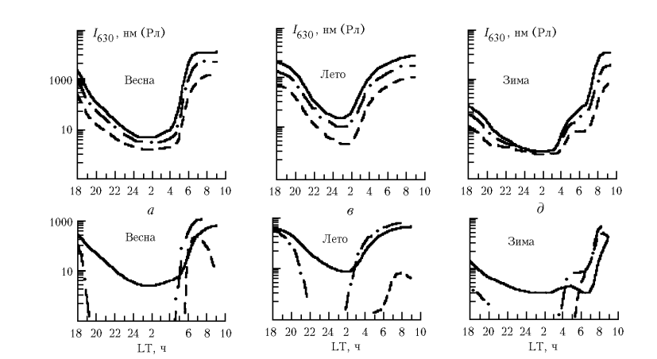
Background. Airglow predawn enhancement
BSFP-2024
Airglow predawn enhancement is also being studied in the ISTP. Here are pictures of modeled 630 nm intensity using various $F_{10.7}$ during different seasons from 2003 work of R.A. Kononov and A.V. Tashchilin.

Slide 4
Background. Atomic oxygen 630 nm line airglow
BSFP-2024
Red oxygen line is a result of spontaneous emission $O\left(1D\right)→O\left(3P\right)$. The main source of excited oxygen atoms is dissociative recombination:
$$O_{2}^{+}+e→O+O+6,96 eV,$$
$$NO^{+}+e→N+O+2,76 eV;$$
Non-emissive quenching of excited oxygen atoms is a result of collisions with molecules:
$$O\left(1D\right)+N_{2}→N_{2}^{∗}+O\left(3P\right),$$
$$O\left(1D\right)+O_{2}→O_{2}^{∗}+O\left(3P\right);$$
Volume emission rate in $\frac{photons}{cm^{3}∙s}$ may be derived as:
$$I_{630}=\frac{0,76βk_{1}\left[O^{+}\right][O_{2}]}{{1+{(k}_{2}\left[N_{2}\right]+k_{3}\left[O_{2}\right]+k_{4}[e])}/{A_{1D}}}.$$
$$β$$ | $$1,2$$
$$k_{1}$$ | $$3,23∙{10}^{−12}e^{{3,72}/{\frac{T_{O_{2}}}{300}} −{1,87}/{{\left(\frac{T_{O_{2}}}{300}\right)}^{2}}}\frac{{cm}^{3}}{s}$$
$$k_{2}$$ | $$2∙{10}^{−11}e^{\frac{111,8}{T_{N_{2}}}}\frac{{cm}^{3}}{s}$$
$$k_{3}$$ | $$2,9∙{10}^{−11}e^{\frac{67,58}{T_{O_{2}}}}\frac{{cm}^{3}}{s}$$
$$k_{4}$$ | $$1,6∙{10}^{−12}T_{e}^{0,91}\frac{{cm}^{3}}{s}$$
$$A_{1D}$$ | $$6,81∙{10}^{−3} s^{−1}$$
Table of coefficients. $β$ – photon yield from an act of recombination, $k_{1}$ - rate of recombination, $k_{2}$ - rate of $N_{2}$ quenching, $k_{3}$ - rate of $O_{2}$ quenching, $k_{3}$ - rate of electron quenching, $A_{1D}$ - reverse lifetime of $O\left(1D\right)$ state

Slide 5
Research tasks
BSFP-2024
Demonstrate the predawn enhancement on the Fabry-Perot interferometers’ data;
Investigate the dynamic of the airglow intensity, neutrals temperature and electron density near local and conjugated sunset/sunrise;
Compare these parameters’ dynamic for different time periods.

Slide 6
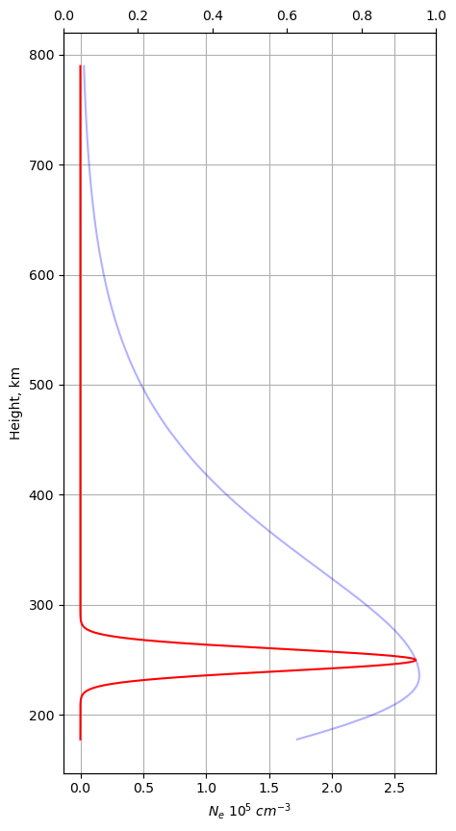
Predawn 630 nm enhancement shown on FPI data
BSFP-2024
Red line represents FPI data, blue line – electron density obtained via DPS-4 digital ionosonde;
Photometric data on the FPI is not calibrated. To obtain absolute airglow intensities we used FPI and DPS-4 data section, where Ne and intensity are synchronic to each other;
For calibration, all density parameters’ height profiles were multiplied by normal distribution and integrated along heights axis to account for finite glowing layer thickness.

Slide 7
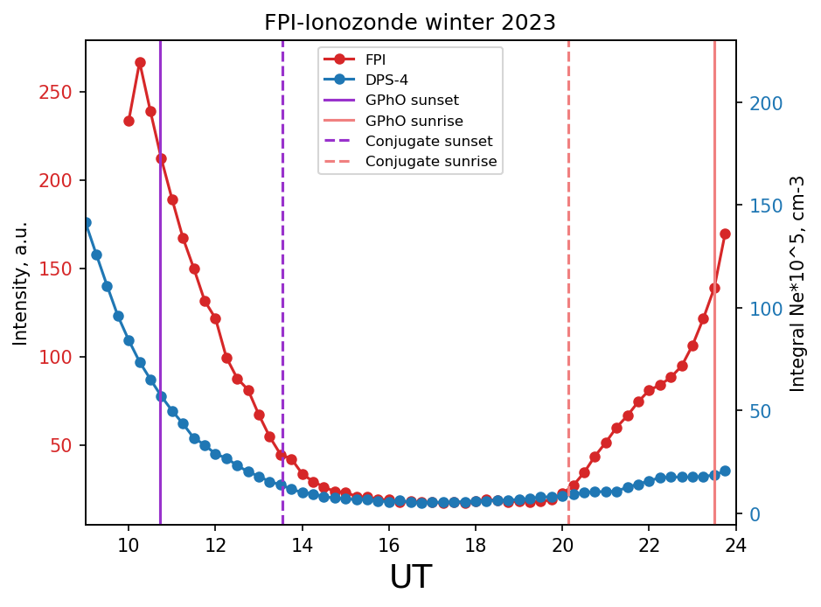
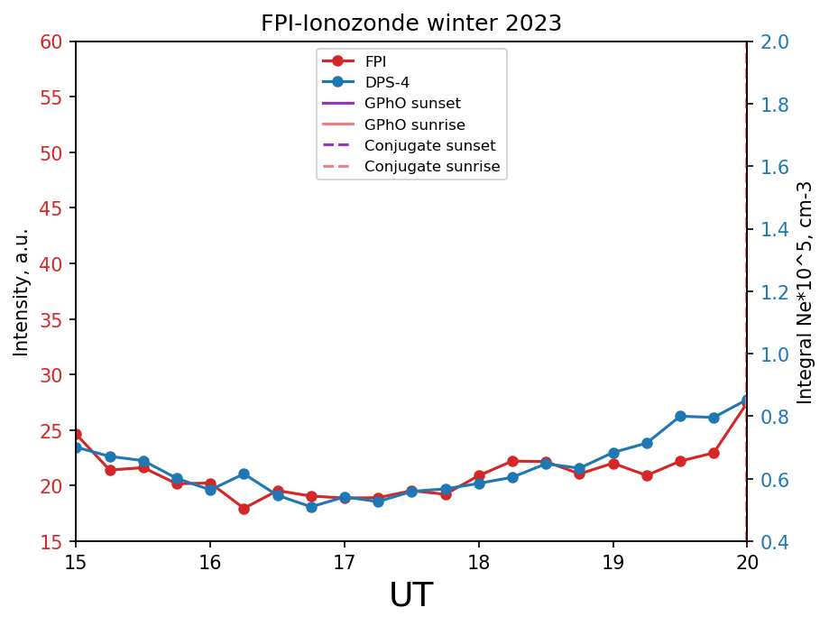
Predawn 630 nm enhancement shown on FPI data
BSFP-2024
Red line represents FPI data, blue line – electron density obtained via DPS-4 digital ionosonde;
Photometric data on the FPI is not calibrated. To obtain absolute airglow intensities we used FPI and DPS-4 data section, where Ne and intensity are synchronic to each other;
For calibration, all density parameters’ height profiles were multiplied by normal distribution and integrated along heights axis to account for finite glowing layer thickness.

Slide 8
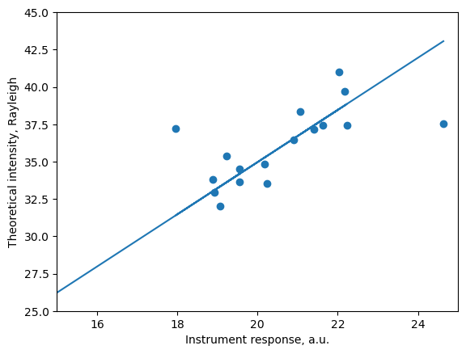
Interferometers’ photometric calibration using ionosonde data
BSFP-2024
MSIS 2.0, IRI 2020 models and DPS-4 data were used to obtain the equation terms;
To get Rayleighs from volume emission rate we used formula:
$$R\left[Rayleigh\right]=I\left[\frac{erg}{cm^{2}∙s}\right]∙\frac{λ\left[nm\right]}{1,98∙{10}^{−3}};$$
All that is left is to build theoretical to experimental intensity relation and approximate it. Coefficient of approximation is then used to calibrate FPI response.
Season | Coef, Rayleigh/a.u.
Spring 2022 | 1,454
Autumn 2022 | 1,567
Winter 2022-2023 | 1,694
Spring 2023 | 1,554
Autumn 2023 | 1,123
Winter 2023-2024 | 1,685

Slide 9
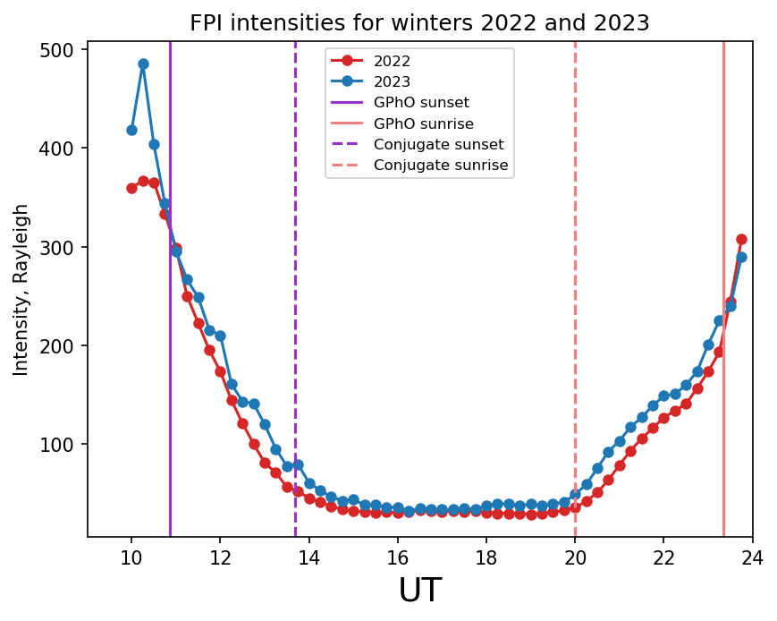
Dynamics of intensity from 2022 to 2023, winter
BSFP-2024
Intensity stops rapid decrease after conjugated sunset. Temperature drops faster after conjugated sunset;
Immediately after conjugated sunrise intensity starts rising;
During winter 2023 intensity is generally 10-30 Rayleighs higher, than during 2022.
Red line represents FPI intensity during winter 2022 and blue – FPI intensity during winter 2023. Vertical lines represent local and conjugated sunset/sunrise.

Slide 10
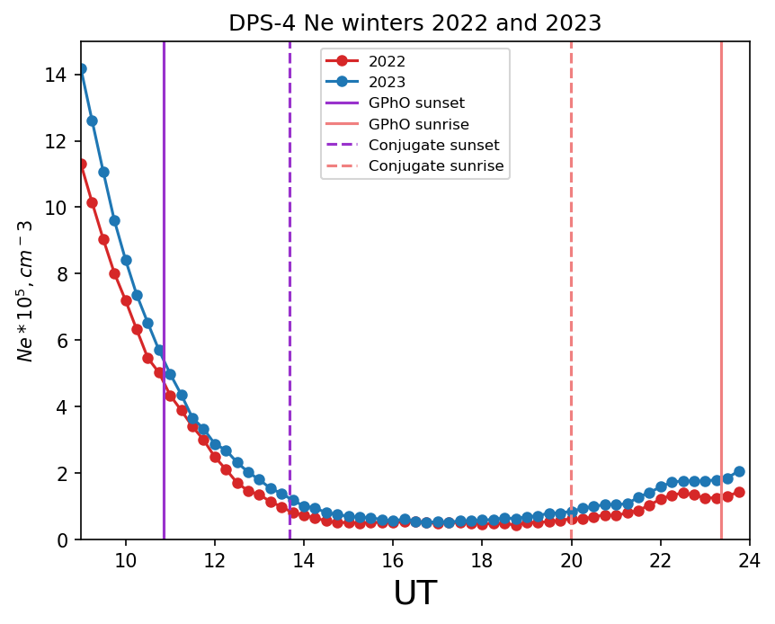
Dynamics of electron density from 2022 to 2023, winter
BSFP-2024
Electron density doesn’t noticeably change near conjugated sunrise but starts rising after local sunrise;
During winter 2023 electron density is generally $0,1−0,3 {10}^{5}cm^{−3}$, than during 2022;
Near midnight (17 UTC) 2022 and 2023 electron density as well as intensity become equal.
Red line represents DPS-4 electron density during winter 2022 and blue – DPS-4 electron density during winter 2023. Vertical lines represent local and conjugated sunset/sunrise.

Slide 11
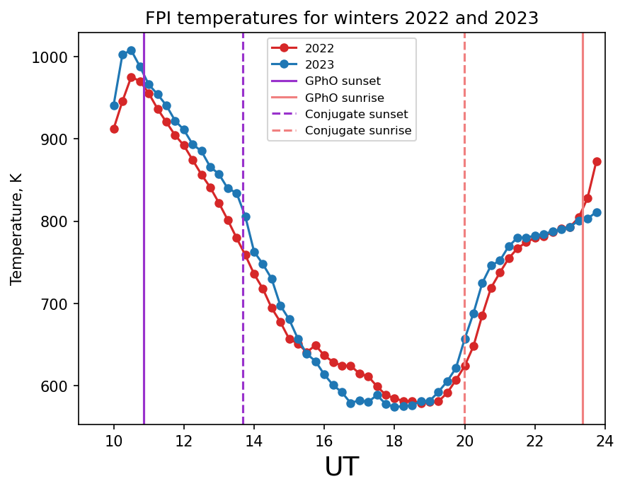
Dynamics of temperature from 2022 to 2023, winter
BSFP-2024
Temperature starts rising near conjugated sunrise. Growth slows in the middle between conjugated and local sunrise, then accelerates again near local sunrise;
During winter 2023 temperature is generally 10-20 Kelvin higher, than during 2022;
Near midnight (16-18 UTC) temperature slows its descent during 2022 winter. Temperature difference during midnight is 30-50 Kelvin;
This temperature variation may be caused by some sort of geomagnetic activity at that time.
Red line represents FPI temperature during winter 2022 and blue – FPI temperature during winter 2023. Vertical lines represent local and conjugated sunset/sunrise.

Slide 12
Conclusions
BSFP-2024
Intensity, temperature and electron density dynamics relative to local and conjugated sunset/sunrise have been investigated. These dynamics match current conceptions of conjugated ionospheres interaction through plasmasphere;
At 17 UT red line intensities and electron densities become equal for 2022 and 2023 winters;
During winter 2022 at 15 UT temperature slows its decrease. At 17 UT 2022 temperature is 30-50 Kelvin higher;
There is an almost constant increase of intensity (10-20 Rayleigh), temperature (10-20 Kelvin) and electron density ($1−3∙{10}^{4}cm^{−3}$) during the year with more solar activity.

Slide 13
Thank you for your attention!

