Slide 1

Spatial and spectral evolution
of microwave and X-ray sources
during the limb solar flare February 5, 2023
Julia Shamsutdinova¹, Larisa Kashapova¹, Zhentong Li² and Yang Su²
¹ Institute of Solar-Terrestrial Physics SB RAS, Irkutsk, Russia
² Key Laboratory of Dark Matter and Space Astronomy, PMO CAS, Nanjing, China
BSFP “Physical processes in space and near-Earth space, September 1-7, 2024

Slide 2
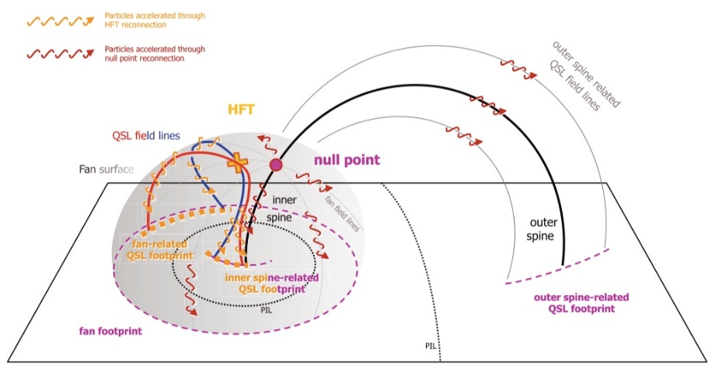
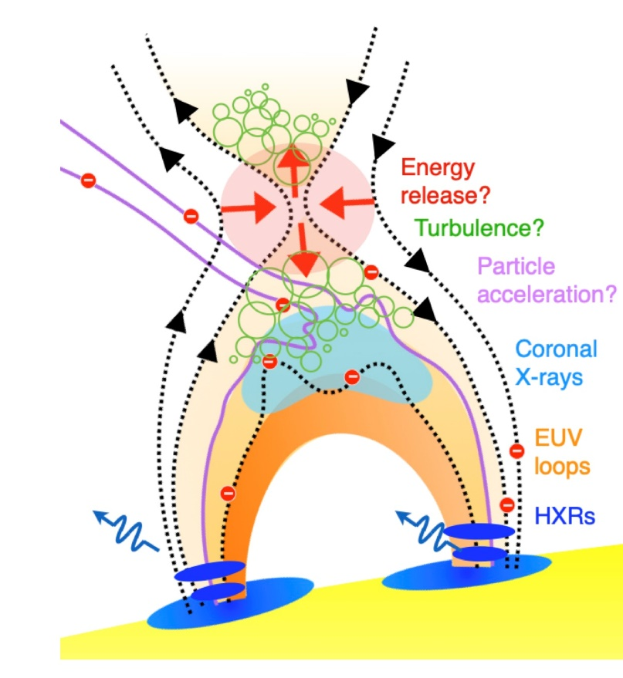
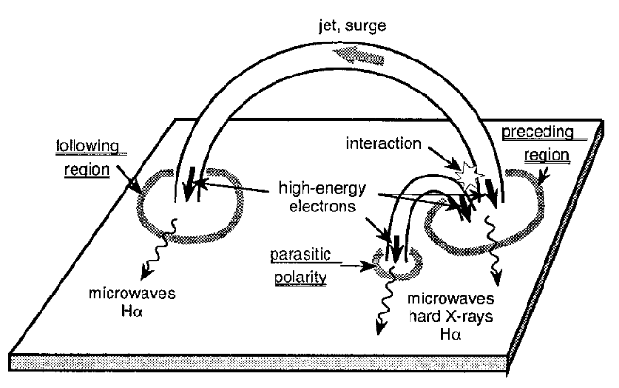
motivation
CSHKP model (standard model)
For the same population of electron:
Microwave and X-Ray temporal profiles coincide
The properties of plasma parameters obtained from the X-ray and microwave ranges must be consistent
BUT – in reality, it is rare ->
Model of circle flare [Reid, H.A.S., 2012]
For the development theoretical models, it is necessary to have events with parameters that are consistent across different spectral ranges
[Jeffrey, Natasha L.S., 2020]
Hanaoka model [Hanaoka, 1997]

Slide 3
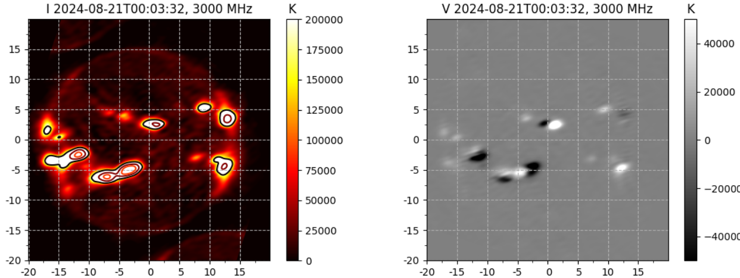
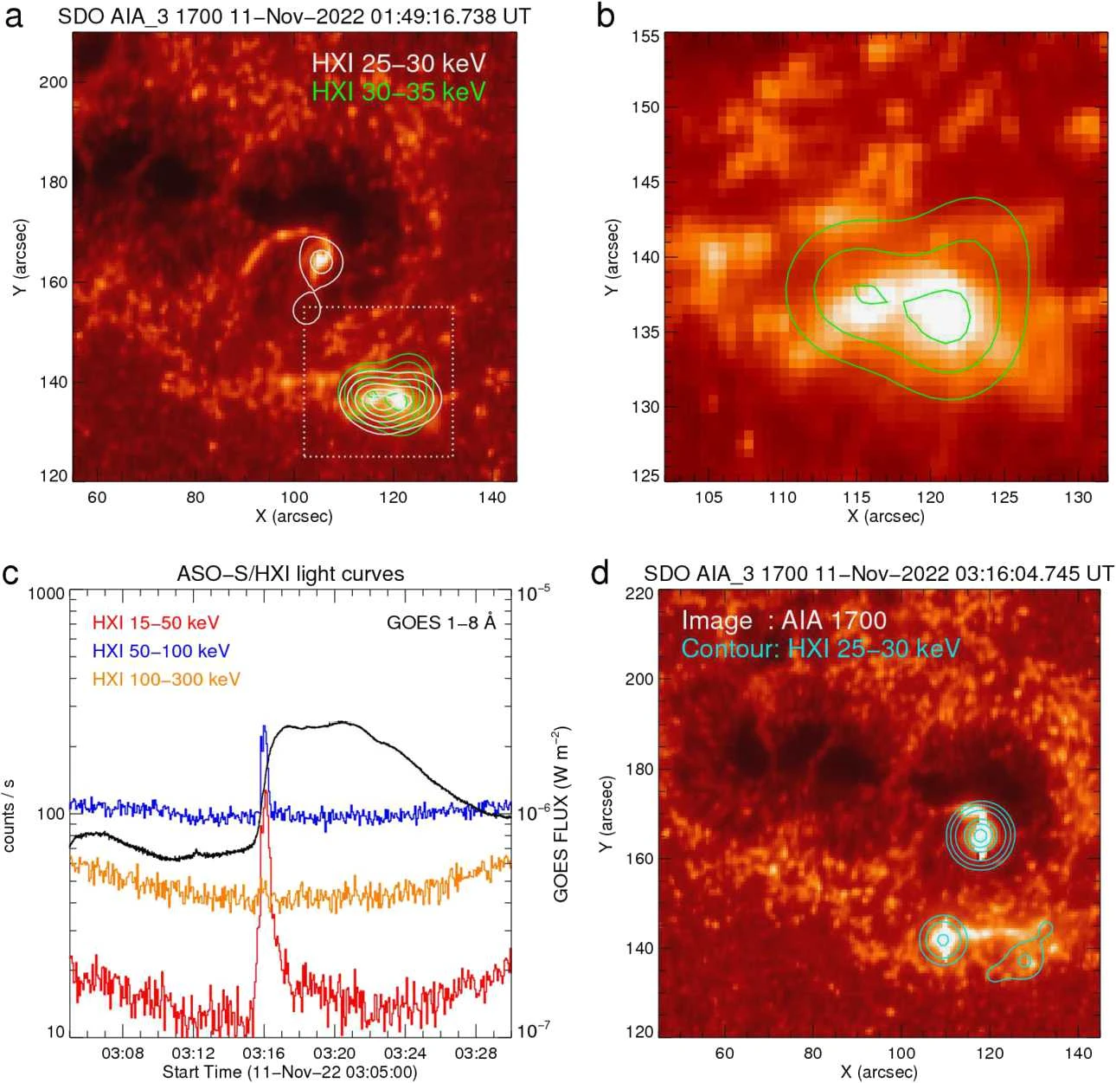
Siberian Radioheliograph (SRH)
T-shape grid
Frequency range: 3 – 24 GHz
Temporal resolution: 2 – 3 seconds
Spatial resolution: 30 – 7 arcsec
Sensitivity: 4 – 25*10⁻³ s.f.u.
Advanced Space-based Solar observatory / Hard X-ray Imager (ASO-S/HXI)
Energy range: 10 – 300 keV
Temporal resolution: 0.125 – 1 seconds
Spatial resolution: 3.2`` @ 32 keV
FOV: 40.3 arcsec
12-24 GHz 1 m. 207 antennas
6-12 GHz 2 m. 192 antennas
3-6 GHz 3 m. 129 antennas
[Altyntsev et al., 2020, STP]
[Gan et al., 2023, Solar Physics]
[badary.iszf.irk.ru]
[http://aso-s.pmo.ac.cn/en_index.jsp]

Slide 4
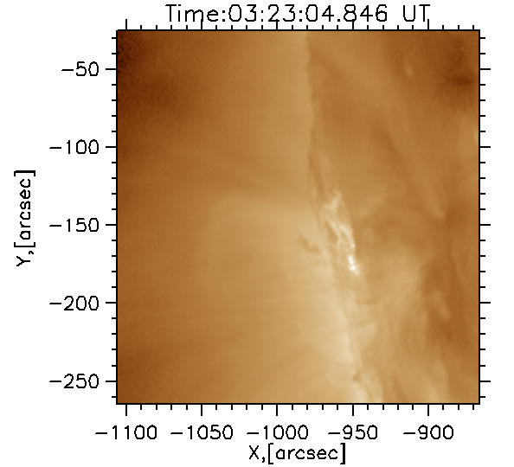
SOL2023-02-05T03:24:38
03:24:00 – 03:30:32 UT
GOES class – C6.6
SDO/AIA 94 Å
Hanaoka model (1997) ?

Slide 5
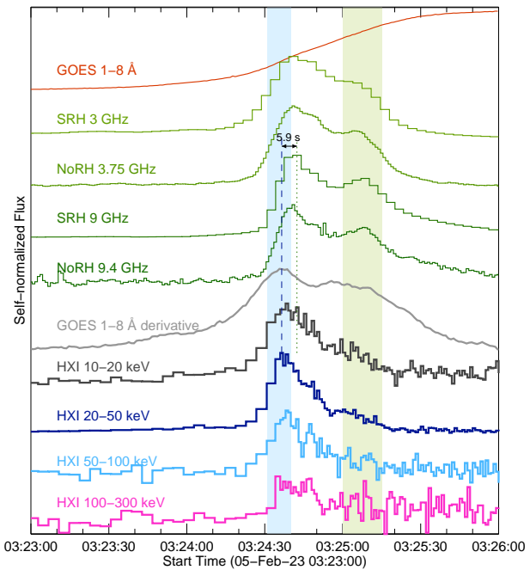
instruments
ASO-S/HXI 10–300 keV
GOES 1–8 Å
SRH 3–12 GHz
NoRP (3.75 and 9.4 GHz)
SDO/HMI and SDO/AIA

Slide 6
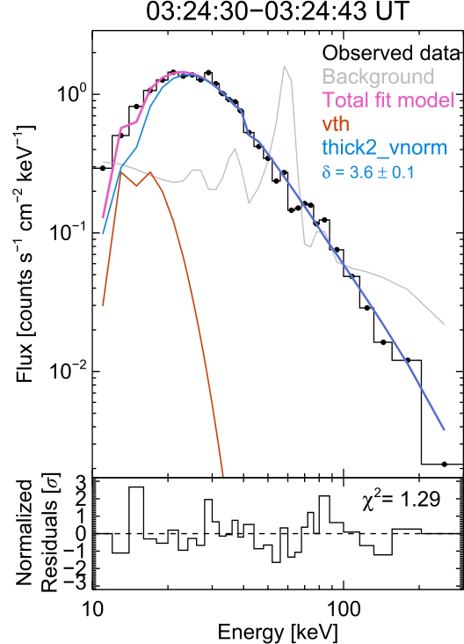
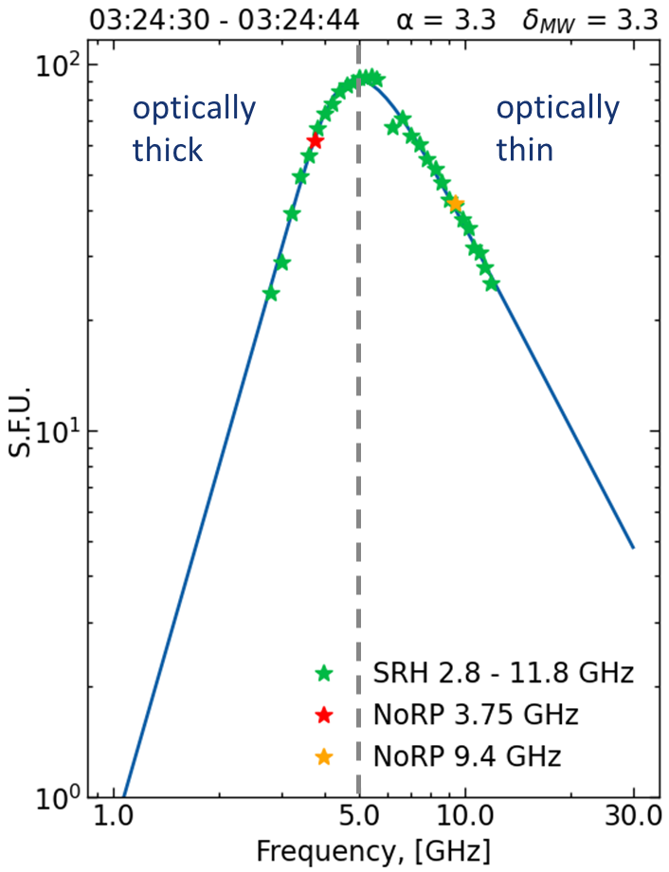
Spectral analysis

Slide 7
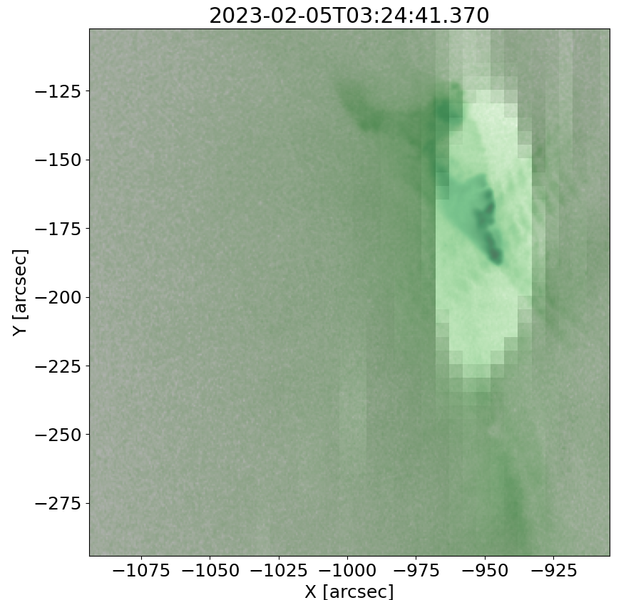

Spatial structure of the flare loop
Estimation the magnetic field strength at the observed MW flare source using Dulk (1985) formula:
  Size of the flare source = 30 arcsec
  Photon spectral index = 3.3
  Electron flux =
  Peak frequency = 5.2 GHz
  Magnetic field = 130 G
SDO/AIA 94 Å 03:24:36 UT
SRH 11.8 GHz 03:24:41 UT
Small compact flare loop

Slide 8
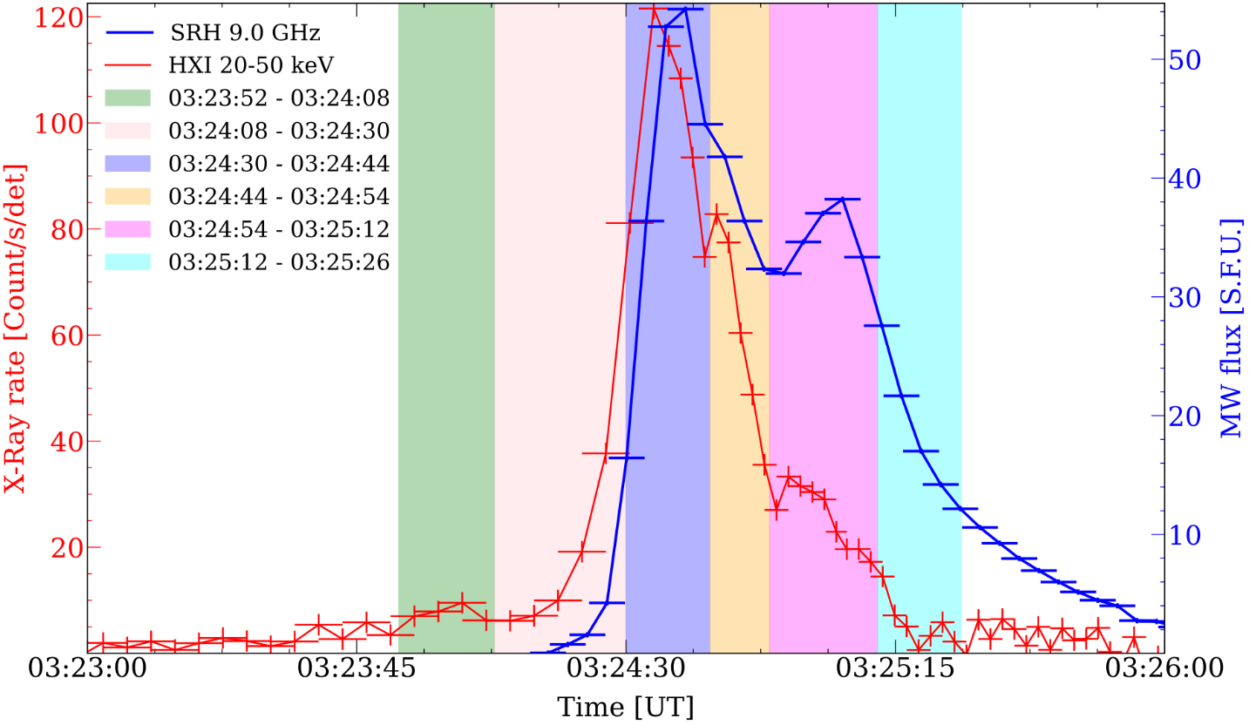
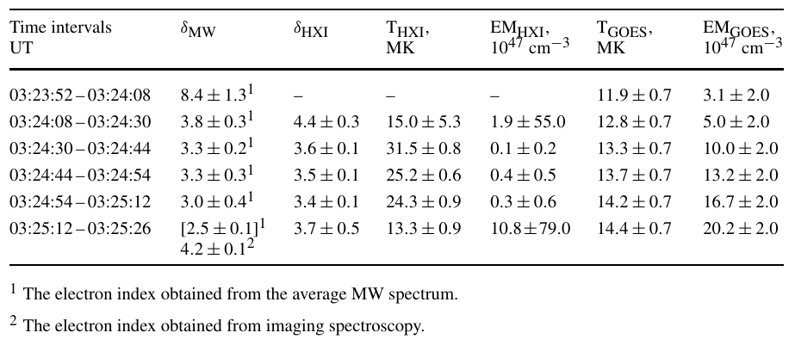



Gyrosynchrotron emission of thermal electrons
Spectral analysis of the flare loop
Gyrosynchrotron emission of nonthermal electrons
$$δ=8.4$$
$$δ=3.0$$
Heating -> acceleration
Gyrosynchrotron emission of nonthermal electrons
High temperature in the preflare phase
$$δ=3.3$$

Slide 9
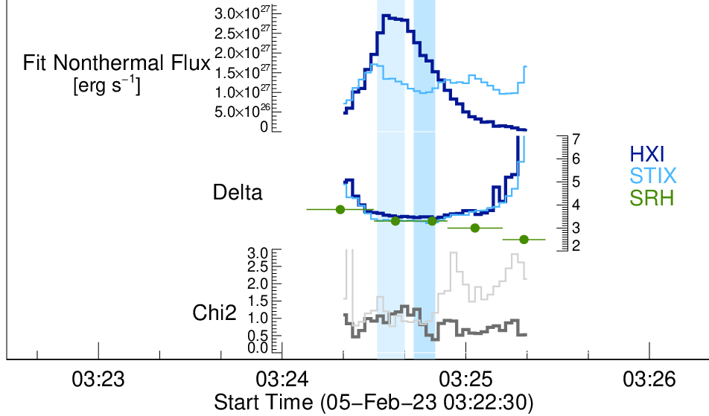

Microwave and x-ray spectral indices
Is the index getting harder?
$$δ=2.5 (?)$$
Have the accelerated parameters changed only in microwaves?

Slide 10
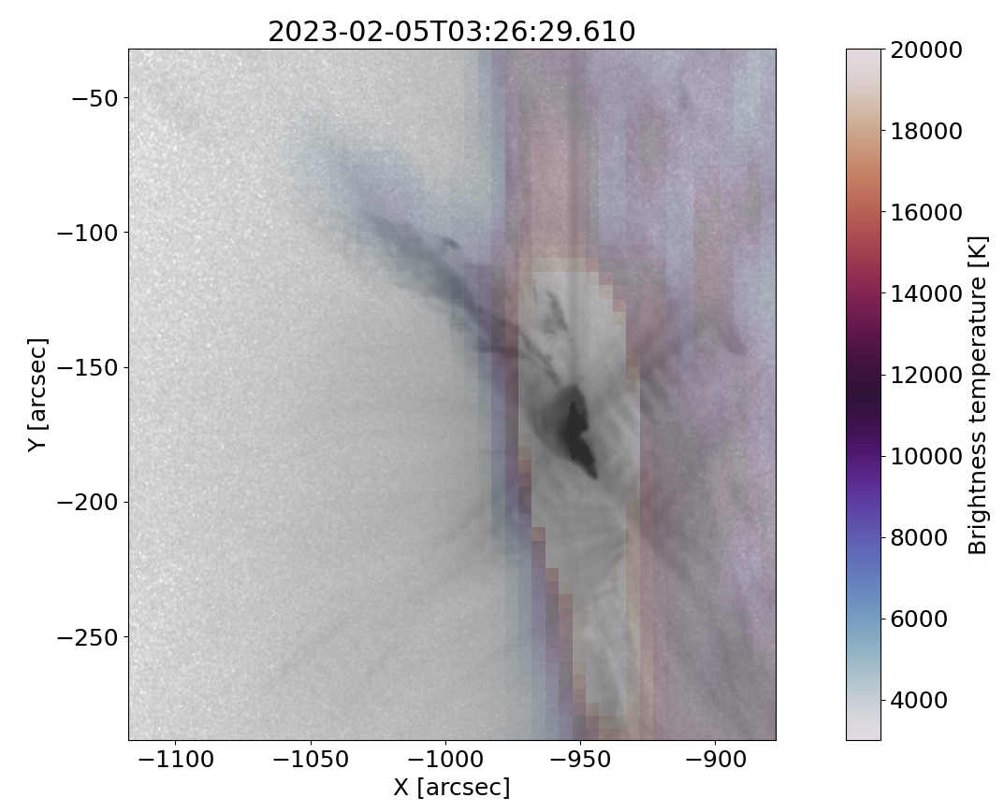
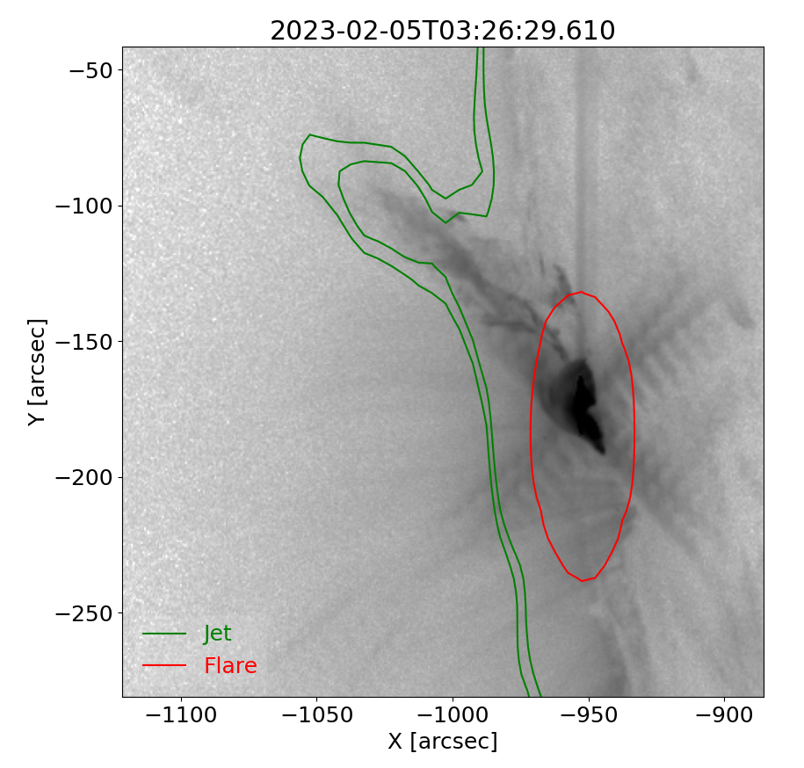

spectrum for time moment with a jet
$$δ=4.2$$
SRH 11.8 GHz (color palette)
SDO/AIA 131 Å (black palette)
SDO/AIA 94 Å
Green contours SRH 11.8 GHz

Slide 11
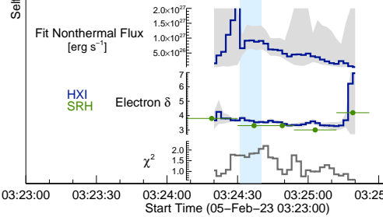
More details in the paper doi:10.1007/s11207-024-02331-w
soft-hard-soft
(false hardening of the microwave spectral index due to the jet contribution)

Slide 12
Resume
The main source of energy release was a small compact loop with a magnetic field of 130 G;
At the preflare phase the microwave spectrum indicates gyrosynchrotron emission of thermal electrons, which preceded the appearance of accelerated electrons (heating -> acceleration). Is it typical for the Hanaoka model?
Spectral indices of accelerating electrons obtained from the data of the two ranges are consistent at all stages of the flare evolution, that indicates a simple topology of the event;
Hardening of average microwave spectra at the end of impulsive phase was caused by the contribution of jet MW emission.

Slide 13
Thank you for attention!

Slide 14
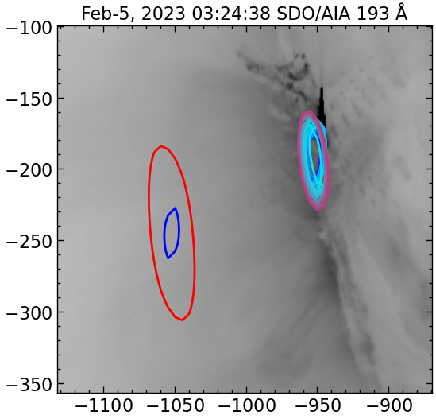
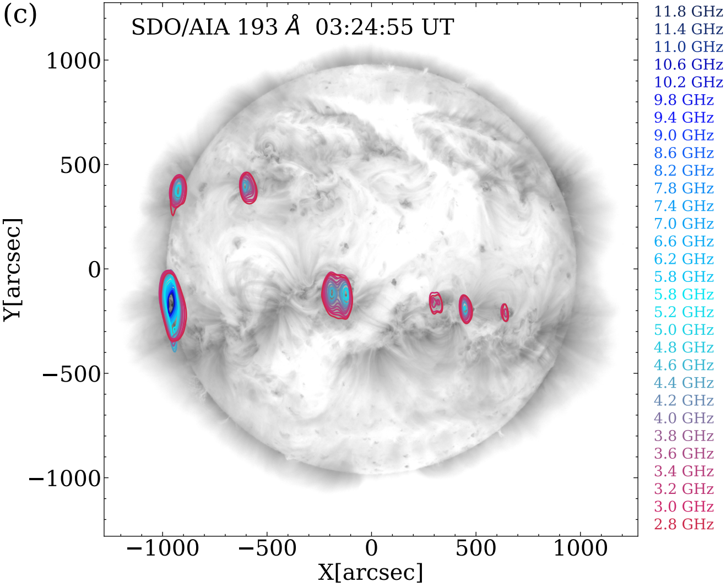
Метод восстановления пространственной структуры микроволновых источников по данным СРГ
Диаграмма направленности
Вычтенные источники в момент максимума 03:24:38

