Slide 1
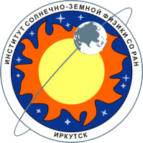
SPATIAL STRUCTURE OF THE INTERPLANETARY CORONAL MASS EJECTION: IMAGE/EUV DATA ANALYSIS
Baikal Young Scientists’ International School on Fundamental Physics
Aleksandr Rubtsov¹
avrubtsov@iszf.irk.ru
¹Institute of Solar-Terrestrial Physics SB RAS, Irkutsk, Russia
Sergey Anfinogentov^{1,2}
²Space Research Institute RAS, Moscow, Russia
2 September 2024

Slide 2
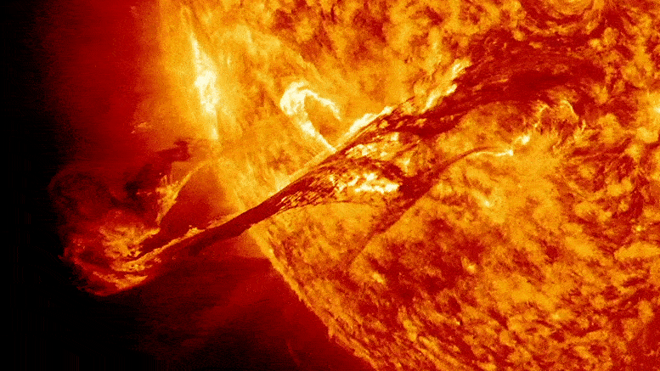
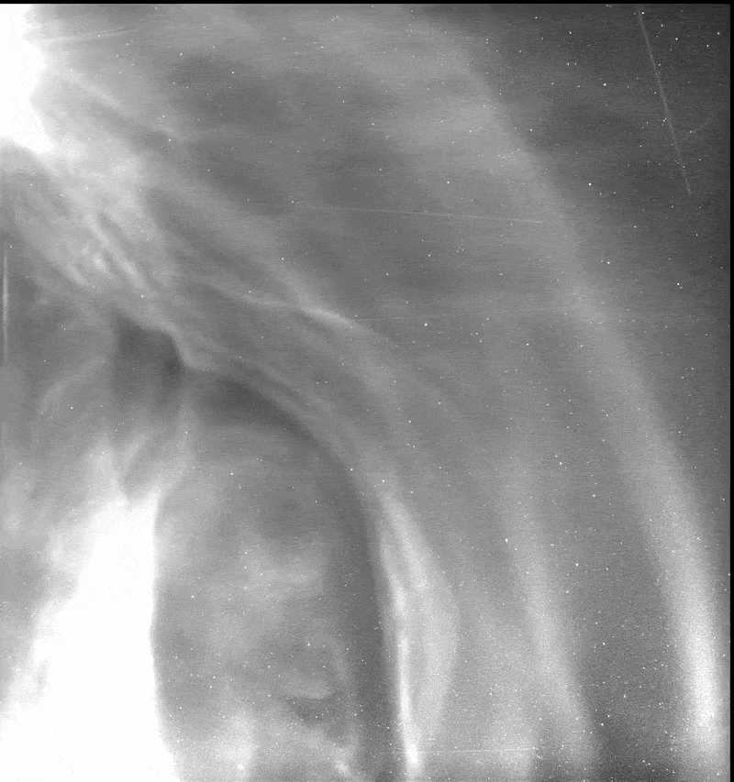
What is ICME?
CME is a significant ejection of magnetic field and accompanying plasma mass from the Sun's corona.
When CME enters interplanetary space it calls ICME.
ICME propagates to the heliopause.
ICME causes the most powerful magnetic storms on the Earth.
[Stenborg+, 2023]
[Pitña+, 2021]

Slide 3
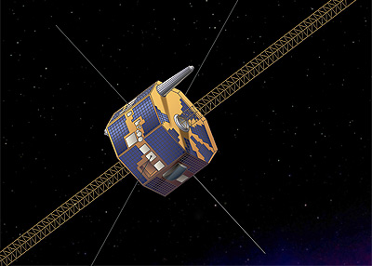
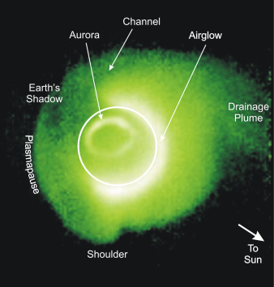
IMAGE Extreme Ultraviolet Imager
IMAGE is the spacecraft uses imaging and radio sounding techniques to provide global images of Earth’s inner magnetosphere and upper atmosphere.
IMAGE was operated in 2000–2005.
EUV imager was detecting He⁺ resonantly-scattered emission at 304 Å in Earth’s plasmasphere.
[Sandel+, 2003]

Slide 4
Long story short
We were looking for plasmasphere phenomena
But did not find anything we expected
Although 2000-2005 dataset was visually inspected
And we found something nobody observed before

Slide 5
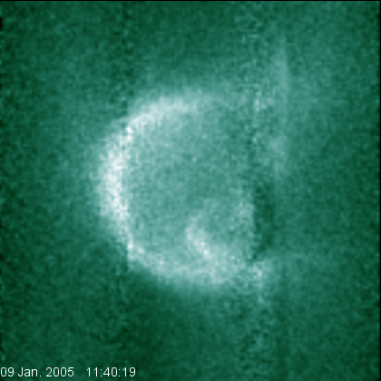
Long story short
We were looking for plasmasphere phenomena
But did not find anything we expected
Although 2000-2005 dataset was visually inspected
And we found something nobody observed before

Slide 6
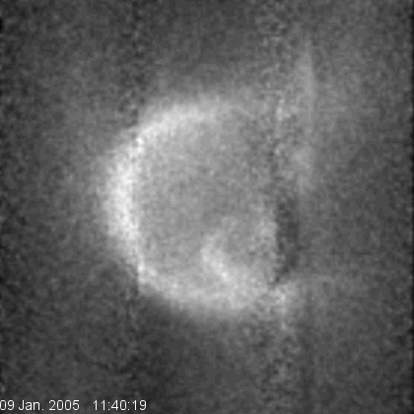
Long story short
We were looking for plasmasphere phenomena
But did not find anything we expected
Although 2000-2005 dataset was visually inspected
And we found something nobody observed before

Slide 7
Long story short
Some plasma formations were traveling across the EUV field of view on Jan. 9, 2005

Slide 8
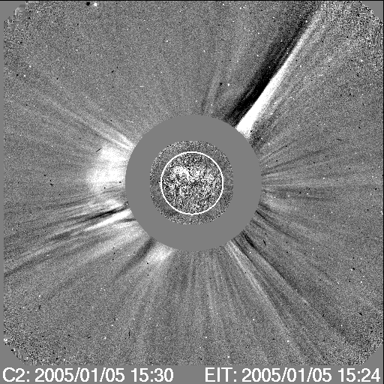
Initial ejection
SOHO/LASCO data on Jan. 5, 2005
CME list information:
Central PA [deg] | Angular Width [deg] | Linear Speed [km/s]
Halo | 360 | 735

Slide 9
ICME near the Earth’s orbit
ACE and Wind data at L1 point:
No changes in Vx solar wind
Simultaneous sharp changes in Vy, Vz and IMF By, Bz
Sudden increase in Ni at Wind which was closer to the ICME

Slide 10
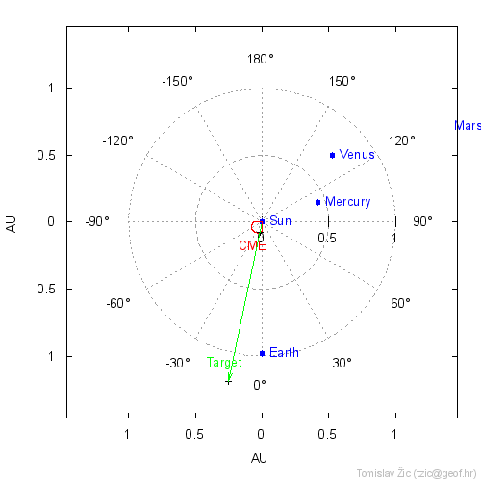
ICME propagation
Drag-Based Model
Assumes that beyond certain distance the ICME propagation is governed solely by its interaction with the ambient solar wind
Cone-shaped ICME: the leading edge is considered to be a semi-circle, spanning over the ICME full angular width
Yes, it is 2D
[Vršnak+, 2013]
Notes:
acceleration/deceleration of the ICME can be expressed in terms of the magnetohydrodynamical (MHD) analogue of the aerodynamic drag

Slide 11
Summary
Unique case of ICME observation by IMAGE/EUV at the background of the Earth, supported by Solar corona observations and measurements in L1 points of Sun-Earth system
Why this observation is so unique?

Slide 12
To be continued…

