Slide 1
Limb Flare with Failed Eruption
S.A. Polukhina¹, L.K.Kashapova²
¹SPbU, ²ISTP SB RAS
Limb Flare with Failed Eruption
S.A.Polukhina (SPbU)
August 26, 2024
0 / 9

Slide 2
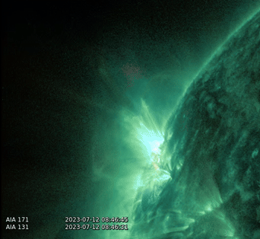
Solar Flare 2023-07-12 8:50UT M2.7
Limb Flare with Failed Eruption
S.A.Polukhina (SPbU)
August 26, 2024
1 / 9

Slide 3
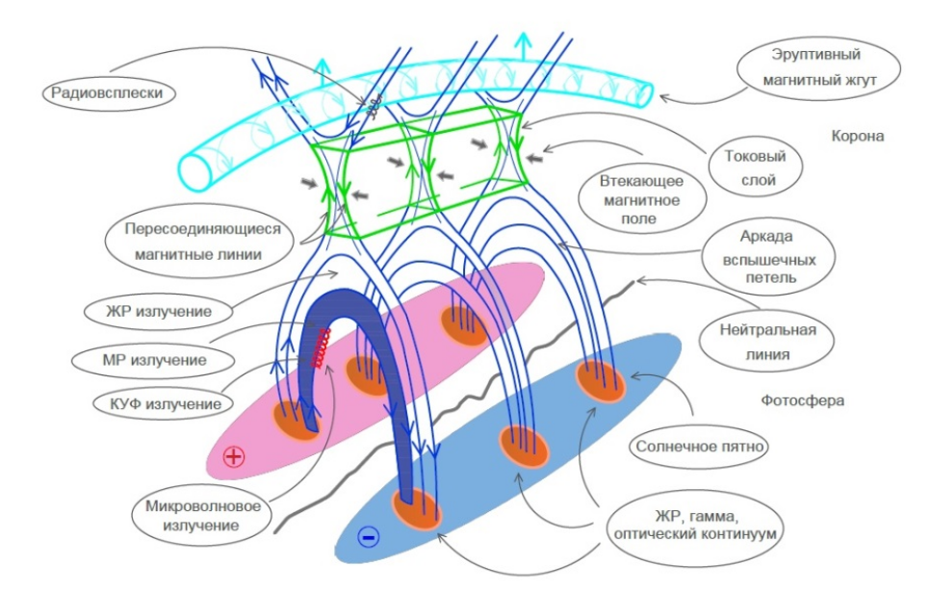
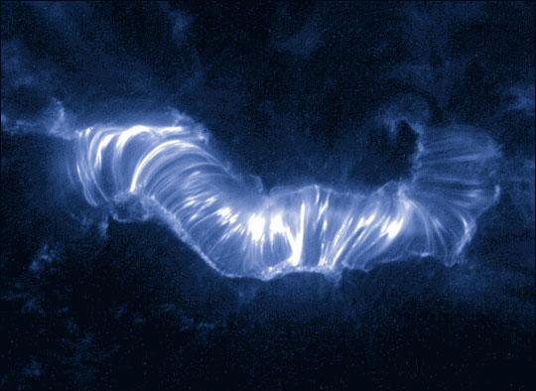
The Standard model of a Solar Flare
The classical two-dimensional-like reconnection
model (CSHKP model). Kupriyanova et al., 2020
Massive flare on July 14th, 2000. TRACE 171Å image
Limb Flare with Failed Eruption
S.A.Polukhina (SPbU)
August 26, 2024
2 / 9

Slide 4
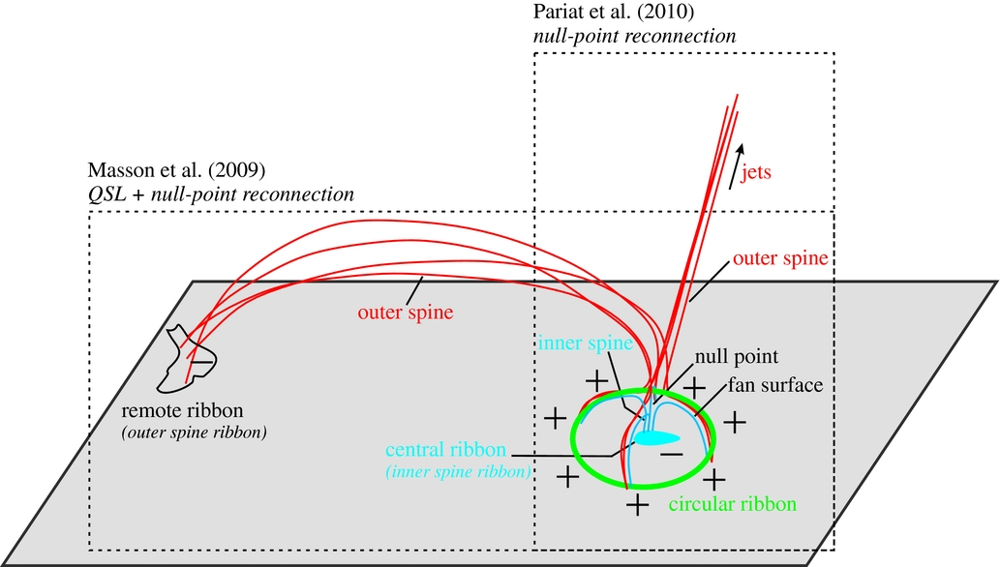
The Circular-ribbon Flare
The relationship among circular ribbon flare ribbons,
jets and remote brightenings in a 3D null-point magnetic
topology. Wang and Liu, 2012
Left: circular ribbon flare observed in 304 Å,
right: corresponding magnetogram.
Zhang et al., 2022
Limb Flare with Failed Eruption
S.A.Polukhina (SPbU)
August 26, 2024
3 / 9

Slide 5
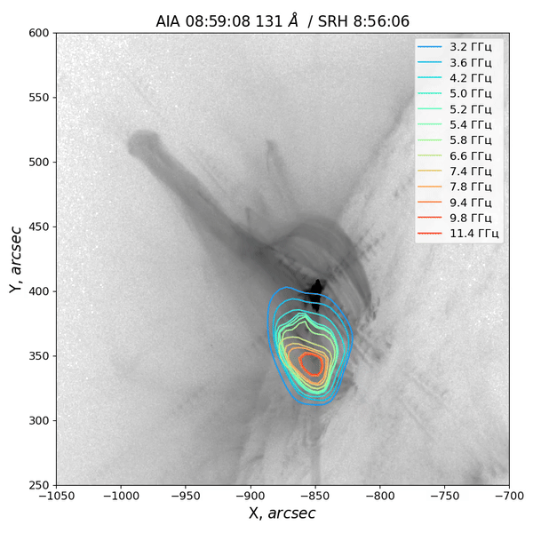
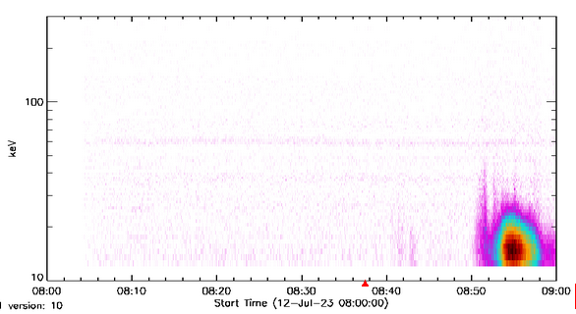
Flare Topology and Evolution
ASO-S HXI spectrogram (BKG removed)
100
keV
10
08:00
08:10
08:20
08:30
08:40
08:50
09:00
Start Time (12-Jul-23 08:00:00)
Limb Flare with Failed Eruption
S.A.Polukhina (SPbU)
August 26, 2024
4 / 9

Slide 6
Hard X-Ray sourses vs chromospheric emission
HXI resolution: 2’’ per pix (reconstructed images)
Limb Flare with Failed Eruption
S.A.Polukhina (SPbU)
August 26, 2024
5 / 9

Slide 7
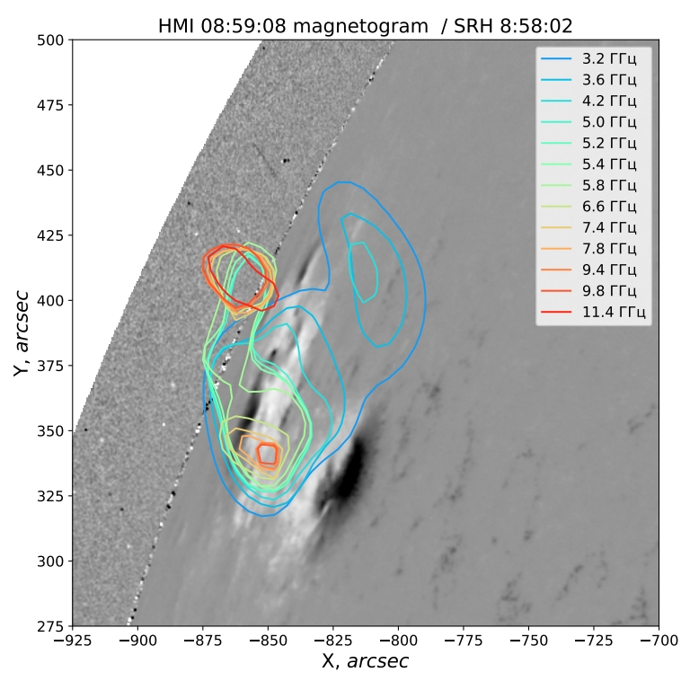
Hard X-Ray sourses vs chromospheric emission
GHz
GHz
GHz
GHz
GHz
GHz
GHz
GHz
GHz
GHz
GHz
GHz
GHz
HXI resolution: 2’’ per pix (reconstructed images)
SRH resolution: 7’’-30’’ per pix
Limb Flare with Failed Eruption
S.A.Polukhina (SPbU)
August 26, 2024
6 / 9

Slide 8
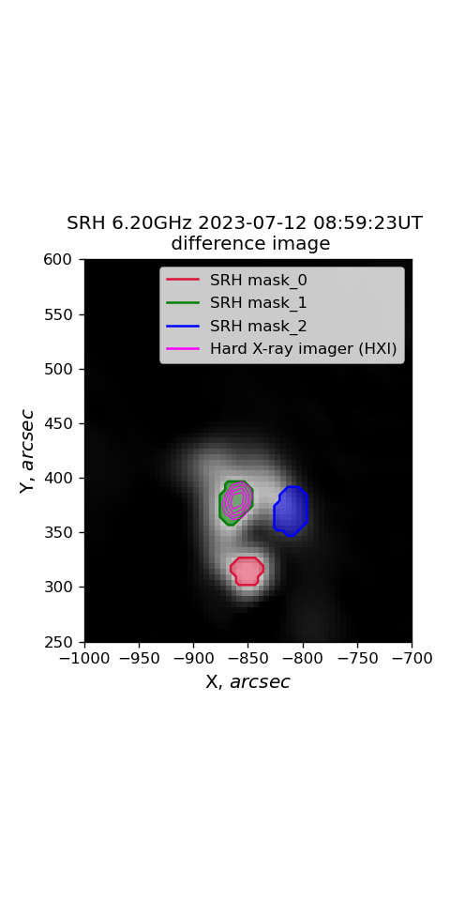
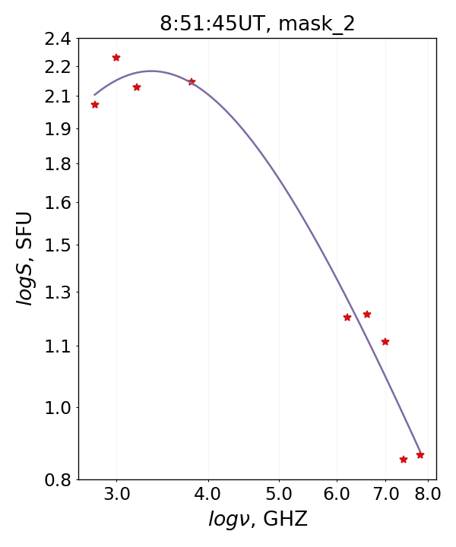
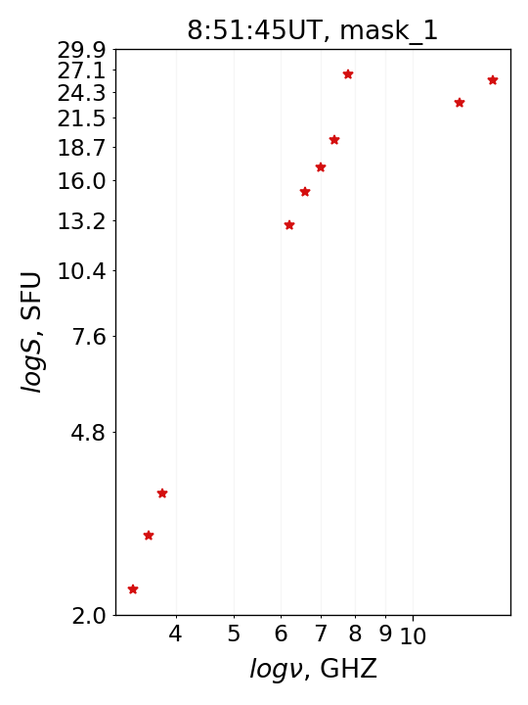
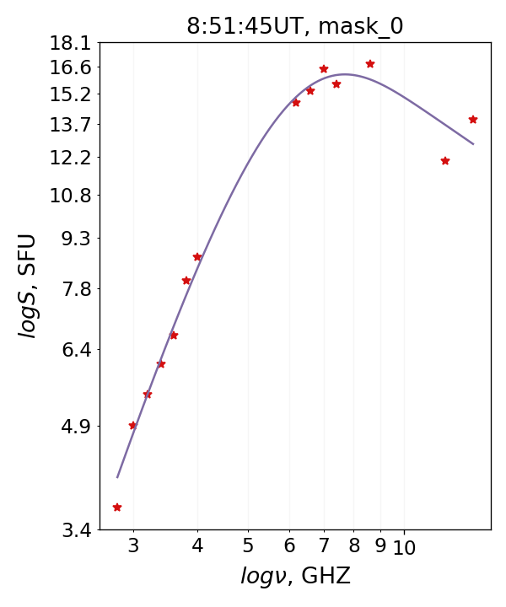
Hard X-Ray sourses vs chromospheric emission
δ=2.59
gyrosynchrotron
δ=3.91
bremsstralung?
gyrosynchrotron
Limb Flare with Failed Eruption
S.A.Polukhina (SPbU)
August 26, 2024
7 / 9

Slide 9
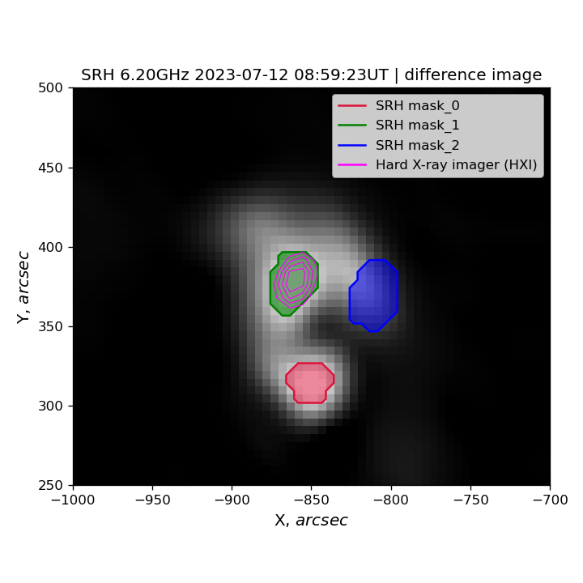
Microwave sourses
GHz
GHz
GHz
GHz
GHz
GHz
GHz
GHz
GHz
GHz
GHz
GHz
GHz
Limb Flare with Failed Eruption
S.A.Polukhina (SPbU)
August 26, 2024
8 / 9

Slide 10
Results
1) We analyzed the characteristics of emission from different regions of a circular ribbon solar flare. Three sources were identified in microwaves.
2) The only one of them was associated with a hard X-ray source in the range of 12–50 keV. The spectrum of this source suggests bremsstrahlung emission mechanisms, indicating a high plasma density.
3) The source located close to the sunspot area showed a peak frequency of approximately 7–8 GHz. On the other hand, a source not associated with a strong magnetic field showed a peak around 3 GHz, or even lower. These facts assume that emission sources were formed in magnetic fields with varying strengths. We note that the spectra of these two sources differed as well, with electron spectral indices of approximately 4 and 3, respectively.
Thank you for your attention!
Limb Flare with Failed Eruption
S.A.Polukhina (SPbU)
August 26, 2024
9 / 9

Slide 11
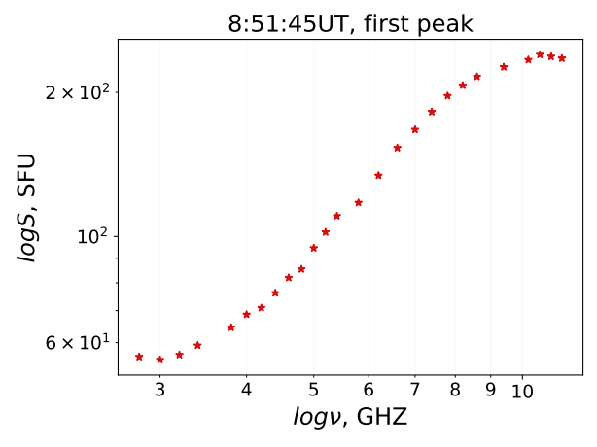
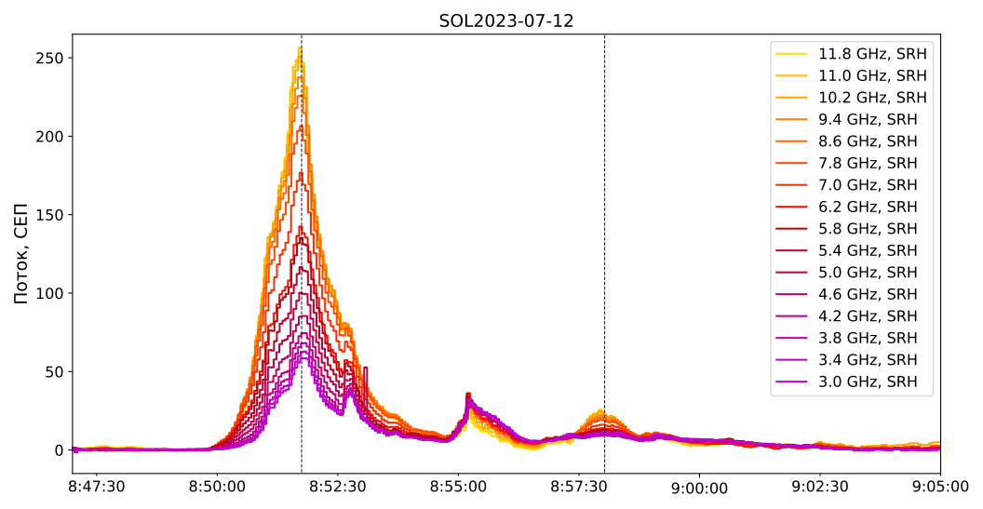
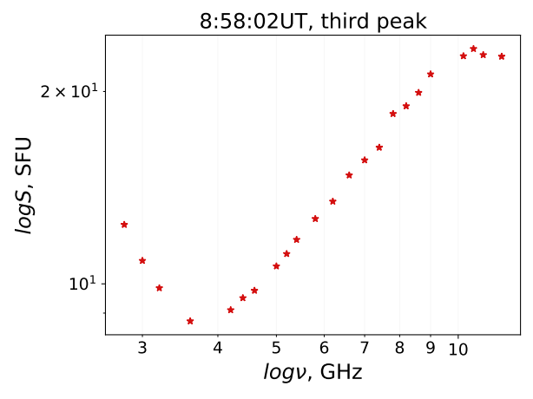
Solar Flare 2023-07-12 8:50UT M2.7
Flux, SFU
Limb Flare with Failed Eruption
S.A.Polukhina (SPbU)
August 26, 2024
10 / 9

Slide 12
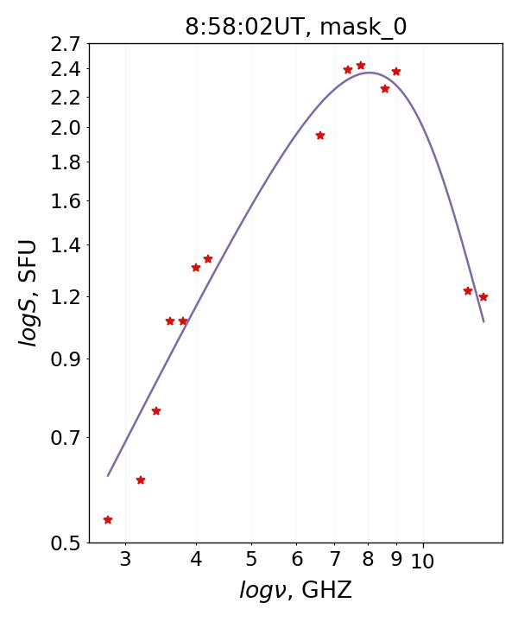
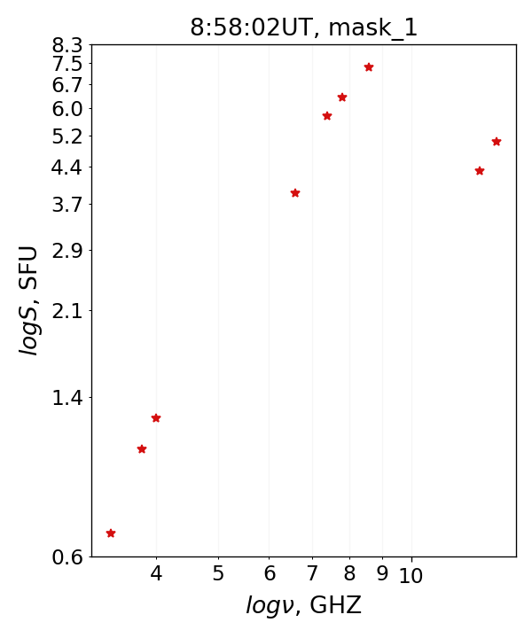
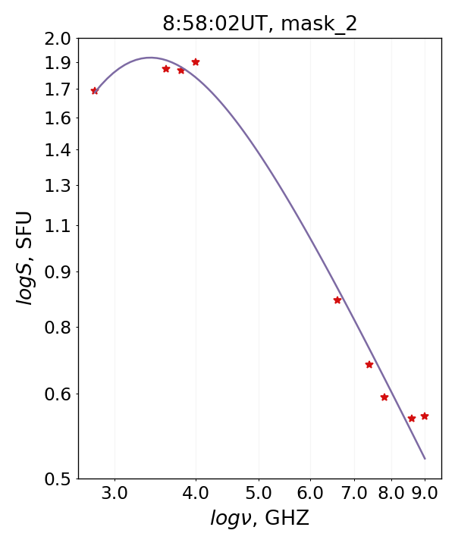
Hard X-Ray sourses vs chromospheric emission
δ=3.02
δ=3.91
δ=2.59
Nita, Gary et al., 2004
George A.Dulk, 1985
Limb Flare with Failed Eruption
S.A.Polukhina (SPbU)
August 26, 2024
11 / 9

Slide 13
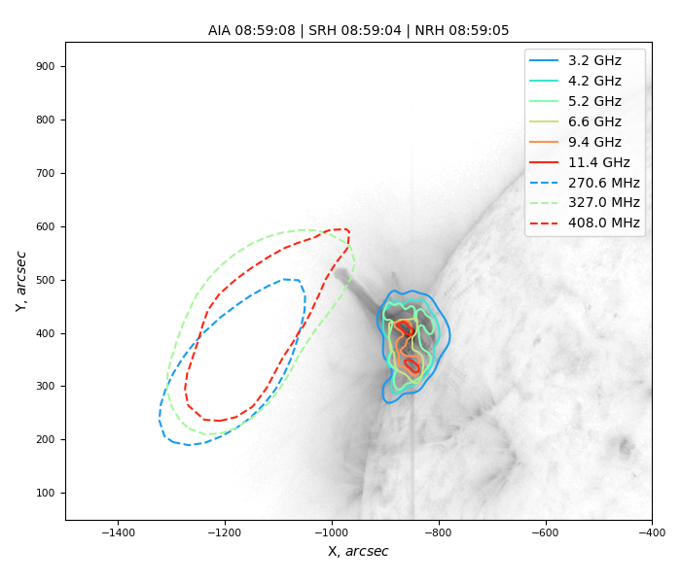
Solar Flare 2023-07-12 8:50UT M2.7
The plasma motion stopped
Limb Flare with Failed Eruption
S.A.Polukhina (SPbU)
August 26, 2024
12 / 9

