Slide 1
BAIKAL YOUNG SCIENTISTS’ INTERNATIONAL SCHOOL ON FUNDAMENTAL PHYSICS
“PHYSICAL PROCESSES IN OUTER AND NEAR-EARTH SPACE”
XVIII Young Scientists’ Conference
“Interaction of fields and radiation with matter”
Irkutsk, September 1-7, 2024
SENSOR DIAGNOSTICS OF WIDEBAND IONOSPHERIC CHANNELS OF 1 MHZ WIDTH TO INCREASE THE COVERTNESS OF FREQUENCY HOPPING DATA TRANSMISSION SYSTEMS BY MEANS OF ADAPTIVE EQUALIZATION OF INTRAMODE DISPERSION
speaker: candidate of technical sciences, associate professor at Radio Engineering and Communications dept.
Ovchinnikov Vladimir

Slide 2
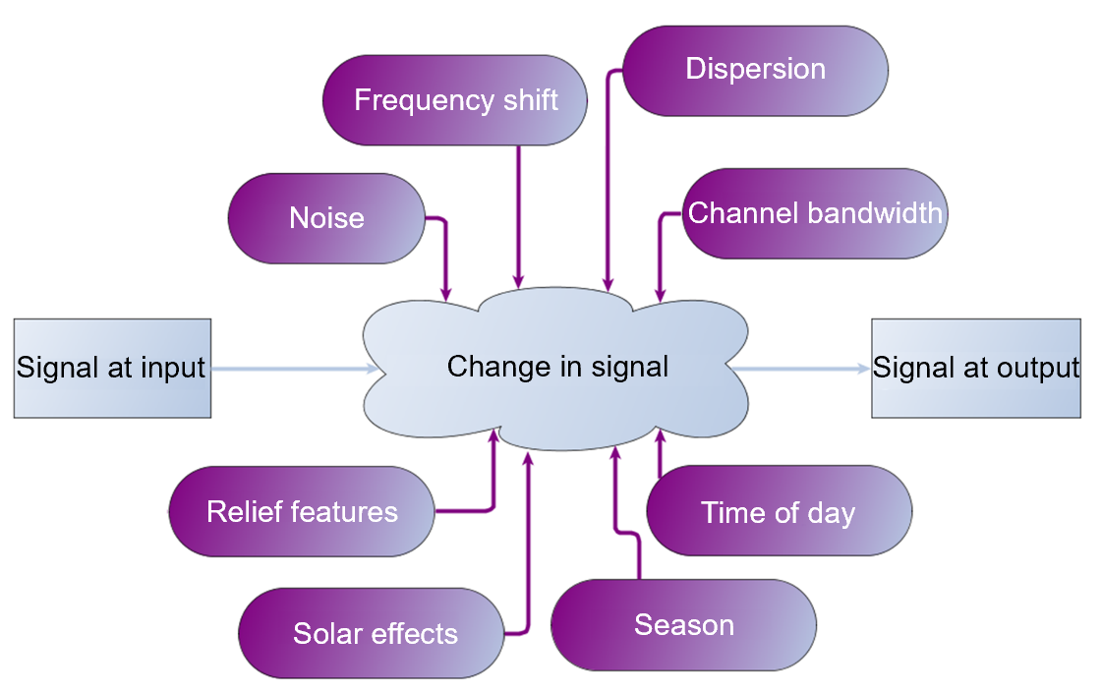
2
Relevance: there is an urgent need to significantly expand the bandwidth of the HF communication channel beyond its coherence bandwidth, which, along with the use of the fast frequency hopping, will improve the covertness and noise immunity of communication systems. However, spreading the bandwidth is limited by the effect of frequency dispersion of the ionosphere, which leads to significant distortions of wideband communication signals. Another challenge is the presence of narrowband interferences which reduce the percentage of partial channels available for transmission.
The aim of the research is increasing the covertness and noise immunity of NVIS HF communication systems by overcoming ionospheric dispersion using channel sensor data.
Fig. 1. Factors affecting ionospheric HF radio channel
Fig. 2. Variability of the propagation medium over slow time

Slide 3
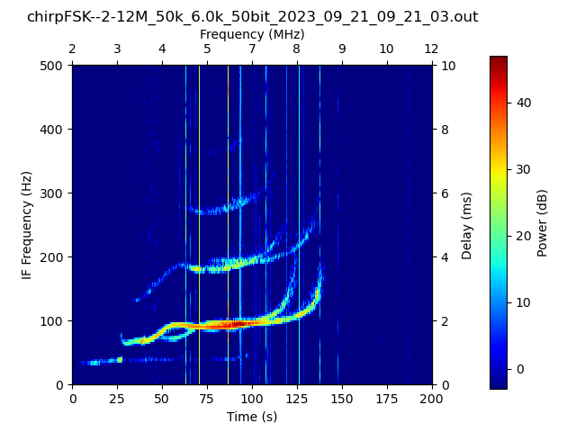
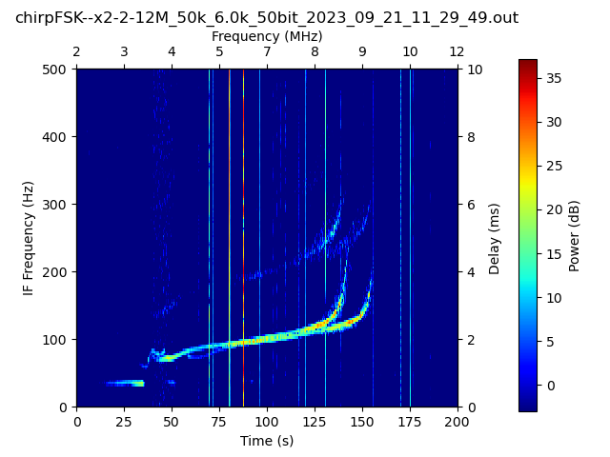
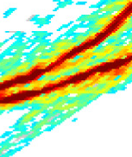
3
FEATURES OF PROPAGATION OF WIDEBAND SIGNALS
Amplitude
O-mode
Delay
X-mode
Fig. 3. Typical band-limited transfer function for single-mode oblique propagation
Fig. 4. Examples of vertical incidence ionograms recorded on the Yoshkar-Ola-to-Yalchik path

Slide 4
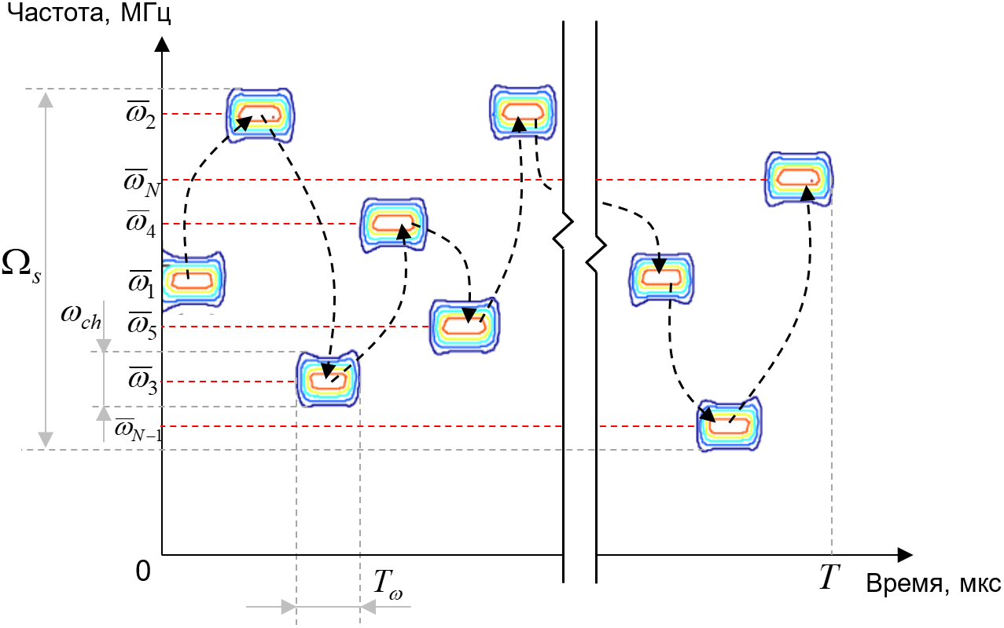
4
METHOD OF INCREASING COVERTNESS AND NOISE IMMUNITY
Typically, tactical (military) communication systems with frequency hopping employ a hopping band of roughly 1% of the channel central frequency or a smaller value. So, with a central frequency of 3 MHz, the hopping band would be equal to 30 kHz, and with a central frequency of 7 MHz, the hopping band would be 70 kHz. It is well known that interference generation in the ~50 kHz frequency band does not pose a technical challenge. Therefore, frequency hopping systems with a bandwidth of roughly 50 kHz exhibit weak resistance to electronic warfare systems. On the other hand, organizing the generation of interference in the frequency band of 256 kHz and wider is a complex technical challenge. Thus, the use of frequency hopping with a bandwidth exceeding 256 kHz provides sufficient noise immunity and increased energy covertness.
Fig. 5. Example of a time-frequency matrix of a frequency hopping signal

Slide 5
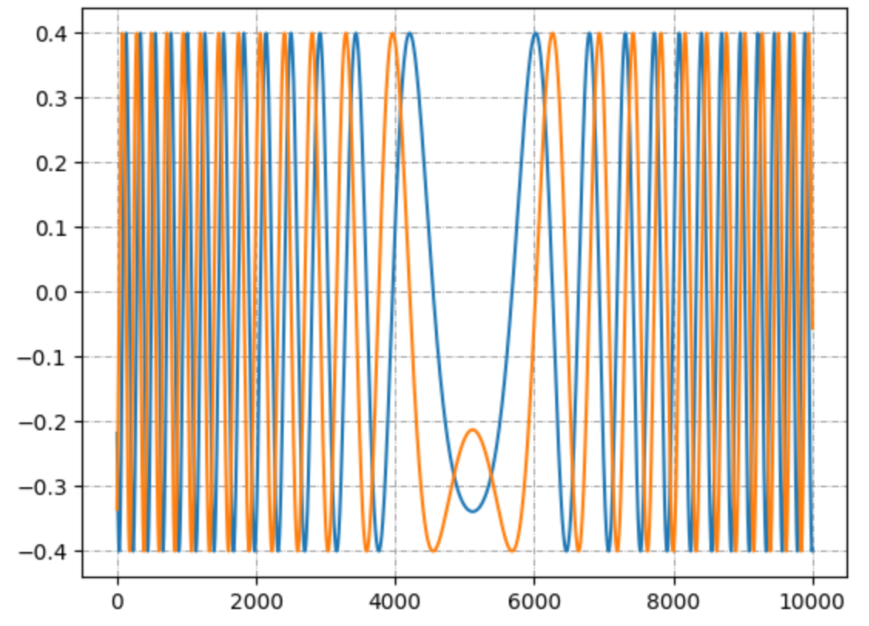
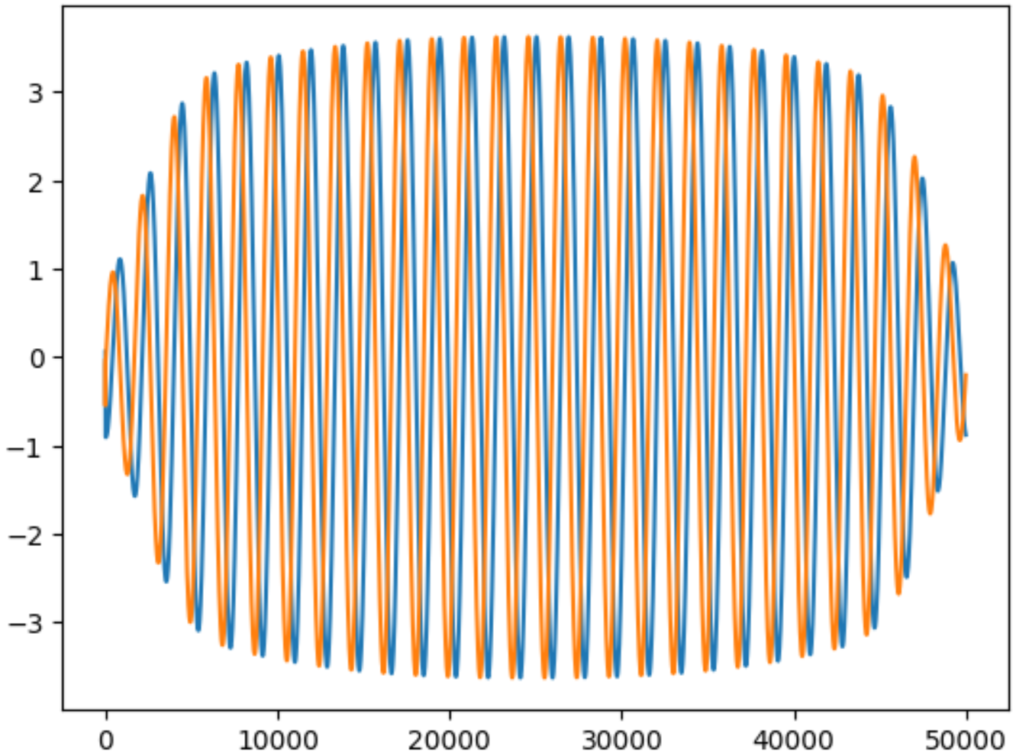
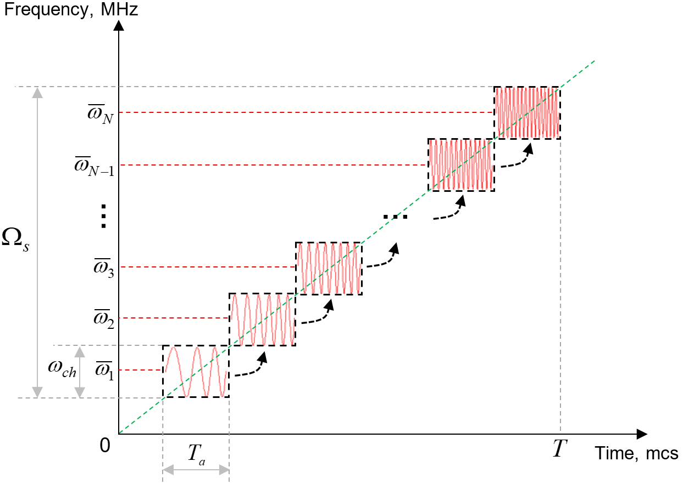
5
METHOD OF INCREASING COVERTNESS AND NOISE IMMUNITY
It is proposed to use fast frequency hopping with a hop band of the order of 10% of the channel carrier frequency (for example, a hop band of 1 MHz, with a carrier $f_{c}=10$ MHz). At the same time, the communication system will simultaneously exhibit high energy covertness and noise immunity in the occupied frequency range.
Within the framework of the proposed method, the transmitter generates a fast frequency hopping signal of duration $T$. The signal must consist of $N$ adjacent radio pulses of duration $t=T/N$. Each pulse has its own carrier frequency and is an element of the total signal. Thus, when transmitting over duration $T$, each signal element occupies a partial channel for time $t$.
Fig. 7. Examples of reference LFMCW signal (left) in baseband and compressed in receiver beat-note signal (right)
$b_{ch}=8$ kHz
$$T_{a}=8 ms$$
$$D=b_{ch}∙T_{a}=64$$
- element bandwidth
- element duration
Fig. 6. Physical model of signal with wideband fast frequency hopping based on LFMCW signal
- time-bandwidth product

Slide 6
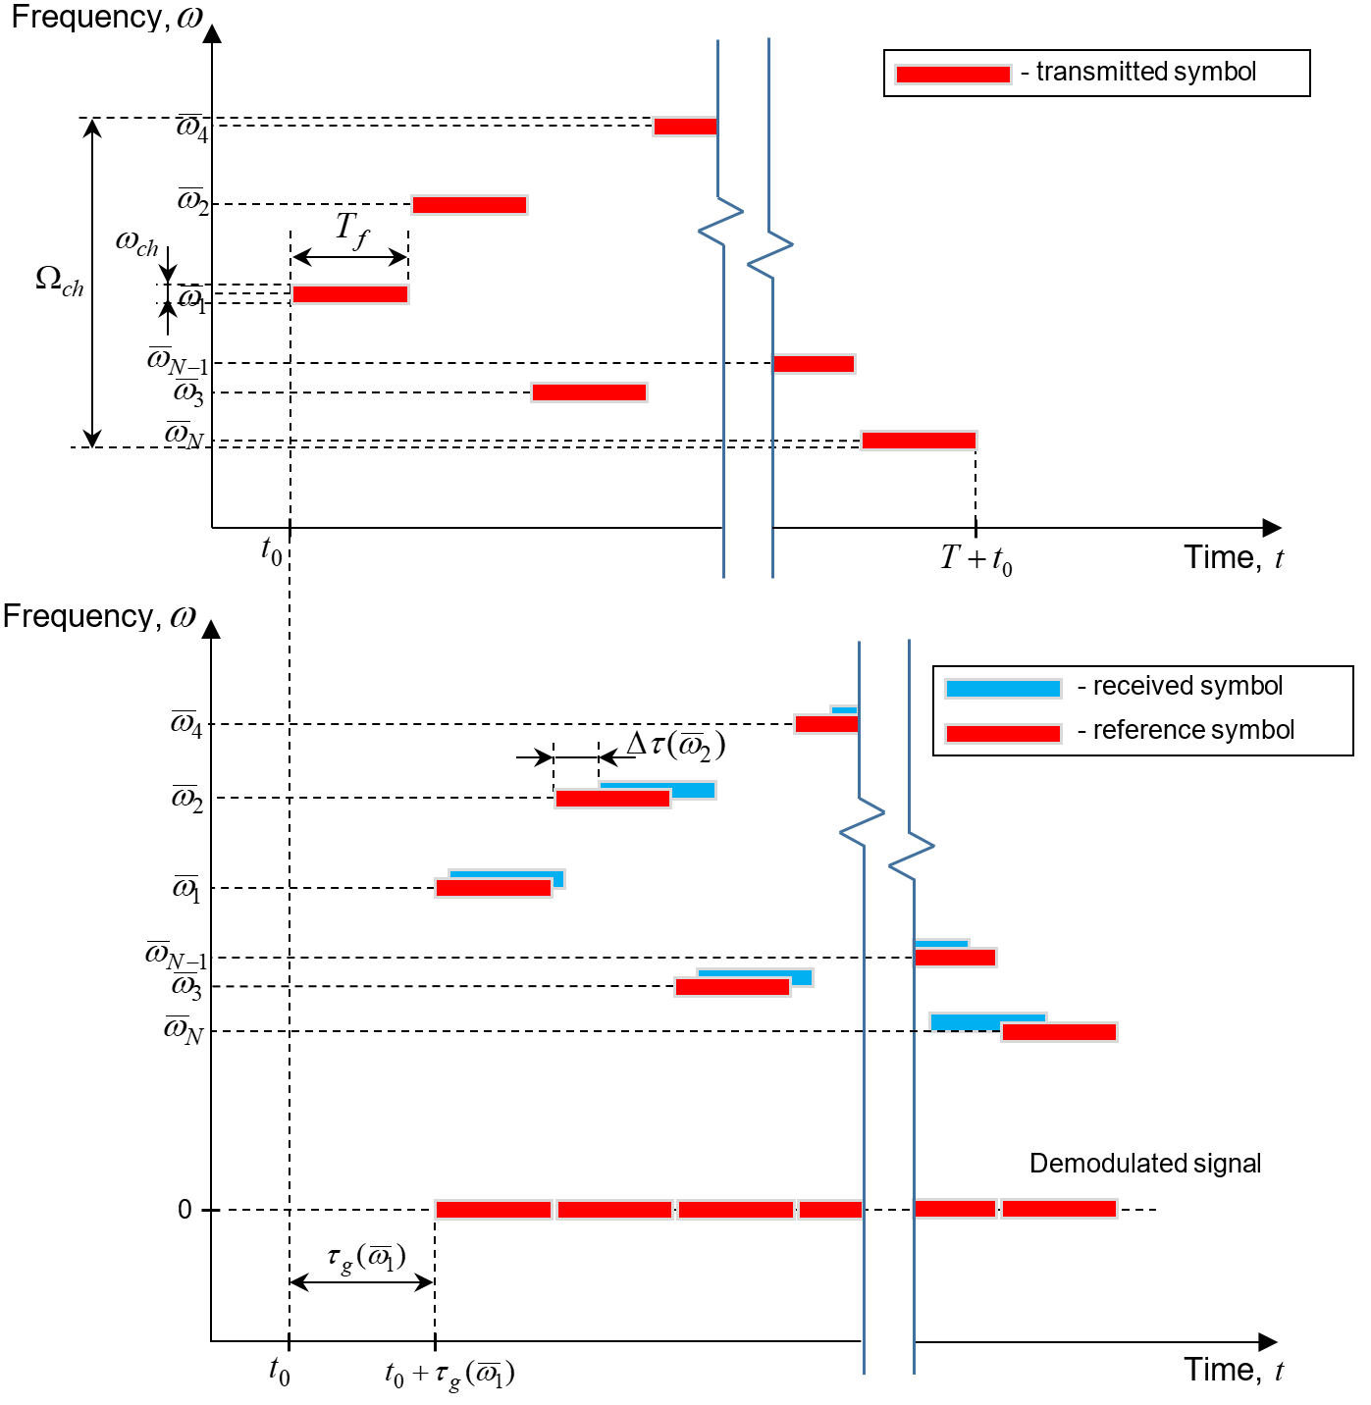
6
METHOD OF INCREASING COVERTNESS AND NOISE IMMUNITY
FR of partial radio channel:
(1)
Spectrum of a random FH signal element, at the ionospheric channel output with FR $H(jω_{k})$:
(2)
Problem: for communication systems it is crucial to filter multipliers, associated with a channel, that lead to phase jitter of a communication FFH wideband signal.
Transfer function of the equalizer taking into account the features of FFH, that filters channel multipliers:
(3)
FIg. 8. Effect of frequency phase dispersion on wideband signal with fast frequency hopping
The method takes into account that the spectrum of the received signal is the product of the spectrum of the emitted signal and the frequency response of a linear system, which is equivalent in its action to the signal propagation path in the medium. In this work, the function that specifies the spectrum of the emitted signal is useful, and the frequency response is interference. To mitigate it, an inverse filtering algorithm is used.

Slide 7
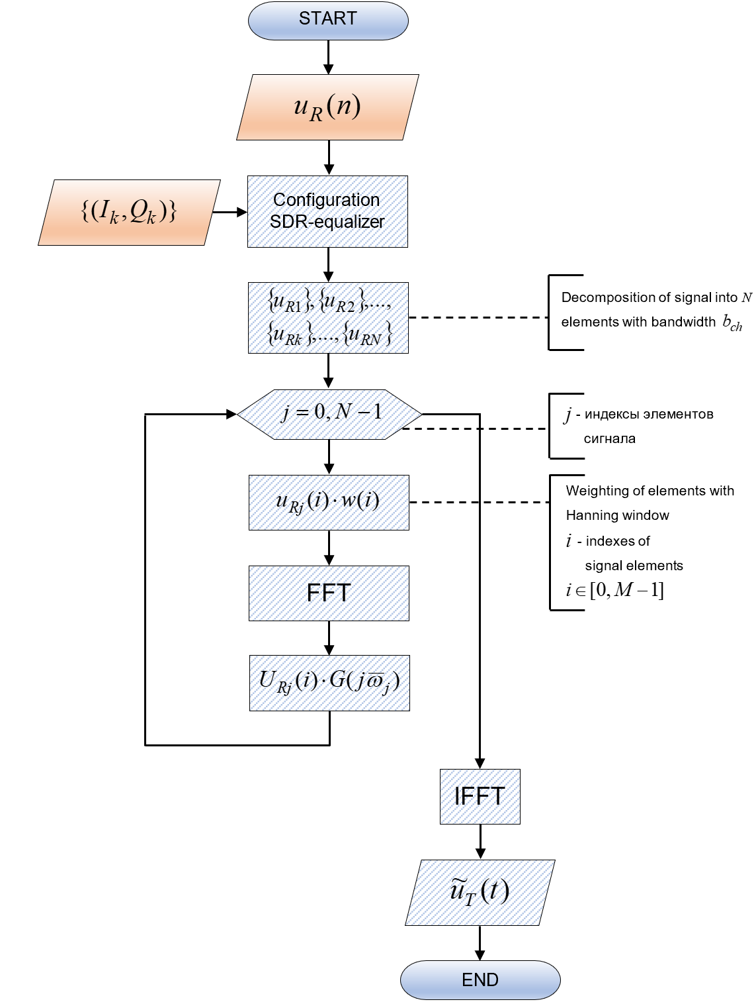
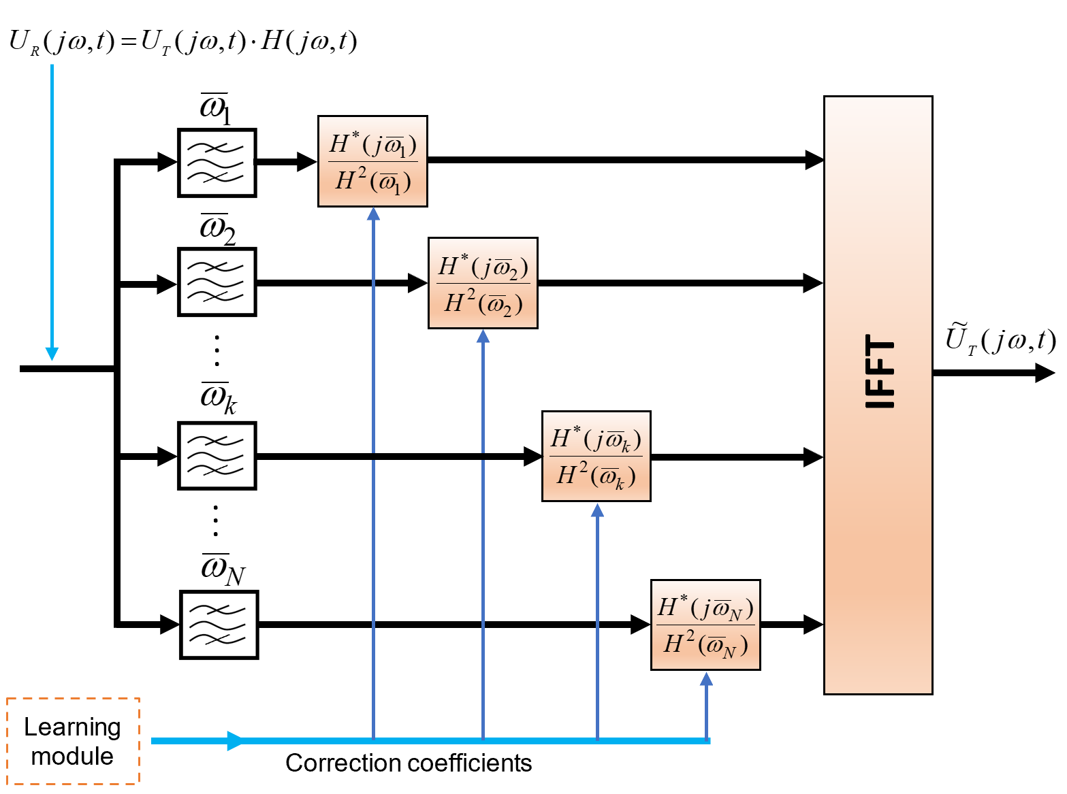
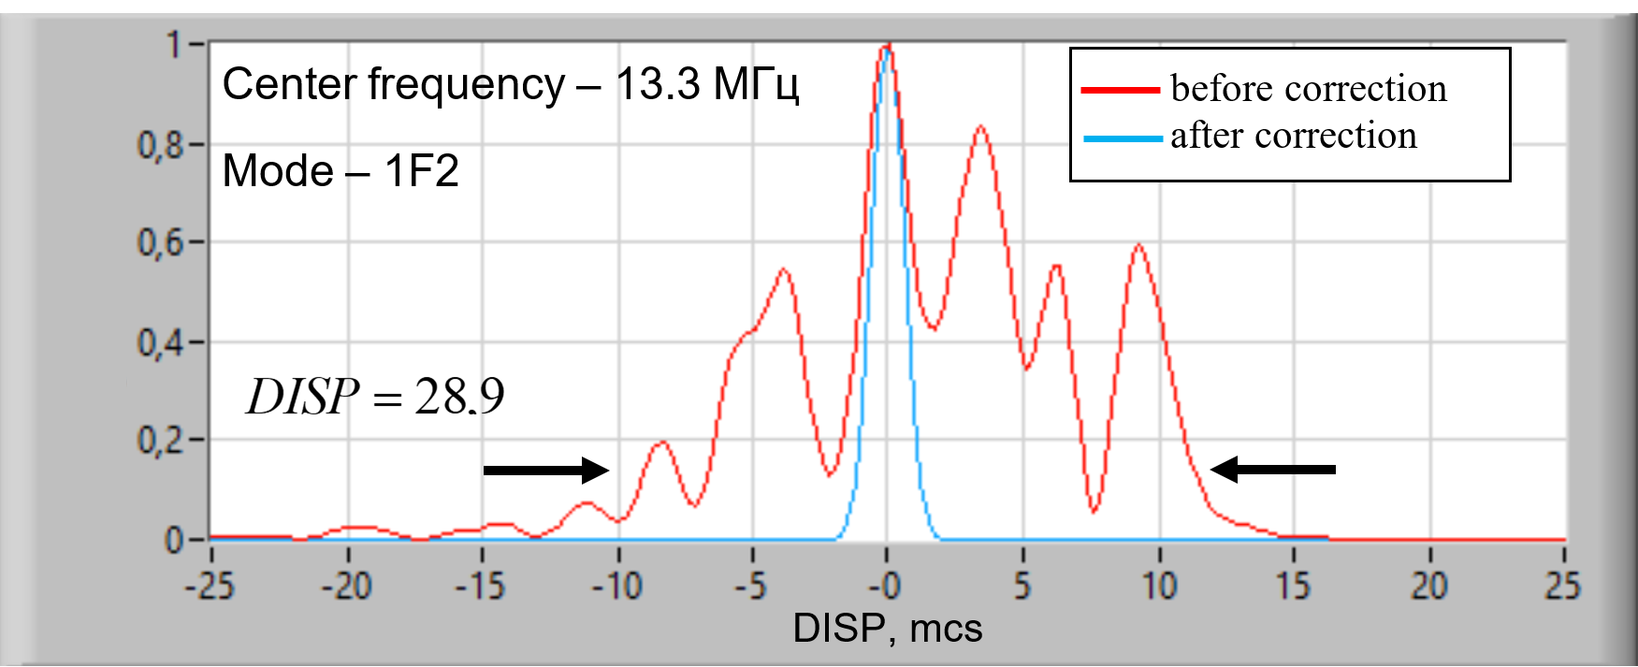
7
Algorithm for correcting amplitude and phase frequency dispersion in HF communication channel for FH wideband system
Fig. 10. Block diagram of adaptive equalizer of wideband HF communication channel
Fig. 9. Algorithm of operation of adaptive equalizer of wideband HF communication channel
(1)
Fig. 11. Example of overcoming amplitude-phase frequency dispersion in HF channel with bandwidth of 1 MHz

Slide 8
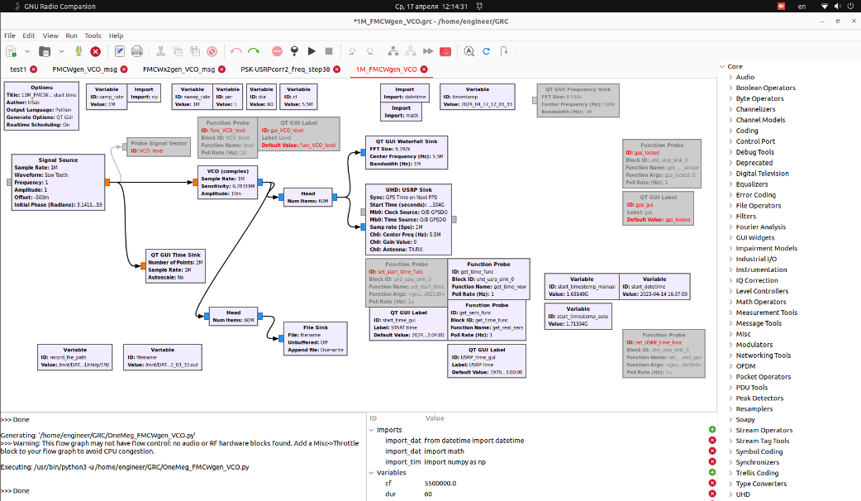
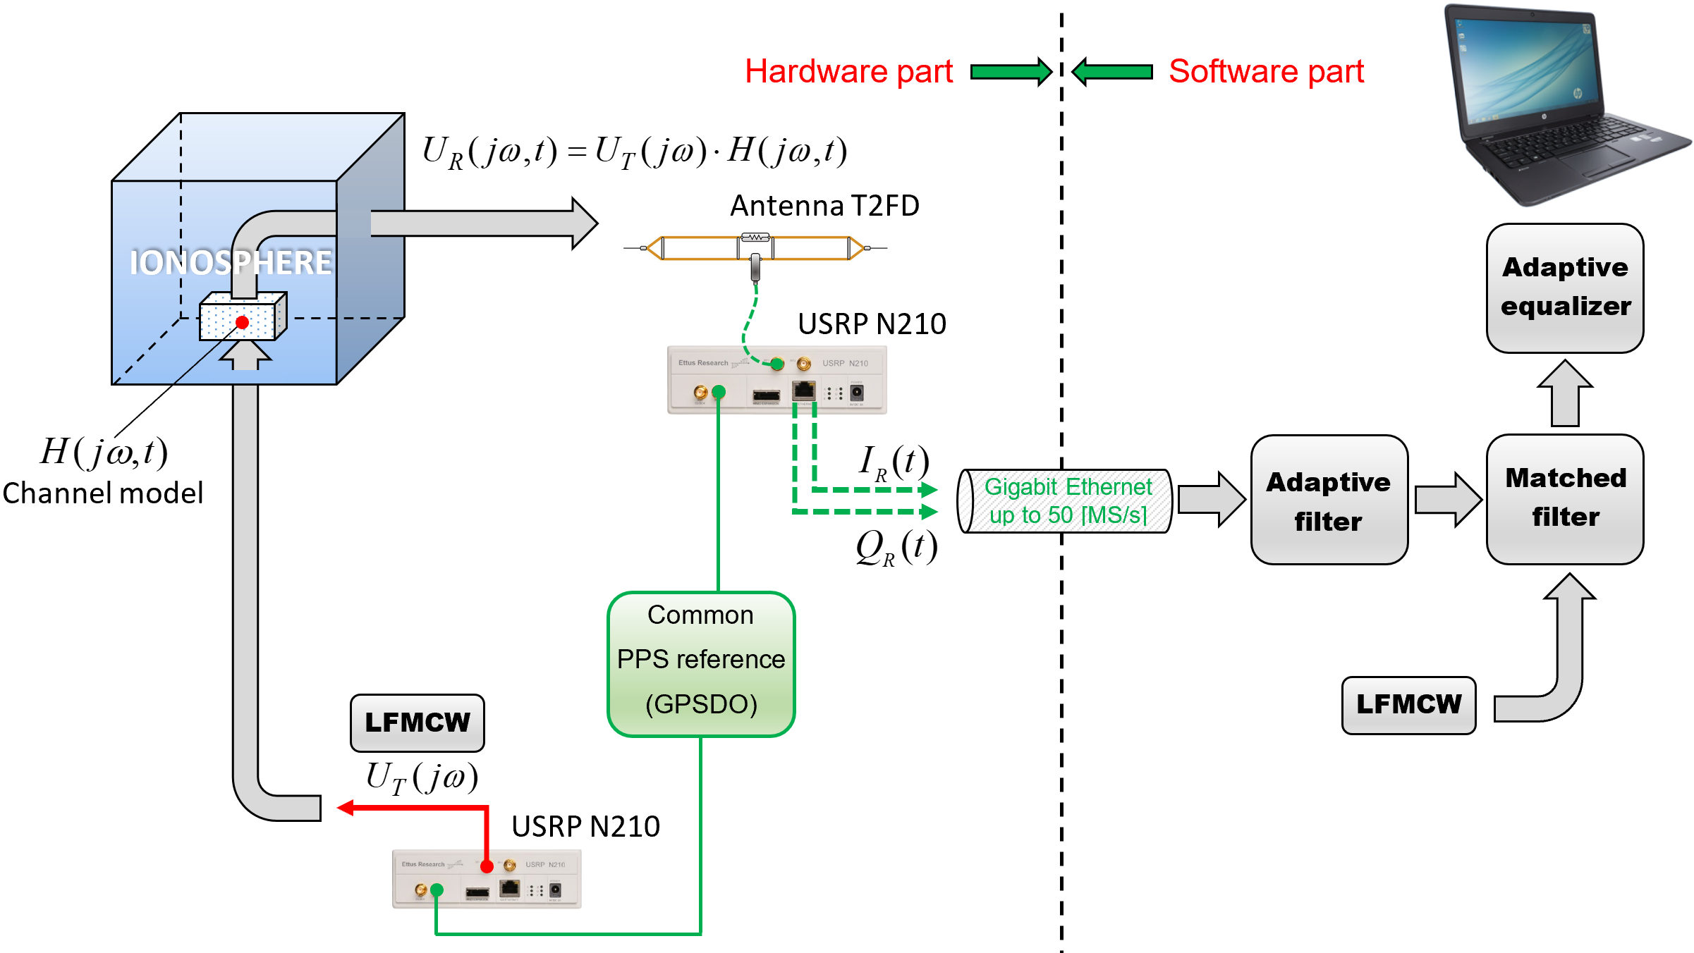
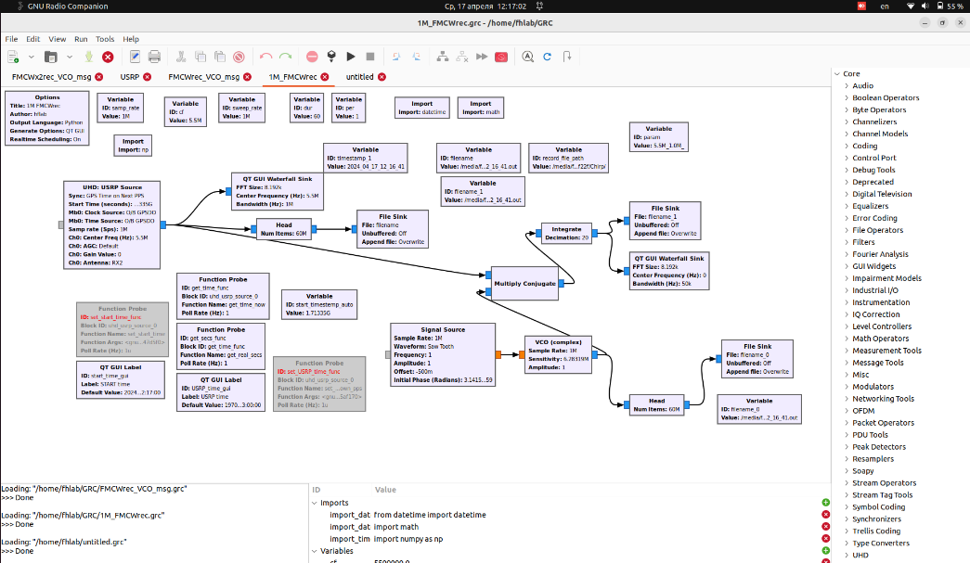
8
Equipment and software for conducting experimental research
Tx
Rx
Fig. 13. Block diagram of software hardware complex of radio channel active sensor
Fig. 12. Software of transmitting (top) and reception (bottom) terminals developed in GNU Radio

Slide 9
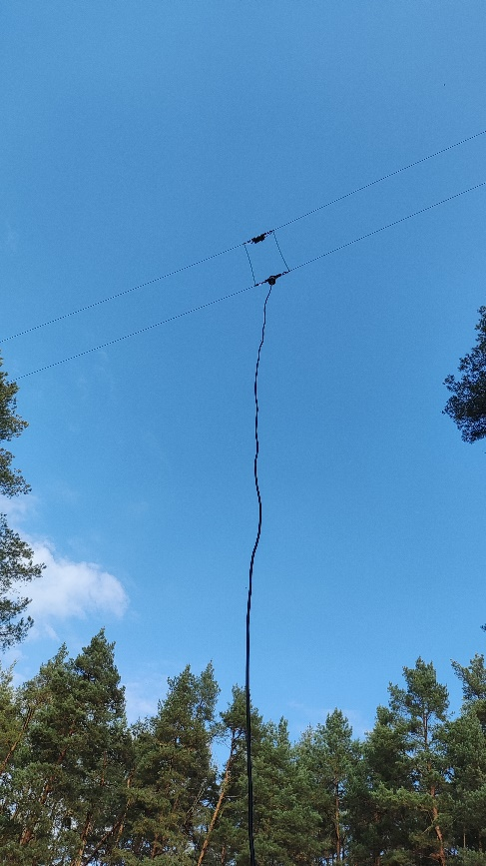
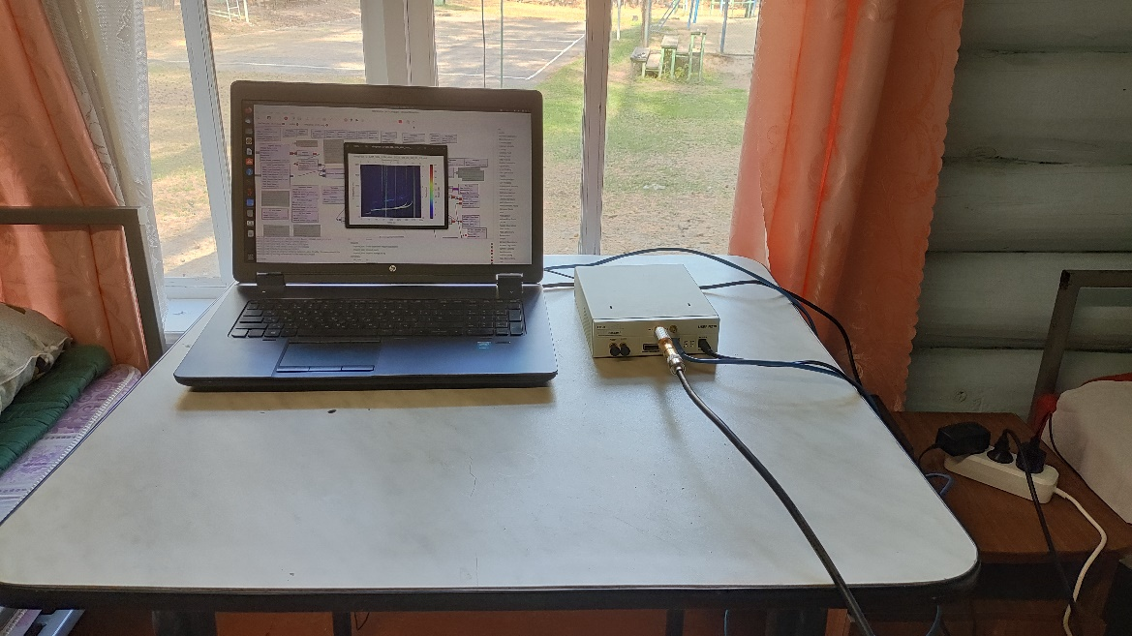
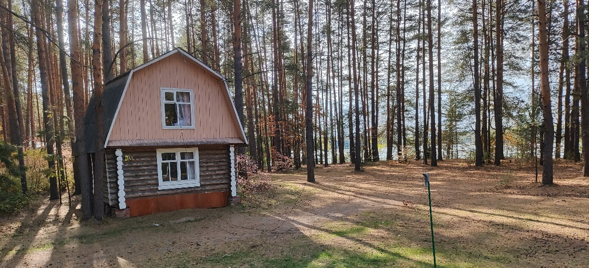
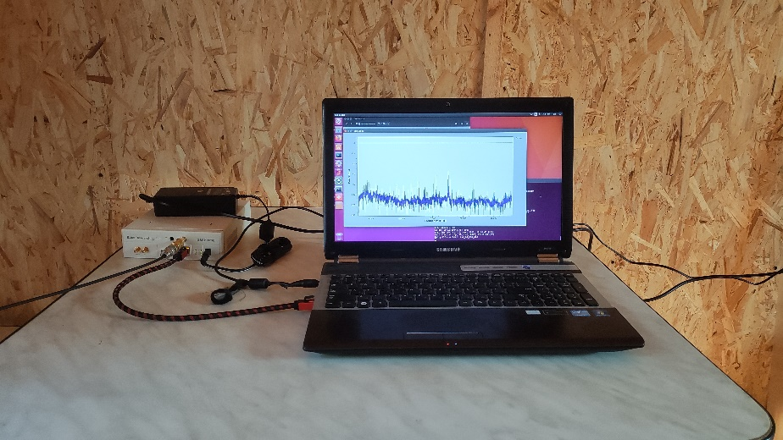
9
Equipment and software for conducting experimental research
Transmission terminal (Yoshkar-Ola)
Reception terminal (Yalchik)
PC
Power amplifier
USRP
Equipment:
PC (personal computer)
Ubuntu 22.04.3 LTS with GNU Radio 3.10.1.1.
USRP N210;
Power amplifier LZY-22+;
Transmission wideband antenna AN-710 installed horizontally (loop dipole 24.5 m x 0.4 m with a wideband matching device and a load resistor);
Self-manufactured reception antenna (loop dipole 34 m x 1 m) installed at an angle of 15 degrees.

Slide 10
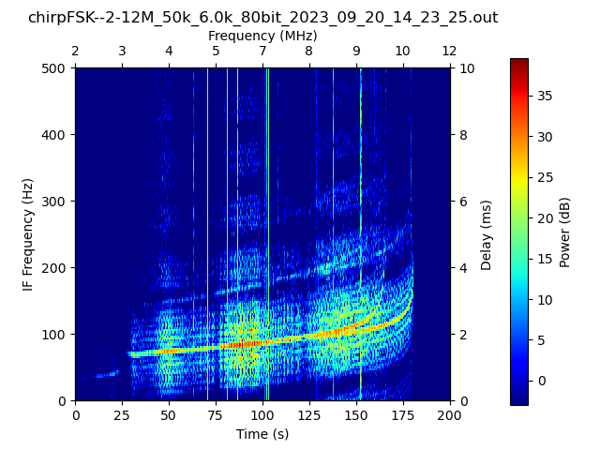
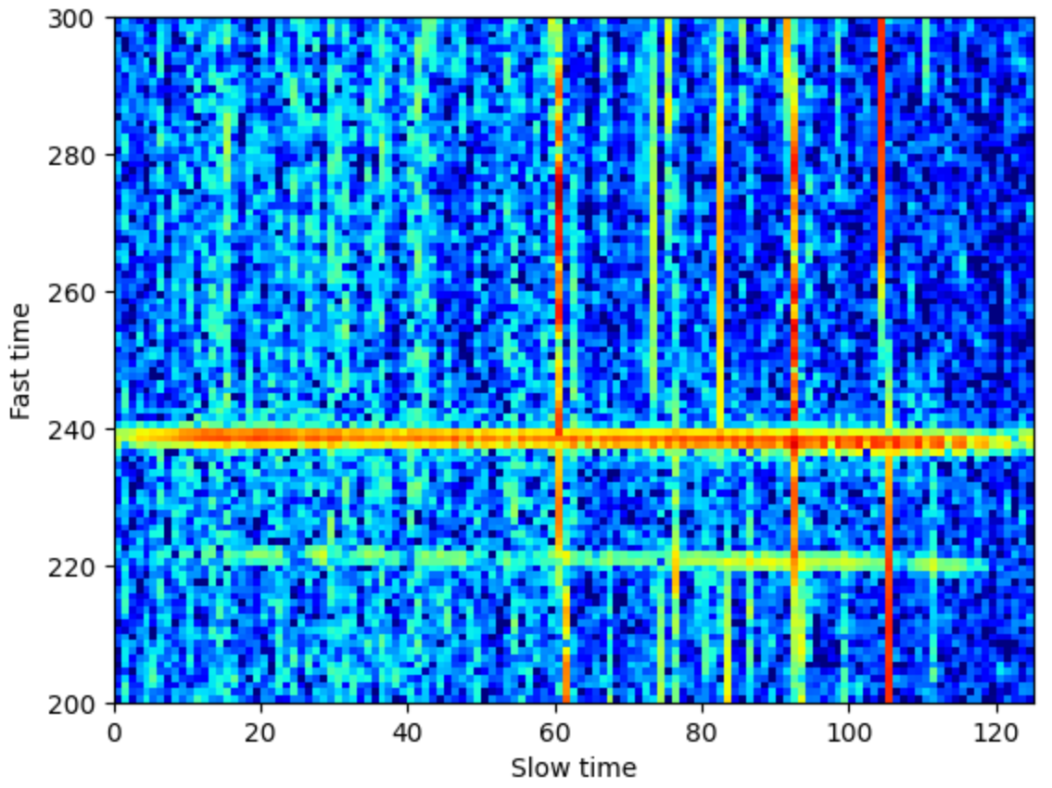
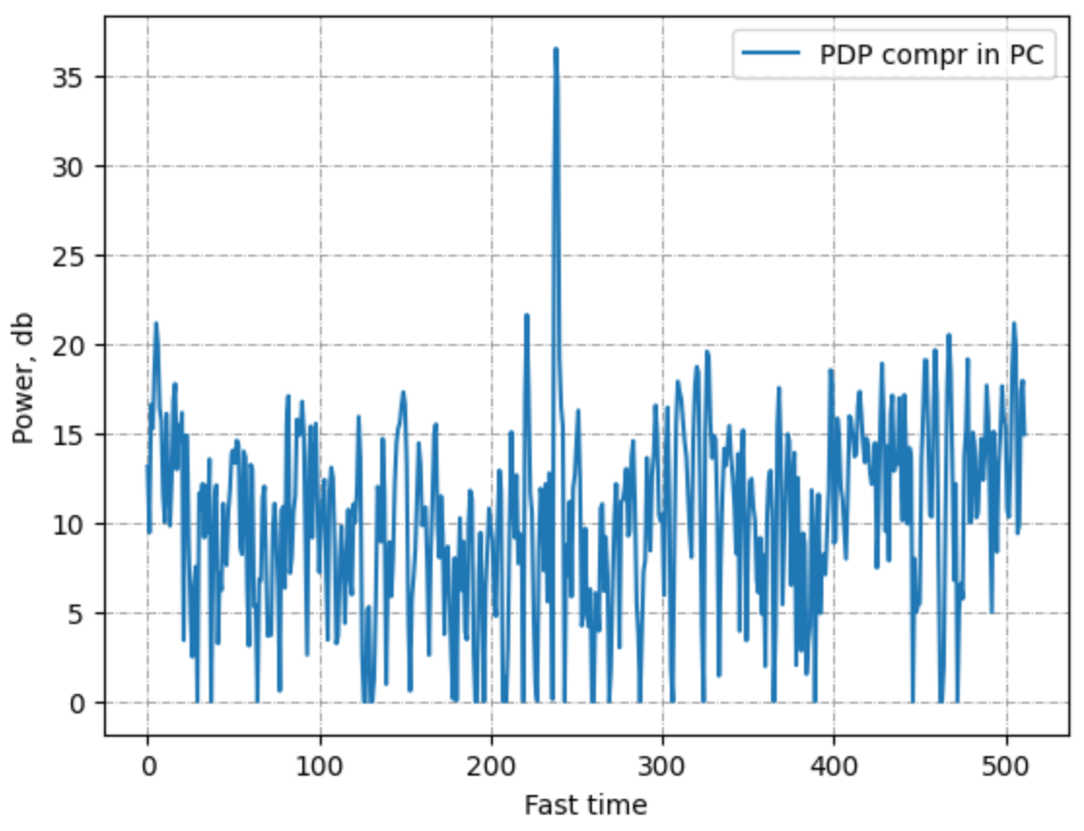
10
Conditions of experimental research
Link: Yoshkar-Ola-to-Yalchik
SSB Signal type: LFMCW
Sweep rate: 1 MHz/s
Sounding range: 2 – 12 MHz
Transmitter output power: 10 W
Sounding sessions dates: 21/09/2023 – 22/09/2023
Sounding session duraion: 60 s
Fig. 14. Example of ionogram within 1 MHz band at central frequency 5 MHz 21/09/2023 14:49:00 (LT)
Fig. 15. Random power delay profile from sounding range 4.5-5.5 MHz 21/09/2023 14:49:00 (LT)

Slide 11
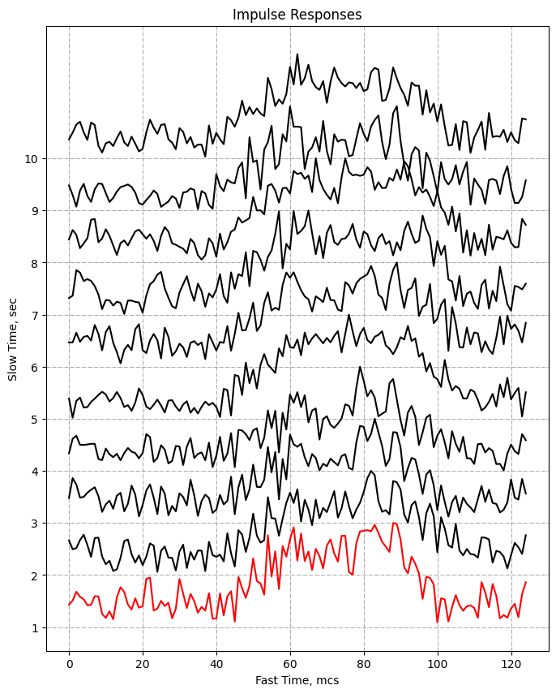
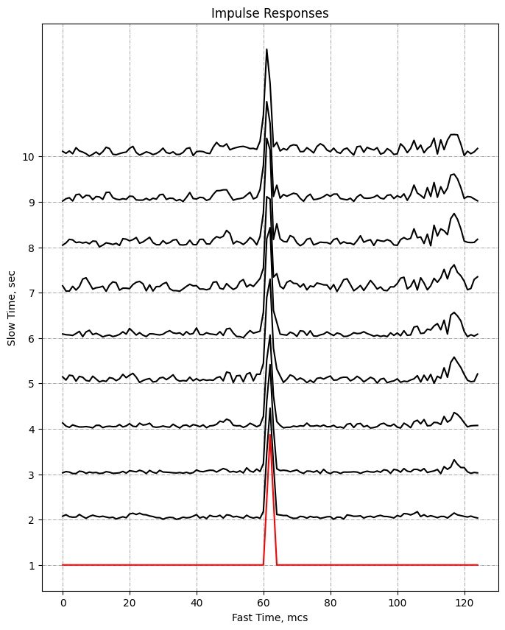
11
Research findings
In the experiments, IR of channels with a bandwidth of 1 MHz were obtained, before and after correction. Correction coefficients were calculated from the frequency response obtained at the 1st second of sounding and were employed for the following 59 seconds.
FIg. 16. IR before correction (left) and after correction (right) for the first 10 seconds.

Slide 12
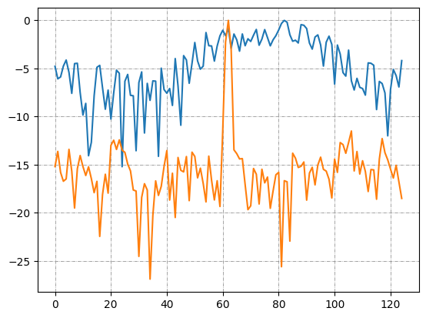
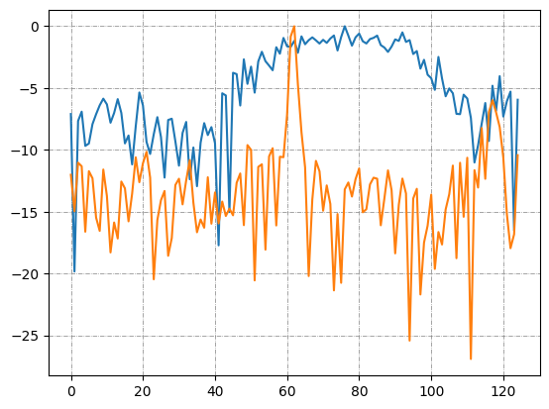
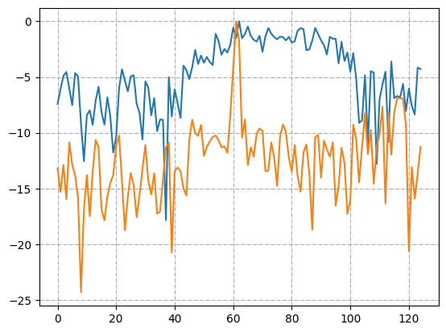
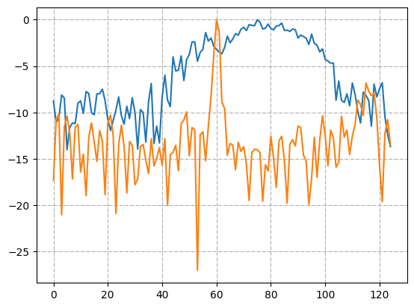
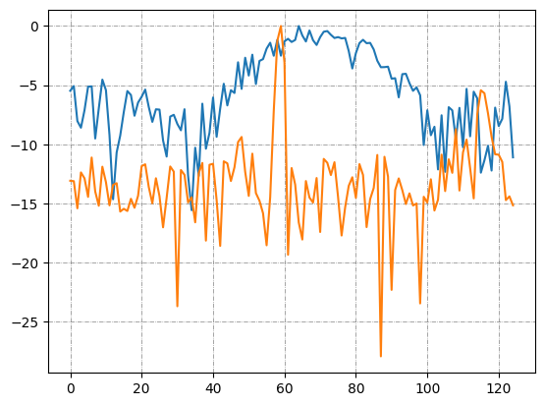
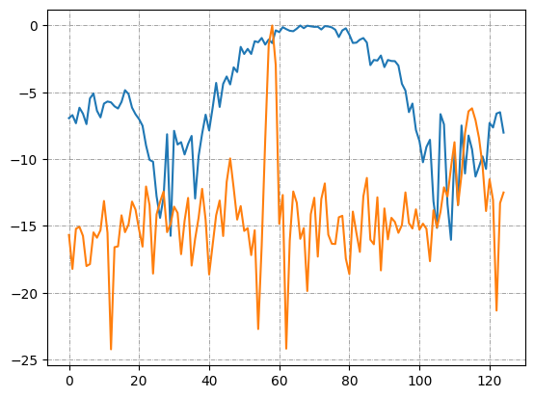
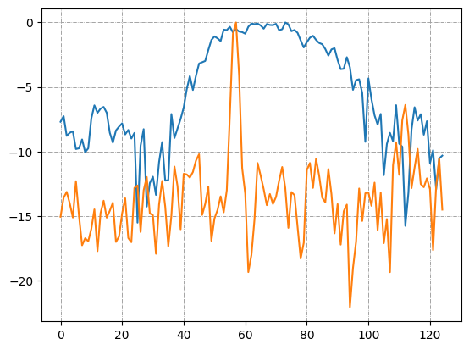
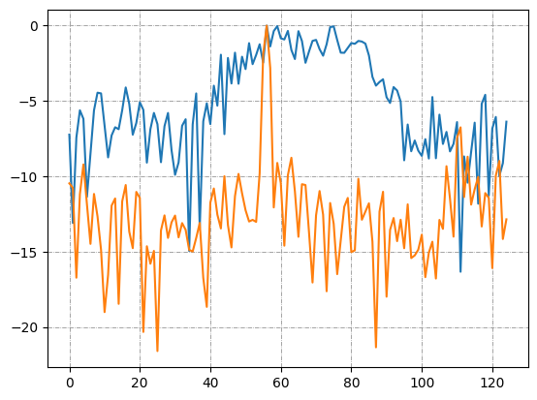
12
Gain in covertness and noise immunity
IR in a logarithmic scale [dB], normalized to its maximum, before correction (blue plot) and after correction (orange plot) for the ionospheric sounding session over the NVIS path Yoshkar-Ola-to-Yalchik in the 1 MHz bandwidth, at an average frequency of 5 MHz 21/09/2023 14:49:00.
2 second
5 second
10 second
20 second
Power, dB
30 second
40 second
50 second
60 second
Power, dB
DISP, mcs
DISP, mcs
DISP, mcs
DISP, mcs

Slide 13
Conclusions
Research proposed a method for increasing the covertness and noise immunity of NVIS HF communication systems. Experimental studies have revealed the feasibility of increasing the covertness of wideband communication systems by leveraging the natural effect of intramode dispersion. Implementation of this method necessitates the utilization of channel testing and frequency response equalization technologies.
Application of the proposed method in a wideband communication system results in an increased energy gain, leading to an additional energy covertness of up to 10 dB. Furthermore, significant phase jitter, which influences structural covertness, is mitigated through equalization.
Experimental findings demonstrated that the channel lifetime can be at least of 60 seconds.

