Slide 1
Observation of a white-light flare decay phase in microwave range
Motyk I.D., Kashapova L.K.

Slide 2
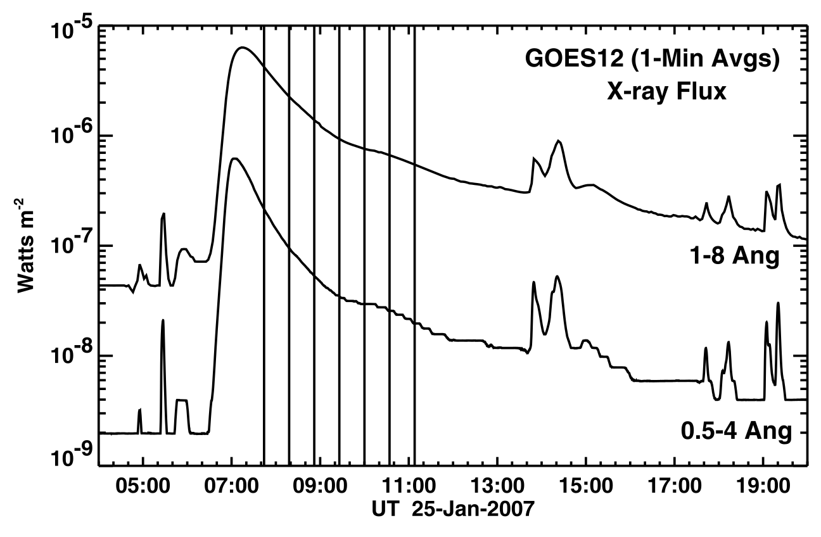
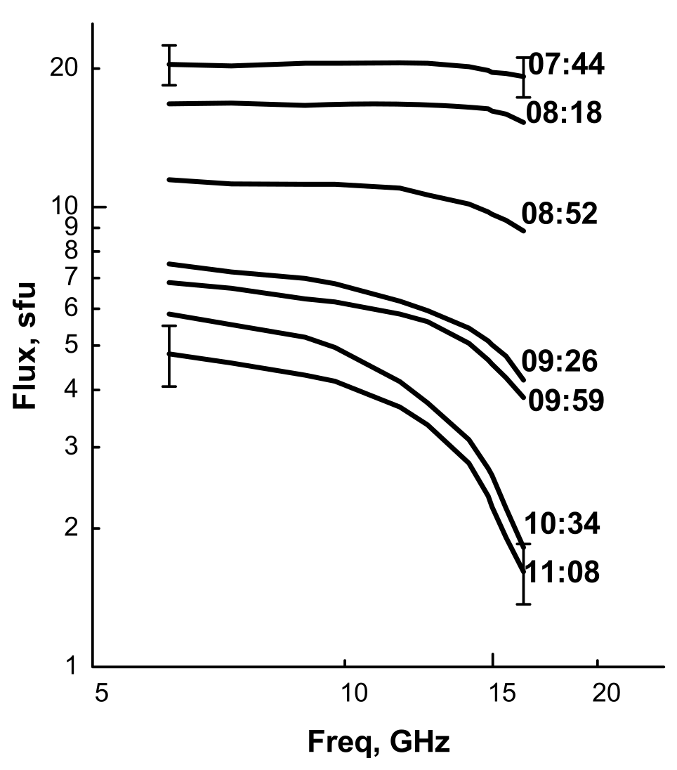
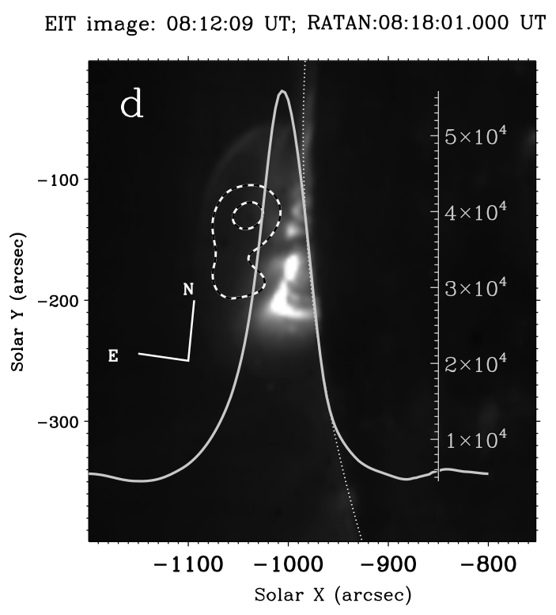
Background and motivation
Long cooling during decay phase, what mechanism?
One dimensional scans were obtained, but the sources were not clearly identified
Grigoryeva et al. 2009
<number> / 12
XVIII Young Scientists’ Conference

Slide 3
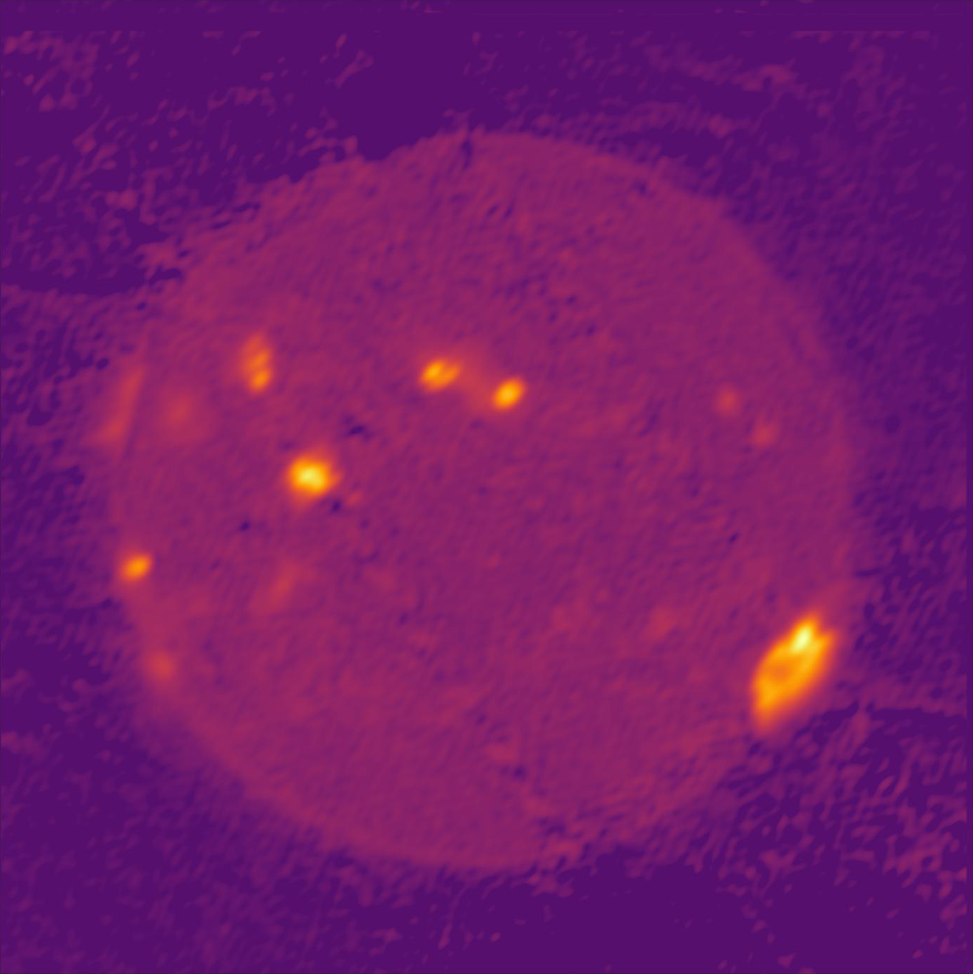
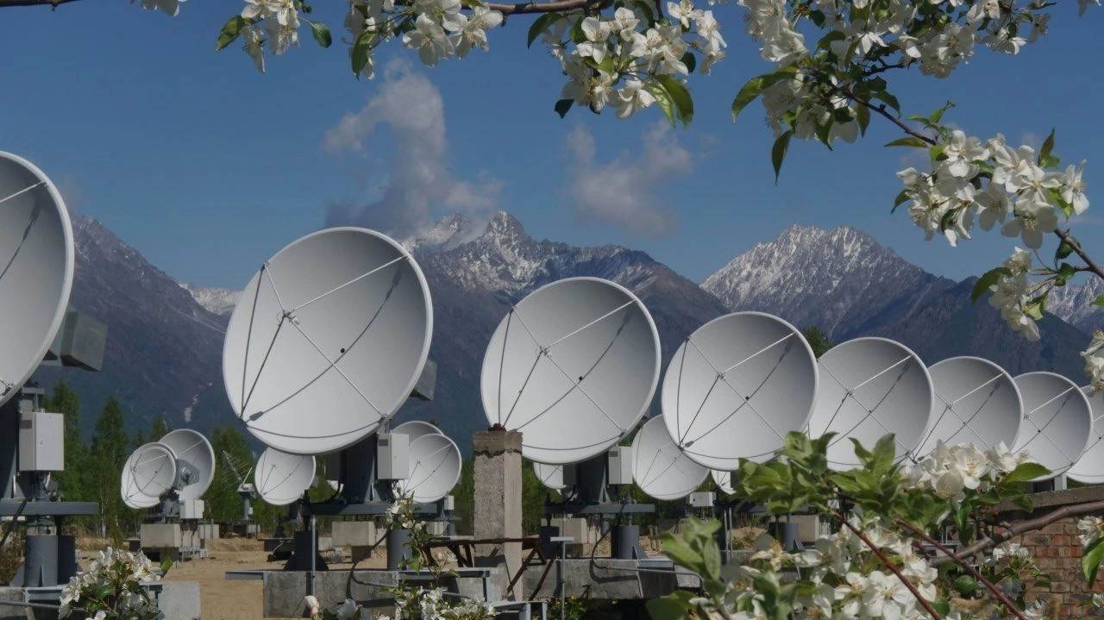
Siberian Radioheliograph (SRH)
Radioimage of the Sun at 7 GHz
Т-shaped radiointerferometer
3 antennas grids
~ 190 antennas each
Frequency range 3.0-23.6 GHz
Timestep ~ 3-4 s
The instrument provides spatial and spectral data not only for ”sun-as-a-star”, but for particular sources with high temporal resolution
<number> / 12
XVIII Young Scientists’ Conference

Slide 4
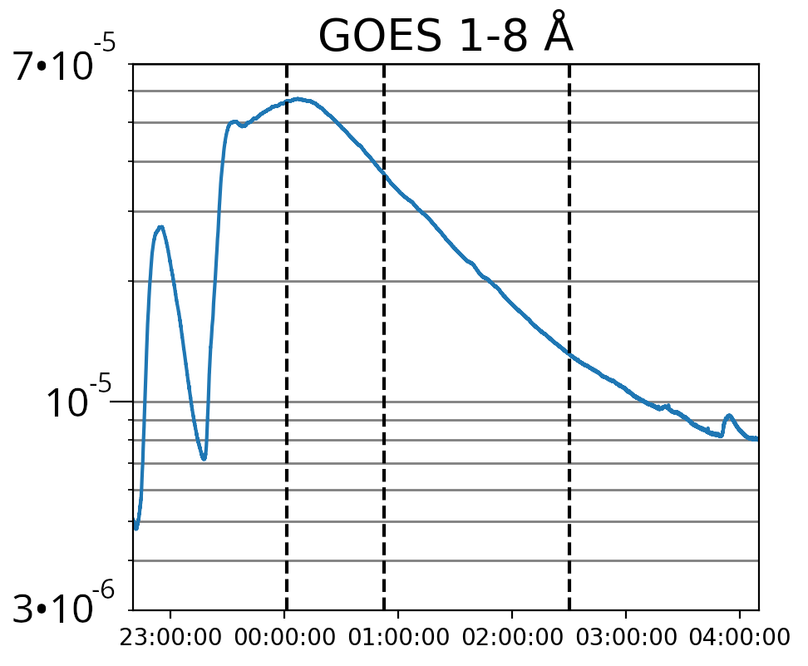
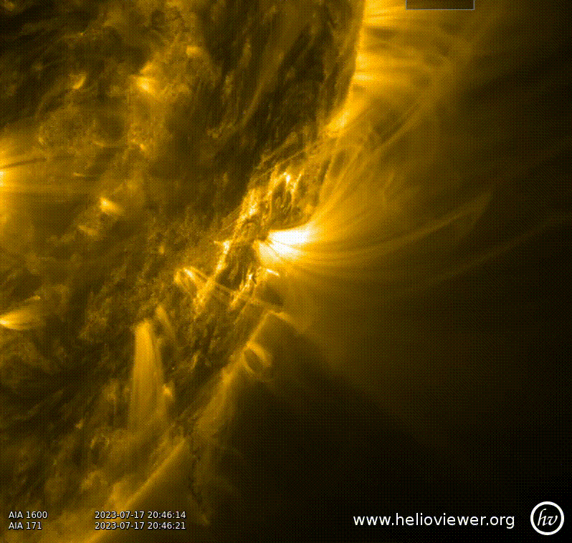
July 17, 2023 flare
Emission from photosphere (ASO-S)
Post-eruptive arcade at the limb of the Sun, near a sunspot
М2.7 Flare (GOES)
Long cooling about 4 hours
Beginning 22:55 UT
<number> / 12
XVIII Young Scientists’ Conference

Slide 5
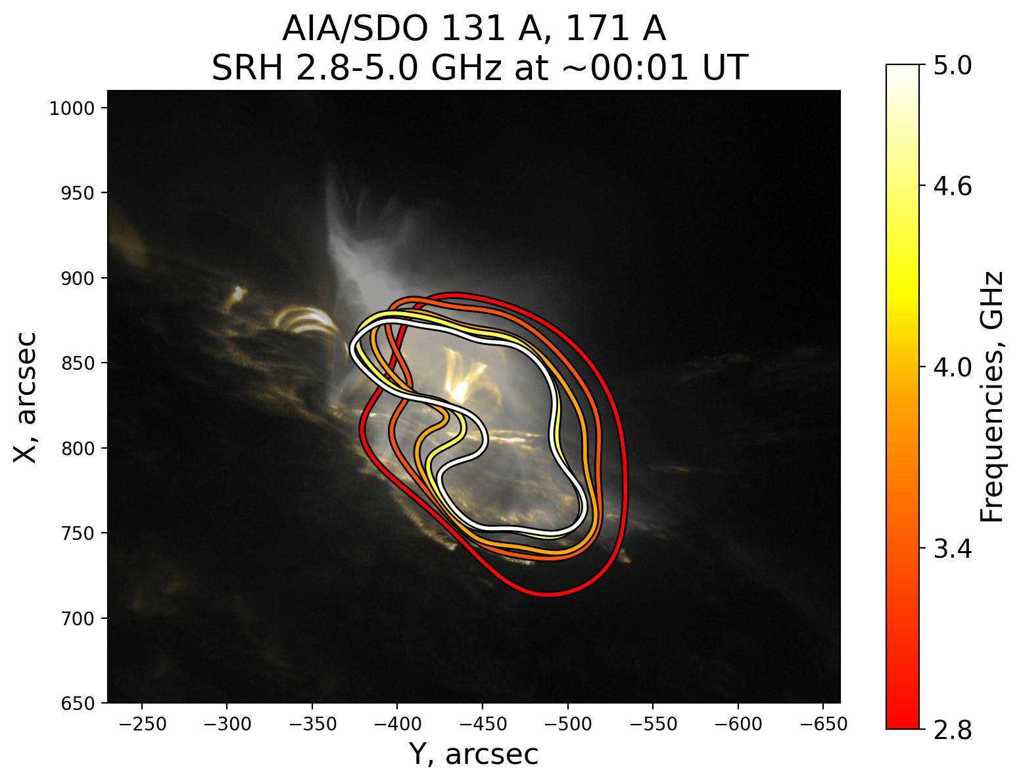
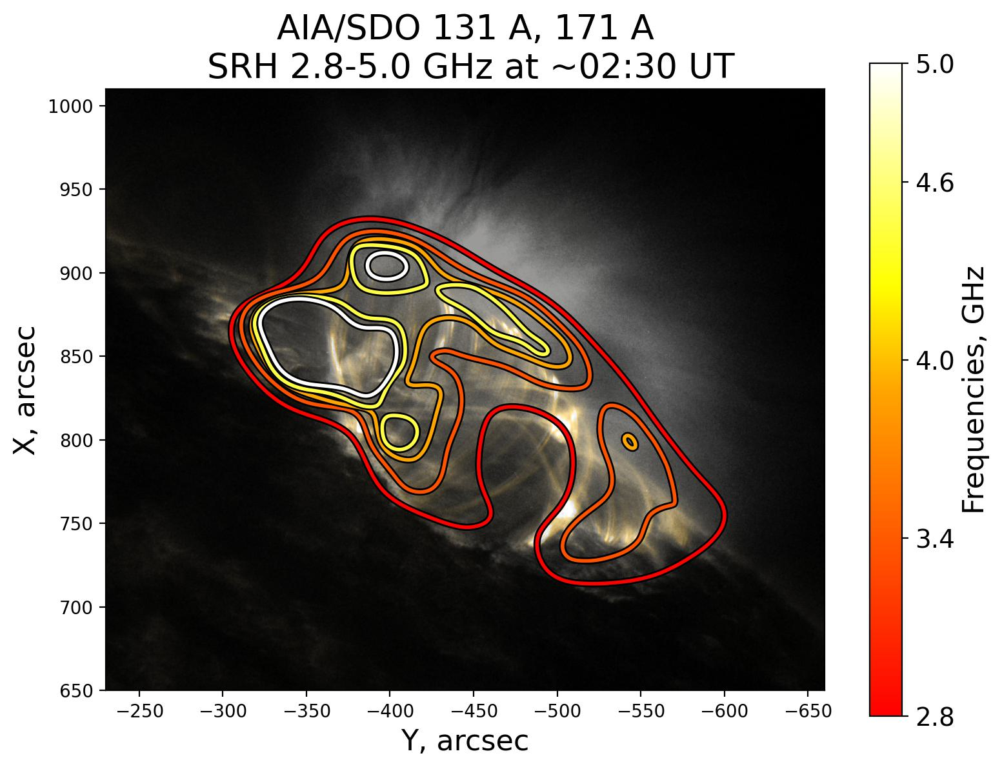
Spatial evolution of the post-eruptive arcade
<number> / 12
XVIII Young Scientists’ Conference

Slide 6
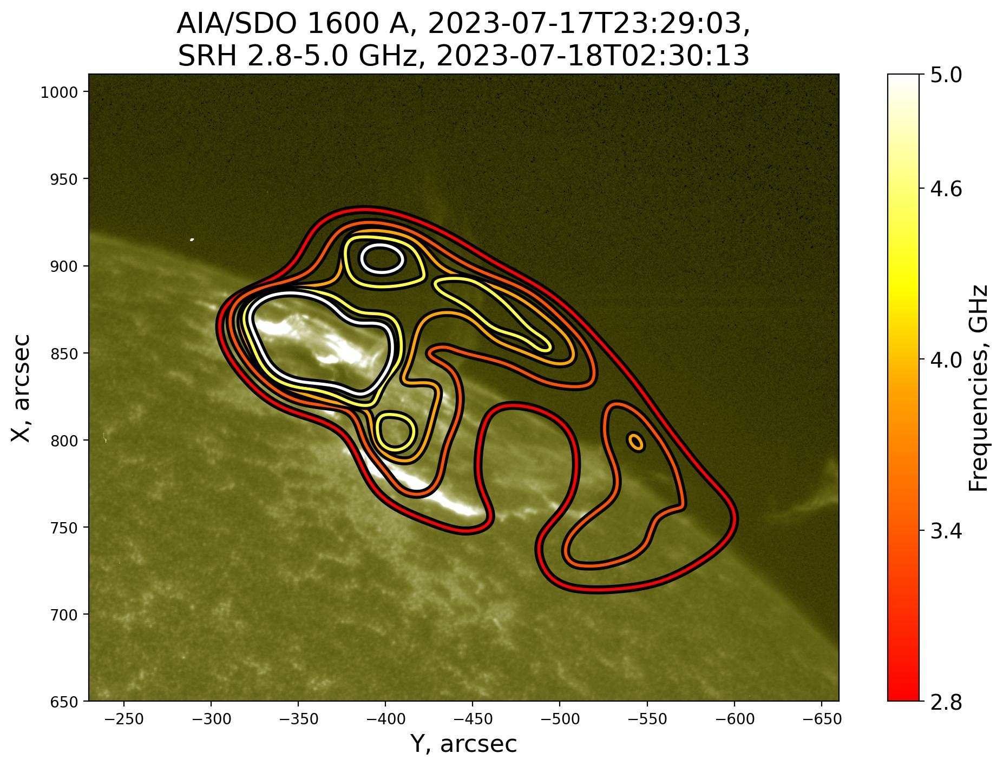
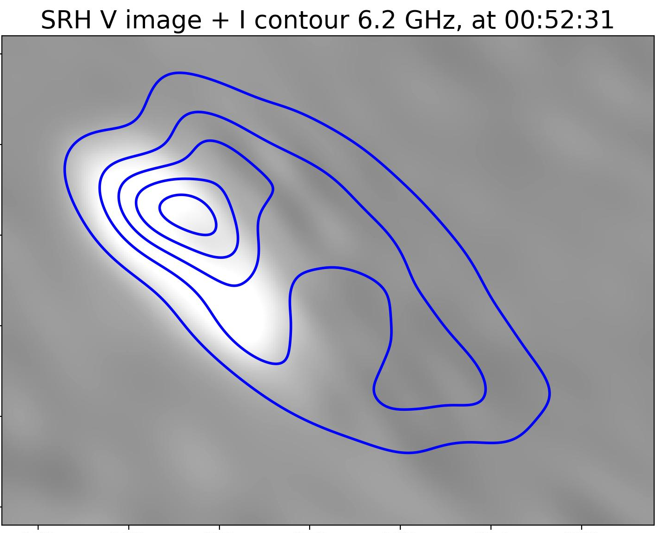
Polarisation of microwaves
Polarisation from sunspot source
<number> / 12
XVIII Young Scientists’ Conference

Slide 7
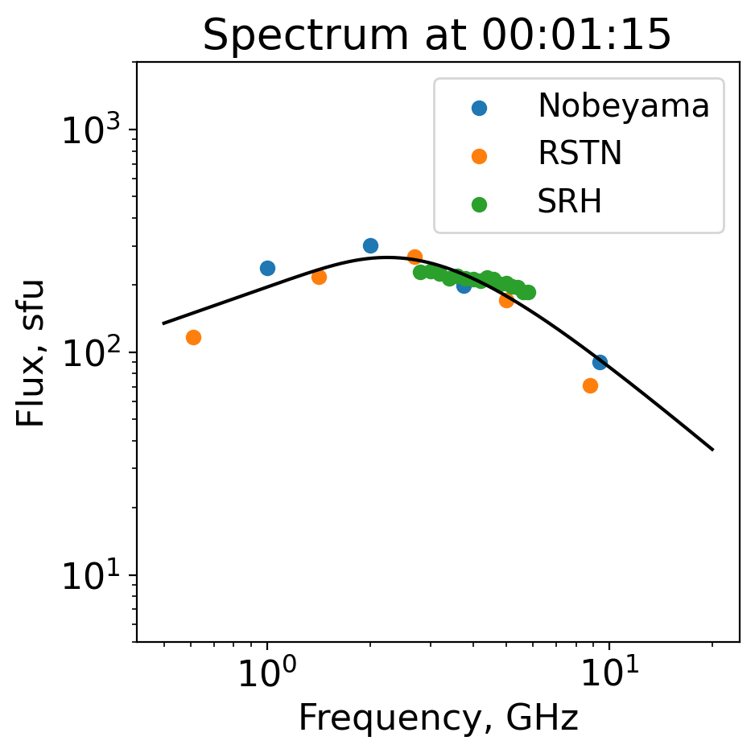
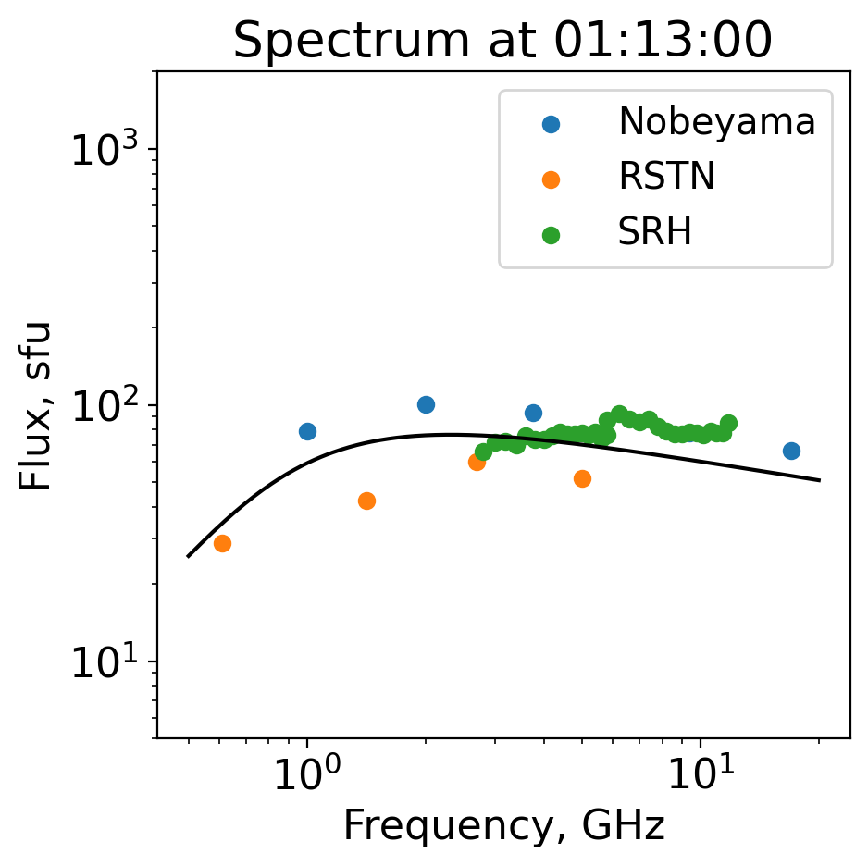
Evolution of average spectra
~ 3 Gauss
Thermal bremsstralung spectrum
~2 ГГц
<number> / 12
XVIII Young Scientists’ Conference

Slide 8
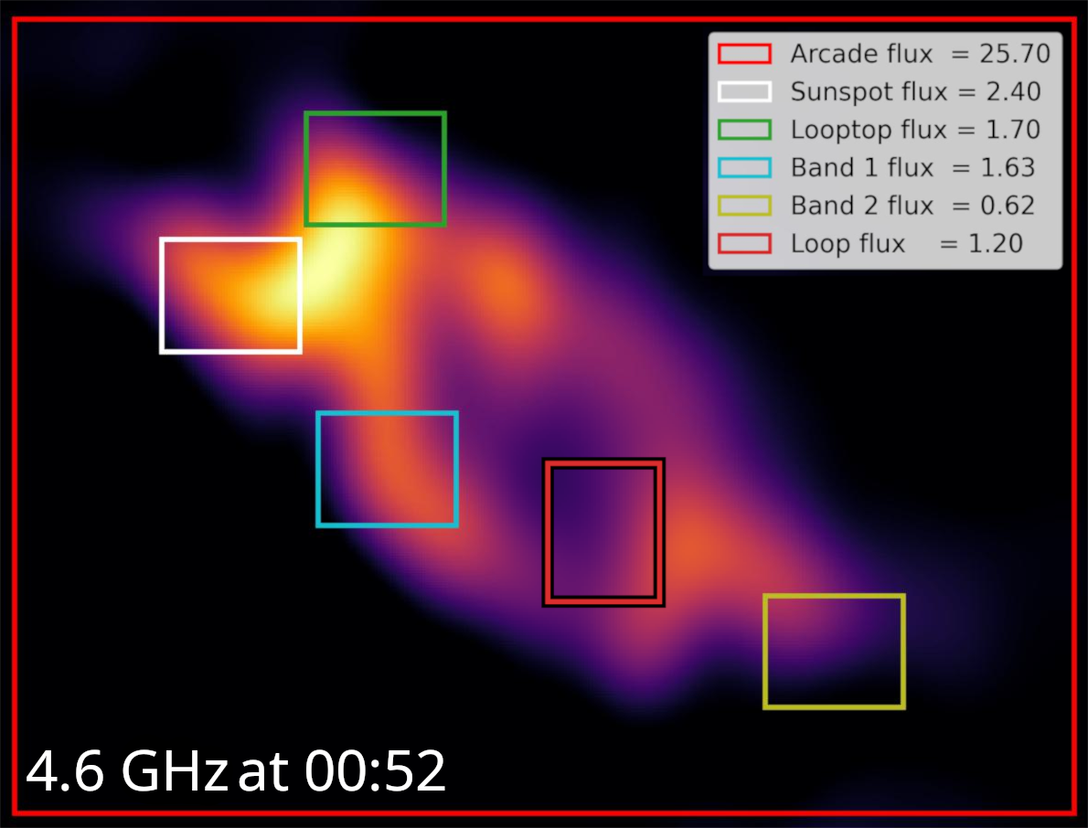
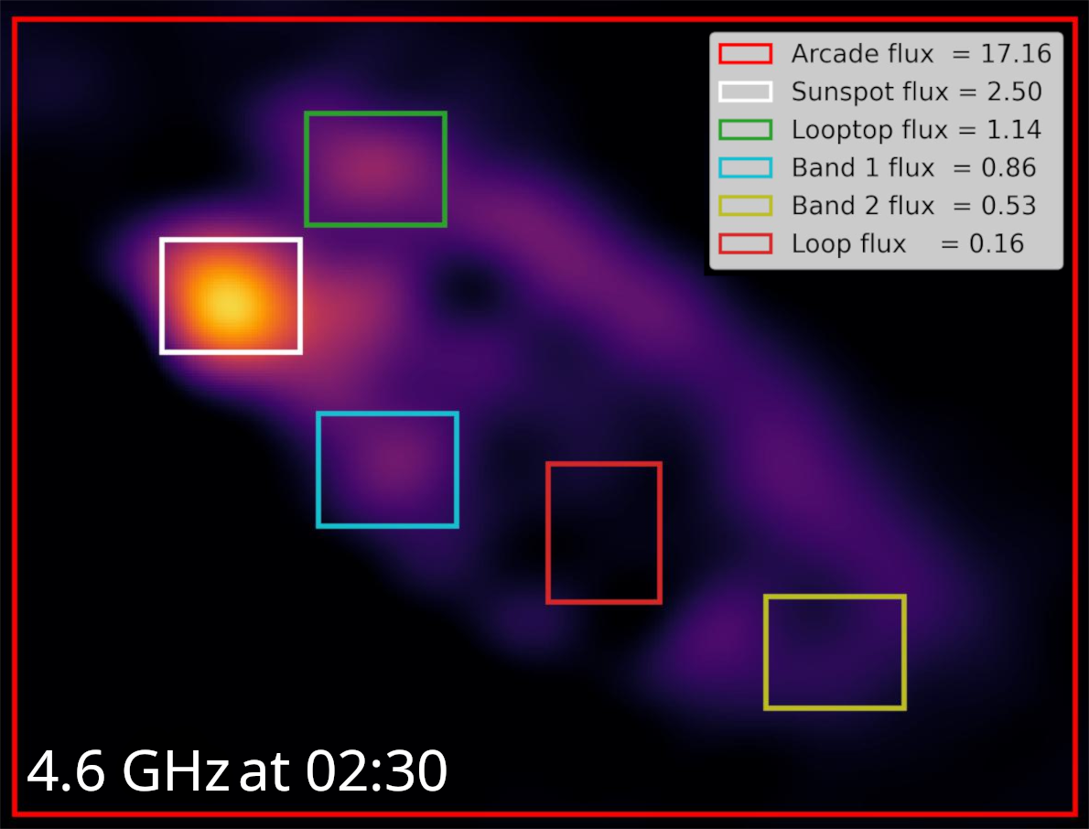
Spectral evolution of the arcade parts
*All values in sfu
<number> / 12
XVIII Young Scientists’ Conference

Slide 9
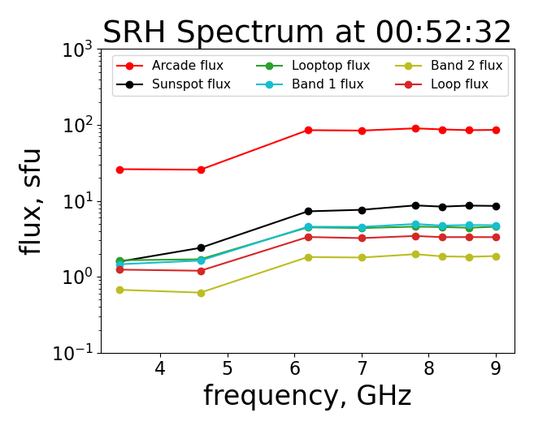
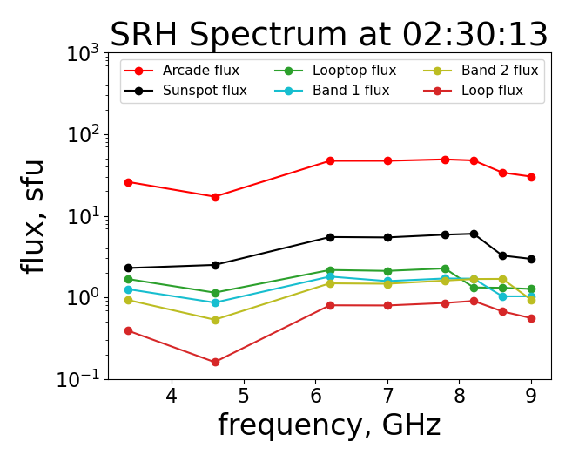
Spectral evolution of the arcade parts
<number> / 12
XVIII Young Scientists’ Conference

Slide 10
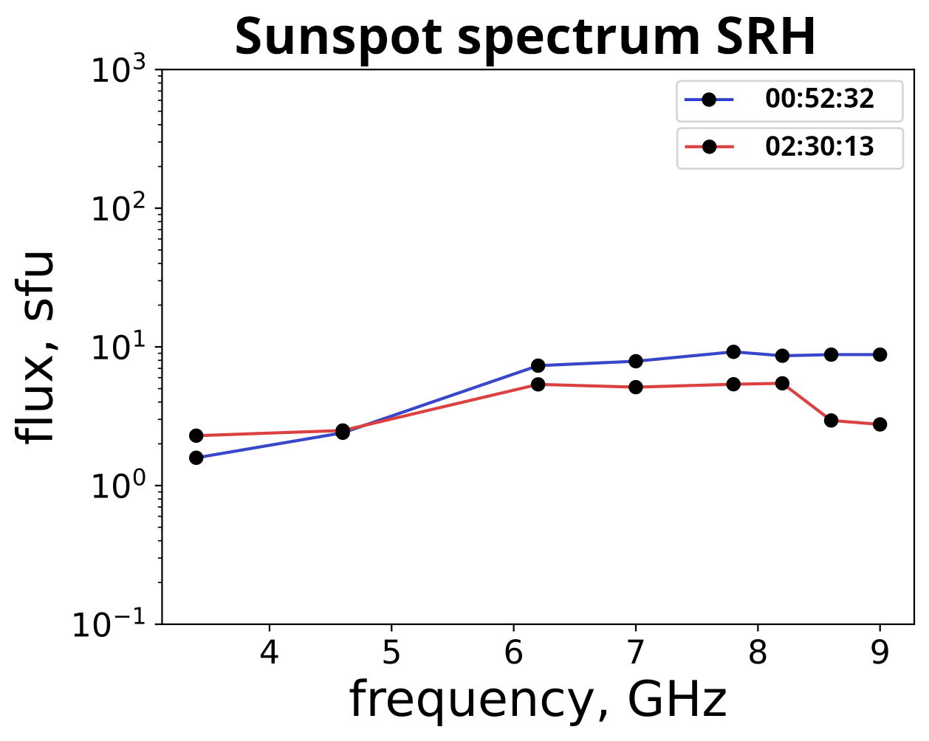
Sunspot or not only sunspot?
Grigoryeva et al. (2009)
Sunspot spectrum after 3 h.
Spectrum of the arcade, not the sunspot?
<number> / 12
XVIII Young Scientists’ Conference

Slide 11
Summary
During post-eruptive arcade developement we observed a transition from gyrosynchrotron spectrum to thermal bremsstralung
Only sunspot region had polarisation
Peak frequency at about 2 GHz corresponds to weak magnetic field ~ 3 G
Peak frequency indicates that during the whole observational period all the emission observed by SRH was from the optycally thin source
The evolution of the sunspot source spectrum indicates a significant contribution of thermal plasma to the radiation
<number> / 12
XVIII Young Scientists’ Conference

Slide 12
Thank you for attention!

