Slide 1


EXPERIMENTAL CONFIRMATION OF THE EXISTENCE OF AN EQUATORIAL RESONATOR FOR PС1 WAVES IN THE MAGNETOSPHERE
BAIKAL YOUNG SCIENTISTS’ INTERNATIONAL SCHOOL ON FUNDAMENTAL PHYSICS
“PHYSICAL PROCESSES IN OUTER AND NEAR-EARTH SPACE”
Irkutsk, September 1-7, 2024
O.S. Mikhailova, P.N. Mager
Institute of Solar-Terrestrial Physics SB RAS, Irkutsk, Russia

Slide 2
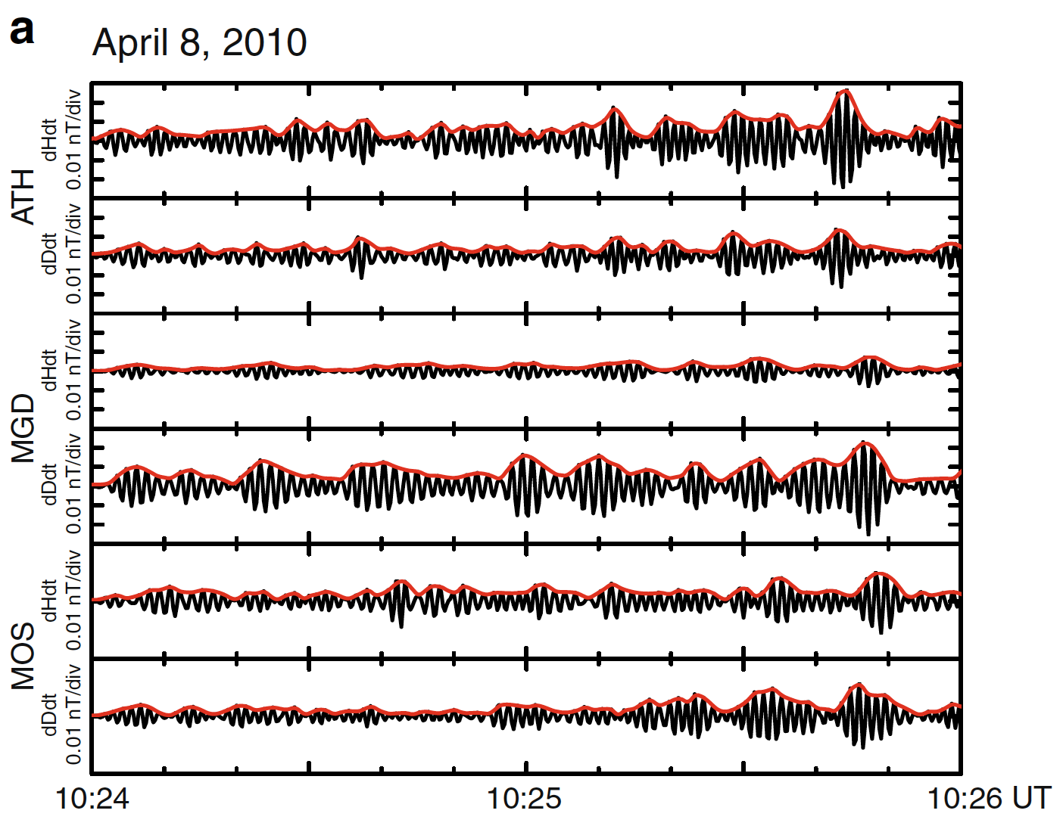
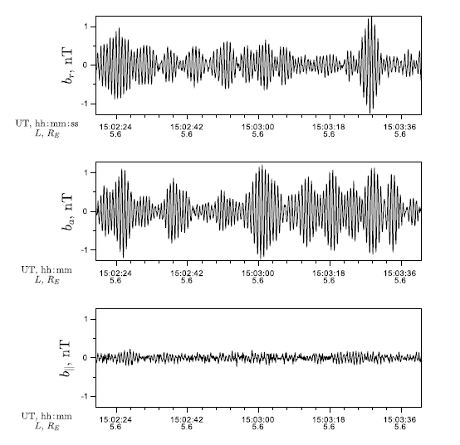
РС1 PULSATIONS
14 July, 2014, Van Allen Probe A
Jun et al., 2014

Slide 3
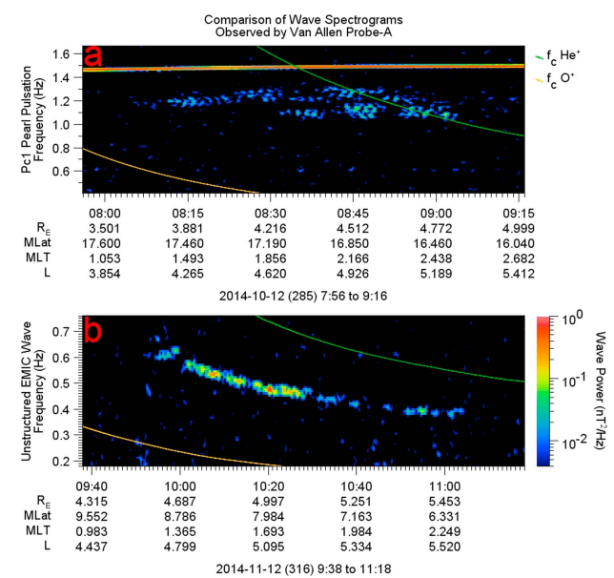
РС1 PULSATIONS
Linear polarized waves – ion-ion hybrid waves, occur in plasma with the admixture of heavy ions
Left circular polarized waves – electromagnetic ion-cyclotron waves (EMIC), occur due to ion-cyclotron instability
Paulson et al., 2017

Slide 4
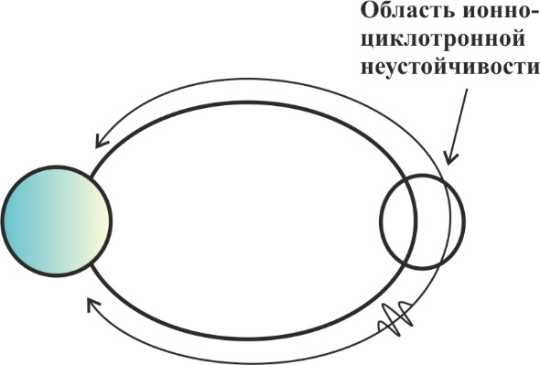
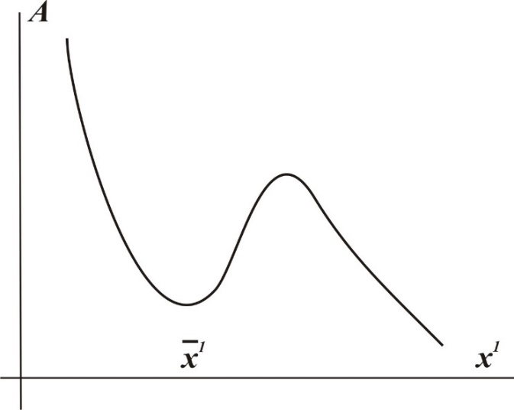
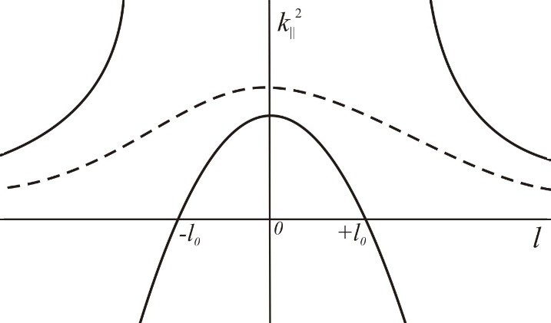
MODELS
    Bouncing wave packet [Jacobs and Watanabe, 1964; Obayashi, 1965].
  Transverse resonator at the plasmapause [Dmitrienko and Mazur, 1992]
  Modulations by Pc4-5 [Mursula, 2007]
  Longitudinal resonator for ion-cyclotron waves in plasma with heavy ions [Guglielmi et al., 2000]
  Longitudinal resonator for ion-ion hybrid waves in plasma with heavy ions [Klimushkin et al., 2010]
Ion-cyclotron
instability

Slide 5
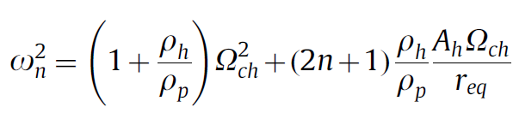
NEAR-EQUATORIAL RESONATOR FOR ION-ION HYBRID MODES
Turning points

Slide 6
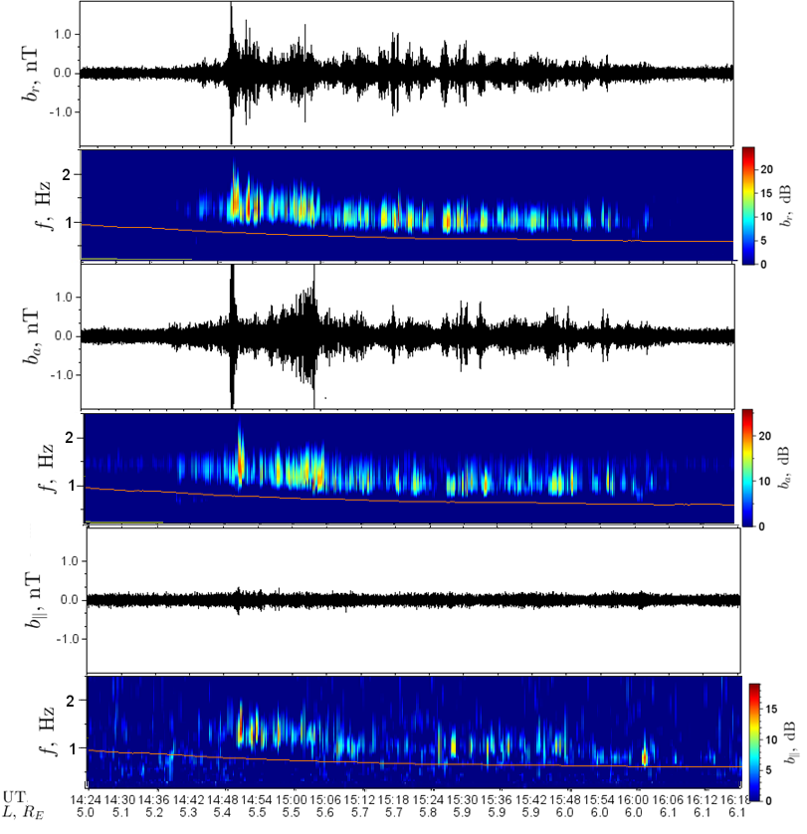
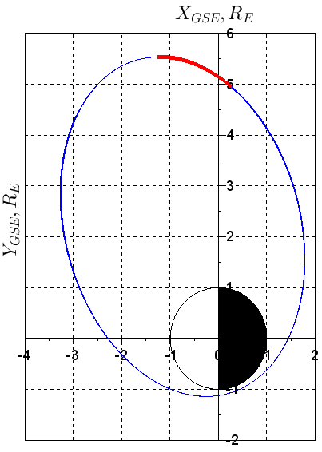
РС1 EVENT
14 July, 2014
Van Allen Probe A

Slide 7
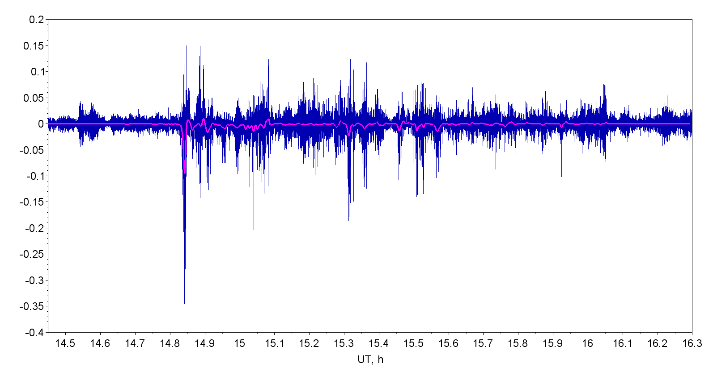
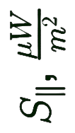
POYNTING VECTOR

Slide 8
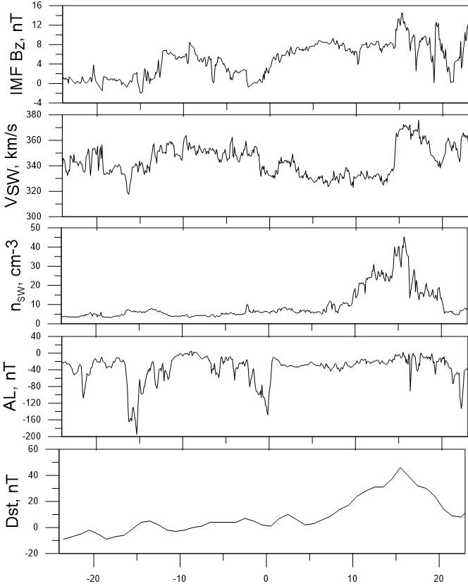
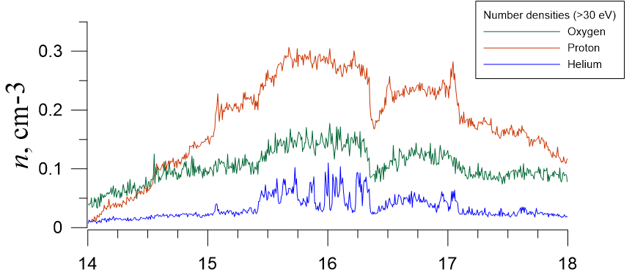
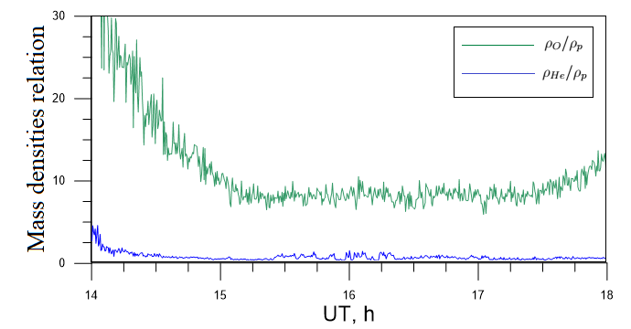
РС1 EVENT

Slide 9
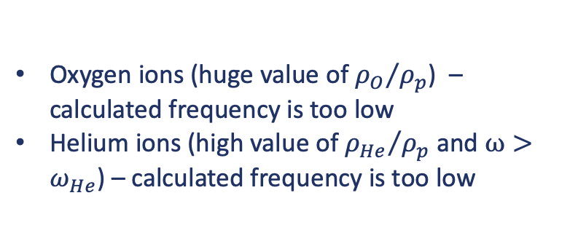
РС1 EVENT
Oxygen ions (huge value of ${ρ_{O}}/{ρ_{p}}$) – calculated frequency is too low
Helium ions (high value of ${ρ_{He}}/{ρ_{p}}$ and $ω>ω_{He}$) – calculated frequency is too low

Slide 10
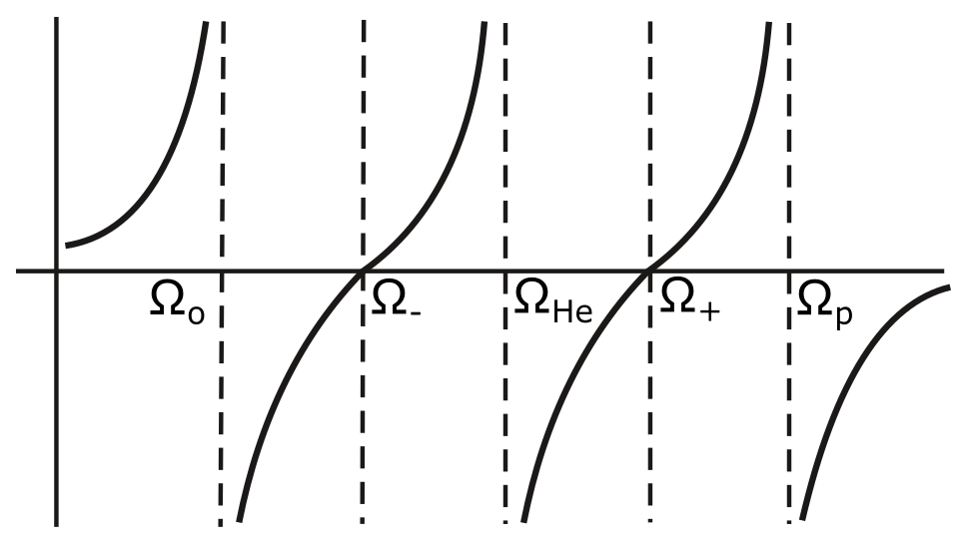




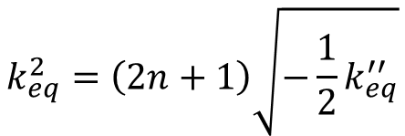
EQUATORIAL LOCALIZATION
$k_{∥}^{2}=\frac{ω^{2}}{A_{p}^{2}\left(1−\frac{ω^{2}}{Ω_{p}^{2}}\right)}$ + $\frac{ω^{2}}{A_{O}^{2}\left(1−\frac{ω^{2}}{Ω_{O}^{2}}\right)}+\frac{ω^{2}}{A_{He}^{2}\left(1−\frac{ω^{2}}{Ω_{He}^{2}}\right)}=\frac{ω^{2}}{A_{p}^{2}}\left[{\left(1−\frac{ω^{2}}{Ω_{p}^{2}}\right)}^{−1}+\frac{ρ_{He}}{ρ_{p}}{\left(1−\frac{ω^{2}}{Ω_{He}^{2}}\right)}^{−1}+\frac{ρ_{O}}{ρ_{p}}{\left(1−\frac{ω^{2}}{Ω_{O}^{2}}\right)}^{−1}\right]$
$$k_{∥}^{2}$$
$$k_{∥}^{2}=k_{eq}^{2}+\frac{1}{2}k_{eq}^{′′}l^{2}$$
$$ω$$
$$k_{eq}^{2}=\left(2n+1\right)\sqrt{−\frac{1}{2}k_{eq}^{′′}}$$
$$k_{∥}^{2}\left(Ω_{±}\right)=0$$

Slide 11
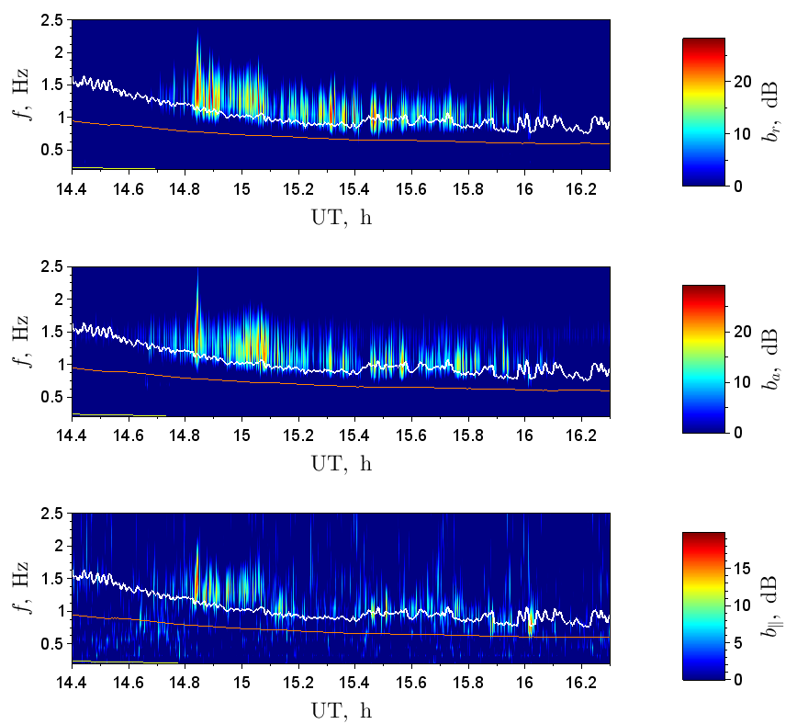
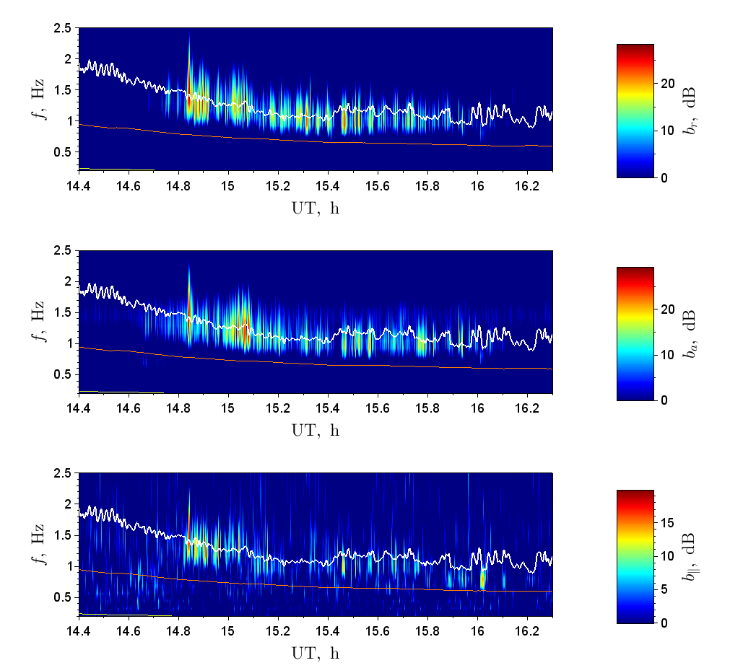
CALCULATED FREQUENCIES
N = 0
N = 10

Slide 12
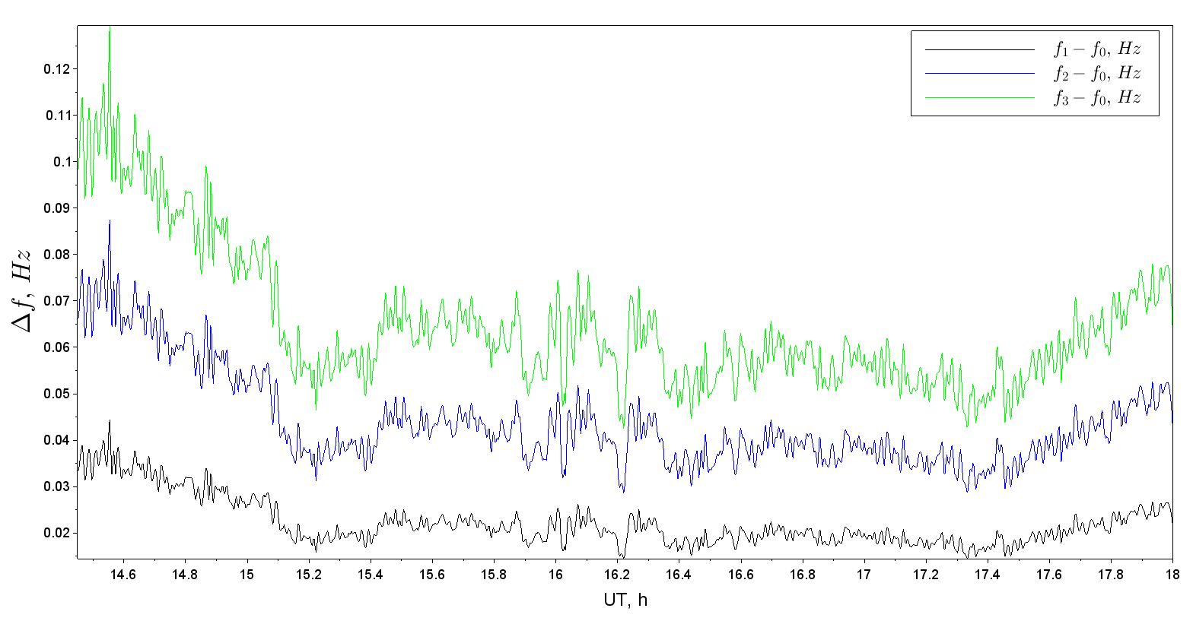
BEATS

Slide 13
RESULTS
Pc1 pearl event at the frequency just above the helium gyrofrequency was registered by Van Allen Probe A. During the event we observed high densities of oxygen and helium ions.
It was shown that theoretical approach have to include the admixture both oxygen and helium ions.
We consider this event as evidence of the existence of a near-equatorial resonator for ion-ion hybrid modes in the magnetosphere.
The Pc1 wave’s frequency corresponds to the calculated frequencies of ion-ion hybrid modes in the near-equatorial resonator.
The frequency difference between two close resonator’s harmonics is close to the observed Pc1 beat modulations.

Slide 14
THANK YOU!
INSTITUTE OF SOLAR-TERRESTRIAL PHYSICS SB RAS

Slide 15
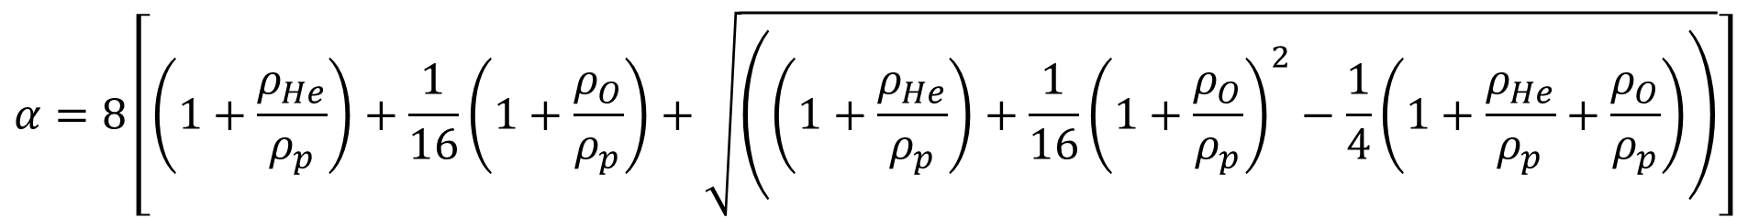

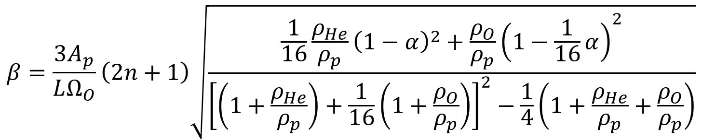
RESONATOR’S FREQUENCIES
$$ω_{n}^{2}=Ω_{O}^{2}\left\{α+β\right\}$$
$$α=8\left[\left(1+\frac{ρ_{He}}{ρ_{p}}\right)+\frac{1}{16}\left(1+\frac{ρ_{O}}{ρ_{p}}\right)+\sqrt{\left({\left(1+\frac{ρ_{He}}{ρ_{p}}\right)+\frac{1}{16}\left(1+\frac{ρ_{O}}{ρ_{p}}\right)}^{2}−\frac{1}{4}\left(1+\frac{ρ_{He}}{ρ_{p}}+\frac{ρ_{O}}{ρ_{p}}\right)\right)}\right]$$
$$β=\frac{3A_{p}}{LΩ_{O}}\left(2n+1\right)\sqrt{\frac{\frac{1}{16}\frac{ρ_{He}}{ρ_{p}}{\left(1−α\right)}^{2}+\frac{ρ_{O}}{ρ_{p}}{\left(1−\frac{1}{16}α\right)}^{2}}{{\left[\left(1+\frac{ρ_{He}}{ρ_{p}}\right)+\frac{1}{16}\left(1+\frac{ρ_{O}}{ρ_{p}}\right)\right]}^{2}−\frac{1}{4}\left(1+\frac{ρ_{He}}{ρ_{p}}+\frac{ρ_{O}}{ρ_{p}}\right)}}$$

