Slide 1
BAIKAL YOUNG SCIENTISTS’ INTERNATIONAL SCHOOL ON FUNDAMENTAL PHYSICS - 2024
02.09.2024
XVIII Young Scientists’ Conference “Interaction of fields and radiation with matter”
Proton spectrum evolution in solar flare: thin and thick target regimes
Speaker: 2nd-year master’s degree student,
Kuzmitskiy Alexey Vladimirovich¹
a.kuzmitskiy@iszf.irk.ru
Scientific advisor: Cand. Sci. (Phys.-Math.),
Kochanov А. A.¹
¹Institute of Solar-Terrestrial Physics SB RAS, Irkutsk, Russia

Slide 2
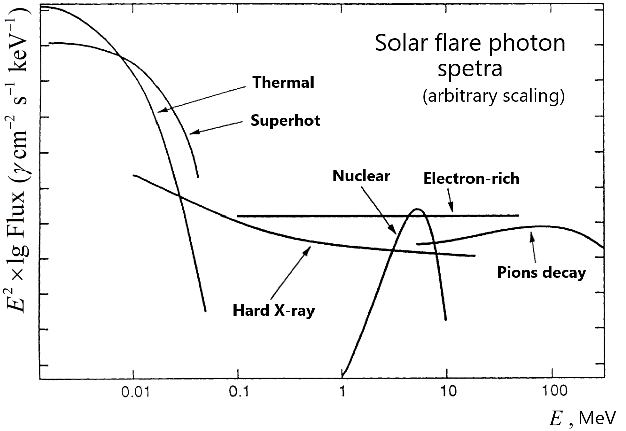
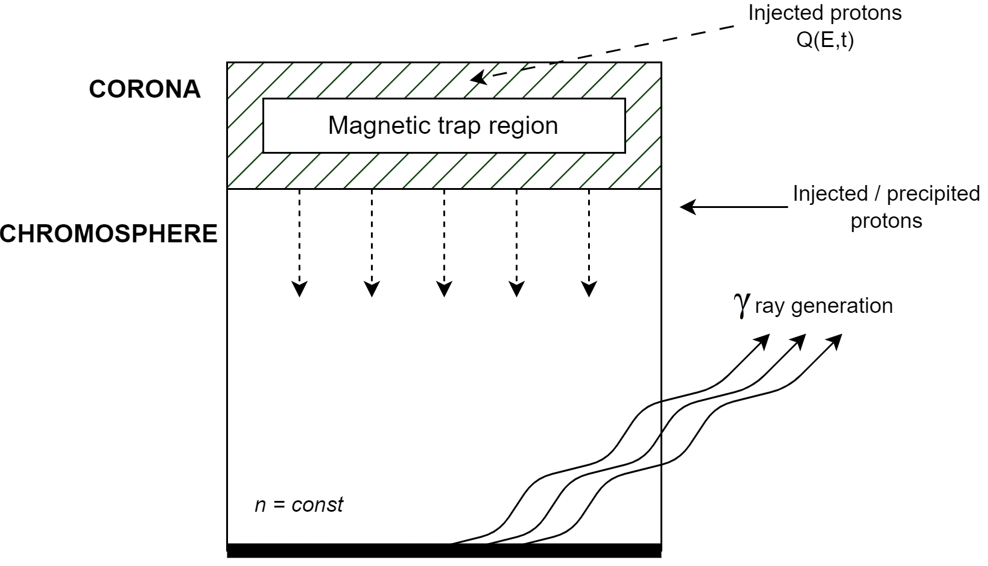
Hudson H. & Ryan J. ARA&A 33 (1), 1995
Current task:
to investigate the proton spectrum evolution in solar events
The gamma-ray spectrum depends on the spectrum of accelerated protons and the characteristics of the medium in which they found themselves
Possible scenario: protons were captured in a magnetic trap, the evolution of their spectrum may occur for a long time directly in trap with a gradual precipitation of particles into the chromosphere.
The only information source about accelerated to energies > 300 MeV protons is the broad gamma-ray emission line from pion decay in the solar atmosphere.
Determination of the resultant γ-ray spectrum produced through p-p interactions with a power-law distribution of protons:
Kafexhiu E. Phys. Rev. D 90 (12), 2014
Hulot E. [et al.] A&A 213 (1-2), 1989

Slide 3
Ginzburg-Syrovatskii transport equation
(full equation see in backup)
The transport of particles in the solar atmosphere can be described using the kinetic equation :
(in case of homogeneous process in space)
Ginzburg V. L., Syrovatskii S. I. Origin of cosmic rays, 1963
– proton distribution function, – continuous loss rate.
‘1’ – continuous, systematic change in the energy of particles as a result of the action of processes leading to energy losses in a collision,
‘2’ – the ejection of particles from the phase volume due to "catastrophic" energy losses and/or due to their leaving the considered system,
‘3’ – the intensity of cosmic ray sources or the particle injection rate.

Slide 4
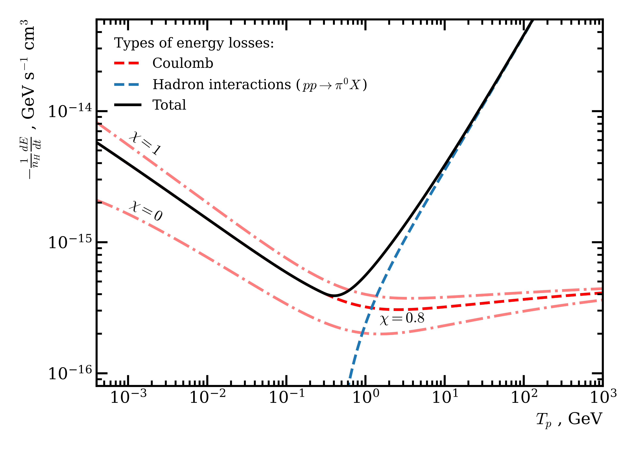
Proton energy losses
(χ for Quiet Sun see in backup)
Coulomb losses:
Bethe-Bloch formula adjusted for the ionization degree of plasma χ
(for more see backup)
Belyaev G. [et al.] Phys. Rev. E. 53, 1996
Workman R. [et al.] PTEP 2022, 2022
Light π-meson production:
Proton energy losses due to nuclear interactions (inelastic collisions with the nuclei of medium atoms)
the average lifetime of a proton before a nuclear reaction
range of interest
Mannheim K. & Schlickeiser R. A&A 286, 1994
All radiative losses (~1/m²) negligibly small in comparison with the above two kinds of losses (unlike electrons, which manifest themselves in the entire range of electromagnetic radiation)

Slide 5
Equation solution
The solution of equation is obtained using the Green's function method:
Green's function
time needed for particle with energy E0 to cool down to energy E
Cheng C. Space Sci. Rev. 13 (1), 1972
Two limiting cases of the solution
Thin target regime
Thick target regime
(particles exit interaction volume far more faster than they will stop due to energy losses)
(particles lose energy until stop in interaction volume)
exponent can be ignored…
over a time interval of order
and interval from E0 to E ,
let's consider this particular solution further

Slide 6
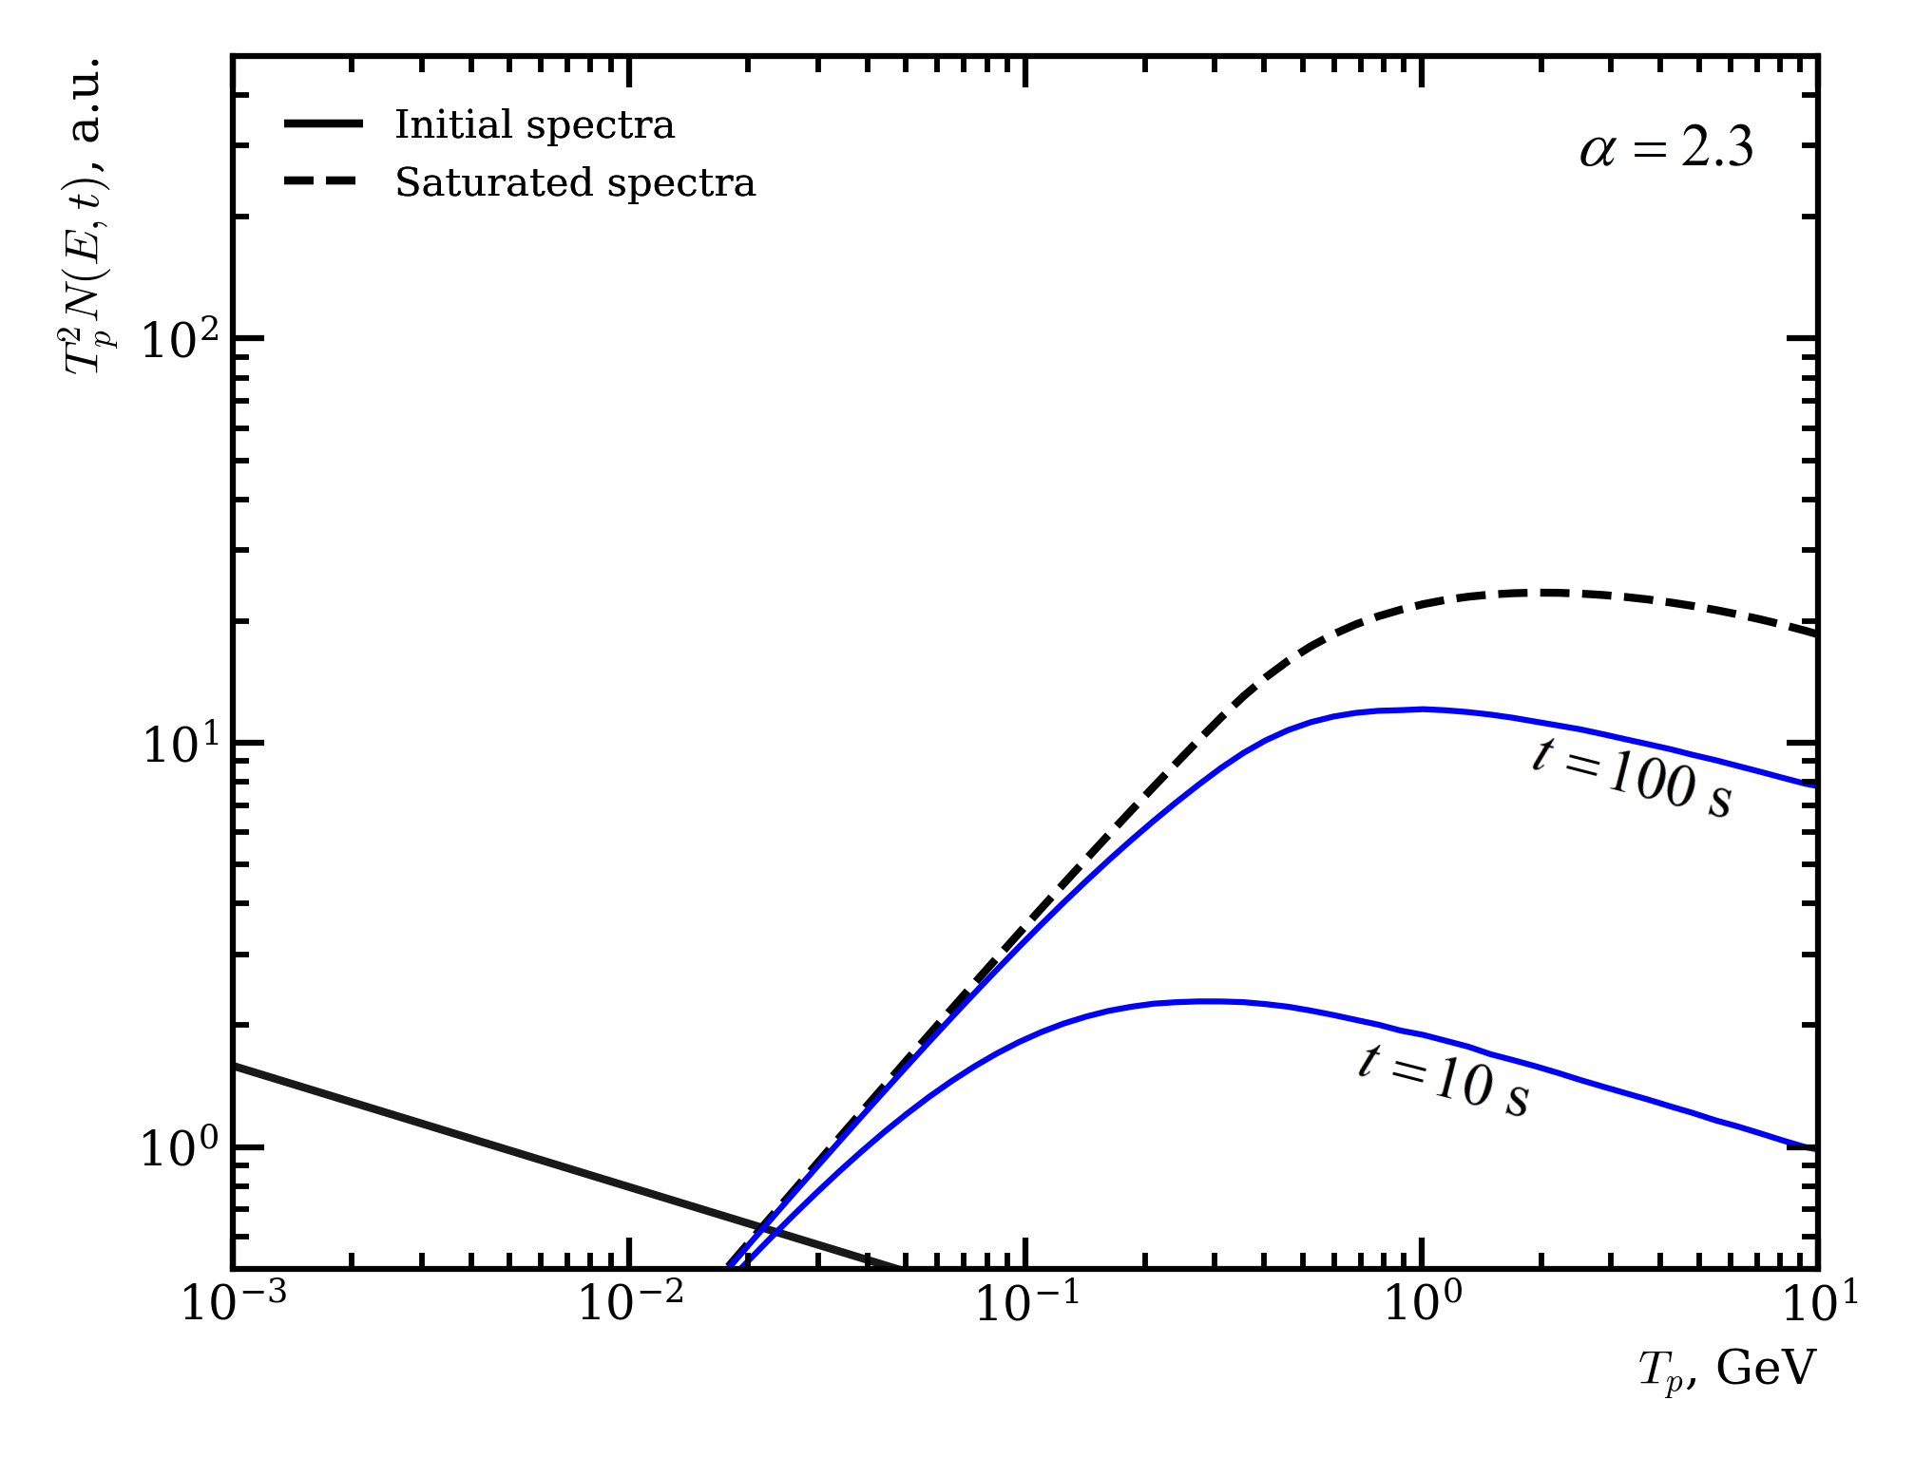
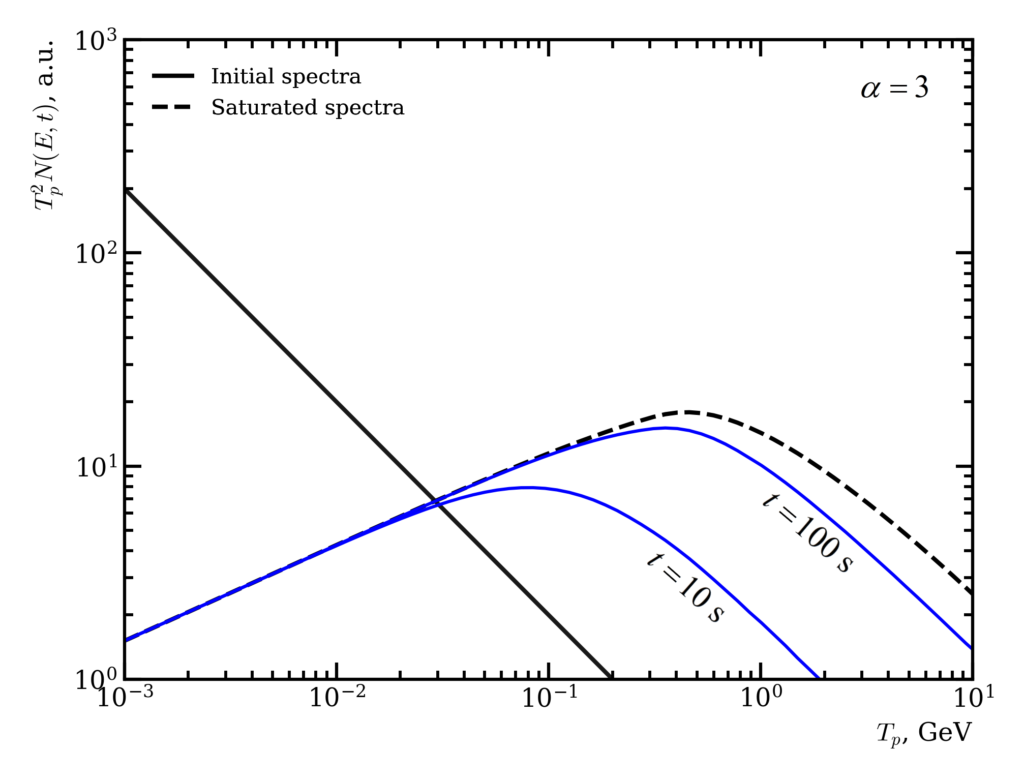
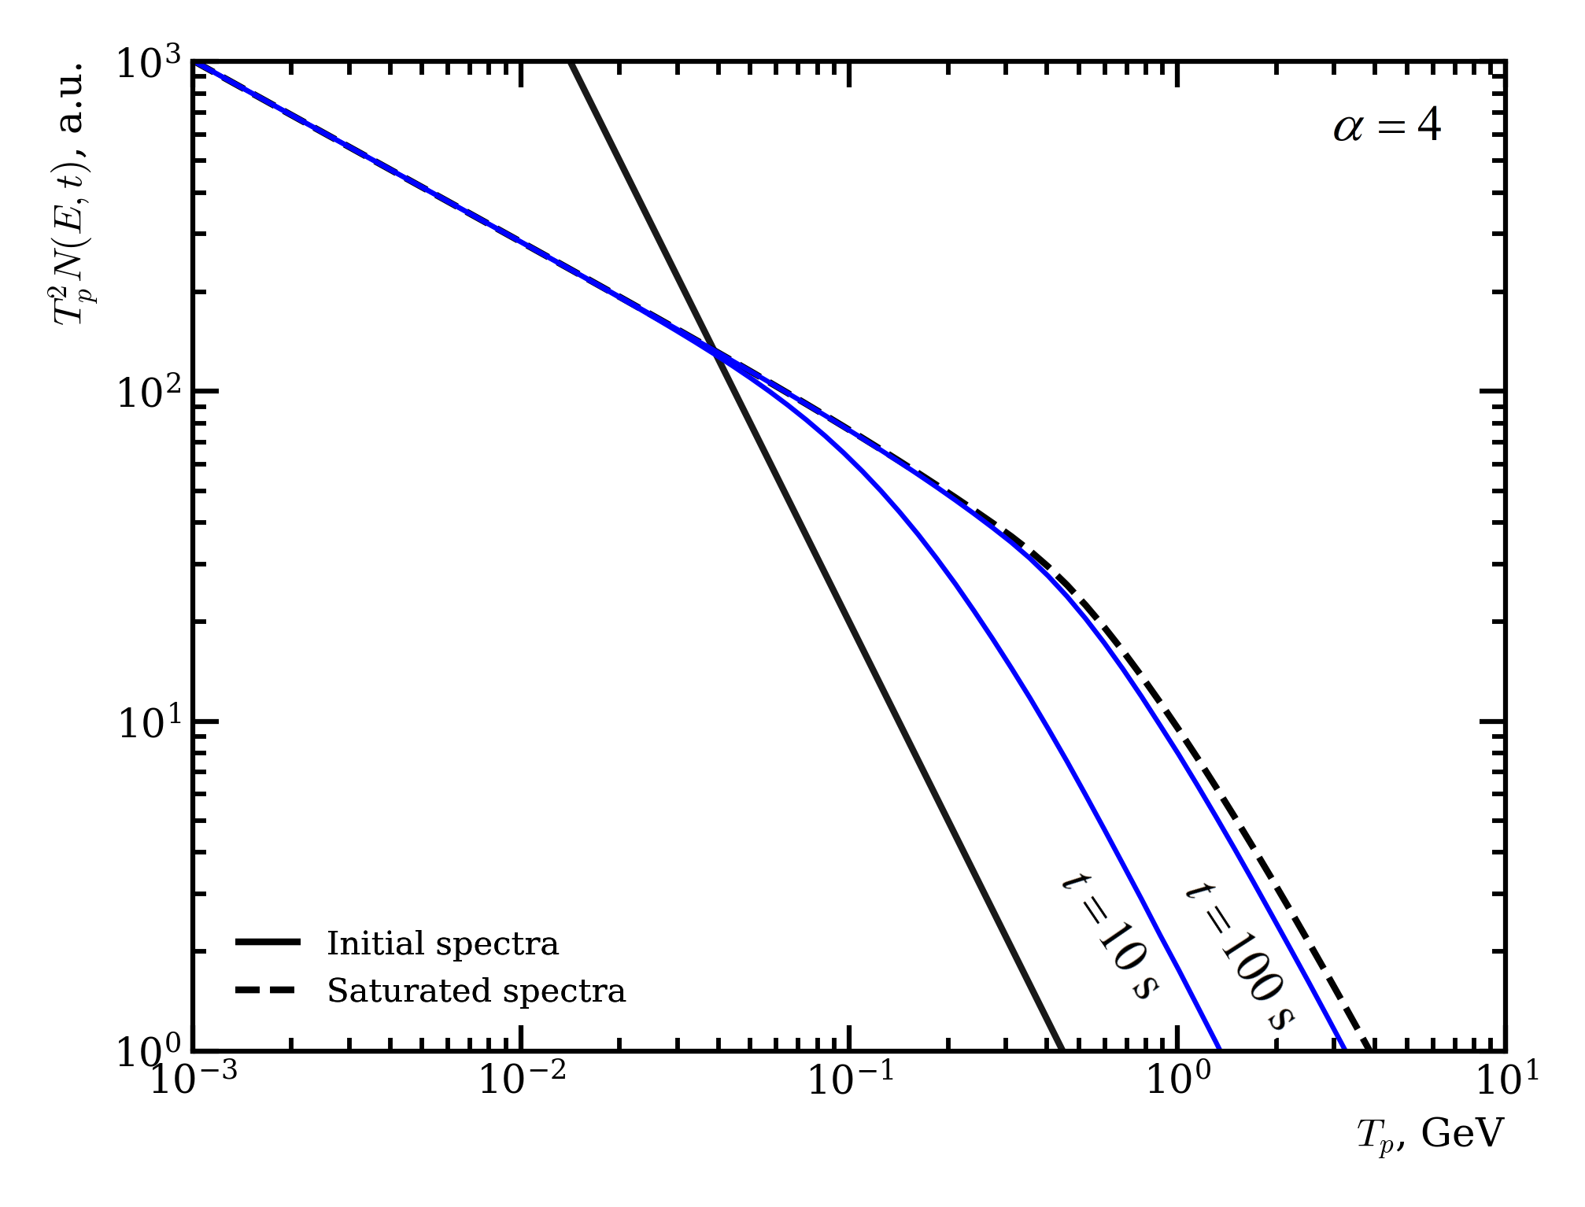
Proton spectra with continuous injection Q(E)
Energy spectrum of accelerated protons is determined by balance between acceleration and energy losses.
As time increases, losses become important; there is an effect of high-energy particles shift toward low-energy region. Proton energy distribution reaches saturation.
Break in spectrum ← combination effect of coulomb and nuclear losses
Also, there is an effect of tightening the index of the proton spectrum due to its evolution
At high energies nuclear losses (~ E ) dominate, practically no change of injection spectrum

Slide 7
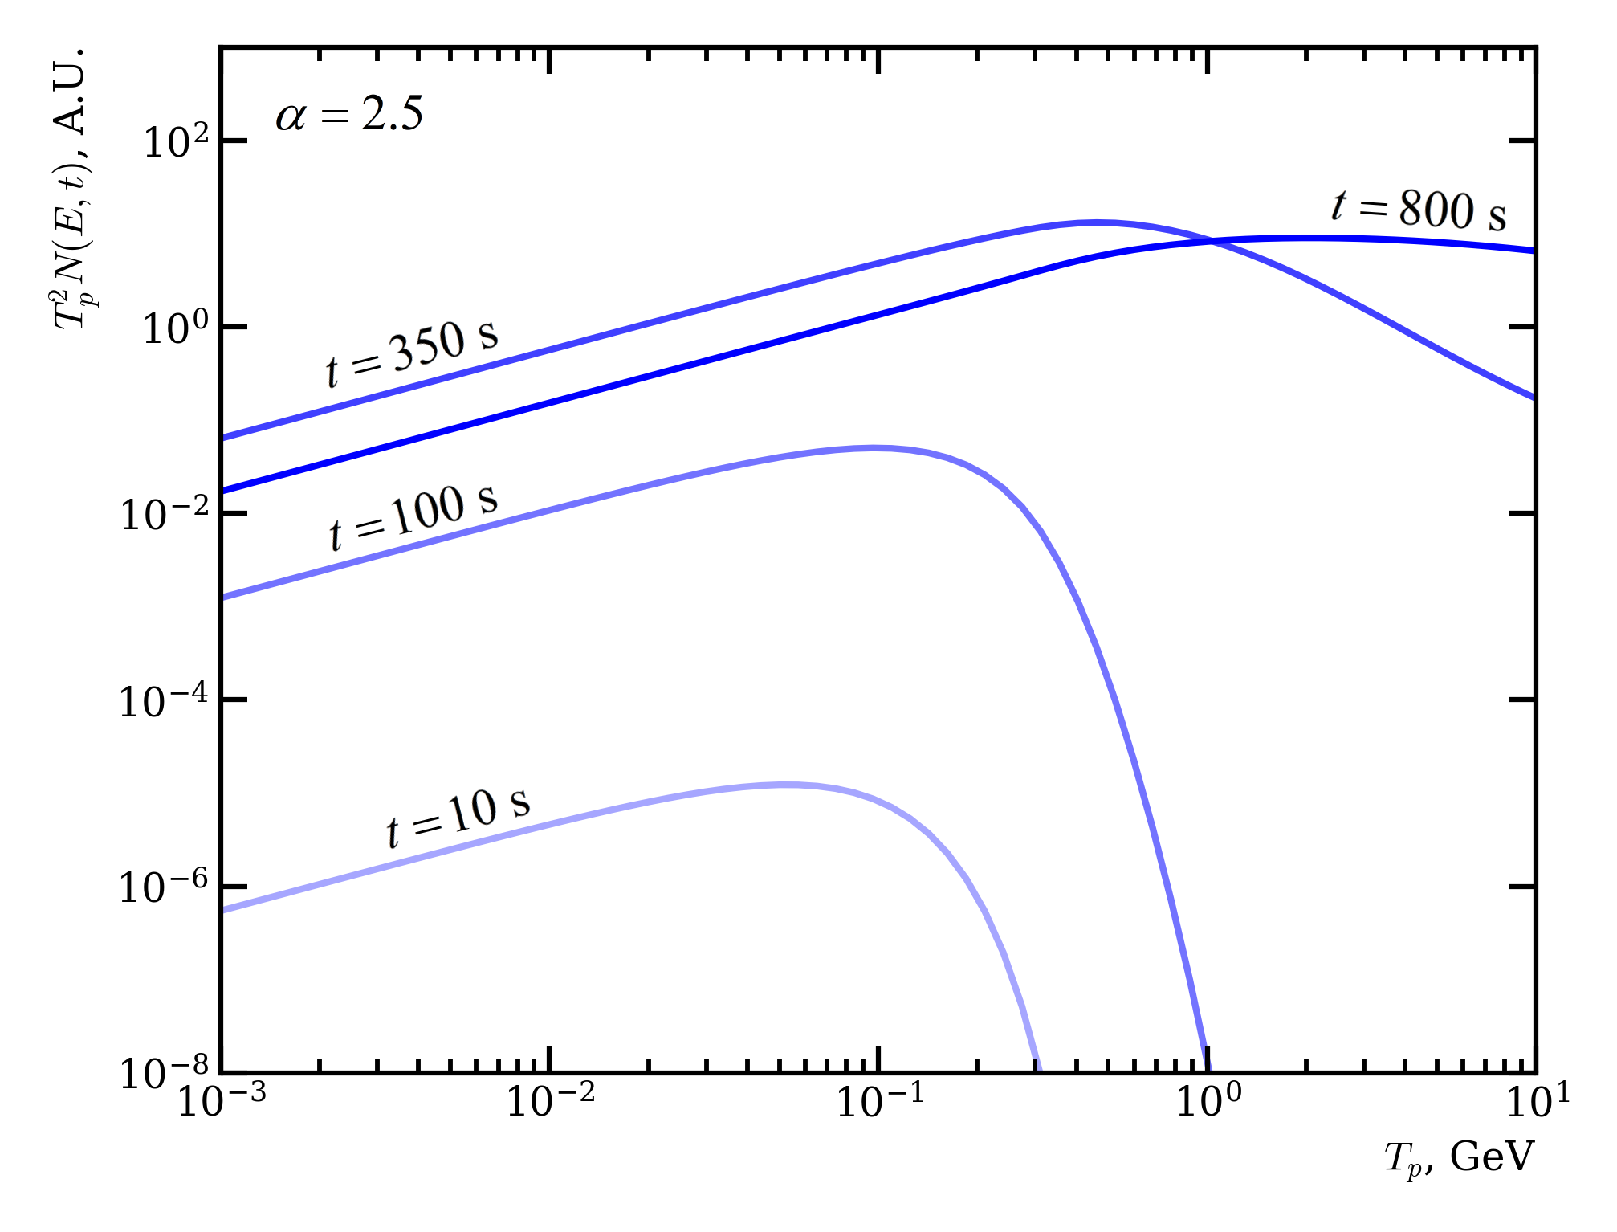
Proton spectra with impulse injection Q(E,t)
Landau function
(in the scenario of proton evolution without trapping in corona region)
In case of representation the source function as
No longer reaching saturation
As time flows, the proton spectrum increases with the preservation of a break in spectrum;
After reaching a maximum in the intensity of the solar flare, the spectrum will slowly decrease.
With impulse injection, the protons spectrum generally takes on a different shape, which will eventually affect the shape of the recorded gamma-ray spectrum

Slide 8
Conclusion
High-energy solar flare protons spectrum calculations were made based on the Ginzburg-Syrovatskii transport equation for two limiting cases – "thin" and "thick" targets. Continuous and impulse injections of particles was assumed;
As it can be seen, in both continuous and impulse regimes of the particle injections there is:
effect of tightening the index of the proton spectrum
characteristic break in spectrum as a result of combined effect of coulomb and nuclear energy losses.
Prospects for further development
The obtained result can be used to calculate gamma-ray spectra for further analysis of experimental data;

Slide 9
THANK YOU FOR YOUR TIME AND ATTENTION!
Speaker: Kuzmitskiy Alexey Vladimirovich a.kuzmitskiy@iszf.irk.ru

Slide 11
Solar particle acceleration mechanisms
Charged particle can be accelerated only by electric field that have different temporal and spatial scales
Basic acceleration mechanisms:
Direct acceleration by large-scale electric field associated with magnetic reconnection;
Shock-wave acceleration;
Stochastic (II-order Fermi) acceleration on turbulence and plasma waves (wave-particle interactions in small-scale electric fields);
Combined acceleration is also being considered:
Collapsing magnetic traps acceleration (I-order Fermi + betatron + shock-waves accelerations)
…

Slide 12
Plasma Ionization degree in solar atmosphere
Ionization degree χ :
– ions density,
– total density,
– neutral atoms density.
In corona for χ we can use Elwert’s formula:
– rate of collisional ionization,
– rate of radiative recombination.
Kotelnikov I. A. Lectures on plasma physics. V. 1., 2021
Ambartsumyan V. A. [et al.] Theoretical Astrophysics, 1952
If we want to find χ analytically, then we need to take into account other rates of elementary processes:
– rate of photoionization,
– rate of collisional recombination.
Vernazza J. [et al.] ApJS 45, 1981
Fontenla J. ApJ 406, 1993
Avrett E. & Loeser R. ApJS 175 (1), 2008

Slide 13
Bethe-Bloch formula (modified with presence of ion.degree)
During the motion of proton with mass mp and velocity v = bc, the loss rate due to coulomb interactions is given by
accounting for thermal motion of background electrons
Coulomb logarithm for bound electrons
Coulomb logarithm for free electrons
Workman R. [et al.] PTEP 2022, 2022
Gould R. J. Physica 58, 1972
- ionisation degree,
- mean excitation energy,
- maximum possible energy transfer to an electron in a single collision,

Slide 14
Full Ginzburg-Syrovatskii transport equation
«1» – spatial diffusion of particles with a diffusion coefficient Di;
«2» – systematic movement of the medium (expansion or contraction);
«3» – continuous change in the energy of particles as a result of the action of acceleration mechanisms and processes leading to energy losses in collisions. It is assumed that such an energy change occurs in small portions, i.e. continuously;
«4» – fluctuations with continuous energy change (small with ionization losses), di - the average square of the energy increment per unit of time;
«5» – intensity of cosmic ray sources;
«6» – ejection of particles from the phase volume due to ‘catastrophic’ energy losses and/or due to their leaving the considered system;
«7» – appearance of new particles as a result of ‘catastrophic’ collisions;

