Slide 1
Comparative analysis of two weak GLEs in May and August 1998 by spectrographic global survey method
I.I. Kovalev*, M.V. Kravtsova, S.V. Olemskoy, V.E. Sdobnov

Slide 2
Data & Method:
Goal:
Investigation of cosmic ray (CR) spectra and anisotropy during Ground Level Enhancements of May 2nd (GLE56) and August 24th, 1998 (GLE58).
For analysis, we used data of the worldwide network of neutron monitors (NM) with time definition of 5 minutes (20 NMs for GLE56, 16 NMs for GLE58).
The analysis was carried out by spectrographic global survey (SGS) method, developed in Institute of Solar-Terrestrial Physics.
Based on the obtained parameters of CR variations spectra and cosmic ray intensities obtained by GOES-9 and GOES-10 spacecraft, we calculated differential rigidity spectra of primary CR.
XVIII Конференция молодых ученых «Взаимодействие полей и излучения с веществом» Иркутск, 1–7 сентября 2024 г.

Slide 3
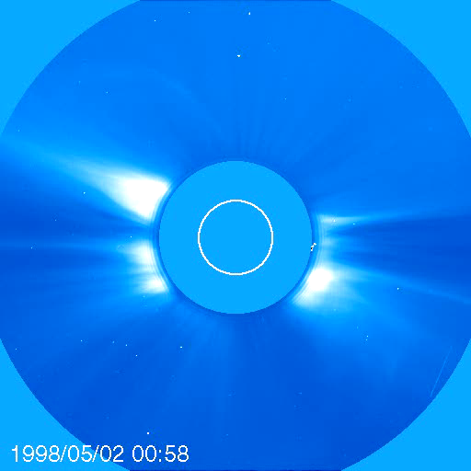
Heliospheric conditions:
GLE |  |  | Max proton flux, pfu (IMP, GOES) |  | Flare |  |  | CME V, km/s
№ | Date | Max increase, % (NM) | > 10 MeV | > 700 MeV | GOES class | Location | Radio bursts
56 | 02.05.1998 | 7 (Oulu) | 150 | 9.2 | Х1.1 | S15W15 | II–III | halo, 938
58 | 24.08.1998 | 4 (Cape Schmidt) | 200 | 5.1 | Х1.0 | N35E09 | II–IV | 1420*
*CME speed calculated (in [Gopalswamy et al., 2012]); direct speed measurement unavailable due to LASCO data gap
NM observations:
Относительная интенсивность высокоширотных НМ во время GLE56 (сверху) и GLE58 (снизу).
XVIII Конференция молодых ученых «Взаимодействие полей и излучения с веществом» Иркутск, 1–7 сентября 2024 г.

Slide 4
Results - spectra
Differential rigidity spectra of accelerated particles in different moments of GLE56 (left) and GLE58 (right).
XVIII Конференция молодых ученых «Взаимодействие полей и излучения с веществом» Иркутск, 1–7 сентября 2024 г.

Slide 5
Results – spatial distribution
Spatial distribution of 2-GV rigidity particles in solar elciptic geocentric coordinate system in various moments of GLE56 (upper row) и GLE58 (lower row).
XVIII Конференция молодых ученых «Взаимодействие полей и излучения с веществом» Иркутск, 1–7 сентября 2024 г.

Slide 6
Results – spatial distribution
Spatial distribution of 2-GV rigidity particles in solar elciptic geocentric coordinate system in various moments of GLE56 (upper row) и GLE58 (lower row).
(Wireframe surface visualizations)
XVIII Конференция молодых ученых «Взаимодействие полей и излучения с веществом» Иркутск, 1–7 сентября 2024 г.

Slide 7
Conclusions
Differential rigidity spectra of particles accelerated in the Sun’s vicinity during GLE56 and GLE58 have been calculated.
The dynamics in the accelerated particles’ differential rigidity spectra over events of interest is demonstrated. The obtained information might prove useful for selecting possible acceleration mechanisms of solar cosmic rays.
We established that differential rigidity spectra of accelerated particles during GLE56 and GLE58 are similar. Maximal rigidity of accelerated particles is below ~ 2–3 GV;
When considering GLE58 with the use of 5-minute data, we found enhanced bidirectional anisotropy not found in previous investigations that used hourly NM data.
Presence of enhanced bidirectional anisotropy can imply Earth’s location in a loop-like structure of interplanetary magnetic field.
XVIII Конференция молодых ученых «Взаимодействие полей и излучения с веществом» Иркутск, 1–7 сентября 2024 г.

Slide 8
Thanks for listening!

