Slide 1


VOLGA STATE UNIVERSITY OF TECHNOLOGY
BAIKAL YOUNG SCIENTISTS’ INTERNATIONAL SCHOOL
ON FUNDAMENTAL PHYSICS
“PHYSICAL PROCESSES IN OUTER AND NEAR-EARTH SPACE”
XVIII Young Scientists’ Conference
“Interaction of fields and radiation with matter”
Intelligent Diagnostic System with a Mode for Predicting the Parameters of Broadband Radio Channels Based on Data from GNSS Passive Radio Sensors
A. A. Kislitsin, N. V. Ryabova, M. A. Kislitsina, Konkin N. A.
Department of Radio Engineering and Communication,
Volga State University of Technology
Yoshkar-Ola, Russian Federation
Irkutsk, September 1-7, 2024

Slide 2
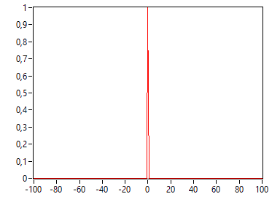
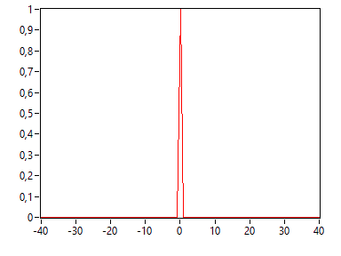
Relevance. Problem. Aim
RELEVANCE:
Development and enhancement of invariant SCS, where signal energy metrics, channel capacity, noise immunity, susceptibility, and bandwidth remain unaltered during transitions to new ionospheric conditions.
PROBLEM:
The coherence band of the transionifier radio channel is determined by the total electronic content (TEC) of the ionosphere, the value of which varies depending on various factors: the time of day, season, geomagnetic situation, solar activity. Due to various variations of TEC when processing data, emissions (abnormalities) occur in the daily variations of the coherence strip. The problem in the forecast based on the use of intellectual methods is the absence of additional predictors of the daily variations of the predictable parameter (coherence band), which would affect the accuracy of forecasting the final model of machine learning.
AIM
To study the structures of artificial neural networks for analyzing and predicting the dynamics of coherence bands of broadband transionospheric radio channels
Ne(h)
TEC

Slide 3
Influence of the effect of frequency dispersion in the transionospheric radio channel
PFC of a broadband radio channel
On the issue of features of transionospheric radio channels
Influence of frequency dispersion on the impulse response of a radio channel
1st order dispersion parameter
2nd order dispersion parameter
Third order dispersion parameter
3
Notes:
Встваить===

Slide 4
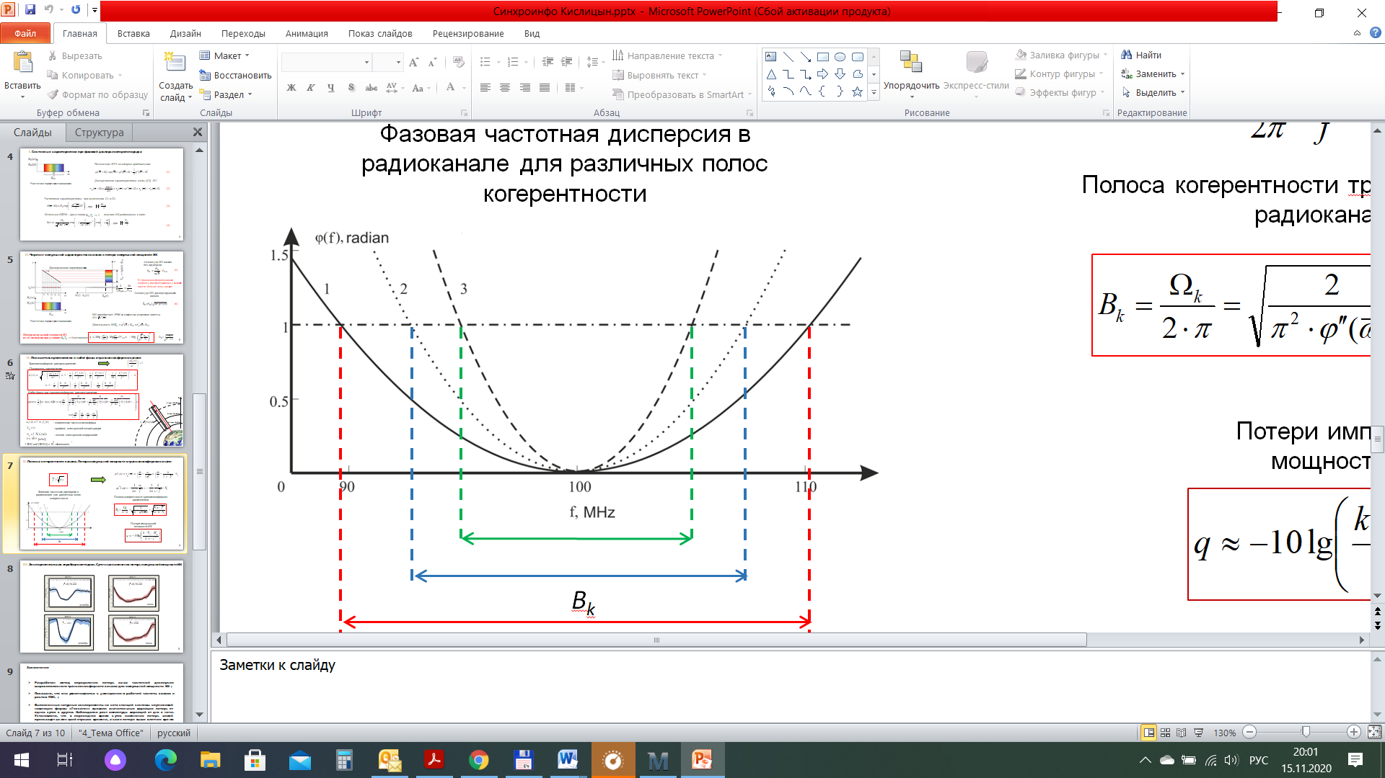
Ivariability of ultimate bandwidth of a transionospheric radio channel
Group delay in the channel:
(1)
where is the intramode group delay dispersion.
(2)
Coherence band determination
Coherence bandwidth in angular frequencies
(3)
where TEC – Total Electrons Content in TECU (1 TECU = 10¹⁶ м⁻²);
– operating frequency;
– base frequency;
– relative frequency
When passing to the normal frequency f, the expression for the coherence bandwidth will have the following form
(4)
An example of the daily variation of the coherence
bandwidth for a wave packet at a reference frequency

Slide 5
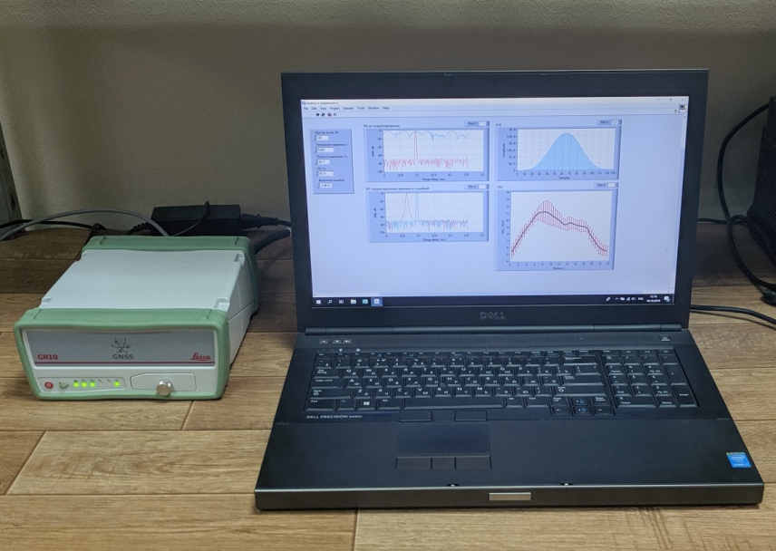
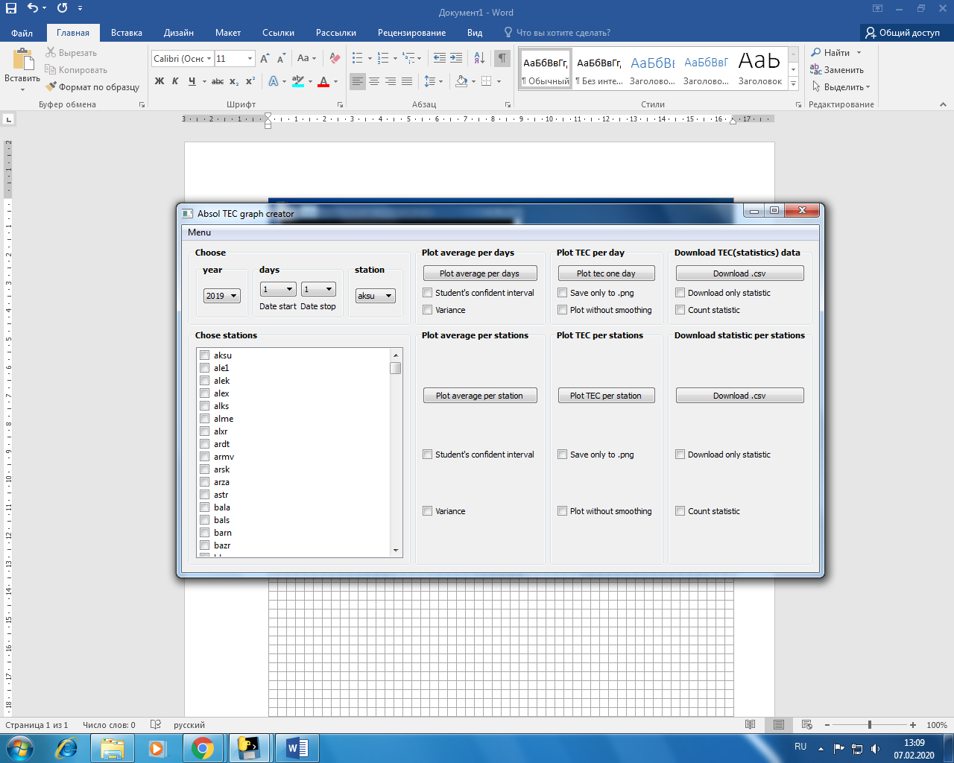
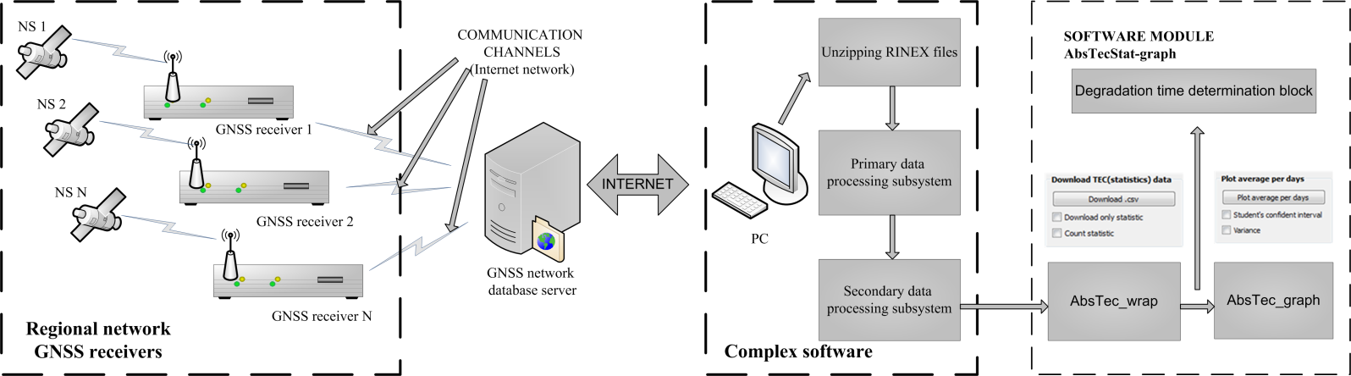
Technique and conditions of the experiment

Slide 6
Daily variations of the coherence band of the transionospheric radio channel for different seasons

Slide 7
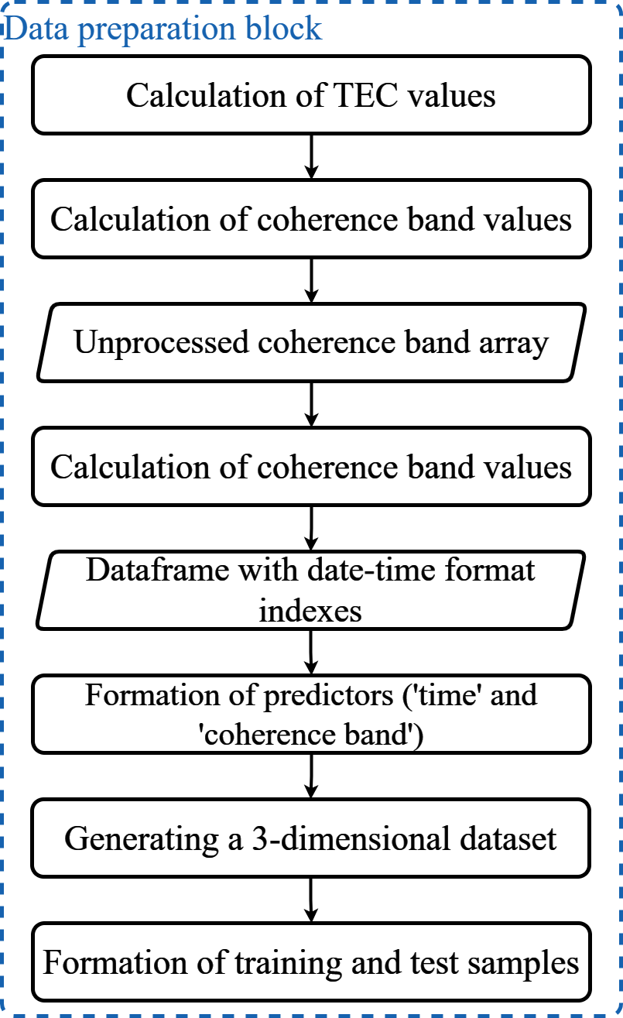
Block diagram of the process of data preparation for a recurrent neural network
formation of a dataset for research. The dataset is generated based on data from ground-based GNSS stations, the values of which are accumulated on PSTU storage servers;
calculation of TEC and coherence band, recording of the results obtained in the database. Single samples of the time course of the coherence band that are missing due to reception errors are interpolated for the entire series. To eliminate high-frequency variations, filtering using the Hodrick-Prescott method is used;
formation of a dataframe with date-time format indexes and additional predictors. Temporal components and components of the coherence band values of neighboring GNSS stations were used as predictors. Temporal predictors include such predictors as minutes, hours, day of the week, season of the year, month number, day number of the year. Thus, the generated dataframe contains a temporary objective function (the course of the coherence band) and 9 predictors;
creation of a three-dimensional array for further use in preparing the training and test parts.

Slide 8
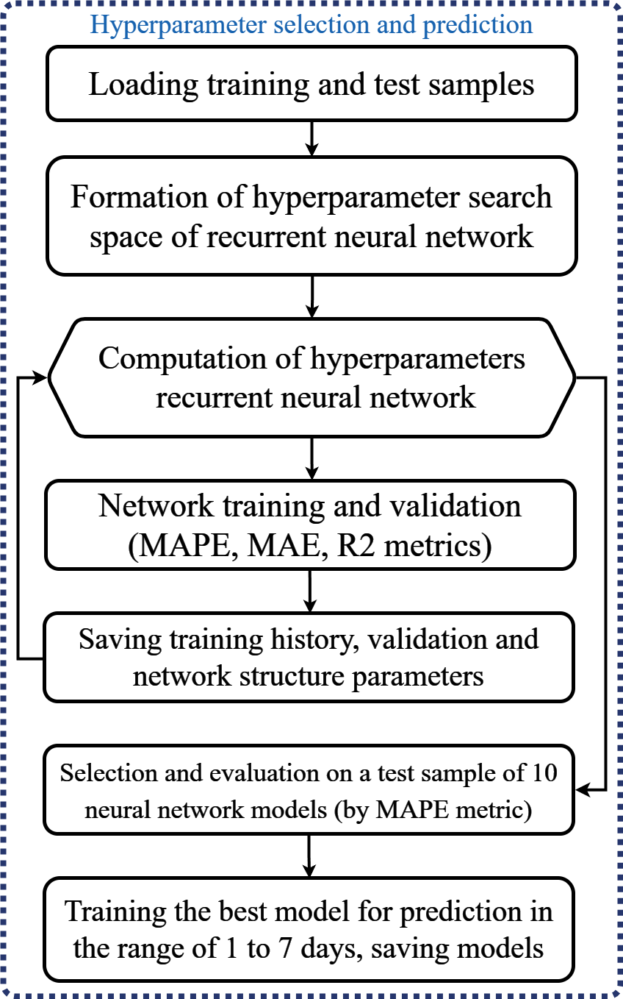
Algorithm for preparing data and training neural network models for forecasting
1) loading of training and test samples into the hyperparameter search function of the neural network, prepared. The process of searching for optimal hyperparameters was controlled using the Keras Tuner tool, to ensure systematic exploration of the hyperparameter space and selection of the best parameters based on the model quality metrics using the Bayesian Optimizator method (Bayesian Optimizer);
2) based on the specified ranges of hyperparameters of the neural network, the search space was formed. When organizing the hyperparameter space, first of all, the ranges of the number of neurons for each layer of the neural network were set in increments of 4. In LSTM layers, the range varied from 64 to 300 neurons, in Dense layers - from 32 to 240 neurons.;
3) running a cyclic search, during which all newly formed recurrent neural network structures are trained and validated using the metrics of mean absolute percentage error (MAPE), mean absolute error (MAE) and coefficient of determination (R2);
4) saving the results of training and validation for later analysis, similar to the structure of a synthesized recurrent neural network;
5) selection of ten promising post-cycle models for further analysis based on the MAPE metric. These models are tested on forecasts ranging from 1 to 7 days. Since the size of the test sample changes as the size of the training sample changes, a different recurrent neural network model is trained and stored for each of the ranges.
7

Slide 9
Experiments on predicting coherence bands using neural networks
The interpretation of the obtained data referred to the question of the influence of structural parameters of the synthesized recurrent neural network on the forecasting accuracy. As a result of the analysis, some limits of the hyperparameter space of the neural network were determined, namely, the layer activation function - SELY (Self-Normalizing Neural Networks), the number of LSTM layers up to two, the number of neurons for one layer up to 300, the Adam optimization function with the training step up to 0.001. The accuracy of training and validation of the model by MAPE metrics was less than 5% (3.3% on average), which indicates a high accuracy of fitting the network coefficients to the studied time course.
Forecast accuracy for all ranges, except for the six-day range, fits within the confidence intervals. In terms of the coefficient of determination, the models for 1 and 6 days have medium accuracy (76 % on average), and the others have high accuracy (94 % on average).
Summary result for metrics including average absolute percentage error,
coefficient of determination, average absolute error and confidence interval
for a forecast in the range of 1 to 7 days
Training and validation results based on the average absolute percentage error metric of a synthesized recurrent neural network
with a forecast for 1 and 7 days
9

Slide 10
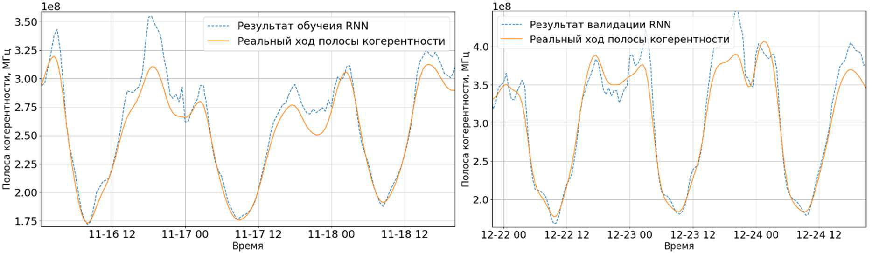
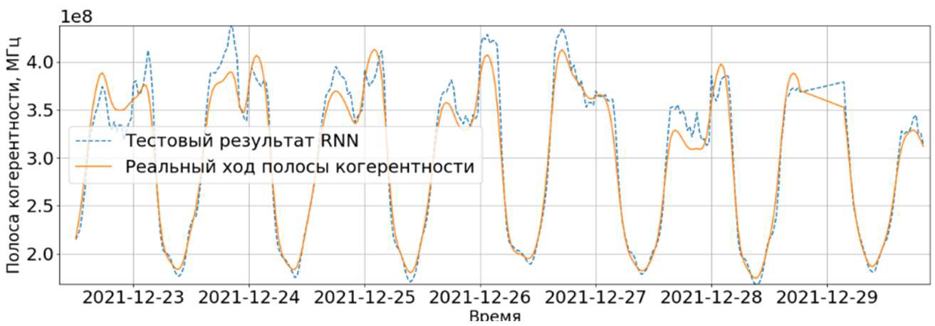
Training , validation and prediction results of a synthesized recurrent neural network
9

Slide 11
CONCLUSION
Methods for analyzing and predicting the dynamics of coherence bands of broadband transionospheric radio channels using artificial neural networks have been developed. A successful validation of the architecture was performed for a specialized hybrid RNN-LSTM network. The high efficiency of the developed approach for predicting the coherence band describing the intra-mode group delay dispersion of wave packets used for broadband satellite communications was demonstrated.
Within the framework of this work, an algorithm for data preparation and training of the neural network model was created and its structure was developed. For the created specialized architecture RNN LSTM were achieved the following quality indicators averaged over a week period on the test sample in predicting the parameter of transionospheric radio coherence bandwidth: Mean Absolute Error (MAE) = 18.2 MHz; coefficient of determination R2 = 0.89; Mean Absolute Percentage Error (MAPE) = 6%. This shows that the model provides high accuracy and adequacy in predicting the coherence bandwidth, with a mean absolute percentage error of less than 6 % and explains more than 89% of the variance of the target variable by the coefficient of determination metric.
The results obtained in this study indicate that the chosen neural network architecture is optimal and has the ability to adapt to the operation of transionospheric radio links in real conditions. This allows to adjust the parameters of satellite communication systems depending on the predicted value of the coherence bandwidth.
This work was supported by the grant No. 23-19-00145 from the Russian Science Foundation.

Slide 12
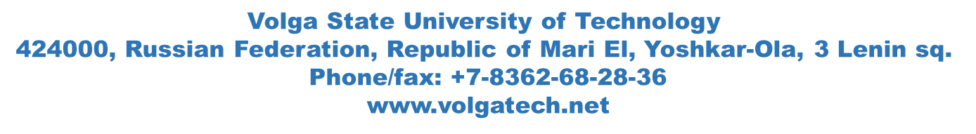
Thank you!
E-mail: KislitsinAA@volgatech.net

Slide 13

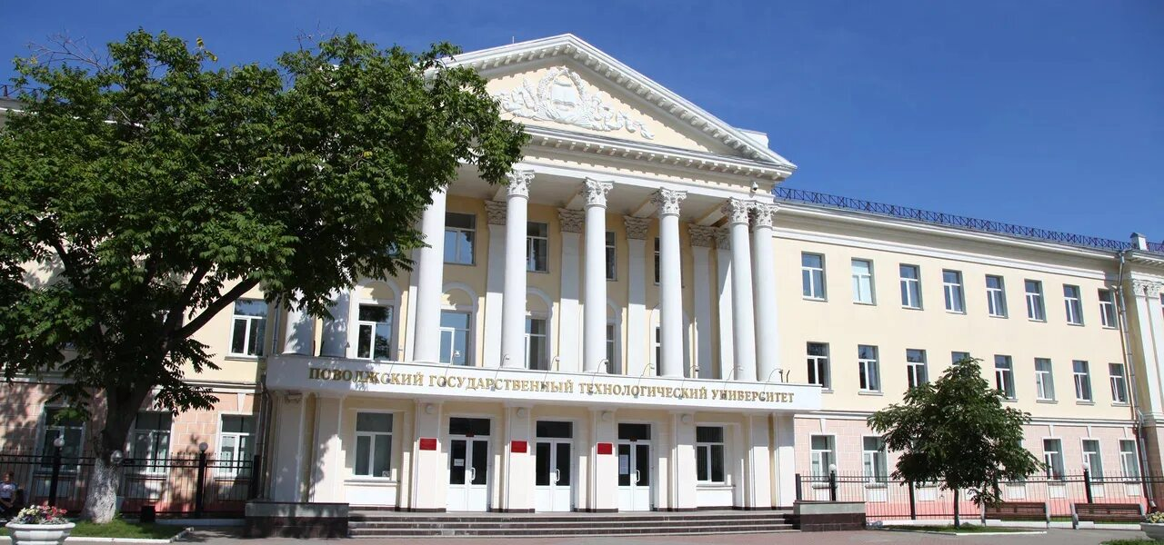
ПРИГЛАШАЕМ ПРИНЯТЬ УЧАСТИЕ В РАБОТЕ
I Молодежной научной
школе-конференции «Распространение радиоволн»,
посвященной памяти Д.С. Лукина
(I МНШК РРВ-2024), 11 – 14 ноября 2024,
г. Йошкар-Ола, Россия
ПОВОЛЖСКИЙ ГОСУДАРСТВЕННЫЙ ТЕХНОЛОГИЧЕСКИЙ УНИВЕРСИТЕТ
Эл. почта: KislitsinAA@volgatech.net Моб. Тел.+7(927)681-41-73

