Slide 1
Dynamics of field-aligned currents in the Iijima-Poterma Region 1 during the period of stationary magnetospheric convection (SMC) from the magnetogram inversion technique
Kapustin V.E., Lunyushkin S.B., Karavaev Y. A., Penskikh Y.V., Mishin V.V.
Irkutsk, 2024

Slide 2
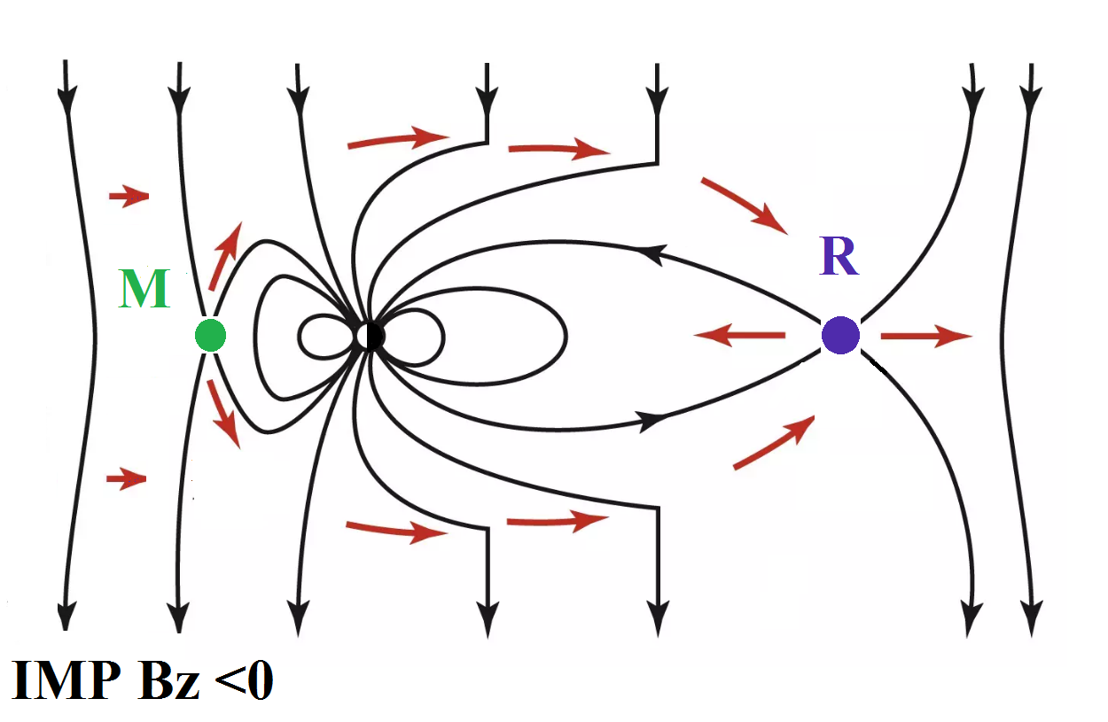
SMC: M [kV] ≈ R [kV]
Sergeev et al. [1996]:
SMC is observed for 3–6 hours stable IMF Bz<0;
no signs of the substorm expansion phase;
Indices AU ≥ 150 nT and |AL|≥ 200 nT.
Dungey [1961]
M (merging) and R (reconnection) – dayside and nightside reconnection rates.

Slide 3
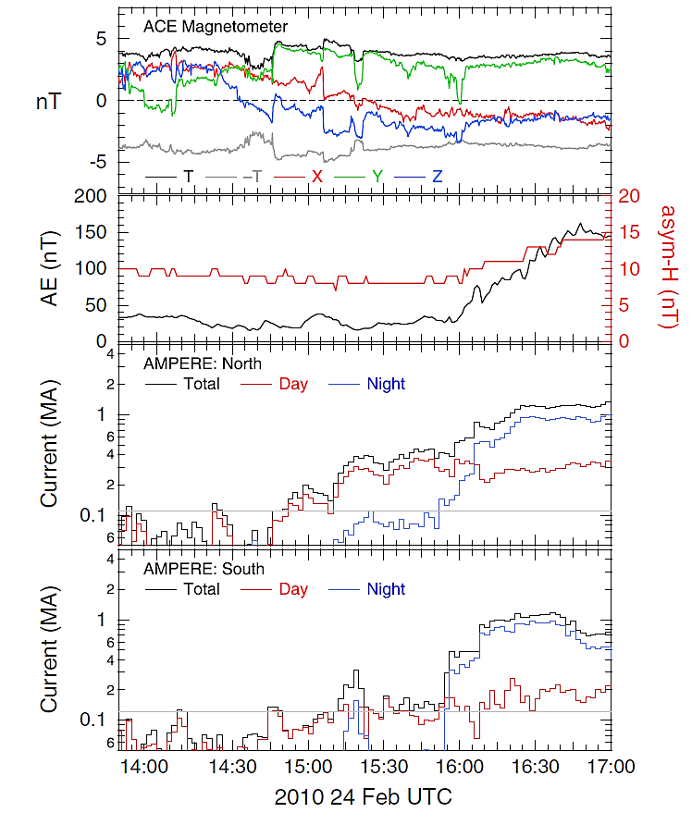
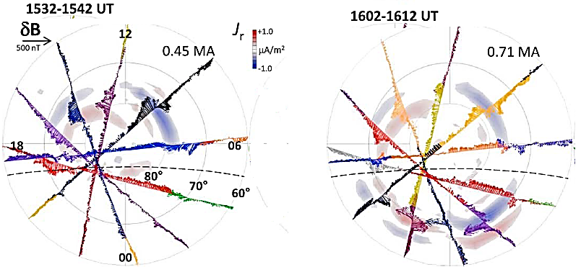
(growth phase)
(onset)
Substorm
onset
growth phase
Anderson et al. [2014] concluded that the dayside Birkeland currents are driven by magnetopause reconnection (process M);

Slide 4
Goal
Study of the Region 1 FACs dynamics based on the magnetogram inversion technique (MIT) during the SMC period

Slide 5
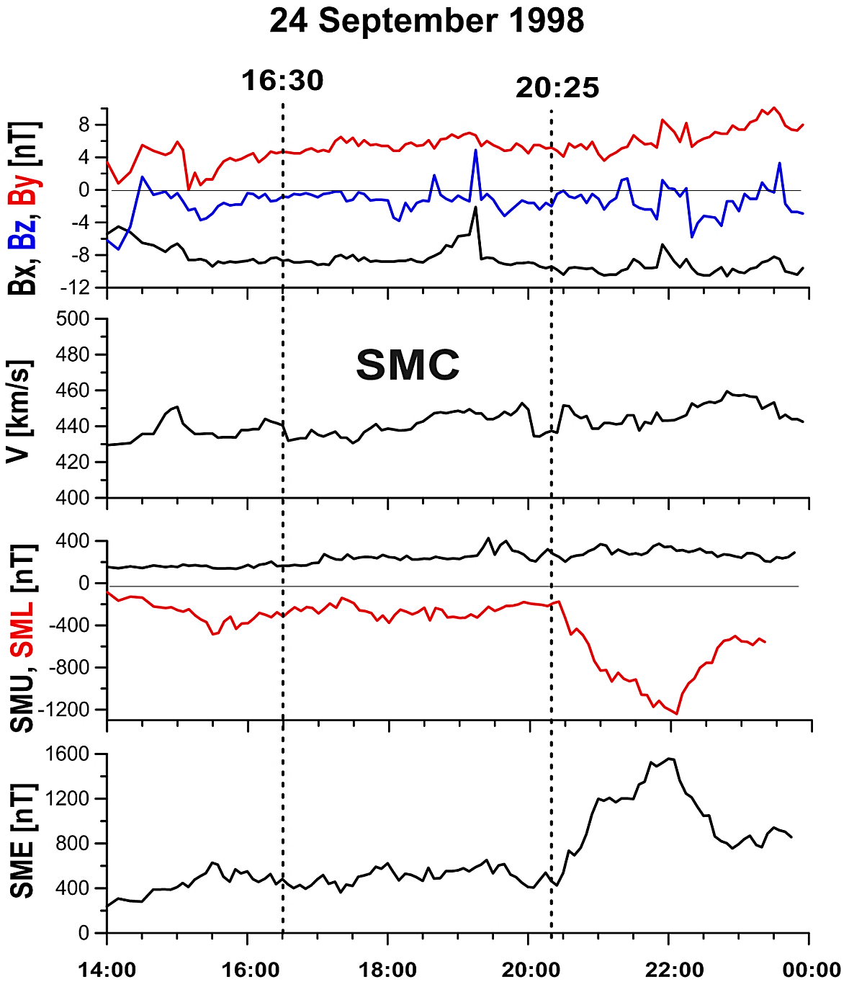
This SMC period was described in SMC lists by DeJong et al. [2009] and Kissinger et al. [2012].
substorm
substorm

Slide 6
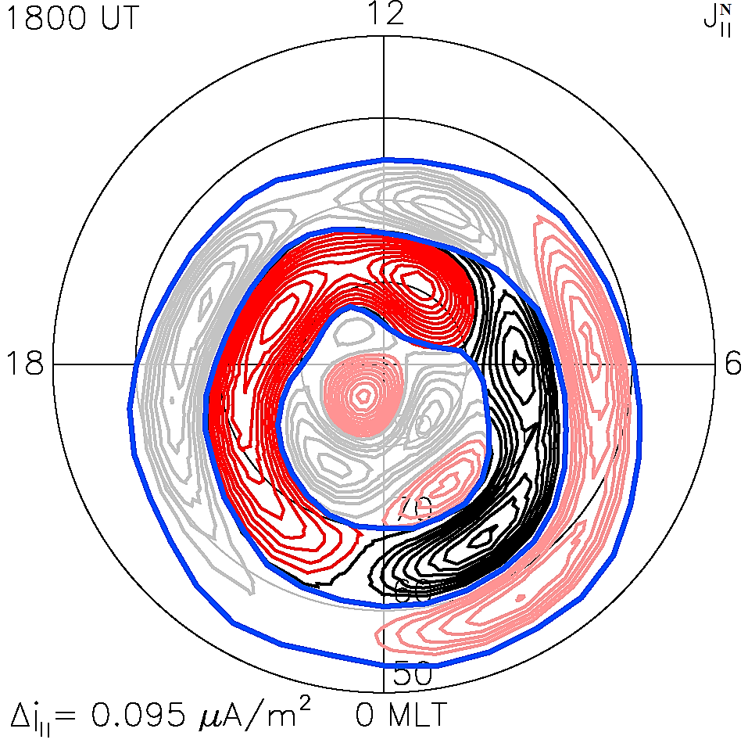
I day = $\frac{\left(\left|I_{R1}^{+}\right|+\left|I_{R1}^{−}\right|\right)}{2}$
I night = $\frac{\left(\left|I_{R1}^{+}\right|+\left|I_{R1}^{−}\right|\right)}{2}$
R2
R1
R0
downward FACs ($+$)
MIT: Penskikh et al. [2021]
upward FACs ($−$)

Slide 7
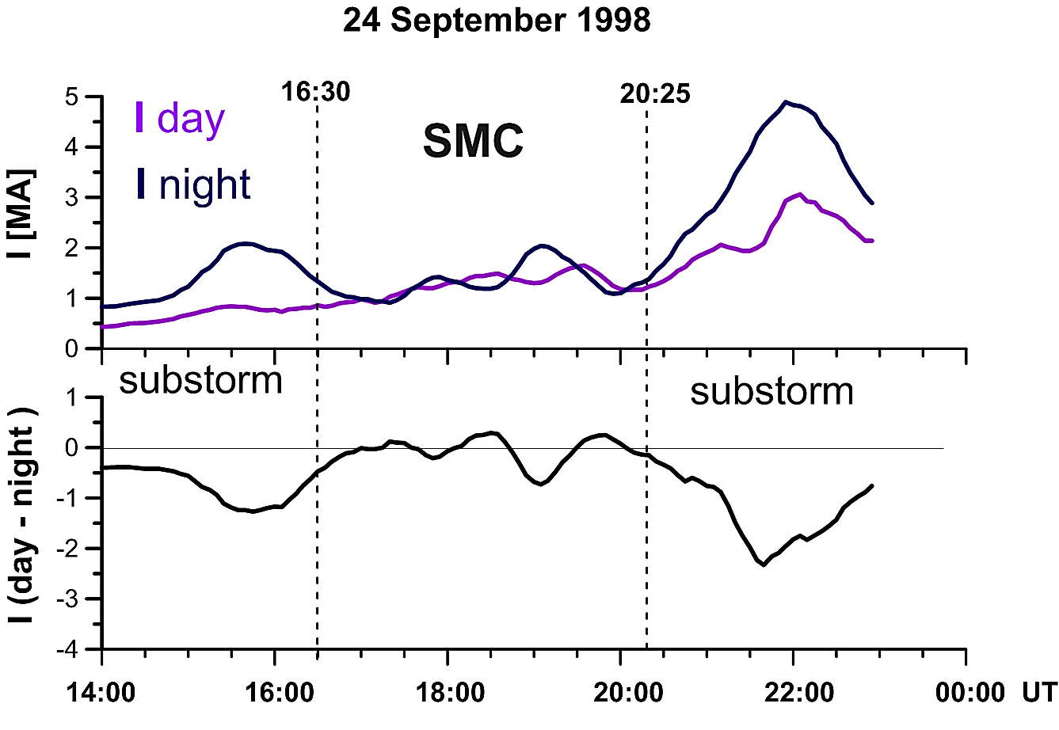
Substorm : I day < I night
SMC: I day ≈ I night

Slide 8
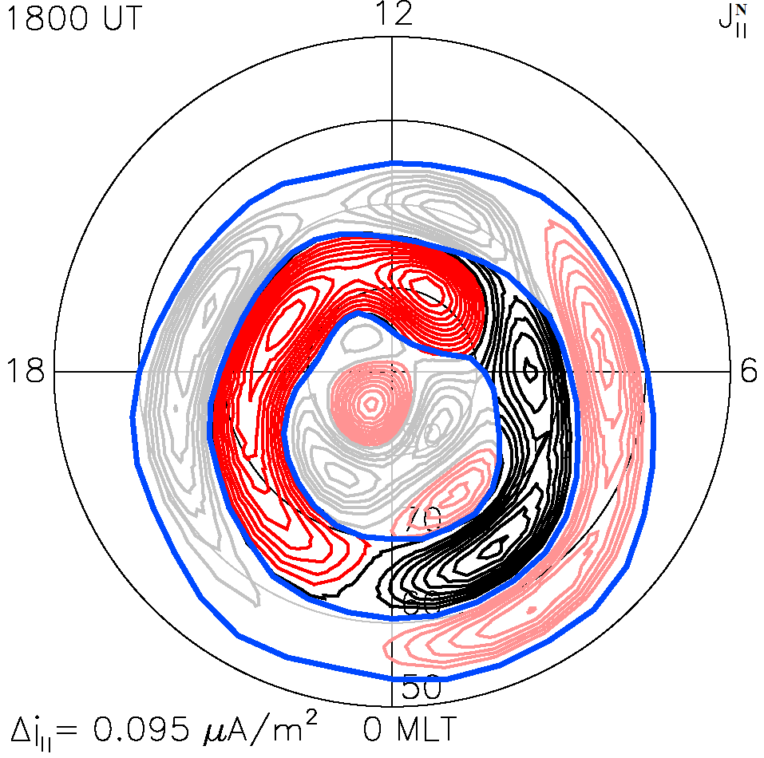
Bn
SMC: I day ≈ I night
~
~
~
dawn
During the SMC period, two generators operate continuously:
Bn component at the open magnetopause/plasma mantle [Lee, Roederer, 1982];
Distant X-line (R) was formed at 35–50 R_{E} as a result of tailward movement of NEXL (12-18 R_{E}) after the substorm [Kissinger et al., 2012].
NEXL
Ey
dusk
R
~
~
~
(35–50 R_{E})
IMP Bz <0

Slide 9
Conclusion
Quantitative and qualitative analysis showed that during the SMC period there was observed:
The increase in the intensity of dayside FAC began during the substorm before the SMC.
A monotonic increase Region 1 FACs intensities at quasi-equilibrium between dayside and nightside.
In the late SMC a decrease in FAC intensities was observed before the second substorm.

Slide 10
References:
Penskikh Y.V., Lunyushkin S.B., Kapustin V.E. Geomagnetic method for automatic diagnostics of auroral oval boundaries in two hemispheres of Earth. Solar-Terrestrial Physics. 2021, vol. 7, no. 2, pp. 57-69. DOI: 10.12737/stp-72202106. https://doi.org/10.12737/stp-72202106
Anderson B.J., Korth H., Waters C.L., Green D.L., Merkin V.G., Barnes R.J., Dyrud L.P. Development of large-scale Birkeland currents determined from the Active Magnetosphere and Planetary Electrodynamics Response Experiment. Geophysical Research Letters. 2014, vol. 41, no. 9, pp. 3017-3025. DOI: 10.1002/2014gl059941.
DeJong A.D., Ridley A.J., Cai X., Clauer C.R. A statistical study of BRIs (SMCs), isolated substorms, and individual sawtooth injections. Journal of Geophysical Research: Space Physics. 2009, vol. 114, no. A8, pp. A08215. DOI: 10.1029/2008ja013870.
Dungey J.W. Interplanetary Magnetic Field and the Auroral Zones. Physical Review Letters. 1961, vol. 6, no. 2, pp. 47-48. DOI: 10.1103/PhysRevLett.6.47.
Kissinger J., McPherron R.L., Hsu T.S., Angelopoulos V. Diversion of plasma due to high pressure in the inner magnetosphere during steady magnetospheric convection. Journal of Geophysical Research: Space Physics. 2012, vol. 117, no. A5, pp. A05206. DOI: 10.1029/2012ja017579.
Mishin V.M., Mishin V.V., Lunyushkin S.B., Wang J.Y., Moiseev A.V. 27 August 2001 substorm: Preonset phenomena, two main onsets, field-aligned current systems, and plasma flow channels in the ionosphere and in the magnetosphere. Journal of Geophysical Research: Space Physics. 2017, vol. 122, no. 5, pp. 4988-5007. DOI: 10.1002/2017ja023915.
Sergeev V.A., Pellinen R.J., Pulkkinen T.I. Steady magnetospheric convection: A review of recent results. Space Science Reviews. 1996, vol. 75, no. 3, pp. 551-604. DOI: 10.1007/bf00833344.
https://supermag.jhuapl.edu/

Slide 11
Thank you for your attention

