Slide 1
INVESTIGATION OF THE RADIAL DISTRIBUTION OF EUF RADIATION SOURCES IN LASER PLASMA USING THE ABEL TRANSFORM
Ифм РАН
Valeie Е. Guseva, A. N. Nechay, А. А. Perecalov, N. I. Chkhalo
Нижний Новгород, 2024

Slide 2
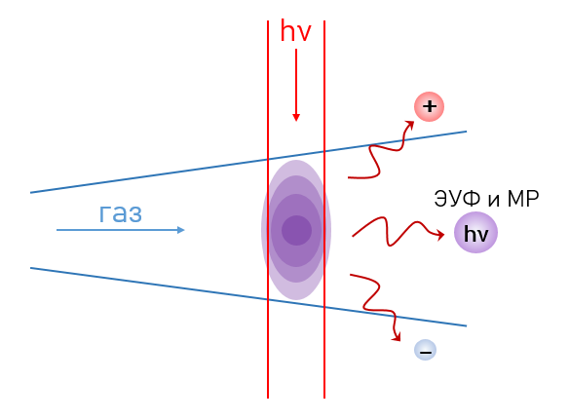
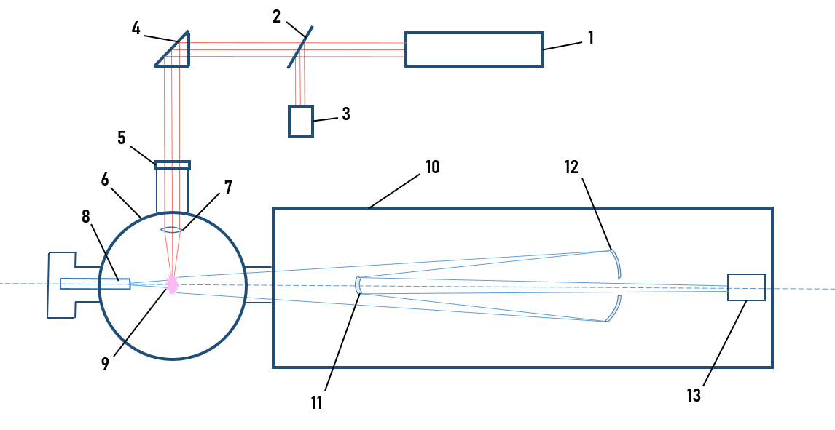
Installation Scheme
1 – Nd:YAG laser
2 – dividing plate
3 – power meter
4 – prism
5 – the introductory window
6 – vacuum chamber
7 – the lens
8 – the nozzle
9 – laser spark
10 – EUV microscope
11, 12 – EUV mirrors
13 – detector
Laser parameters: τ = 4 ns, λ = 1064 nm, f = 10 Hz.
Target parameters: Ar, Kr, Xe; p = 3-10 bar, conic nozzle d_{кр}=500 µm.
EUV microscope parameters: λ = 11.25 nm, CMOS matrix detector 2048х2048.

Slide 3
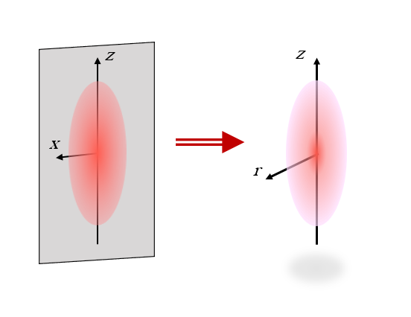
Images of laser spark and Abel Transformation
The original image is a projection of P (x, z) on a 2048x2048 pixel grid
1 pixel = 1.3 µm
The obtained radial distribution of radiation centers I (r, z)
$$P \left(x, z\right)=2\int_{\left|x\right|}^{∞}{\frac{\left.rI(r,z\right)}{\sqrt{r^{2}−x^{2}}}dr}$$
$$I \left(r, z\right)=−\frac{1}{π}\int_{r}^{∞}{\frac{\left[{dP\left(x,z\right)}/{dx}\right]}{\sqrt{x^{2}−r^{2}}}}dx$$
Projection of the radiation of ions Ar-VII, Kr-IX and Xe-XI at λ=11.25 nm

Slide 4
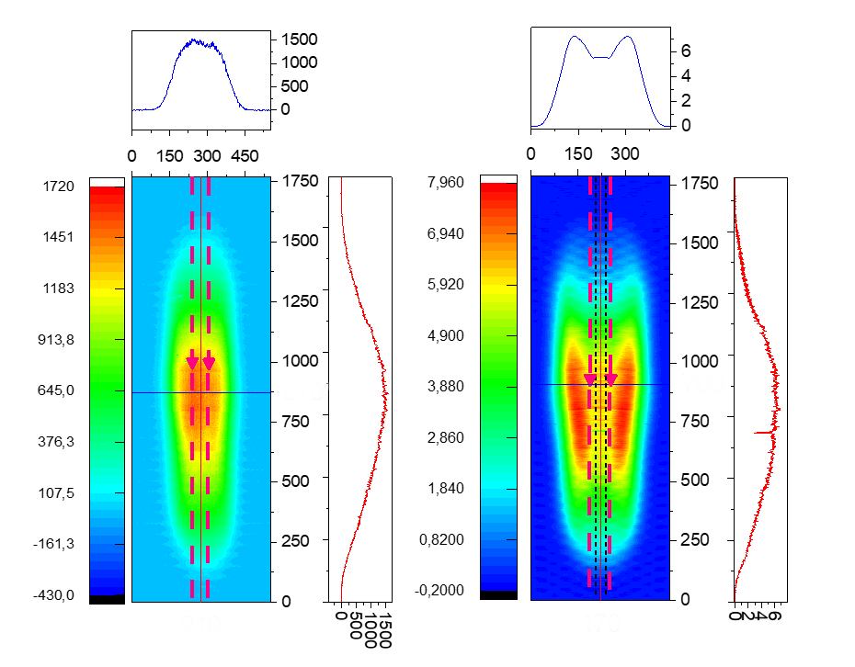
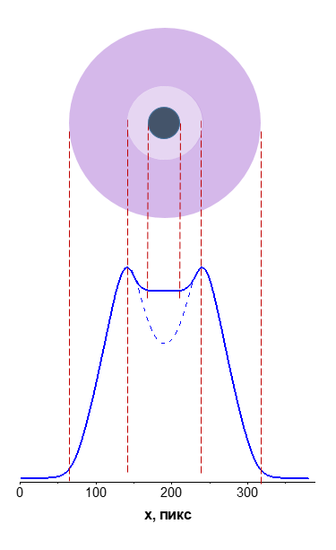
Argon Spark
Nd:YAG laser, τ=4 ns, d_{ф}=66 µm
Ar target, p=5 bar, d_{кр}=500 µm
Ar-VII ions (T=1.7 million K)
Argon spark projection and the resulting radial distribution
The shape of the radiating region in the cross section y=760 µm (p=5 bar)
Integral intensity from pressure
The argon spark has the shape of a pipe. This is one wave radially diverging. The length and intensity of the emission of an argon spark at λ=11.25 nm increase linearly with increasing pressure.

Slide 5
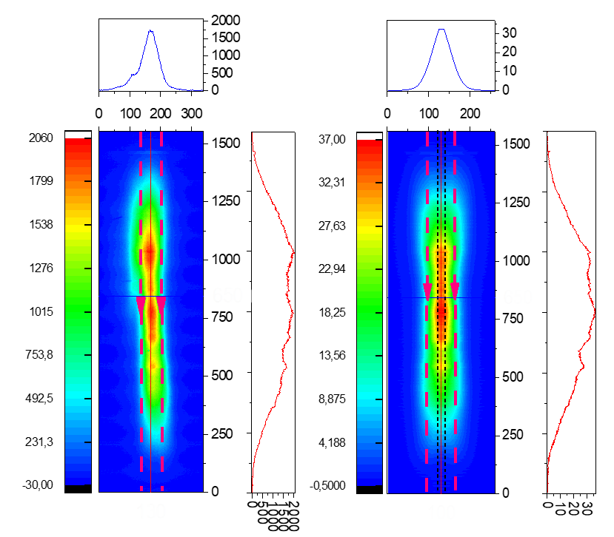
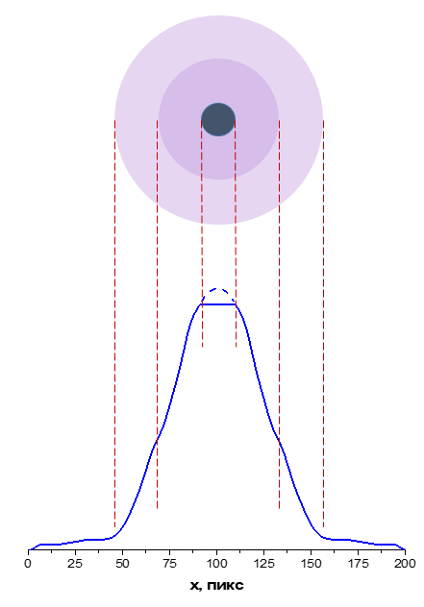
Krypton Spark
Nd:YAG laser, τ=4 ns, d_{ф}=66 µm
Kr target, p=5 bar, d_{кр}=500 µm
Kr-IX ions (T=2.7 million K)
Krypton spark projection and the resulting radial distribution
The shape of the radiating region in the cross section y=755 µm (p=8 bar)
Integral intensity from pressure
The krypton spark has the shape of a dense rod at p up to 8 bar, it is a single wave radially diverging. At p above 8 bar, the spark shape is a rod in a less dense tube, these are two waves propagating at different speeds. The length and intensity of the krypton spark radiation at λ=11.25 nm grow non-linearly with increasing pressure.

Slide 6
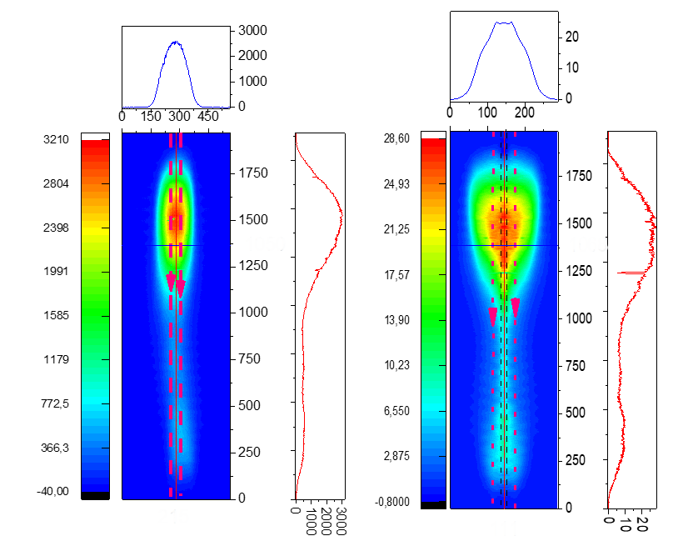
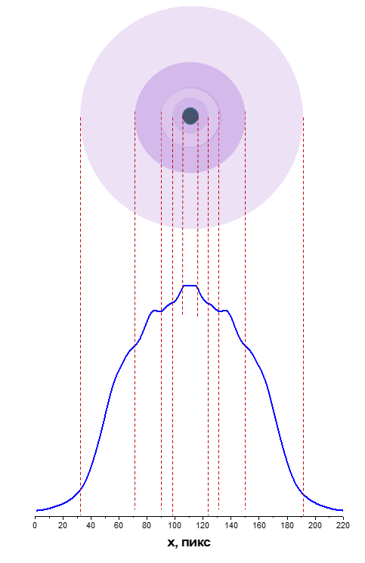
Xenon spark
Nd:YAG laser, τ=4 ns, d_{ф}=66 µm
Xe target, p=5 bar, d_{кр}=500 µm
Xe-XI ions (T=2.7 million K)
Distortion of the spark profile with increasing pressure
Xenon spark projection and the resulting radial distribution
The shape of the radiating region in the cross section y=1480 µm (p=5 bar)
Integral intensity from pressure
The xenon spark has the shape of several nested tubes, which corresponds to a multitude of radially diverging waves with different speeds. The length and intensity of the emission of a xenon spark at λ = 11.25 nm decrease with increasing pressure due to the influence of self-absorption.

Slide 7
Conclusions
The radial distribution of radiating ions in argon, krypton, and xenon laser sparks was obtained using the inverse Abel transform of radiation projections at 11.25 nm.
The ions in the argon spark propagate from the breakdown region as a single cylindrical wave. The radiation intensity increases linearly with pressure.
The krypton spark is a radiating rod at gas pressures up to 8 bar. At high pressures, a second wave of radiating ions appears at the periphery. The radiation intensity increases non-linearly with pressure.
The ions in the xenon spark propagate as several waves at different speeds. The intensity of the radiation drops sharply with increasing pressure due to self-absorption.

Slide 8
Thank you for your attention!

