Slide 1
Development of an information system for complex analysis of geophysical data obtained at radio-physical facilities of ISTP SB RAS
Nikita A. Gromik, ISTP SB RAS
Vladimir A. Ivonin, ISTP SB RAS
Valentin P. Lebedev, ISTP SB RAS

Slide 2
Goals and objectives of information and analysis system
Goal: Creating a software package to visualize and analyze scientific data collected by instruments at the Institute of Solar-Terrestrial Physics SB RAS. The software will model the physical processes involved in data collection, visualize these processes, and allow scientists to study them.
Types of objectives to be solved:
• research
• educational
• application tasks
Target audience:
• scientists and researchers
• students
• pupils
BSFP-2024

Slide 3
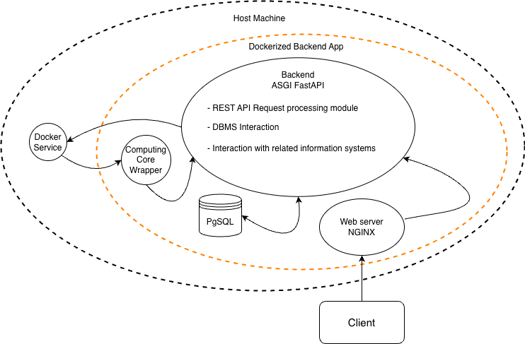
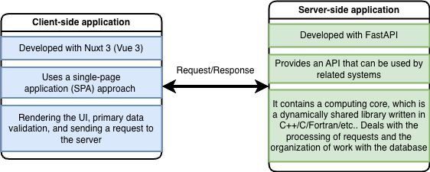
Component and Architecture diagram
BSFP-2024

Slide 4
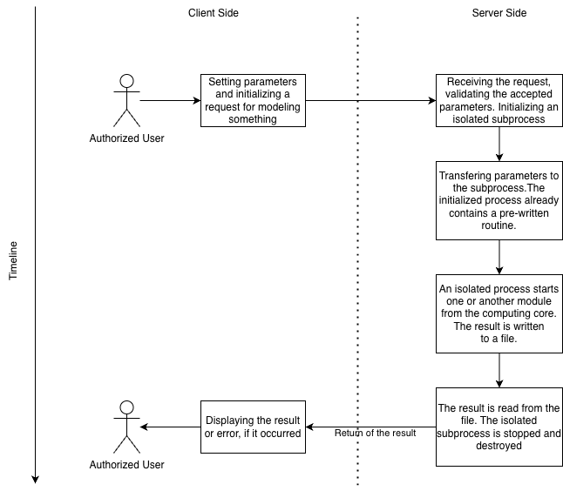
Process diagram
BSFP-2024

Slide 5
Functions of the information and analysis system
• Radio propagation environment modelling using various models of the troposphere, ionosphere, and Earth's magnetic field.
• Modeling the polarization state of VHF radio waves as they propagate through the atmosphere.
• Refraction modeling.
• Comparison and analysis of daily dynamics of ionospheric model parameters.
• Correction of high-altitude ionospheric electron concentration profiles obtained from IISR.
• Visualization of ionograms.
BSFP-2024

Slide 6
Existing models
Ionosphere | Geomagnetic Field | Troposphere | Horizontal Wind | Neutral atmosphere
IRI-2020 | IGRF-13 | Exponential profile n | HWM-14 | NRLMSIS-2.1
IRI-2016 | WMM-2020 |  | HWM-07 | NRLMSIS-2.0
NeQuick 2 | Dipole |  |  | NRLMSISE-00
NeQuick-G
Chapman layer
Another analytical models
BSFP-2024

Slide 7
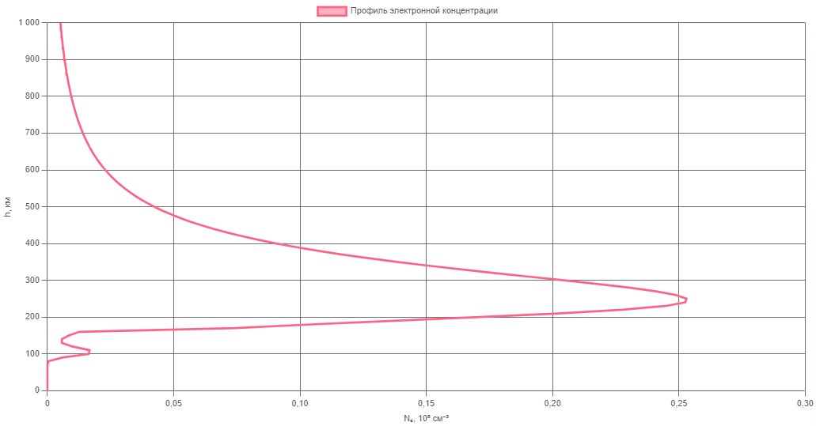
High-altitude profile of the electron concentration of the ionosphere (IRI-2016)
BSFP-2024

Slide 8
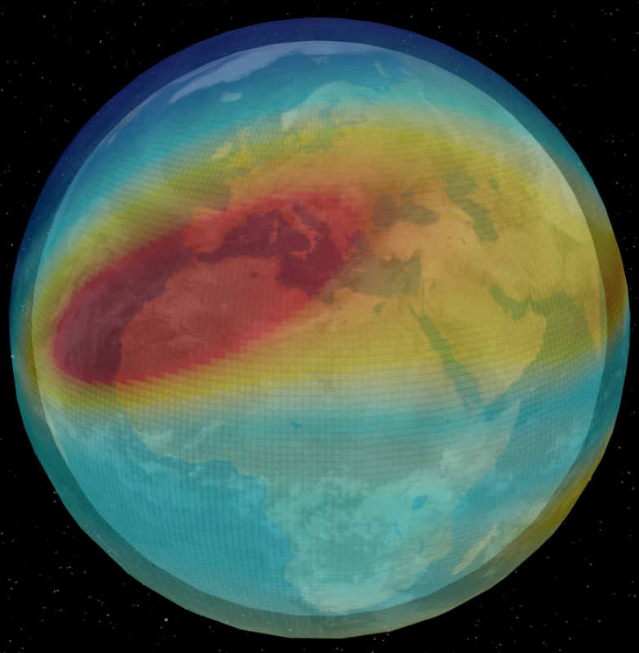
Longitude-latitude profile of the electron concentration of the ionosphere (NeQuick 2)
BSFP-2024

Slide 9
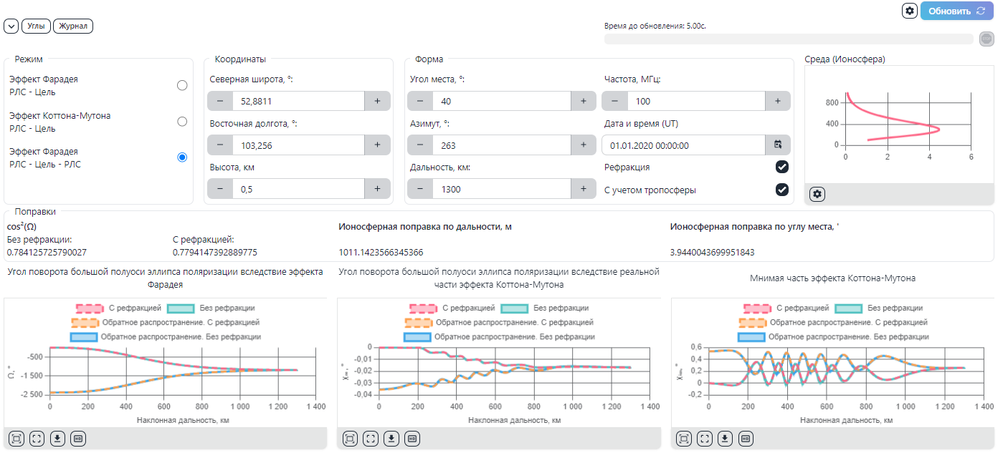
Simulation of radio signal propagation
BSFP-2024

Slide 10
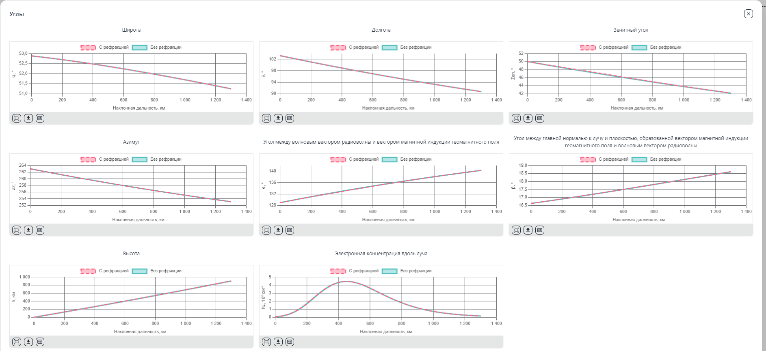
Modeling the trajectory of the radio signal propagation
BSFP-2024

Slide 11
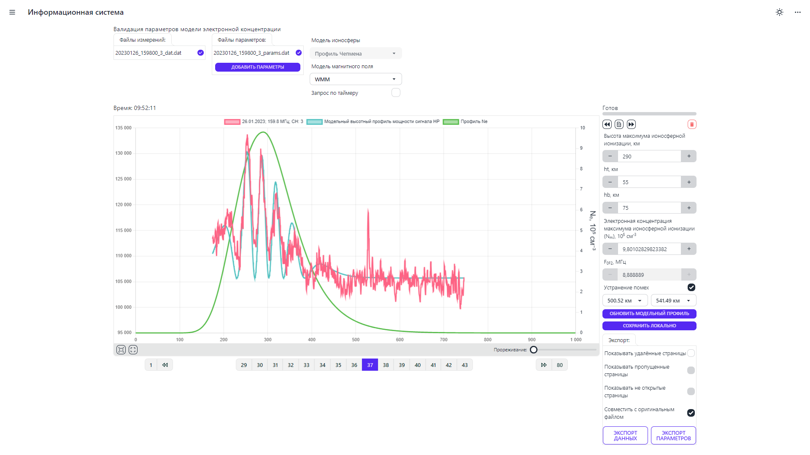
Correction of the obtained height profiles Ne.
BSFP-2024

Slide 12
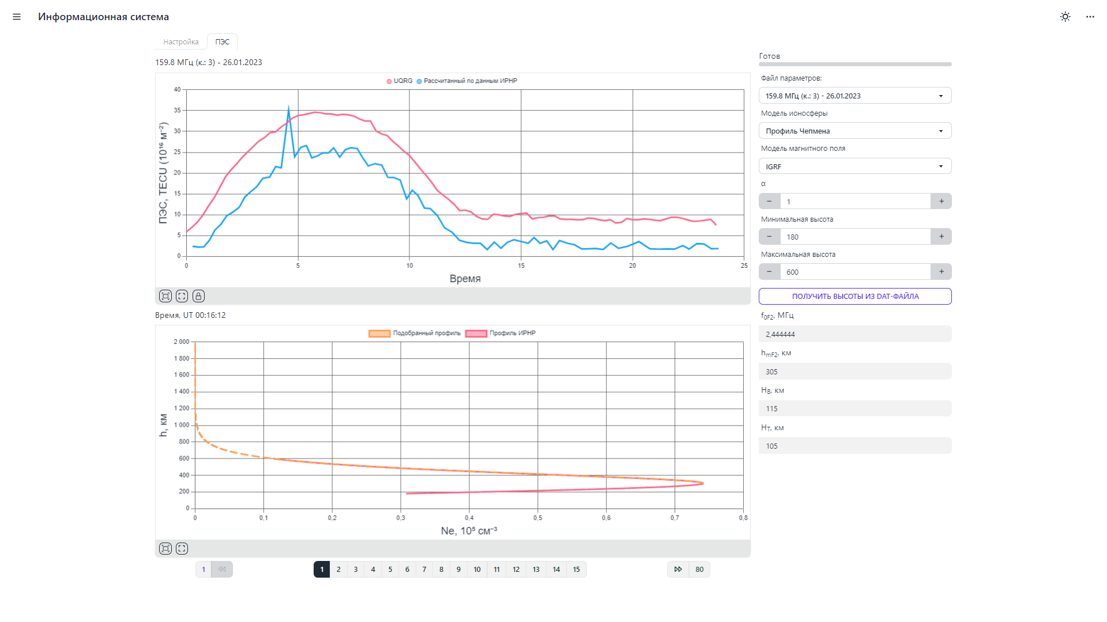
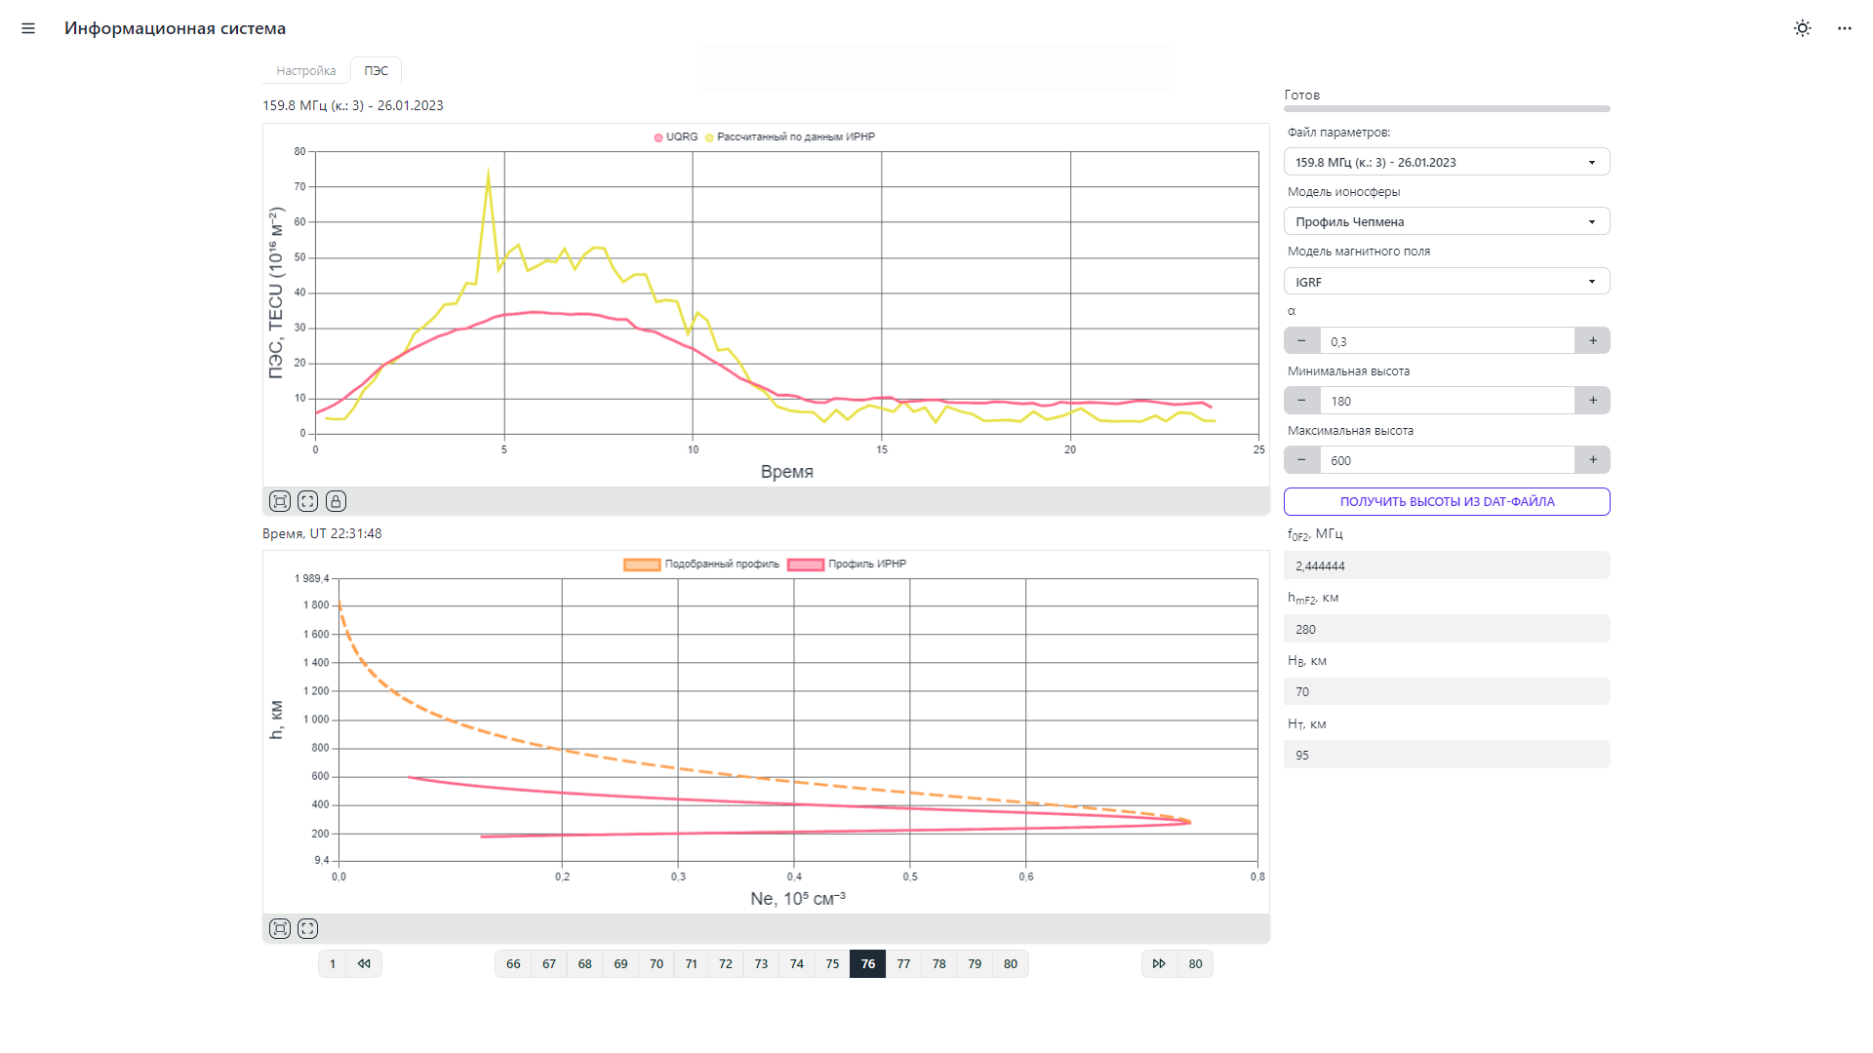
TEC
BSFP-2024

Slide 13
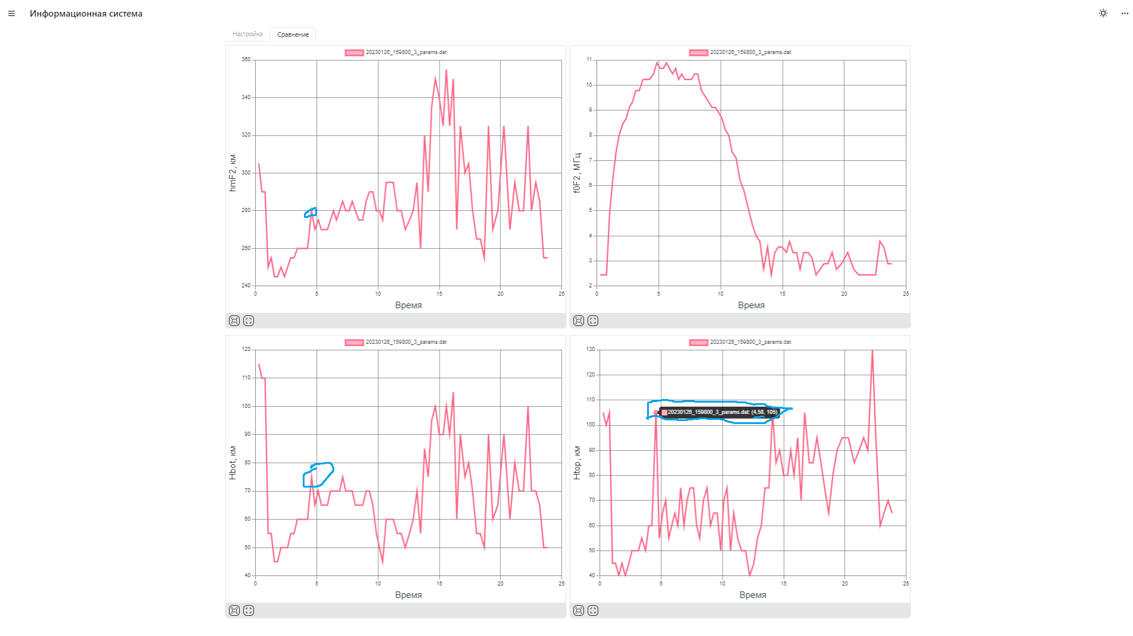
Quick assessment of ionospheric parameters
BSFP-2024

