Slide 1
ANALYSIS OF INTERANNUAL VARIATIONS OF STRATOSPHERE-TROPOSPHERE DYNAMIC COUPLING IN THE NORTHEN HEMISPHERE
K.A. Didenko, Т.S. Ermakova, А.V. Koval, Е.N. Savenkova
didenko.xeniya@yandex.ru
Baikal Young Scientists’ International School on Fundamental Physics “Physical processes in space and near-Earth space” (BSFP-2024), Irkutsk, September 1 – 7, 2024

Slide 2
Overview
Despite the difference in the mechanisms generating and sustaining circulation in the troposphere and stratosphere, the dynamics of these layers are fundamentally inseparable.
Interannual changes in the troposphere–stratosphere coupling are not only indicators of ozone-layer and climate changes but can also be used as predictors of extreme winter weather events.
Variations in the stratosphere–troposphere interaction are a consequence of observed and modeled variations in planetary wave amplitudes.
Purposes and tasks:
to investigate the interannual variability of the stratosphere–troposphere dynamic interaction;
to analyze the vertical component of the three-dimensional wave activity fluxes;
to evaluate the significance of wave activity fluxes time series.

Slide 3
The three-dimensional wave activity flux vector:
(1)
,
where S
.
(2)

Slide 4
JRA-55 reanalysis data
Figure 1. Vertical component of three-dimensional wave activity flux averaged over 65 years (1958–2022), 20 km

Slide 5
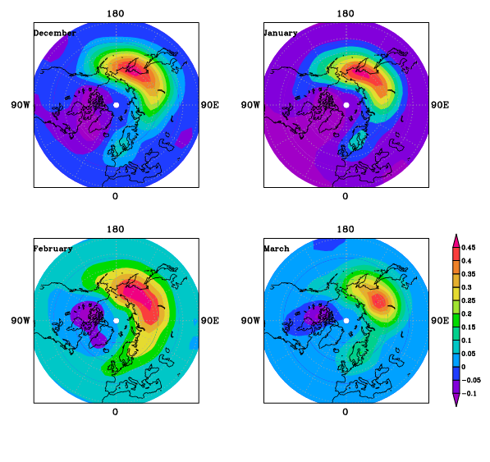
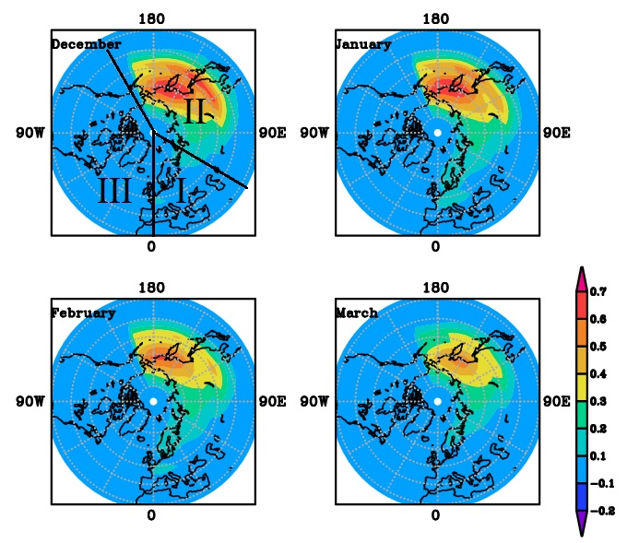
Downward wave activity fluxes and sectors selection
Figure 2. Vertical component of three-dimensional wave activity flux averaged over 10 years (2008–2017), 20 km
Figure 3. An example of division into sectors for the study of interannual variability and trends construction (upper left panel)

Slide 6
Temporal variability of vertical component of wave activity flux, December
I sector II sector III sector
December
December
December
Figure 4. Temporal variability of vertical component of wave activity flux for December at 20 km level, averaged for each sector in 37.5–77.5° N band

Slide 7
Temporal variability of vertical component of wave activity flux from 1980, December
I sector II sector III sector
December
December
December
Figure 5. Temporal variability of vertical component of wave activity flux for December at 20 km level, averaged for each sector in 37.5–77.5° N band

Slide 8
Temporal variability of vertical component of wave activity flux, January
I sector II sector III sector
January
January
January
Figure 6. Temporal variability of vertical component of wave activity flux for January at 20 km level, averaged for each sector in 37.5–77.5° N band

Slide 9
Temporal variability of vertical component of wave activity flux from 1980, January
I sector II sector III sector
January
January
January
Figure 7. Temporal variability of vertical component of wave activity flux for January at 20 km level, averaged for each sector in 37.5–77.5° N band

Slide 10
Temporal variability of vertical component of wave activity flux, February
I sector II sector III sector
February
February
February
Figure 8. Temporal variability of vertical component of wave activity flux for February at 20 km level, averaged for each sector in 37.5–77.5° N band

Slide 11
Temporal variability of vertical component of wave activity flux, March
I sector II sector III sector
March
March
March
Figure 9. Temporal variability of vertical component of wave activity flux for March at 20 km level, averaged for each sector in 37.5–77.5° N band

Slide 12
Temporal variability of vertical component of wave activity flux from 1980, March
I sector II sector III sector
March
March
March
Figure 10. Temporal variability of vertical component of wave activity flux for March at 20 km level, averaged for each sector in 37.5–77.5° N band

Slide 13
Conclusion
The method for stratosphere-troposphere coupling analysis is demonstrated.
An increase in the vertical component of wave activity flux from the troposphere to the stratosphere is observed in January and March over the Russian Far East.
The interannual decrease of the upward component of wave activity flux is observed only in December over the European part of Russia, Europe, and the Middle East.
Downward fluxes of wave activity are observed mostly over northern North America.
Various natural long-period oscillations are a possible cause of the observed temporal variability.
The research was supported by Russian Science Foundation grant #23-77-01035

Slide 14
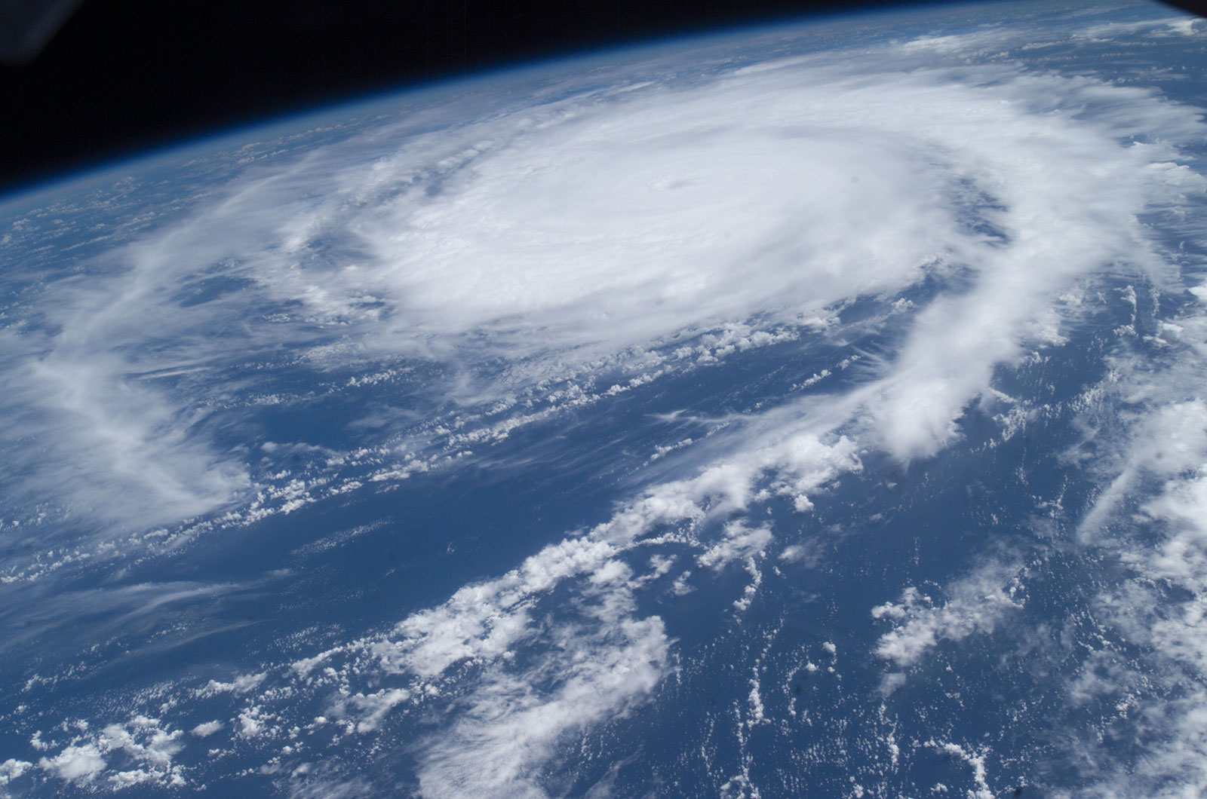
Thank you for your attention

