Slide 1
Polarization jet from GPS satellite navigation system measurements.
BAIKAL YOUNG SCIENTISTS’ INTERNATIONAL SCHOOL ON FUNDAMENTAL PHYSICS
“PHYSICAL PROCESSES IN OUTER AND NEAR-EARTH SPACE”
XVIII Young Scientists’ Conference
“Interaction of fields and radiation with matter”
Irkutsk, September 1-7, 2024
Spiridon I. Danilov, Stepanov A.E., Gololobov A.Yu.
Yu.G. Shafer Institute of Cosmophysical Research and Aeronomy of the Siberian Branch of the RAS

Slide 2
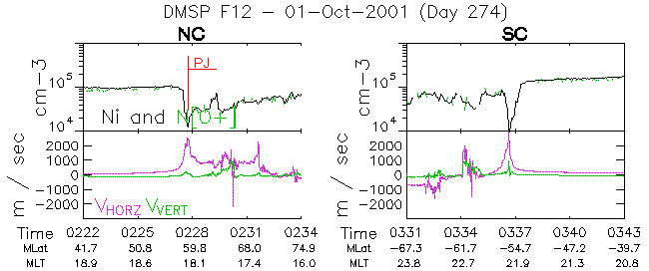
Polarization jet (PJ) is a rapid, westward flowing ions in the plasmapause region. Plasma drifts with velocities above 1000 m/sec in the evening sector lead to the formation of rapid ionization dips as a result of plasma being carried to the pre-noon sector in the jet's zone of action and is most noticeable during magnetic storms. Many ground-based and satellite measurements indicate that the width of the PD is between 100 and 200 km (1°-2°).
Data from 1 October 2001 by the DMSP-F12 satellite in the interval from 02:22 UT to 03:43 UT
The purpose of this work is to study the possibility of determining the polarization jet based on measurement data from satellite navigation systems, and to compare the results obtained with measurements of the polarization jet from the Yakutsk ground-based ionospheric station and satellites of the DMSP series.

Slide 3
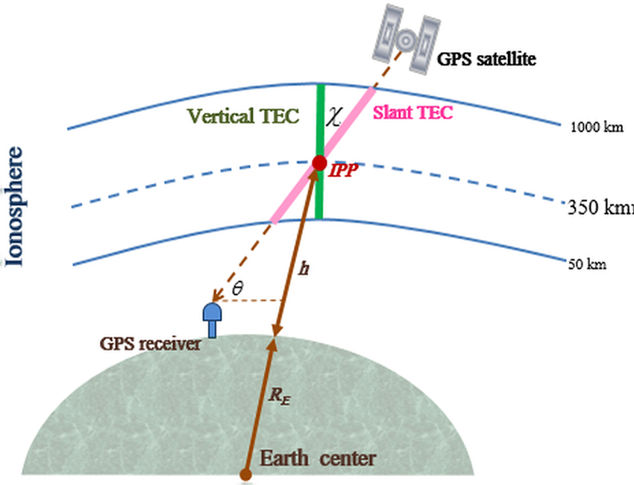
Global Positioning System (GPS) is one of the global navigation satellite systems. The GPS system consists of 32 satellites rotating in six circular orbits at an altitude of about 20,200 km and with an orbital period of 11 hours and 58 minutes. There are always at least 8 continuously moving satellites in the field of view of the GPS receiver, which makes it possible to obtain satellite measurement data and allow one to calculate the total electron content (TEC) in the ionosphere, which allows continuous observations of the state of the ionosphere.
TEC is the total number of electrons integrated between two points along a tube with a cross-section of one meter squared, i.e. the electron number density in the column. Calculation of TEC based on measurement data from satellite navigation systems is based on the dispersion dependence of the refractive index of radio waves penetrating through the ionosphere

Slide 4
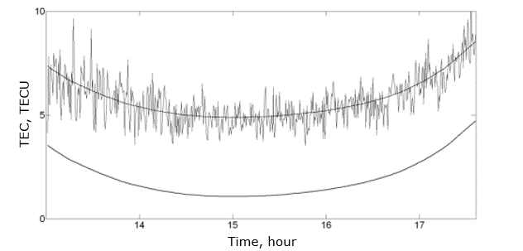
TEC calculations
Corrected TEC values from ISL phase measurements for the satellite passage are obtained
The calculation of the Slant TEC:
a) By pseudorange measurements
where Crs – correction value, obtained from the original TEC by the least squares method; N – number of measurements used to calculate the TEC.
where f1 and f2 – subband frequency L1 and L2, respectively, P1 and Р2 – measured pseudorange at frequency f1 and f2 , respectively;
b) By phase measurements
where L1·λ1 и L2·λ2 – increments of radio signal phase path in the ionosphere, L1 = ∆φ/2π and L2 = ∆φ/2π – GNSS receiver phase measurements taken at frequency f1 and f2, respectively.
The actual values ​​of the slant TEC obtained from the pseudorange can be calculated if there are differences in code delays:
Total electron content calculated from pseudorange measurements and phase measurements, excluding differential code delays and initial phase
2) Vertical TEC
where Isp - is the absolute TEC based on pseudo-range measurements, bs - is the differential code delays in the satellite equipment, br - differential code delays in the equipment receiver
where Is – slant TEC; Re – average radius of the Earth; hi – ionospheric point height; χ – satellite elevation angle.

Slide 5
Data
The GPS-TEC analysis program was used to calculate TEC. A magnetic storm was observed from November 12 to 14, 2012. During this period, simultaneous observations of PD signs were made using data from the Yakutsk ionospheric ground station and the DMSP F-17 satellite.
Measurement data from satellite navigation systems are stored in the RINEX format (The Receiver Independent Exchange Format). The file contains the initial data required to calculate the TES (pseudoranges P1 and P1, phases L1 and L2). In this paper, RINEX data was obtained from the website: https://cddis.nasa.gov/archive/gnss/data/daily.
Ionospheric measurements at the Yakutsk station are carried out by the DPS-4 ionosonde.
Satellite data were obtained from the official website of the DMSP project (https://dmsp.bc.edu/index.html).

Slide 6
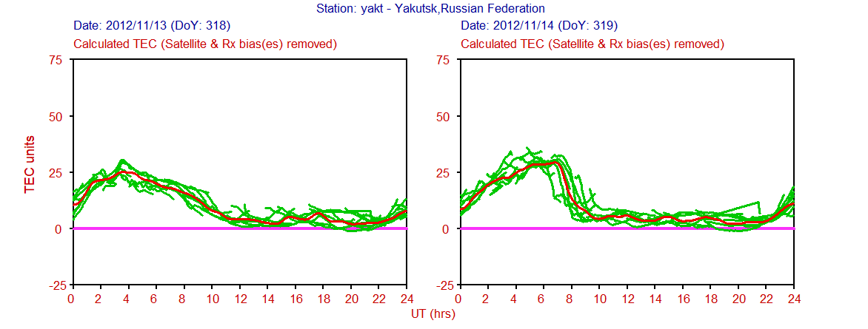
TEC calculations for November 13 and 14, 2012. The green lines are calculations of individual satellites, and the red line is their average value.

Slide 7
TEC calculations for November 13 and 14, 2012.

Slide 8
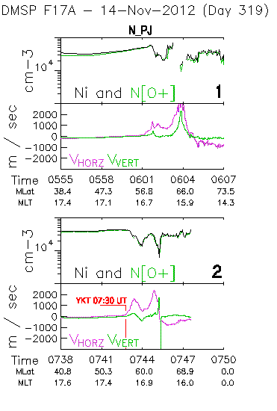
Analysis of Polarization Jet Observations November 14, 2012
Kp-index
Kp-index for November 14, 2012. The sum of Kp is equal to 30.
Data from the DMSP F17 satellite. The horizontal axes are time in UT, magnetic latitude MLat and local magnetic time MLT, and the vertical axes are ion concentration and velocity in m/s.
Days

Slide 9
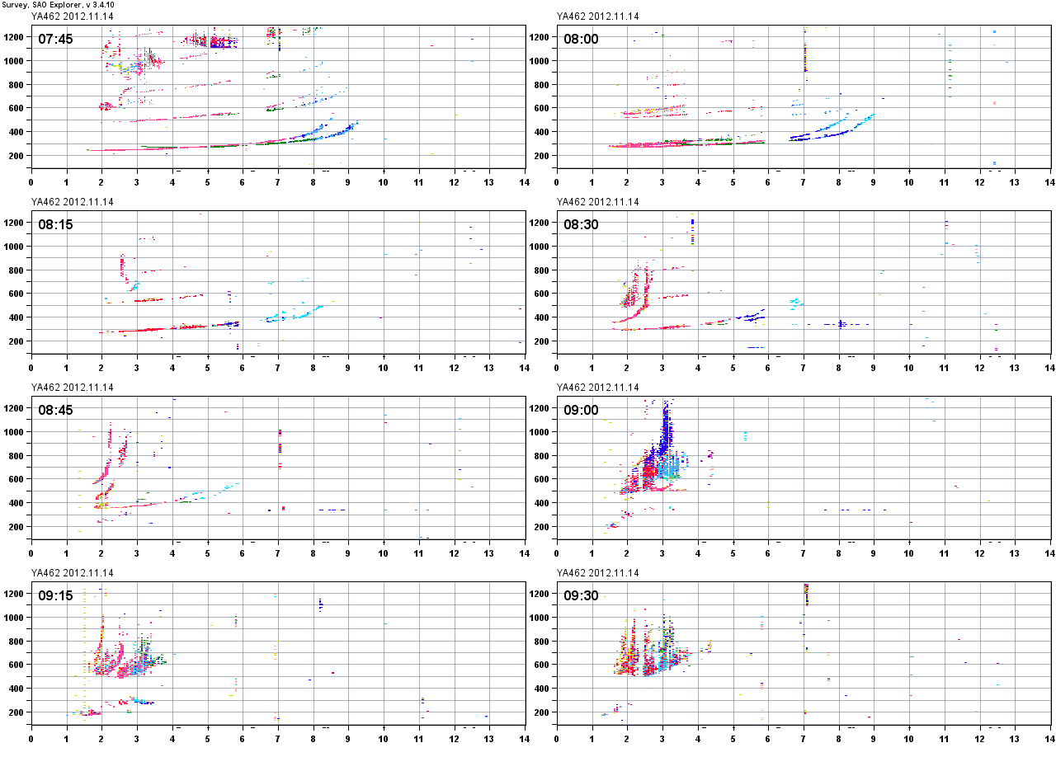
16:45 LT
17:00 LT
Ground-based data November 14, 2012. Sequence of ionograms of the Yakutsk station. On the horizontal axes – frequency in MHz, and on the vertical axes – altitude in kilometers.
17:15 LT
F3s
17:30 LT
F3s
17:45 LT
18:00 LT
18:15 LT
18:30 LT

Slide 10
Conclusion
GPS measurement data showed that the sharp drop in TEC in the daily course coincides in time with the observation of the polarization jet according to the Yakutsk ground ionospheric station and the DMSP F17 satellite and may be a sign of PD.
Further studies involving measurement data from satellite navigation systems reveal additional possibilities for studying the polarization jet.

Slide 11
Thank you for your attention!

