Slide 1
Observing of earthquake on 02.04.24 in Taiwan according "Ionosonde-MS" data
Cedrik M. V.
Ph.D Podlesnyi A. V.

Slide 2
Introduction
In this paper we study ionospheric irregularities caused by Taiwan earthquake 02.04.2024 (23.77 N, 121.67 E) at a distance of 3500 km from the epicenter.
Strong earthquakes are the source of a seismic wave that generates a powerful acoustic wave that can reach ionospheric heights and cause disturbances there. The study of ionospheric responses to such events allows us to understand the mechanisms of energy transfer from sources located in the lower part of the atmosphere.
The difficulty in detecting of response on earthquake with an ionosonde is that it is a fast process, requiring temporal resolution of measurement 1 minute or better. In this work we use data with 15s temporal resolution obtained with Ionosonde-MS.

Slide 3
Observation geometry
Origin time:
2024/04/02
23:58:09 UTC
Mag: 7.2

Slide 4
Ionosonde-MS
“Ionosonde-MS” is digital ionosonde based on software defined radio (SDR) technology. It use continuous signal with linear frequency modulation (LFM or Chirp).
On time earthquake observing ionosonde works with following parameters:
Signal type | Linear frequency modulation (Chirp mode)
Sounding signal power | 15 W
Sounding frequency range | 1-14 MHz
Frequency tuning rate | 1 MHz/s
Sounding period | 15 s
TX and RX antennas type | Vertical delta antennas
Height resolution | 1.25 km
Frequency resolution | 20 kHz

Slide 5
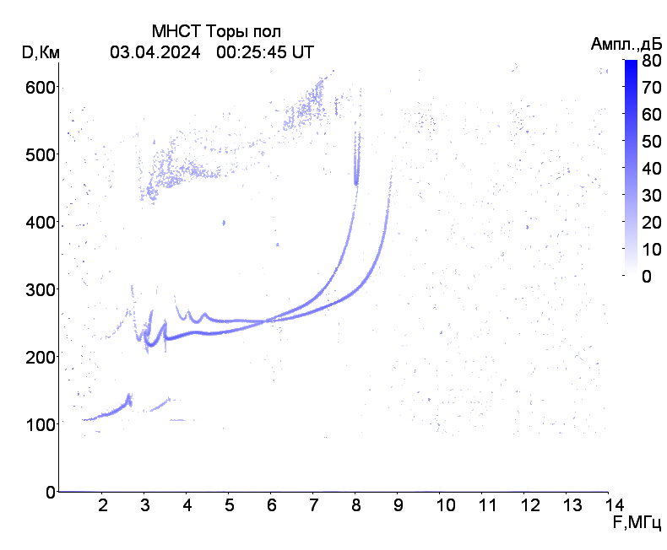
Ionospheric irregularities on Tory vertical sounding ionograms

Slide 6
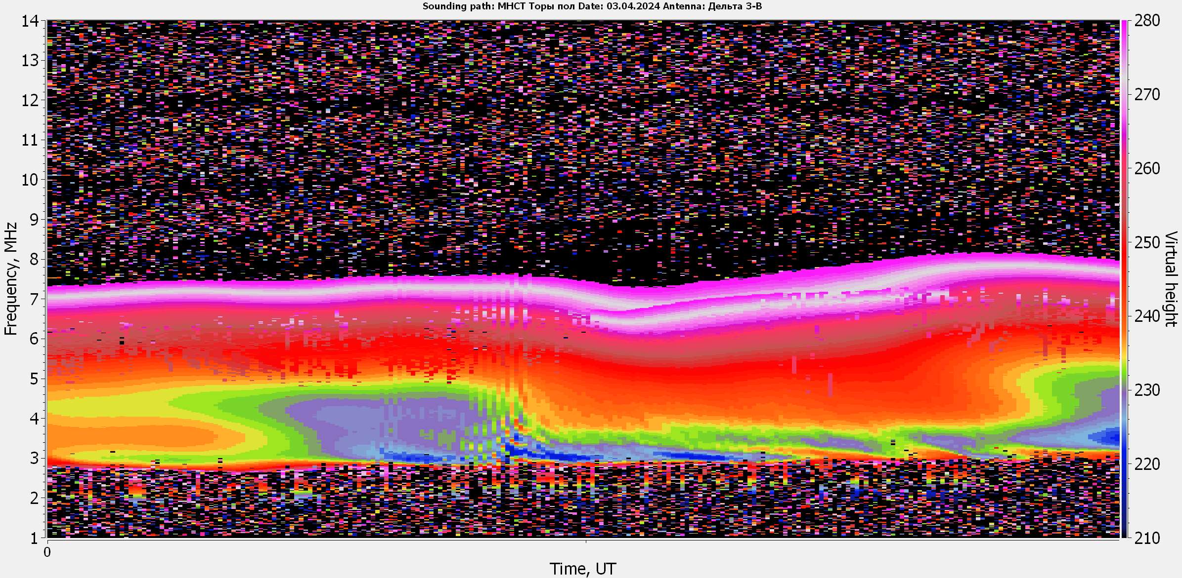

Slide 7
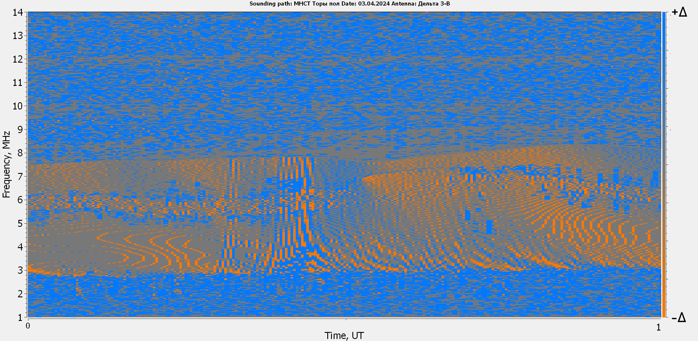
$$\left.H\left(t\right)=H\left(t+1\right)−H(t\right)$$

Slide 8
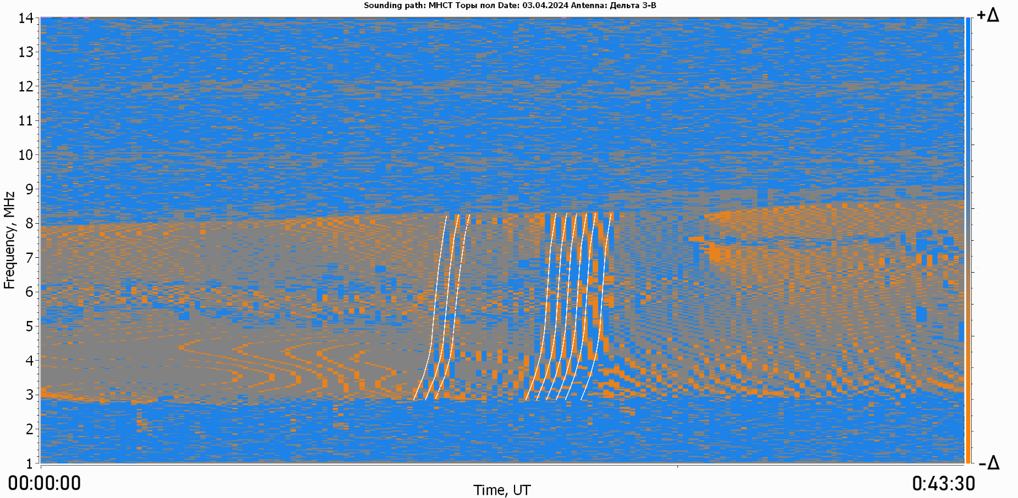
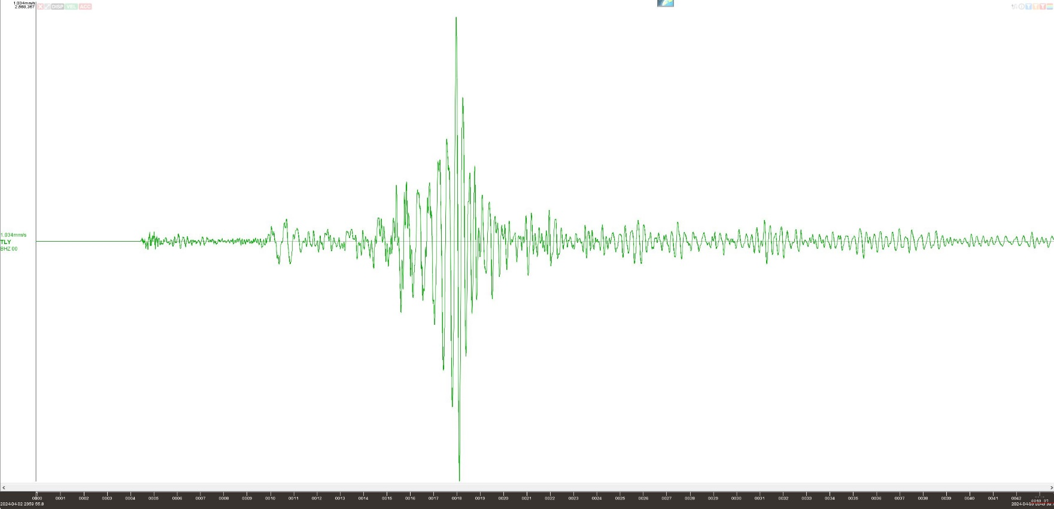
7 m 34 s
0:17:30
As can be seen that the disturbance
propagates to the height of ionosphere
F-layer approximately 8 minutes, which
agree with conclusions in paper [1]
0:09:56
15 s
17 s
¹Dynamics of vertical ionospheric inhomogeneities over
Irkutsk during 06:00–06:20UT 11/03/2011 caused by
Tohoku earthquake / O.I. Berngardt et al./
Journal of Atmospheric and Solar-Terrestrial Physics
132(2015) 106–115
39 s
22 s
32 s
24 s
26 s
28 s
28 s
30 s
TLY station. BHZ channel

Slide 9
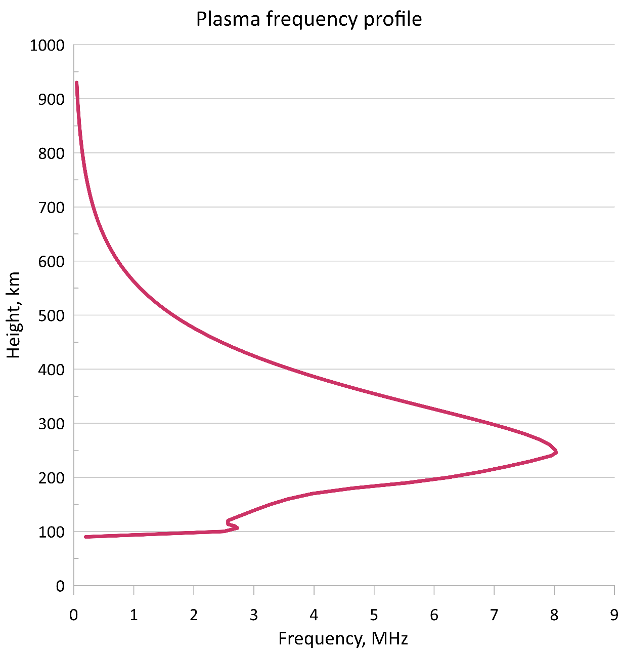
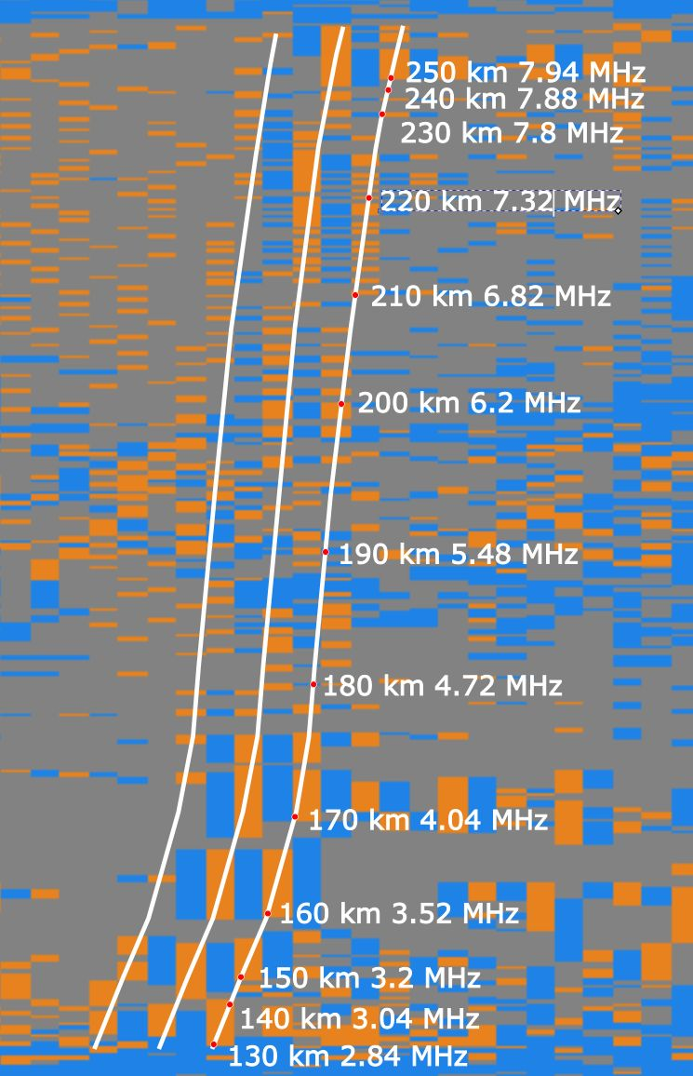

Slide 10
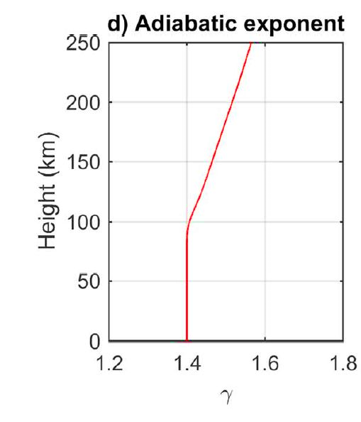
Sound velocity profile calculation
The sound velocity was calculated according to the following expression[1]:
$$V_{s}=\sqrt{γRT}$$
Therefore, at the beginning, an altitude temperature profile was
obtained with NRLMSIS 2.1 model.
¹Nonlinear acoustic waves in the viscous thermosphere and ionosphere above earthquake / Chum et al./ Journal of Geophysical Research: Space Physics Vol. 121 Issue 12 PP. 126-137, 2016

Slide 11
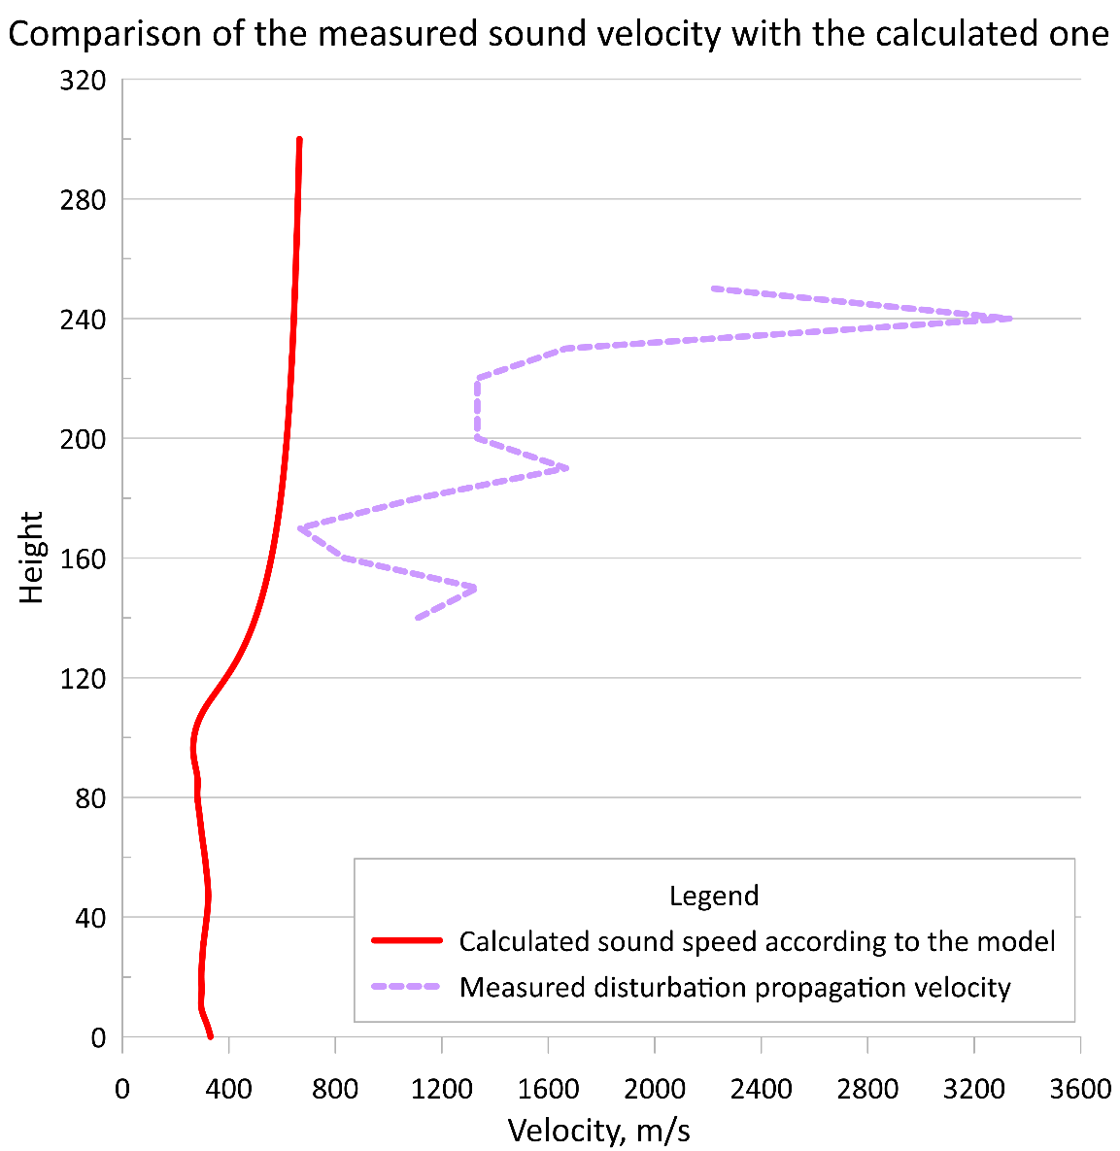
Comparison of the calculated sound velocity profile (red solid line) with the measured disturbation propagation velocity (violet dashed line)

Slide 12
Conclusions
In this paper confirmed the conclusions regarding the value of the horizontal propagation speed of the seismic wave and the propagation time of the sound wave to the heights of the F layer, made earlier by other authors in their papers.
Offered and implemented is a technique of determining the propagation velocity of disturbances in the ionosphere caused by an earthquake.
The average disturbance propagation velocity in the case considered in this study was 1356 m/s in the altitude range of 130-250 km. This indicates the non-sonic origin of the propagation mechanism.

Slide 14
