Slide 1
Lecture: NON-LINEAR PHENOMENA IN THE IONOSPHERIC F-REGION INDUCED BY EXTRAORDINARY POLARIZED POWERFUL HF RADIO WAVES
N. F. Blagoveshchenskaya
State Scientific Center of the Russian Federation
Arctic and Antarctic Research Institute, St. Petersburg, Russia,, nanntaly@aari.nw.ru nataly@aari.nw.ru sova@aari.nw.ru askalishin@aari.nw.ru
International Baikal scientific school on fundamental physics (BSFP-2024), Institute of solar-terrestrial physics SB RAS, Irkutsk, Russia, 1 – 7 September, 2024

Slide 2
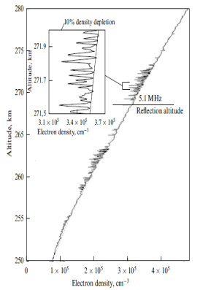
Thrust Areas and Potential Applications
Area 1. High Altitude heating (F Layer)
  Create density irregularities, turbulences, optical emissions, and artificial ionization layers: Affect GPS signals, HF comm., UHF radar, space borne SAR and optical sensors
  Create plasma duct and lens: Inject VLF waves into the RBs, HF focusing
  Create source of ULF-ELF waves < 50 Hz without electrojet current: See Area 2 apps.
Area 2. Low Altitude heating (D/E Layers)
  Modulate electrojet current to create coherent & tunable ULF-ELF-VLF source in the ionosphere
  Potential applications:
    Global communications
    Underground imaging
    Radiation belt remediation

Slide 3
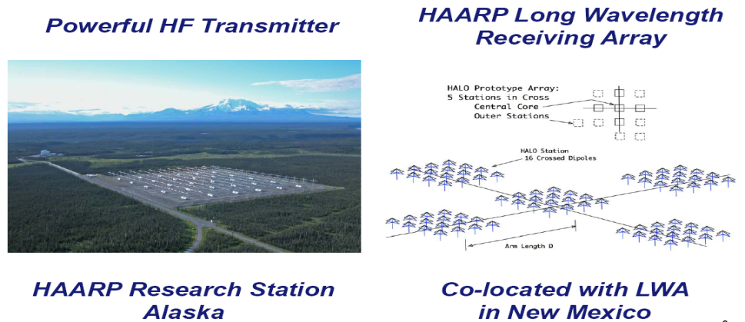
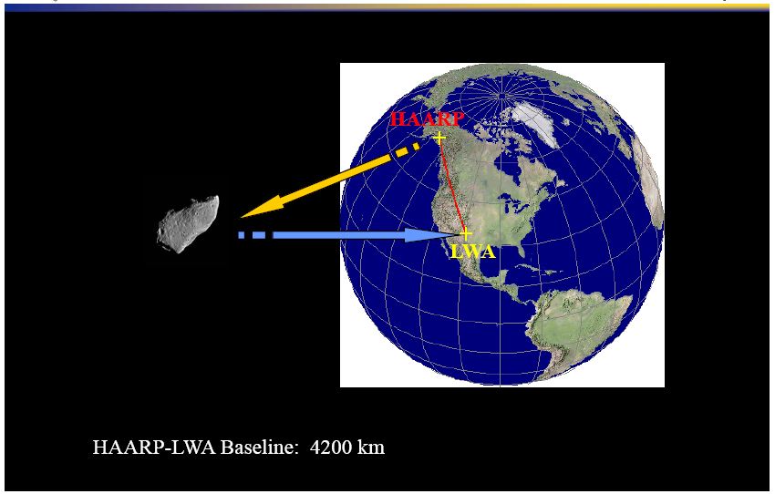
Thrust Areas and Potential Applications
Area 3. Bi-Static Space Radar
  Receiver arrays were installed at Albuquerque, NM to collect backscattered HF signals from space objects.
  Provide space situation awareness (killer asteroid etc..)

Slide 4
“…effects of X-mode pumping are poorly understood and are at the forefront of HF active experiment research, both experimentally and theoretically” (19th International EISCAT Symposium, 2019)
        Outline
Introduction
Features, generation conditions, threshold of excitation, plausible generation mechanisms of various HF-induced phenomena in F-region of the ionosphere under X-mode heating
Comparison of the O- and X-mode effects
Concluding remarks

Slide 5
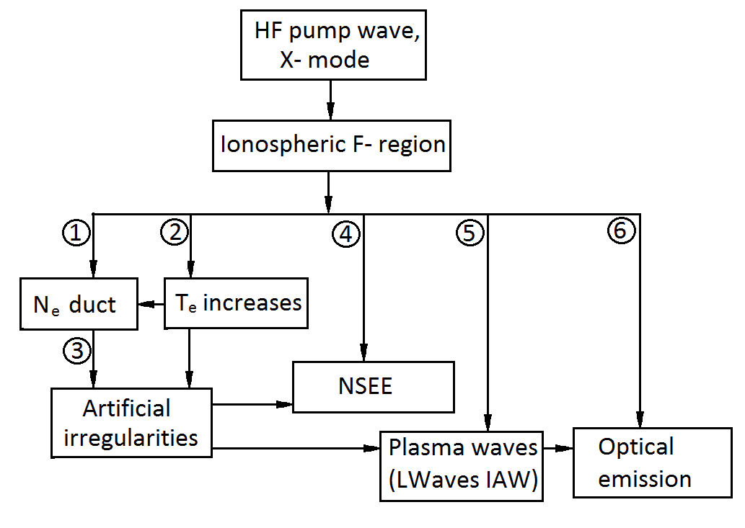
X-mode HF-induced phenomena in the ionospheric F-region
.

Slide 6
Experiments at EISCAT/Heating facility
The EISCAT/Heating facility near Tromsø in northern Norway(69.6° N, 19.2° E) described by Rietveld et al. [2016] was used to modify the F-region of the ionosphere .
Diagnostics:
EISCAT UHF incoherent scatter radar at 930 MHz, co-located with the EISCAT/Heating facility; radar beam towards MZ; from 5 s resolution;
CUTLASS (SuperDarn) radar at Hankasalmi, Finland (62.3° N; 26.6° E) at three or six operational frequencies between 8 and 20 MHz;
ALIS in Scandinavia;
SEE equipment at Tromsø,
NSEE equipment near St. Petersburg;
bi-static HF radio scatter near St. Petersburg;
Tromsø ionosonde (dynasonde)

Slide 7
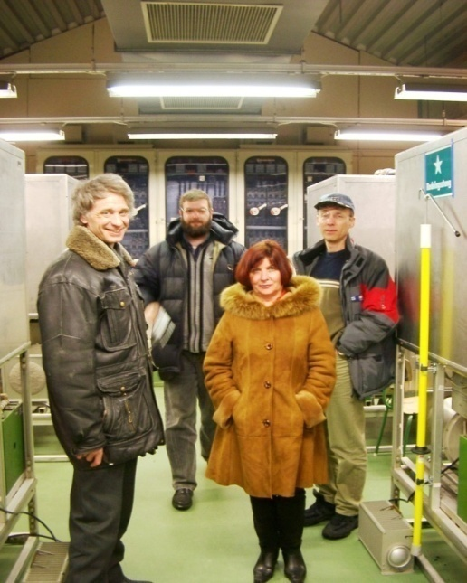
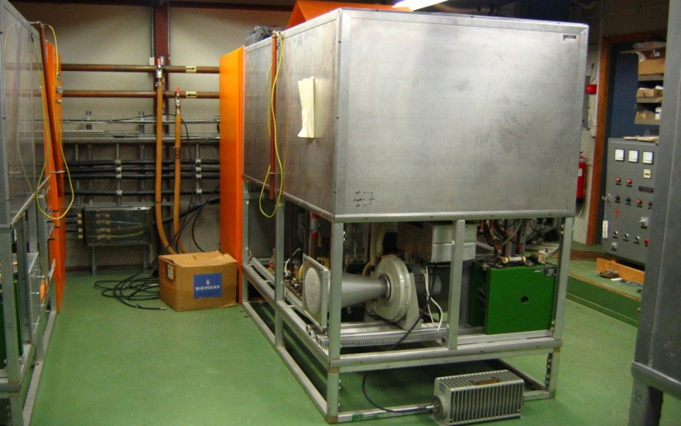
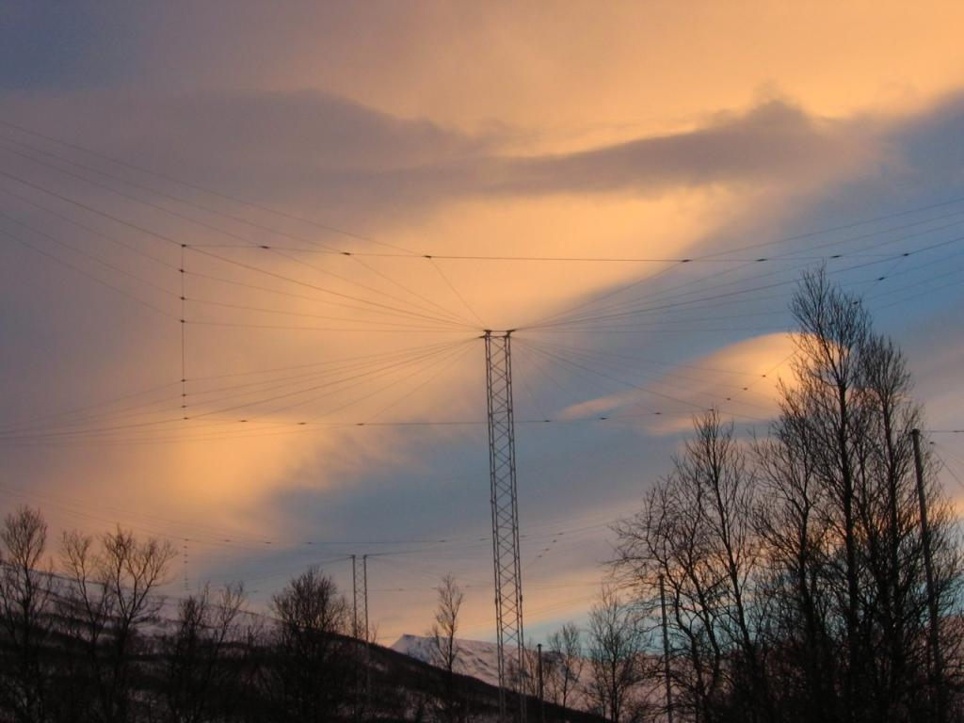
EISCAT/Heating Facility
The EISCAT/Heating facility near Tromsø in northern Norway(69.6° N, 19.2° E) described by Rietveld et al. [2016] was used to modify the F-region of the ionosphere . The heating details are the following: HF heating facility was operating at frequencies between 3.9 and 7.9 MHz, with O/X-mode polarization. Effective radiated power was varied between 100 960 MW (phased array 1, 2 and 3)

Slide 8
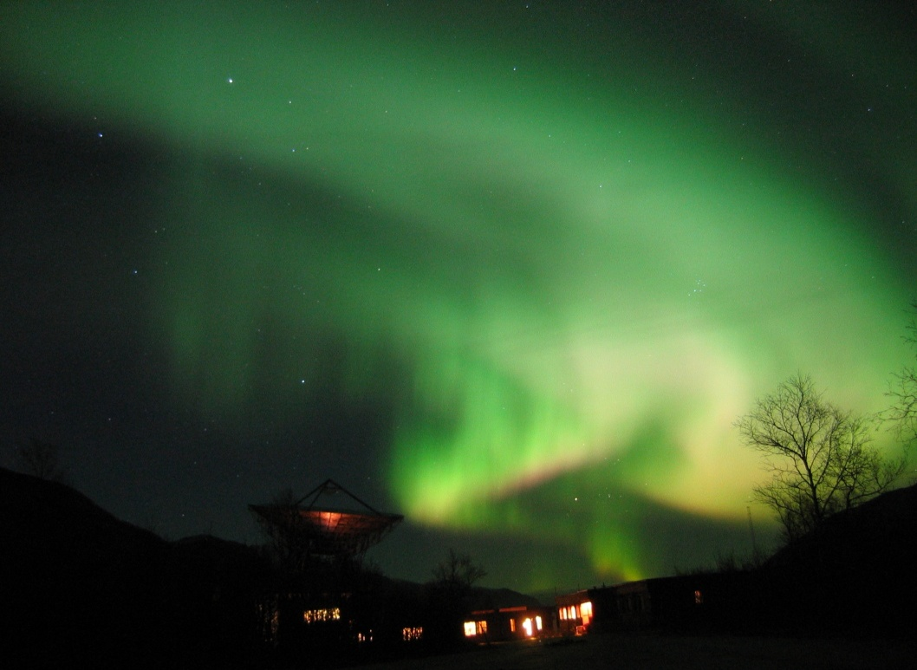
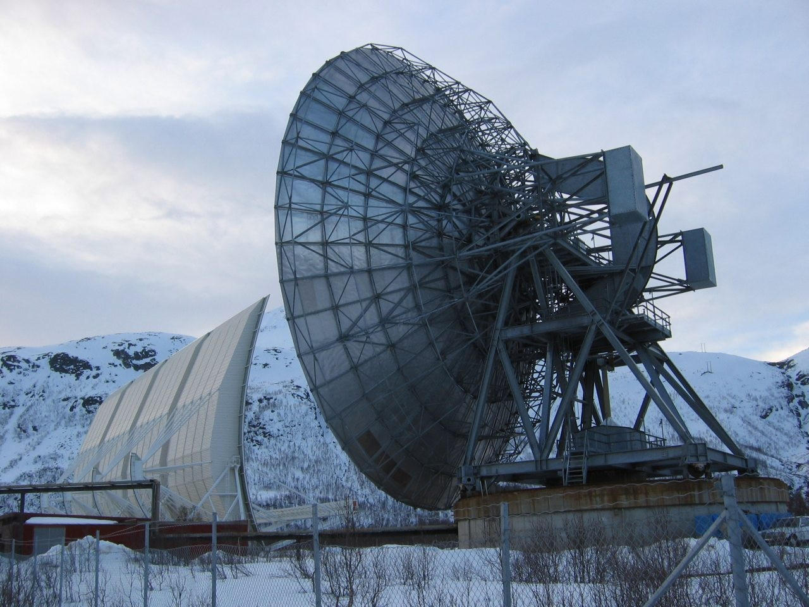
EISCAT Incoherent scatter radars
EISCAT UHF radar (930 MHz).
EISCAT UHF and VHF radars (930 and 220 MHz).

Slide 9
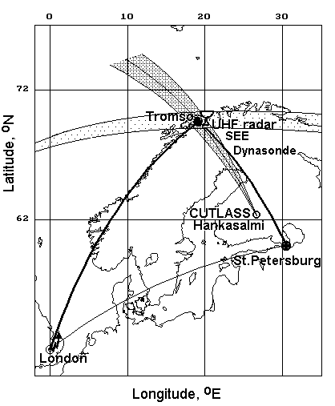
Experimental geometry
A map showing the experiment geometry. Experiments were carried out in 2010 - 2023.
The HF heating facility at Tromsø was used for HF ionospheric modification of F-region. HF heating facility was operating at frequencies between 3.9 and 7.9 MHz, with O/X-mode polarization. Effective radiated power was varied between 150 960 MW (phased array 1, 2 and 3) .
Multi-instrument diagnostics from the European Incoherent Scatter (EISCAT) UHF radar, the Finland CUTLASS (SuperDARN) HF radar, the ALIS in Scandinavia, the SEE equipment at Tromsø, NSEE equipment near St. Petersburg, the bi-static HF radio scatter, and the Tromsø ionosonde (dynasonde) have been used out during campaigns.

Slide 10
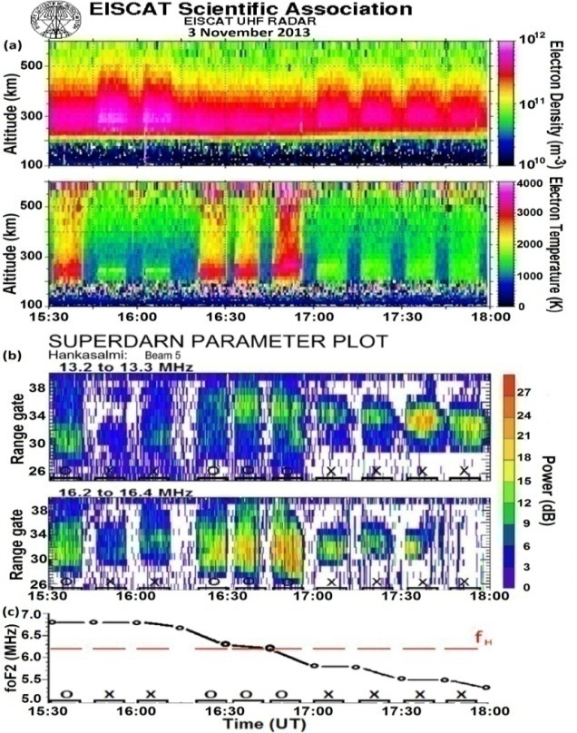
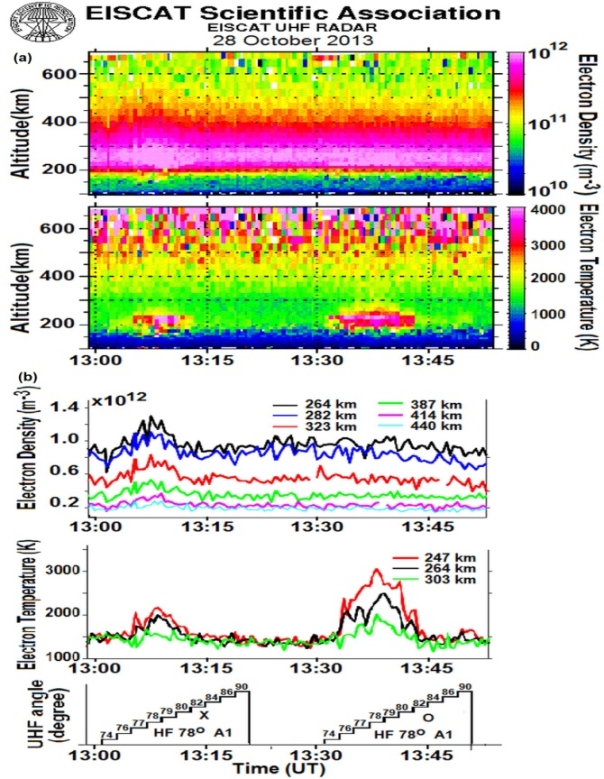
Ducts of enhanced electron density
(a) Altitude-temporal behavior of N_{e} and T_{e} from the EISCAT UHF ISR radar observations; (b) CUTLASS (SuperDARN) radar backscatter at about 13 and 16 MHz (beam 5 directed over Tromsø) depending on distance (range gate) and time; (c) temporal behavior of the foF2 and f_{H..} ERP = 450 MW.
Altitude-temporal behavior of the Ne and Te, the Ne and Te variations at fixed altitudes from the EISCAT UHF radar during alternative O-/X- mode pumping. HF pump wave was radiated at f_{H}= 7.953 МHz (f_{H} ≤ f_{o}F2) towards the MZ. ERP = 840 MW. ISR run in the elevation angle stepping mode from 74 to 90°

Slide 11
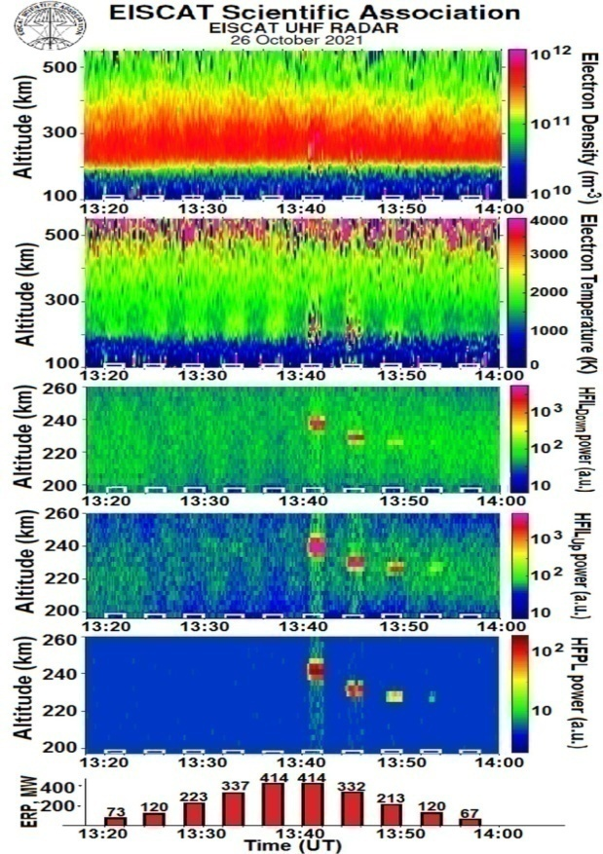
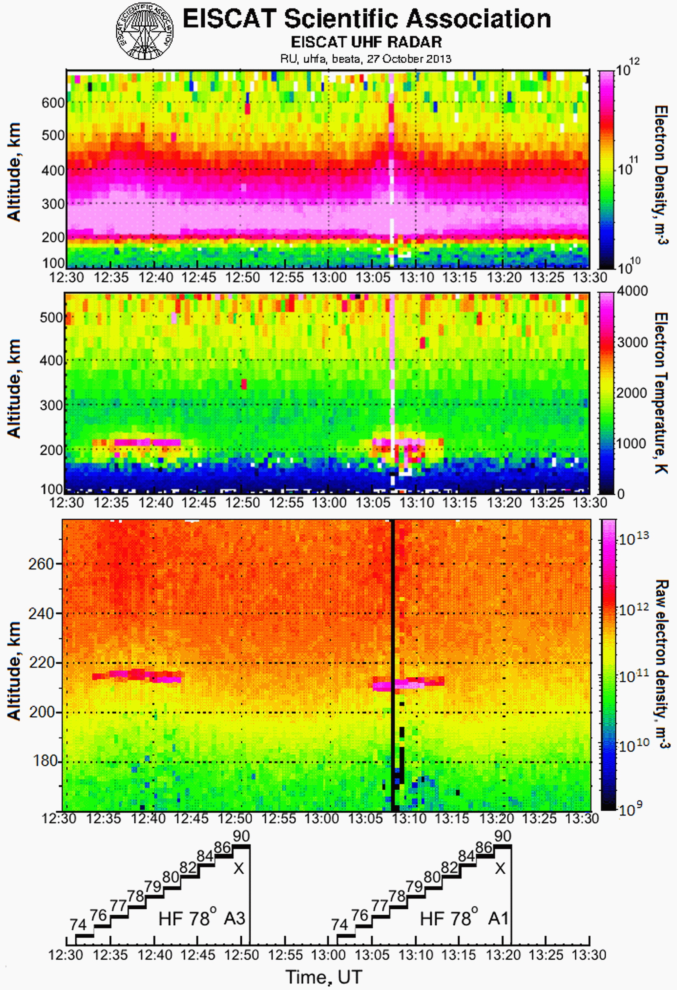
Ducts of enhanced electron density
Altitude-temporal behavior of the Ne and Te and backscattered power from EISCAT UHF radar analysis on 27 October 2013. The X-mode HF pump waves radiated at f_{H}= 7.953 МHz towards the MZ with alternative use of the HF Phased Arrays with the wide (Array 3) and narrow (Array 1) beam width. EISCAT UHF radar run in the elevation angle stepping mode.
EISCAT UHF ISR observations during the X-mode HF power stepping experiment on 26 October 2021, showing the altitude-temporal evolution of the Ne, Te, intensities HFIL_{DOWN} and HFIL_{UP}, and HFPL. HF pump wave was radiated at f_{H}= 6.77 МHz towards the MZ.

Slide 12
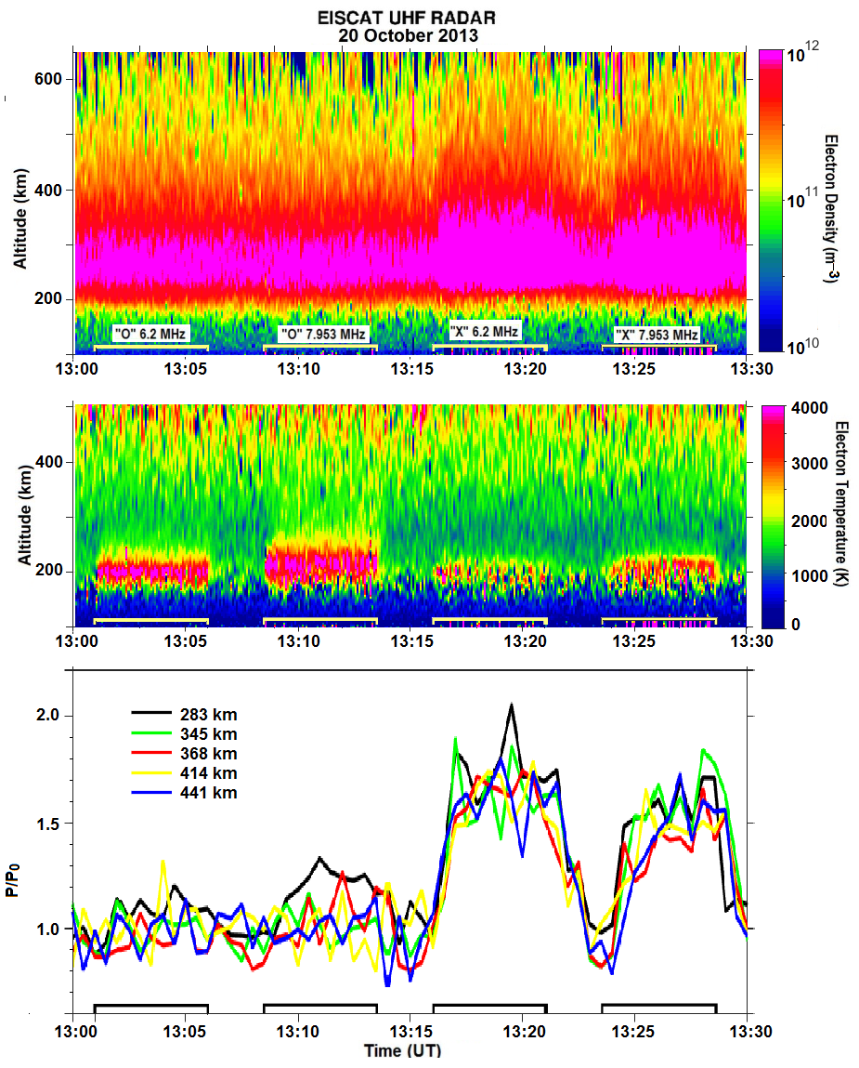
Ducts of enhanced electron density
Summarizing the features of artificial Ne ducts,, we should highlight the following:
(i) field-aligned electron density enhancements by N_{e} - N_{eo} / N_{eo} = 50 – 80% from the background N_{eo} level;
(ii) the extent along the magnetic field line from ~ 300 to 600 km;
(iii) the horizontal width of the duct of 3 - 4 °;
(iiii) the time of the duct development of 30 - 60 s;
(iiiii) the decay time within 2 – 5 min;
(iiiiii) the threshold electric field ERP = 57 – 73 МW (E= 0.24 - 0.27 V/m in a free space).
Fig. Altitude-time plots of the N_{e} and Te from the EISCAT UHF radar observations during alternative O-/X-mode pumping at f_{H}= 6.2 and 7.953 МHz and calculated values of the relative plasma partial pressure P/P₀
P/P₀ can be written as (Gurevich, 1978)
P/P₀= Ne(Te + Ti) /Ne₀(Te₀ + Ti₀)

Slide 13
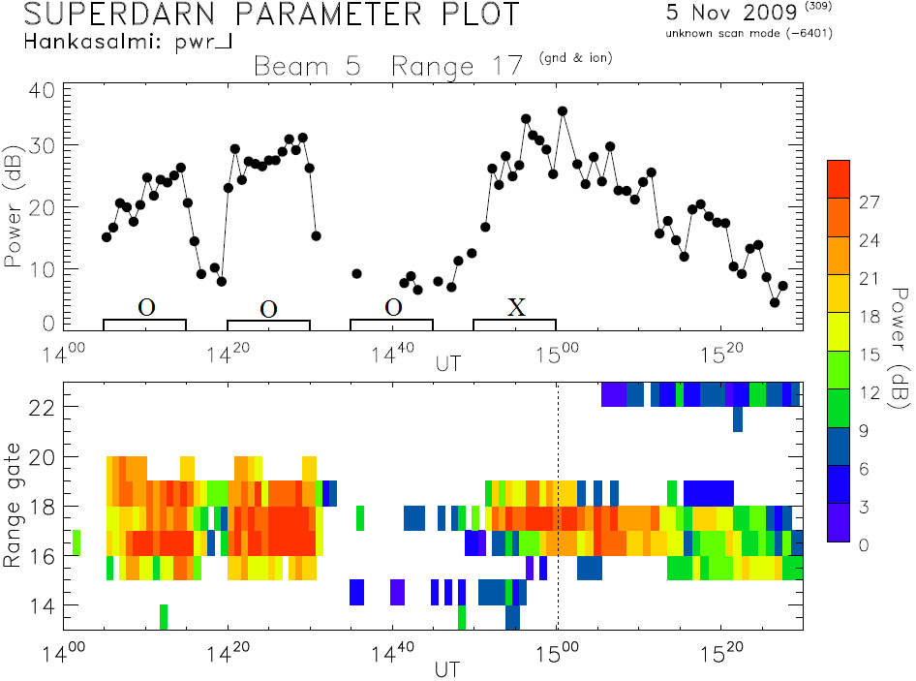
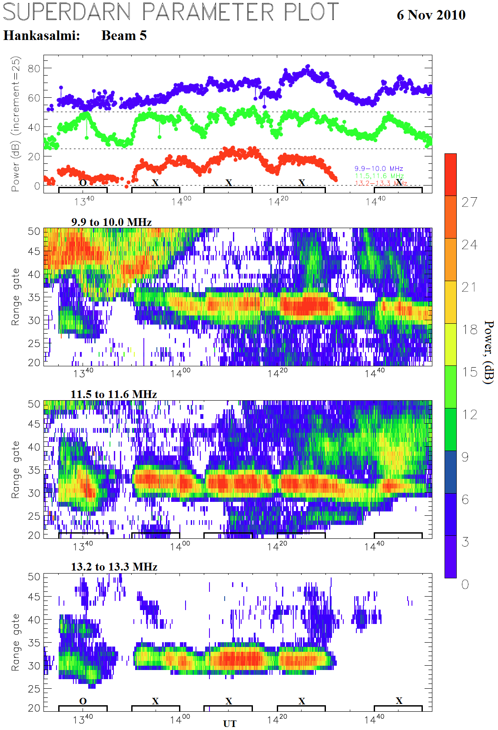
Artificial small-scale field-aligned irregularities (f_{H} >foF2)
Backscattered power from the Hankasalmi (Finland) CUTLASS radar (beam 5) at f ≈ 10 10, 11.5, and 13 MHz at f_{H} = 4.544 MHz for alternating O/X-mode heating towards magnetic zenith on 6 November , 2010 (ERP = 113 MW).
Backscattered power from the Hankasalmi (Finland) CUTLASS radar (beam 5) at f ≈ 10 MHz for alternating O/X-mode heating at f_{H} = 4.040 MHz (ERP= 123 MW) on 5 November, 2009.

Slide 14
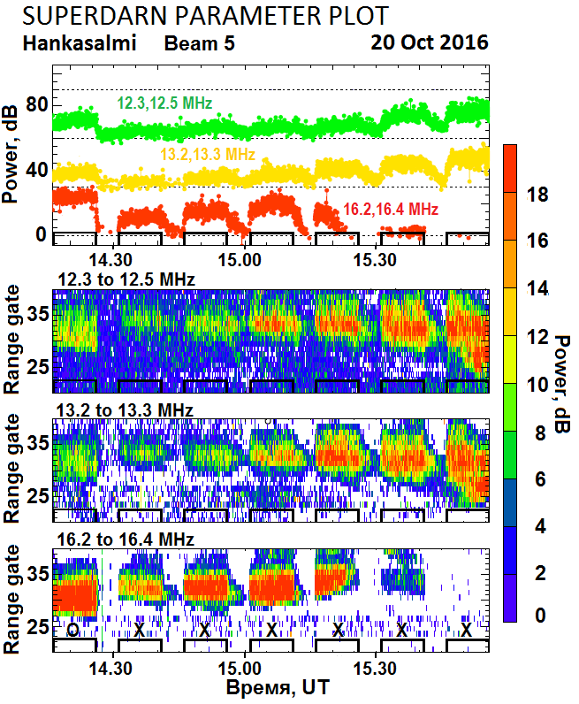
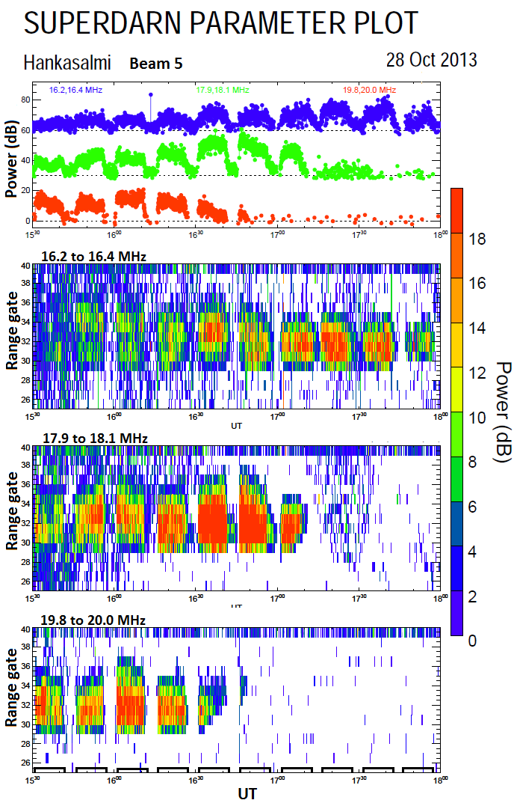
Artificial small-scale field-aligned irregularities (f_{H} ≤ foF2 )
Backscattered power from the Hankasalmi (Finland) CUTLASS radar (beam 5) at f ≈ 12, 13, and 16 MHz for O/X-mode heating at f_{H} = 4.544 MHz (ERP=130 MW) on 20 October, 2016. Heater-on cycles and polarization is shown on the time axis.
Backscattered power from CUTLASS radar (beam 5) at f ≈ 16, 18 and 20 MHz on 28 October 2013 for X-mode heating towards MZ at fH = 6.96 MHz (ERP = 550 MW) . The foF2 values dropped from 7.6 to 5.3 MHz (f_{H} / foF2 = 0.91 - 1.35)

Slide 15

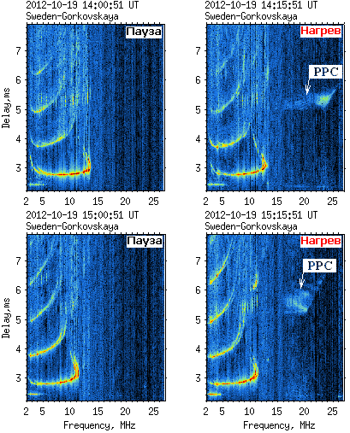
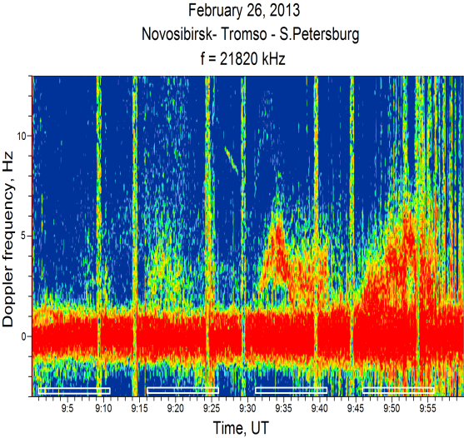
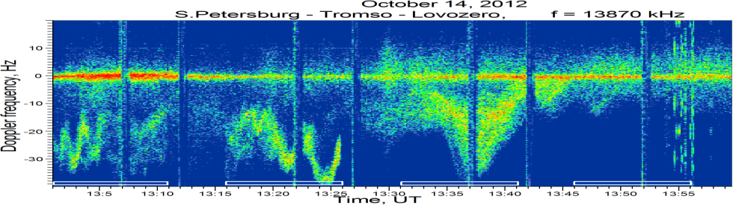
Artificial small-scale field-aligned irregularities
Spectrogram of diagnostic HF signals on the Novosibirsk - Tromso – S. Petersburg path on 26 February 2013. HF pump wave was radiated at fH = 6.2 MHz towards the MZ.
Oblique sounder ionograms on the Sweden – Tromso – St. Petersburg path on 19 October 2012
Spectrogram of diagnostic HF signals on the S. Petersburg – Tromso – Lovosero path on 14 October 2012. HF pump wave was radiated at fH = 6.2 MHz towards the MZ.

Slide 16
Distinctive features of FAIs
X-mode O-mode
generation f_{H} ≤ foF2 ; f_{H} ≤ foF2
f_{H} > foF2 (up to 2 MHz)
spatial scale l⊥≈ 7.5 – 15 m l⊥≈ 7.5 – 15 m
growth time 12 – 120 s 3 – 9 s
decay time 40 – more than 300 s 12 – 30 s
threshold of excitation from the “cold start”
low f_{H} = 4 MHz 75 MW 8 – 10 MW
high f_{H} = 8 MHz 160 MW 26 MW
Generation mechanisms of the FAIs under O-mode HF pumping at f_{H} ≤ foF2 is the thermal parametric (resonance) instability at the upper hybrid resonance altitude (Grach and Trachtengertz, 1975; Gurevich and Vas’kov 1978).
Generation mechanisms of the FAIs under X-mode HF pumping excited at f_{H} ≤ foF2 and f_{H} > foF2 both is not completely understood. It is suggested that X-mode FAIs are generated via two-step process (Borisov et al., 2018; Blagoveshchenskaya et al., 2011). In the first step the generation of elongated large-scale irregularities (with the spatial scale across the geomagnetic field of the order of 1 -10 km ) due to the self-focusing instability is occurred. Excitation and behavior of small-scale FAIs is driven by large-scale irregularities. Their possible generation mechanisms can be the gradient-drift instability (Guzdar et al., 2018) or the filamentation instability (Kuo, 2015).

Slide 17
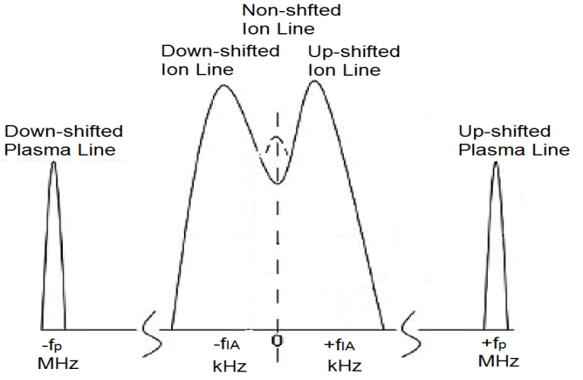
HF-induced Langmuir and Ion-acoustic plasma waves
Incoherent scatter radar in the combination with the HF heating facility is available to provide the investigations in detail of elongated plasma oscillations such as the Langmuir and ion-acoustic plasma waves. The EISCAT UHF (930 MHz) radar allows for the detection of the turbulence wavelengths L = 0.16 м (L= c/2f_{rad} , where с is the speed of light and f_{rad} is the radar frequency).
f_{IA} depends on the radar wave number and for EISCAT UHF radar f_{IA} = ω _{IA} / 2π ≈ 10 kHz.
Parametric decay instability (PDI):
EM → LW + IAW
.
Let’s consider the following:
Temporal evolution of HFPLs and HFILs in conjunction with the development of small-scale artificial field-aligned irregularities (FAIs).
∙ Thresholds of excitation of HFPLs and HFILs in the high latitude ionosphere F-region during alternating O/X-mode HF pumping .
∙ Comparison between the O- and X-mode effects .

Slide 18
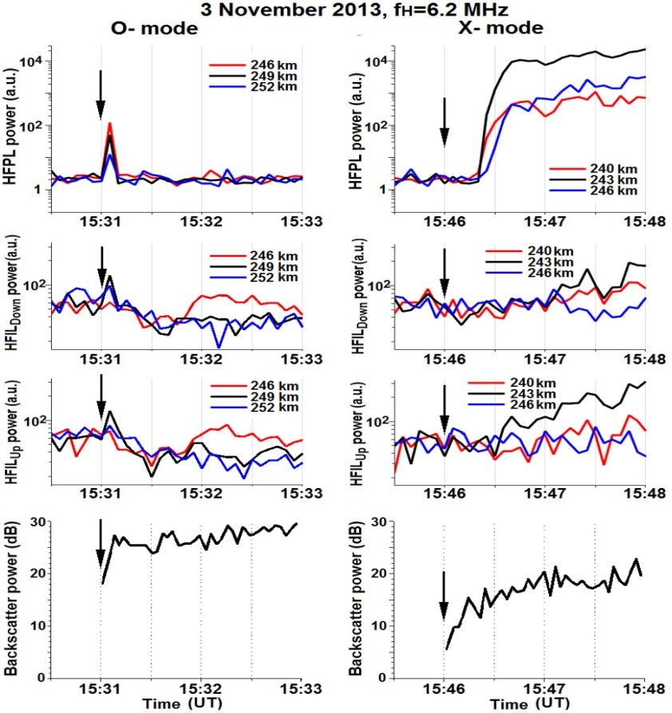
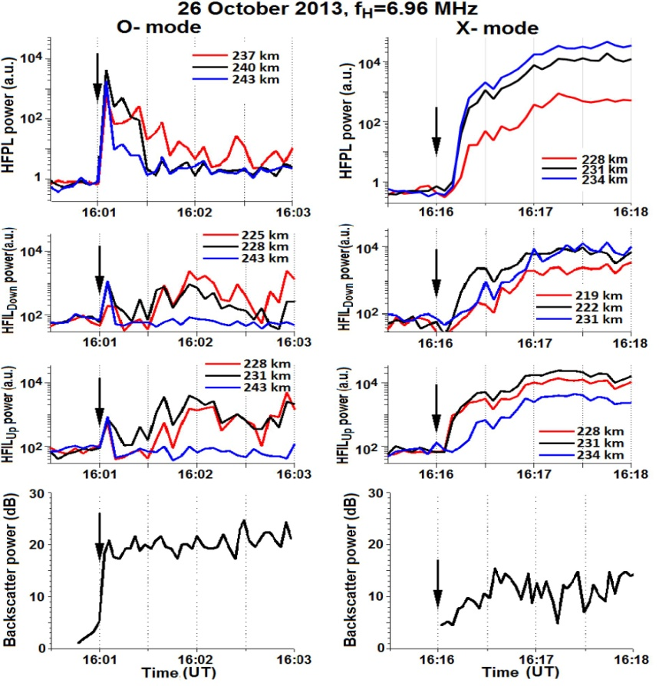
Temporal evolution of O- and X-mode HFPLs, HFILs and FAIs
Behaviors of the O- and X-mode HFPLs, HFILs, and FAIs after the heater is turned on at fH = 6.2 MHz (3 Nov. 2013) with ERP = 450 MW and fH = 6.96 MHz (26 Oct. 2013) with ERP = 560 MW.

Slide 19
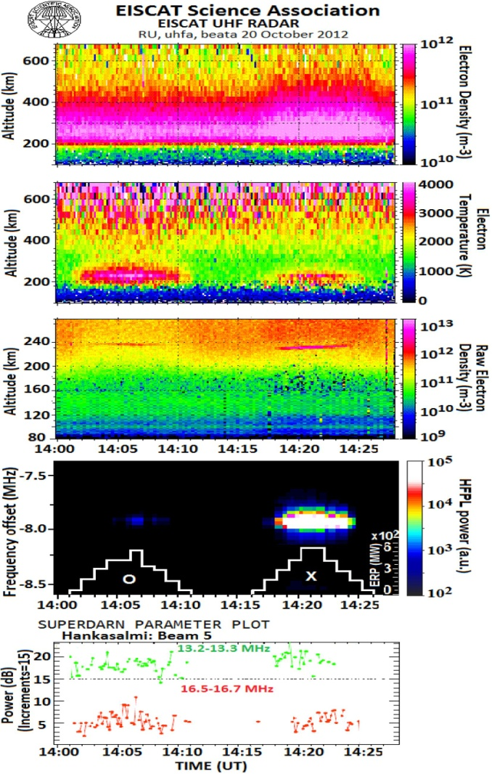
Thresholds for the excitation of O- and X-mode plasma and ion lines
Overview of EISCAT UHF radar and CUTLASS observations in the course of alternating O/X-mode HF pumping experiment at fH = 7.953 MHz. During 10 min heater-on pulse the ERP was changed from 56 to 560 MW and then back to 56 MW in the sequence of about 10%, 30%, 50%, 75%, 100%, 100%, 75%, 50%, 30%, 10% from ERP max = 560 MW. Duration of each power step was 1 min.

Slide 20
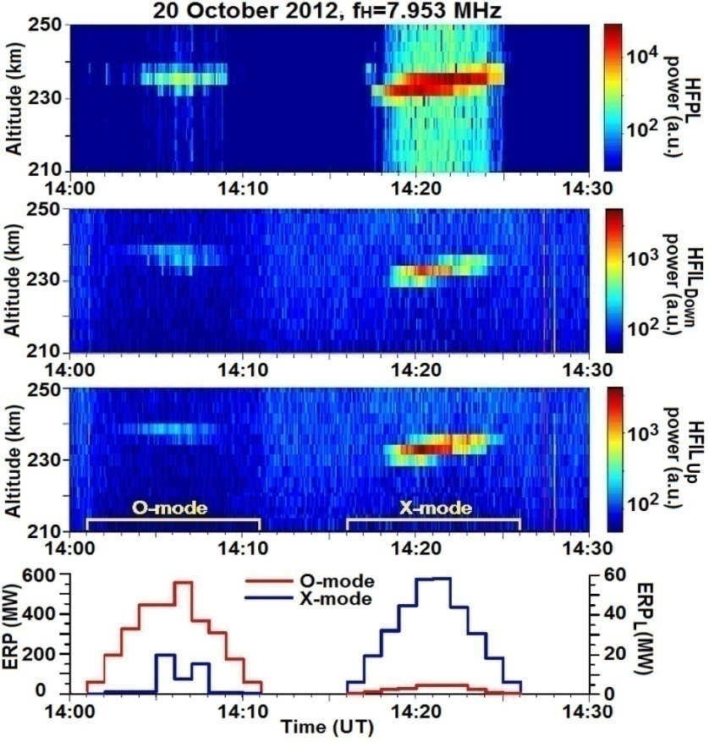
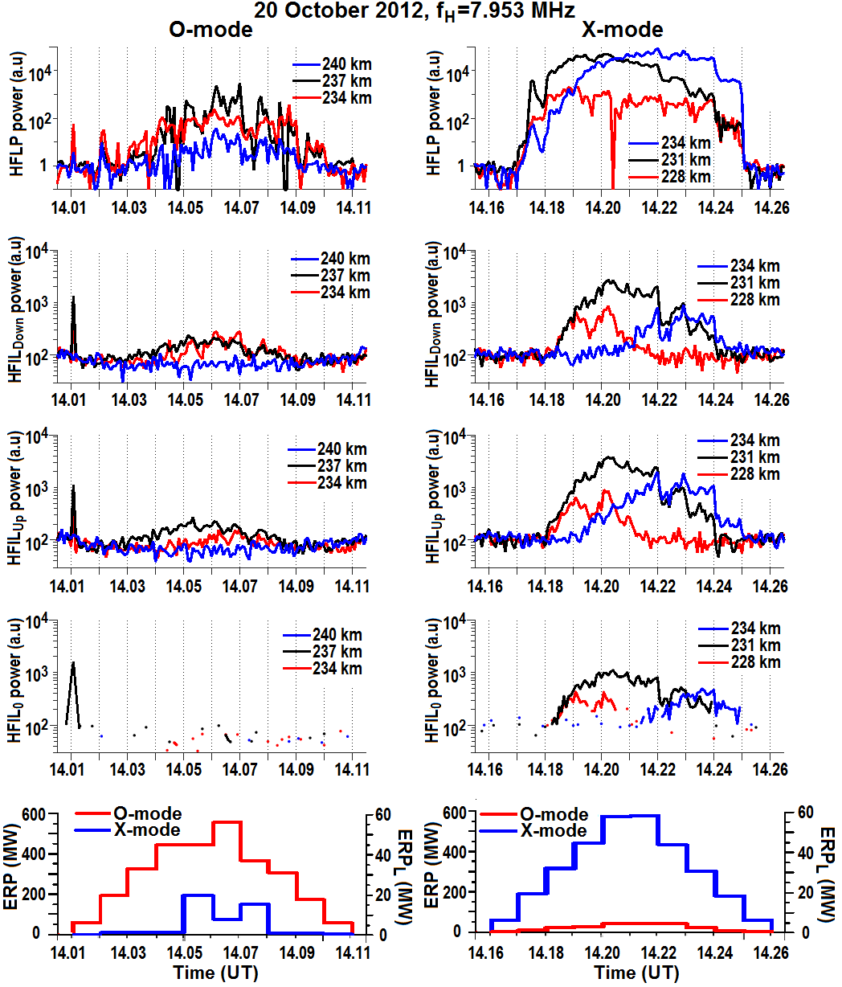
Thresholds for the excitation of O- and X-mode plasma and ion lines
Behaviors of the O- and X-mode plasma and ion lines at fixed altitudes when ERP increased from 56 to 560 MW and then decreased to 56 MW.
Behaviors of the O- and X-mode plasma and ion lines when ERP increased from 56 to 560 MW and then decreased to 56 MW.

Slide 21
Comparison between the O-and X-mode LW and IAW
Features of LW and IAW (O-mode)
Features of LW and IAW (X-mode)
Excitation near the reflection altitude of the O-mode HF pump wave;
Immediate response to the pump on seen in the first 5 s UHF radar data dump;
FAIs commonly quench the PDI excitation, however, the reappearance of LW and IAW after the initial overshoot is possible under high ERP≥ 300 MW;
Descending ion and plasma line backscatter layers are possible under high ERP;
Excitation occurs under HF pumping between vertical and MZ directions.
Excitation near the reflection altitude of the X-mode HF pump wave;
Appearance is delayed by 15 – 30s relatively to the HF pump onset, then the intensity of plasma waves gradually increased and saturated within 60 – 70 s;
FAIs play a key role in the excitation of LW and IAW;
LW and IAW are excited through the whole duration of the pump pulse coexisting with FAIs, ERP ≥ 190 MW;
The intensity of LW and IAW is much higher as compared with the O-mode pumping;
Excitation occurs only under HF pumping towards MZ in quiet magnetic conditions.

Slide 22
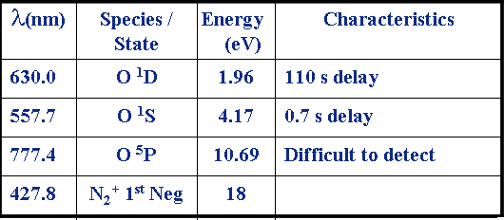
Airglow Emission Lines
⁵P
Emissions stimulated by impact of energetic electrons on ambient species
Main lines from atomic Oxygen at 630.0 and 557.7 nm
Excitation energy an indicator of electron energy spectrum
Green/Red ratio > 0.25 → accelerated electrons
Electron temperature <0.5 eV
10.69 eV
777.4 nm
⁵S
9.11eV
135.6 nm
¹S
4.17eV
557.7 nm
1.96 eV
¹D
630.0 nm
Ground State

Slide 23
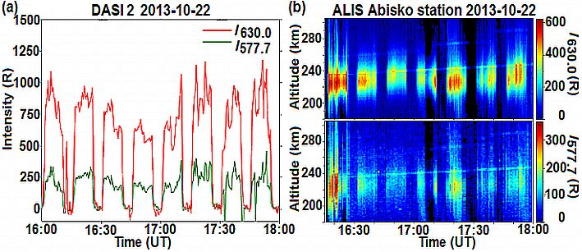
HF-induced optical emissions (Х-mode heating)
Radio-induced optical emissions during the EISCAT heating experiment on 22 October 2013. The X-mode pump wave was radiated at 7.1 MHz towards the MZ.: (a) The intensity of optical emissions at red (630.0 nm) and green (557.7 nm) lines imaged by the DASI-2 at the EISCAT site. (b) Altitude distribution of intensities of red (630.0 nm) and green (557.7 nm) lines versus time (keogram) obtained at the ALIS Abisko station. ALIS was looking at a volume above Tromsø and obtained one image every 10 s with an integration time of 6.5 s. The imager was running a filter sequence alternating between the emissions at 557.7, 630.0 and 844.6 nm.

Slide 24
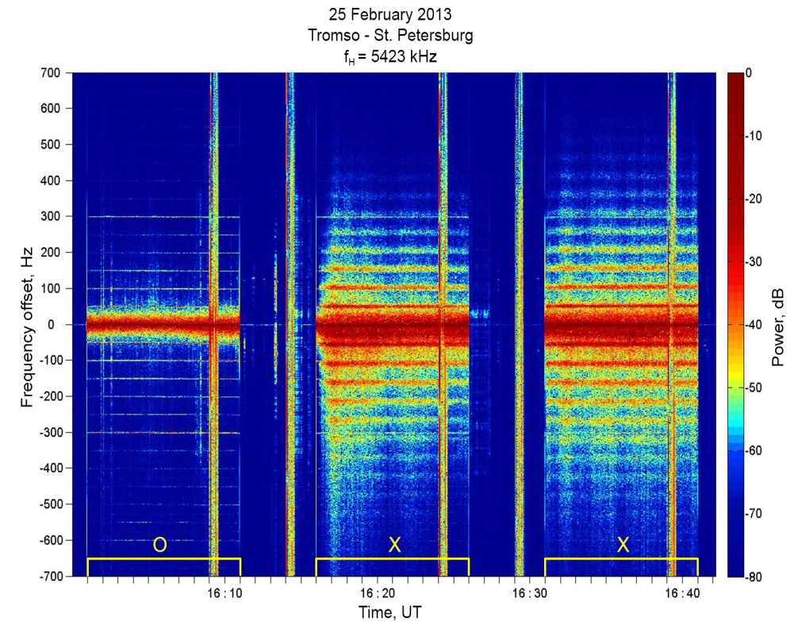
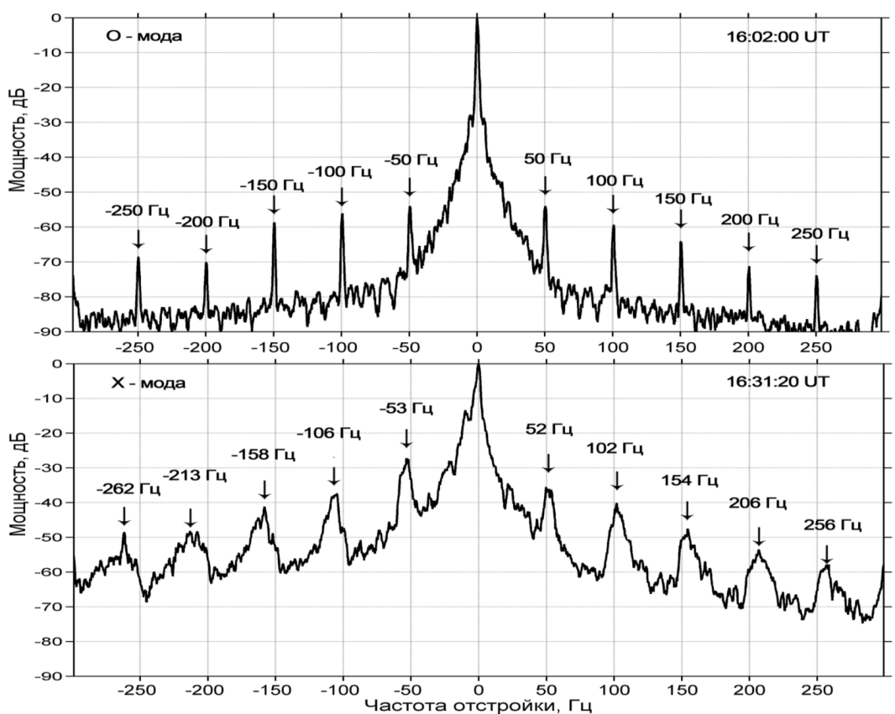
Narrowband SEE at the pump frequency below 4fce
The spectrogram of the narrowband SEE with a frequency resolution of 0.16 Hz and time resolution of 3 s at a distance of 1200 km from the EISCAT/Heating for contrasting O/X-mode HF pumping at fH=5.423 MHz, which was below 4fce, on 25 February 2013. ERP = 450 MW.
Narrowband SEE spectra at fH=5.423 MHz, which was below 4fce, on 25 February 2013 during the heater O- and X-mode pulses recorded at a distance of 1200 km from the EISCAT/Heating .

Slide 25
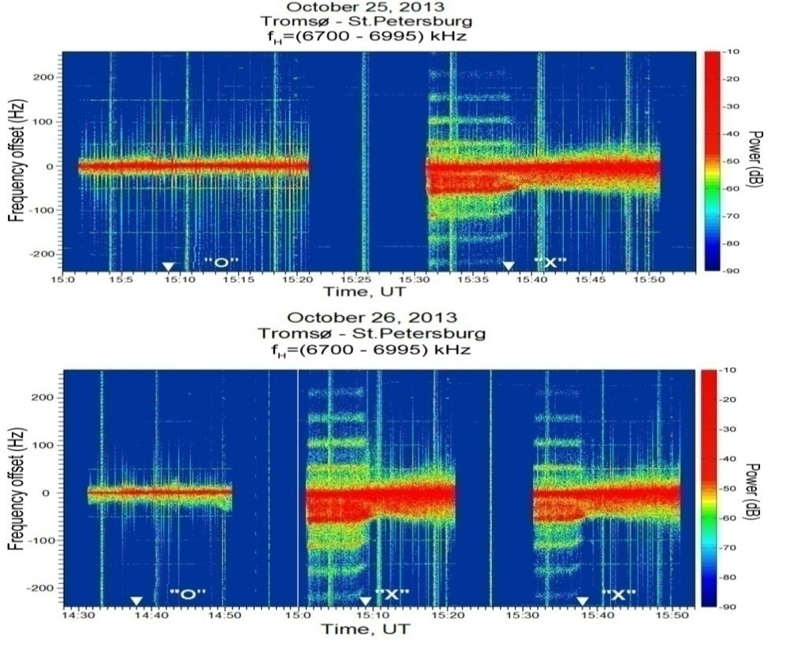
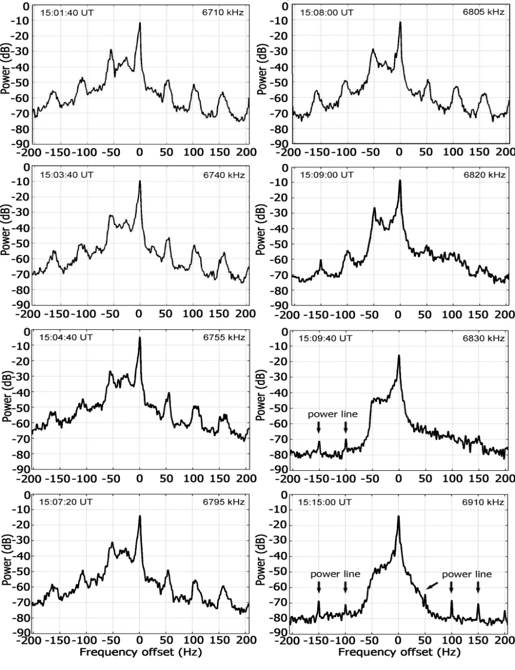
Narrowband SEE in the vicinity of 5fce
The spectrogram of the narrowband SEE with a frequency resolution of 0.2 Hz and time resolution of 5 s at a distance of 1200 km from the EISCAT/Heating for contrasting O/X-mode HF pumping on 25 and 26 October 2013 (ERP = 650 МВт).
Narrowband SEE spectra, showing the downshifted and upshifted ion gyro-harmonic structures taken for different pump frequency offsets relative to 5fce during the X-mode frequency stepping pulse from 15:01 – 15:21 UT on 26 October 2013.

Slide 26
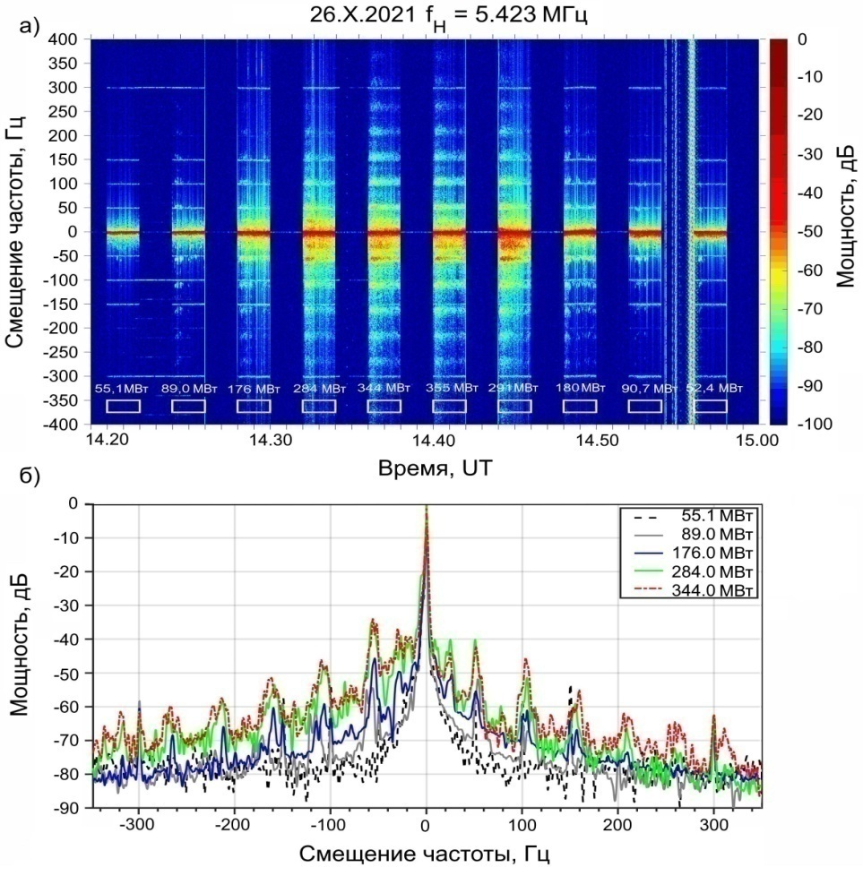
Narrowband SEE depending on ERP
(a) The spectrogram of the NSEE depending on effective radiated power (ERP) on 26 October 2021. HF pump wave with the X-mode p.olarization was radiated at fH = 5423 MHz towards the MZ by pulses of 2 min on, 2 min off. ERP was changed from 55 MW to 350 MW and then returned to 55 MW.
(b) NSEE spectra for different ERP on 26 October 2021 recorded at a distance of 1200 km from the EISCAT/Heating .

Slide 27
Stimulated Ion Bernstein Scatter (SIBS)
IB1
EM
PD
IB2
EB1
PD
FAI
EB2
EM1
FAI
SIBS1
EM2
SIBS2

Slide 28
A high power electromagnetic wave from a ground transmitter can act as a pump to excite a pair of growing waves through the parametric decay instability.
IA wave : propagating along magnetic field
ES wave
Magnetized Stimulated
Brillouin Scatter (MSBS)
EM
EIC wave: propagating perpendicular to the magnetic field
EM1

Slide 29
Summary
In spite of the fact that the excitation of various unexpectedly strong X-mode phenomena in the F region of the high-latitude ionosphere is a repeatable and easily reproducible feature from EISCAT heating, many aspects of the nonlinear interaction between an X-polarized HF pump wave and the ionospheric plasma still remain poorly understood. Up to the present, an adequate theory describing the interactions between the X-mode HF pump wave and ionospheric plasma is absent. Further clarification and theoretical background are needed to explain the origin of unusually strong phenomena excited in the ionospheric F-region by X-polarized HF pump waves.

Slide 30
References
Gurevich, A. V. Nonlinear effects in the ionosphere, Physics-Uspekhi, 2007, 50, 1091–1121.
Fejer, J. A. Ionospheric modification and parametric instabilities. Reviews of Geophysics and Space Physics. 1979, 17(1), 135–153.
Stubbe P. Review of ionospheric modification experiments at Tromso // J. Atmos. Terr. Phys. 1996. V. 58. P. 349 – 368
Robinson T.R. The heating of the high latitude ionosphere by high power radio waves // Physics Reports. 1989. V. 179. Р. 79–209.
Streltsov A.V. et al. Past, Present and Future of Active Radio Frequency Experiments in Space // Space Sci. Rev. 2018. 214:118
Blagoveshchenskaya N. F. Perturbating the High-Latitude Upper Ionosphere (F Region) with Powerful HF Radio Waves: A 25-Year Collaboration with EISCAT // Radio Science Bulletin. 2020. № 373. P. 40 – 55.
. https://doi.org/10.1007/s11214-018-0549-7
Grach, S. M., and V. Y. Trakhtengerts. Parametric excitation of ionospheric irregularities extended along the magnetic field Radiophys. Quant. Electron., 1975, 18, 951–957.
Blagoveshchenskaya N. F., Borisova T. D., Yeoman T., Rietveld M.T., Ivanova I.M., Baddeley L.J. Artificial field-aligned irregularities in the high-latitude F region of the ionosphere induced by an X-mode HF heater wave // Geophys. Res. Lett. 2011. V. 38. doi: 10.1029/2011GL046724
Blagoveshchenskaya N.F., Borisova T.D., Yeoman T.K., Häggström I., Kalishin A.S. Modification of the high latitude ionosphere F region by X-mode powerful HF radio waves: Experimental results from multi-instrument diagnostics // J. Atmos. Sol.-Terr. Phys. 2015. V. 135. P. 50–63.
Blagoveshchenskaya N. F., Borisova T. D., Kosch M., Sergienko T., Brändström U., Yeoman T.K., Häggström I. Optical and Ionospheric Phenomena at EISCAT under Continuous X-mode HF Pumping // J. Geophys. Res.: Space Phys. 2014. V. 119. P. 10483–10498.
Blagoveshchenskaya N. F., Borisova T. D., Kalishin A.S., Yeoman T. K., Häggström I. Distinctive features of Langmuir and Ion-acoustic Turbulences induced by O- and X-mode HF Pumping at EISCAT //J. Geophys. Res.: Space Phys. 2020. V. 125. №7.
.
.

Slide 31
References
Kalishin A.S., Blagoveshchenskaya N.F., Borisova T.D., Yeoman T.K. Ion Gyro-Harmonic Structures and Stimulated Emission Excited by X-mode High Power HF Radio Waves at EISCAT // J. Geophys. Res. Space Phys. 2021. V. 126 (8).
Калишин А.С., Благовещенская Н.Ф., Борисова Т.Д., Егоров И.М. Сравнение спектральных характеристик узкополосного искусственного радиоизлучения ионосферы при Х-нагреве высокоширотной F- области ионосферы на частотах ниже и выше критической частоты Х-компоненты слоя F2 // Метеорология и гидрология. 2022. № 12. С. 21 – 34. DOI: 10.52002/0130-2906-2022-12-21-34
Blagoveshchenskaya N.F., Borisova T.D., Kalishin A.S., Egorov I.M. Artificial Ducts Created via High-Power HF Radio Waves at EISCAT // Remote Sens. 2023. V. 15 (9). 2300.
Rietveld M. T., Senior A. Ducting of incoherent scatter radar waves by field-aligned irregularities // Ann. Geophys. 2020, V. 38. P. 1101–1113.
Senior, A.; Rietveld, M. T.; Häggström, I.; Kosch, M. J. Radio induced incoherent scatter ion line enhancements with wide altitude extents in the high-latitude ionosphere. Geophys. Res. Lett. 2013, 40, 1669–1674.
Благовещенская Н. Ф. Борисова Т. Д., Калишин А. С., Йоман Т. К., Шмелев Ю. А., Леоненко Е. Е. Характеристики мелкомасштабных искусственных ионосферных неоднородностей в высокоширотной F-области ионосферы, вызванных воздействием мощных КВ-радиоволн необыкновенной поляризации // Геомагнетизм и аэрономия. Т.59. № 6. С. 759–773. 2019.
Borisov N., Honary F., Li H. Excitation of Plasma Irregularities in the F Region of the Ionosphere by Powerful HF Radio Waves of X-Polarization. Journal of Geophysical Research: Space Physics. 2018. 123:5246-5260 doi:10.1029/2018JA025530
Kuo S. Ionospheric modifications in high frequency heating experiments // Phys. Plasmas. 2015. V. 22. 012901. doi: 10.1063/1.4905519.
Hansen J.D., Morales G.J., Maggs J.E.) Large-scale HF-induced ionospheric modifications: Theory and modeling Journal of Geophysical Research, 1992. 97:17019 doi:10.1029/92JA01603/.
Rietveld M. T., Kosch M. J., Blagoveshchenskaya N. F., Kornienko V. A., Leyser, T. B., Yeoman T. K. Ionospheric electron heating, aurora and striations induced by powerful HF radio waves at high latitudes: aspect angle dependence // J. Geophys. Res. 2003. V.108(A4), 1141, doi:10.1029/2002 JA 009543

Slide 32
References
Blagoveshchenskaya N.F., Borisova T.D., Kalishin A.S., Egorov I.M., Zagorskiy G.A. Disturbances of electron density in the high latitude upper (F-region) ionosphere induced by X-mode HF pump waves from EISCAT UHF radar observations. Проблемы Арктики и Антарктики. 2022;68(3):248-257.
Blagoveshchenskaya N. F., Borisova T. D., Yeoman T. K., Rietveld M.T., Häggström I., Ivanova I. M. Plasma modifications induced by an X-mode HF heater wave in the high latitude F region of the ionosphere // J. Atmos. Solar-Terr. Phys. 2013. V. 105-106. P. 231 – 244.
Blagoveshchenskaya, N.; Borisova, T.; Kalishin, A.; Egorov, I.; Yeoman, T.; Haggstrom, I. Simultaneous Action of X- and O-Mode HF Pump Waves on the High-Latitude Upper (F-Region) Ionosphere at EISCAT. Universe 2022, 8, 91. https://doi.org/10.3390/ universe8020091.
Wang X, Zhou C, Liu M, Honary F, Ni B, Zhao Z . Parametric instability induced by X-mode wave heating at EISCAT Journal of Geophysical Research: Space Physics. 2016. 121:10, 510-536, 548 doi:10.1002/2016JA023070.
Wang X, Cannon P, Zhou C, Honary F, Ni B, Zhao Z. A theoretical investigation on the parametric instability excited by X-mode polarized electromagnetic wave at Tromsø Journal of Geophysical Research: Space Physics. 2016. 121:3578-3591 doi:10.1002/2016JA022411.
Blagoveshchenskaya N. F., Kalishin A. S., Borisova T. D., Egorov I.M., and Zagorskiy G. A. Phenomena in the High-Latitude F Region of the Ionosphere under the Effect of Powerful HF Radio Waves at Frequencies above the Critical One of the F2 Layer // Geomagnetism and Aeronomy, 2023, Vol. 63, No. 6, pp. 757–769.
Kalishin, A.S., Blagoveshchenskaya, N.F., Borisova, T.D. et al. Features of Narrowband Stimulated Electromagnetic Emission Depending on the Effective Radiated Power of the EISCAT/Heating Facility. Cosmic Res 61, 501–509 (2023).
Sharma, R. P., Kumar, A., Kumar, R., and Tripathi, Y. K., Excitation of electron Bernstein and ion Bernstein waves by extraordinary electromagnetic pump: Kinetic theory // Phys. Plasmas. 1994. V. 1. № 3. P. 522 – 527.· DOI:10.1063/1.870796 https://doi.org/10.1134/S0010952523700478

Slide 33
References
Wang X, Zhou C. Aspect dependence of Langmuir parametric instability excitation observed by EISCAT. Geophys Res. Lett . 2017. 44:9124-9133 doi:10.1002/2017GL074743.
Bryers, C. J.; Kosch, M. J.; Senior, A.; Rietveld, M.T.; Singer, W. A comparison between resonant and nonresonant heating at EISCAT. J. Geophys. Res.:Space Physics. 2013, 118, 6766–6776.
Löfås H., Ivchenko N., Gustavsson B., Leyser T.B., Rietveld M.T. F-region electron heating by X-mode radiowaves in underdense conditions. Ann Geophys. 2009. 27:2585-2592 doi:10.5194/angeo-27-2585-2009.
Blagoveshchenskaya N.F., Borisova T.D., Kalishin A.S., Kayatkin V.N., Yeoman T.K., Häggström I. Comparison of the Effects Induced by the Ordinary (O-Mode) and Extraordinary (X-Mode) Polarized Powerful HF Radio Waves in the High-Latitude Ionospheric F Region, Cosmic Research, 56 (1), 11 – 25, 2018.
Borisova T.D., Blagoveshchenskaya N.F., Yeoman T.K., Haggstrom I. Excitation of Artificial Ionospheric Turbulences in the High-Latitude Ionospheric F region as a Function of the EISCAT/HEATING Effective Radiated Power, Radiophysics and Quant. Electr., 60(4), 273-290, 2017.
Borisova T.D., Blagoveshchenskaya N.F., Kalishin A.S. Features of artificial ionosphere turbulence induced by the O- and X-mode HF heating near the F2-layer critical frequency.Solar-Terrestrial Physics. 2023. Vol. 9. Iss. 1. P. 21–30. DOI: 10.12737/stp-91202303
Borisova T.D., Blagoveshchenskaya N.F., Kalishin A.S. Spectral features of ionospheric plasma waves excited by powerful HF radio waves radiated at frequencies near electron gyroharmonics and F2-layer critical frequency // Solar-Terrestrial Physics. 2023. Vol. 9. Iss. 2. P. 94–102. DOI: 10.12737/stp-92202312

Slide 34
Acknowledgements
EISCAT is an international scientific association supported by research organizations in China (CRIRP), Finland (SA), Japan (NIPR and STEL), Norway (NFR), Sweden (VR), and the United Kingdom (NERC). We would like to thank the Staff of the EISCAT Scientific Association for help in providing the Tromsø heating experiments in conjunction with the EISCAT UHF radar observations in the course of Russian campaigns. We are also thankful to the Department of Physics and Astronomy of University of Leicester for providing CUTLASS observations during heating campaigns.
The investigation was partly carried out within grant № 22-17- 00020 from Russian Scientific Foundation, https://rscf.en.project/22-17-00020/ https://rscf.en/project/22-17-00020/

