Slide 1
OVERVIEW
In modern scientific society, not much attention is paid to the tropopause and its connection with the troposphere and stratosphere. Nevertheless, being a natural boundary between these two layers of the atmosphere, it is influenced by them and participates in stratospheric-tropospheric exchange. Studying the relationship between the processes occurring in the stratosphere and troposphere and changes in the characteristics of the tropopause will help deepen our understanding of the formation and evolution of these processes, as well as become the basis for further research.
Baikal Young Scientists’ International School on Fundamental Physics “Physical processes in space and near-Earth space” (BSFP-2024), Irkutsk, September 1 – 7, 2024
VARIABILITY OF ARCTIC TROPOPAUSE HEIGHT UNDER THE IMPACT OF SUDDEN STRATOSPHERIC WARMING
BIKBULATOV. B.A., DIDENKO.K.A., ERMAKOVA.T.S.
IZMIRAN, TROITSK
RSHU, SAINT PETERSBURG
2024

Slide 2
PURPOSE
To study the variability of the tropopause height under the influence of sudden stratospheric warming in the Arctic region in the period from 2000 to 2019, taking into account different longitude locations.
TASKS
Analysis of the intraseasonal stroke pressure at the tropopause, the average during the period from 2000 to 2009 and from 2010 to 2019
Analysis of zonal wind and temperature in the stratosphere in the period from 2000 to 2019
Analysis of the geopotential height field and the time course of the tropopause height during pronounced SSW
OVERVIEW
In modern scientific society, not much attention is paid to the tropopause and its connection with the troposphere and stratosphere. Nevertheless, being a natural boundary between these two layers of the atmosphere, it is influenced by them and participates in stratospheric-tropospheric exchange. Studying the relationship between the processes occurring in the stratosphere and troposphere and changes in the characteristics of the tropopause will help deepen our understanding of the formation and evolution of these processes, as well as become the basis for further research.
Baikal Young Scientists’ International School on Fundamental Physics “Physical processes in space and near-Earth space” (BSFP-2024), Irkutsk, September 1 – 7, 2024
VARIABILITY OF ARCTIC TROPOPAUSE HEIGHT UNDER THE IMPACT OF SUDDEN STRATOSPHERIC WARMING
BIKBULATOV. B.A., DIDENKO.K.A., ERMAKOVA.T.S.
IZMIRAN, TROITSK
RSHU, SAINT PETERSBURG
2024

Slide 3
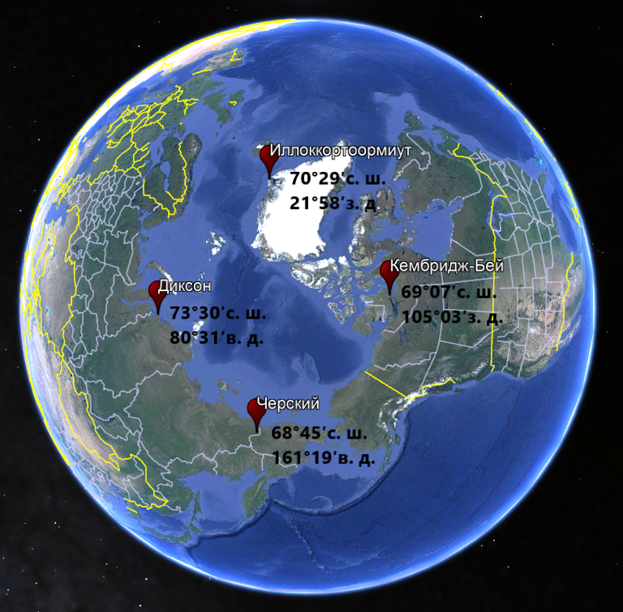
STATION LOCATIONS
It is selected in such a way that all stations are located approximately on the same parallel 70 ° N., but at different longitudes. This requirement was introduced in order to study the effect of SSW on variations in tropopause height along the latitudinal circle without taking into account the meridional component.
PURPOSE
To study the variability of the tropopause height under the influence of sudden stratospheric warming in the Arctic region in the period from 2000 to 2019, taking into account different longitude locations.
TASKS
Analysis of the intraseasonal stroke pressure at the tropopause, the average during the period from 2000 to 2009 and from 2010 to 2019
Analysis of zonal wind and temperature in the stratosphere in the period from 2000 to 2019
Analysis of the geopotential height field and the time course of the tropopause height during pronounced SSW
OVERVIEW
In modern scientific society, not much attention is paid to the tropopause and its connection with the troposphere and stratosphere. Nevertheless, being a natural boundary between these two layers of the atmosphere, it is influenced by them and participates in stratospheric-tropospheric exchange. Studying the relationship between the processes occurring in the stratosphere and troposphere and changes in the characteristics of the tropopause will help deepen our understanding of the formation and evolution of these processes, as well as become the basis for further research.

Slide 4
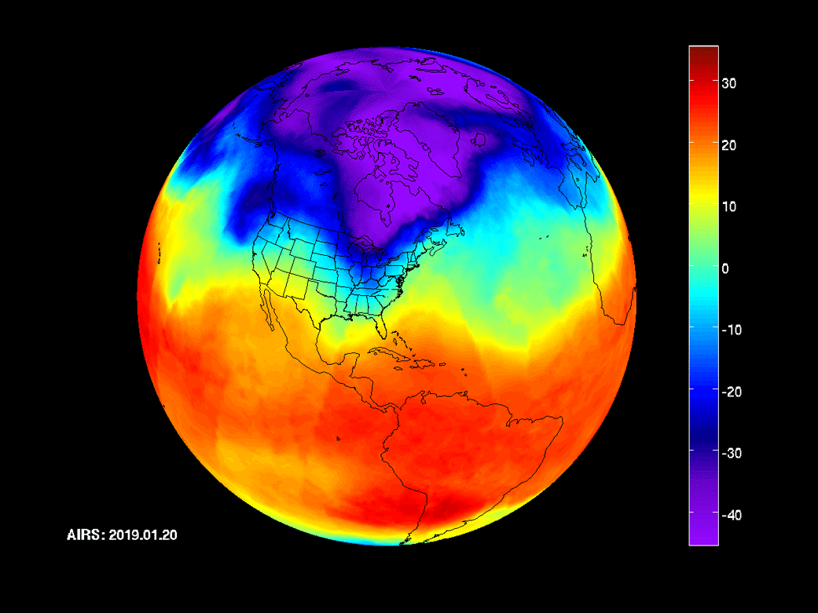
STATION LOCATIONS
It is selected in such a way that all stations are located approximately on the same parallel 70 ° N., but at different longitudes. This requirement was introduced in order to study the effect of SSW on variations in tropopause height along the latitudinal circle without taking into account the meridional component.
SUDDEN STRATOSPHERIC WARMING
PURPOSE
To study the variability of the tropopause height under the influence of sudden stratospheric warming in the Arctic region in the period from 2000 to 2019, taking into account different longitude locations.
This is a strong and sudden increase in temperature of an "explosive nature" in the polar and subpolar stratosphere in winter, sometimes by 50 ° or more for several (about ten) days. It occurs at altitudes from 10 to 50 km. At the same time, the sign of the meridional temperature gradient over the hemisphere changes, a stratospheric anticyclone is formed, and the overall air transport changes from west to east.
TASKS
Analysis of the intraseasonal stroke pressure at the tropopause, the average during the period from 2000 to 2009 and from 2010 to 2019
Analysis of zonal wind and temperature in the stratosphere in the period from 2000 to 2019
Analysis of the geopotential height field and the time course of the tropopause height during pronounced SSW
NASA captures a polar vortex moving throughout Central Canada and the U.S. midwest from January 20th to January 29th using their Atmospheric Infrared Sounder (AIRS)

Slide 5
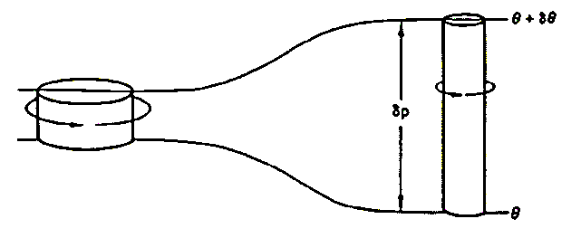
STATION LOCATIONS
It is selected in such a way that all stations are located approximately on the same parallel 70 ° N., but at different longitudes. This requirement was introduced in order to study the effect of SSW on variations in tropopause height along the latitudinal circle without taking into account the meridional component.
SUDDEN STRATOSPHERIC WARMING
This is a strong and sudden increase in temperature of an "explosive nature" in the polar and subpolar stratosphere in winter, sometimes by 50 ° or more for several (about ten) days. It occurs at altitudes from 10 to 50 km. At the same time, the sign of the meridional temperature gradient over the hemisphere changes, a stratospheric anticyclone is formed, and the overall air transport changes from west to east.
NASA captures a polar vortex moving throughout Central Canada and the U.S. midwest from January 20th to January 29th using their Atmospheric Infrared Sounder (AIRS)
DYNAMIC TROPOPAUSE
It is based on the use of the characteristics of the potential Ertel vortex. A potential vortex is the angular momentum of a particle, which is conserved when moving between isentropic surfaces:
$$\vec{Q}=\frac{1}{ρ}\left(f\vec{k}+∇⋅\vec{ν}\right)∇θ$$
In practice, only its vertical component is preserved:
$$q=−g\left(ζ+f\right)\frac{∂θ}{∂p}$$
Unit of measurement:
$$pvu={10}^{−6}\frac{m^{2}K}{kg c}$$
$g$ – acceleration of gravity, $ζ$ – relative vorticity,
$f$ – Coriolis parameter, $θ$ – potential temperature, p - pressure
SUDDEN STRATOSPHERIC WARMING
This is a strong and sudden increase in temperature of an "explosive nature" in the polar and subpolar stratosphere in winter, sometimes by 50 ° or more for several (about ten) days. It occurs at altitudes from 10 to 50 km. At the same time, the sign of the meridional temperature gradient over the hemisphere changes, a stratospheric anticyclone is formed, and the overall air transport changes from west to east.

Slide 6
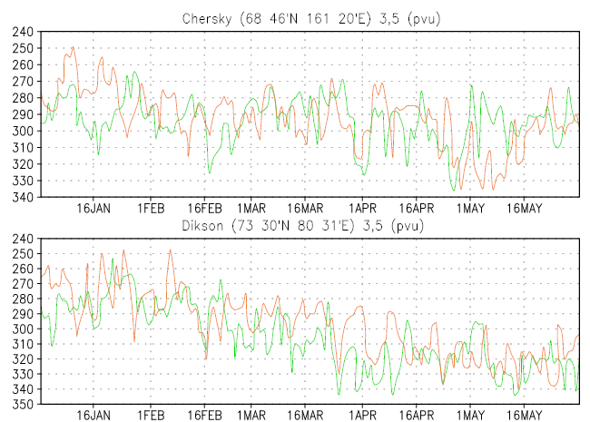
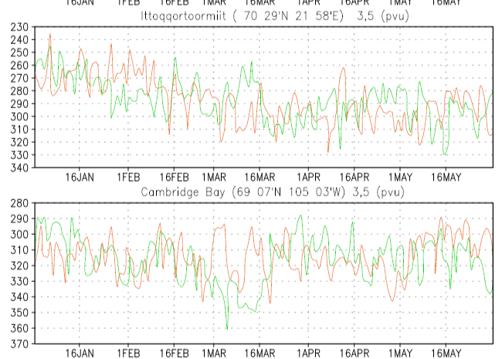
SUDDEN STRATOSPHERIC WARMING
CHANGING THE HEIGHT OF THE TROPOPAUSE
The figures show graphs averaged over decades (2000-2009 (green line) and 2010-2019 (orange line)) of the intra-seasonal course of tropopause pressure in the period from early January to the end of May
This is a strong and sudden increase in temperature of an "explosive nature" in the polar and subpolar stratosphere in winter, sometimes by 50 ° or more for several (about ten) days. It occurs at altitudes from 10 to 50 km. At the same time, the sign of the meridional temperature gradient over the hemisphere changes, a stratospheric anticyclone is formed, and the overall air transport changes from west to east.
DYNAMIC TROPOPAUSE
It is based on the use of the characteristics of the potential Ertel vortex. A potential vortex is the angular momentum of a particle, which is conserved when moving between isentropic surfaces:
$$\vec{Q}=\frac{1}{ρ}\left(f\vec{k}+∇⋅\vec{ν}\right)∇θ$$
In practice, only its vertical component is preserved:
$$q=−g\left(ζ+f\right)\frac{∂θ}{∂p}$$
Unit of measurement:
$$pvu={10}^{−6}\frac{m^{2}K}{kg c}$$
$g$ – acceleration of gravity, $ζ$ – relative vorticity,
$f$ – Coriolis parameter, $θ$ – potential temperature, p - pressure

Slide 7
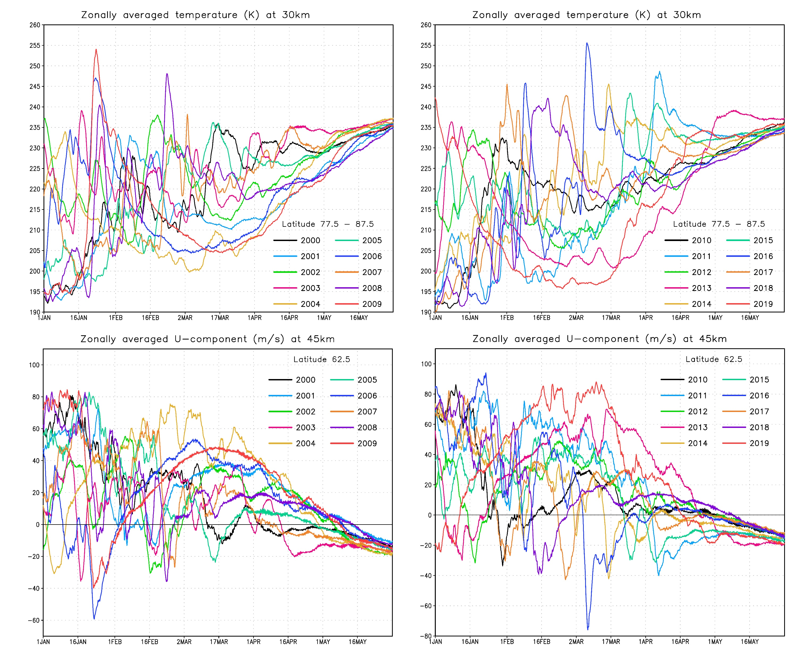
Zonally averaged temperature and wind
а)
b)
CHANGING THE HEIGHT OF THE TROPOPAUSE
The figures show graphs averaged over decades (2000-2009 (green line) and 2010-2019 (orange line)) of the intra-seasonal course of tropopause pressure in the period from early January to the end of May
The figures show graphs of the time course of zonally averaged winds and temperatures in the stratosphere.
a) temperature graphs from 2000 to 2009, b) – graphs of temperatures from 2010 to 2019, c) – graphics of wind from 2000 to 2009, d) – graphs of the wind from 2010 to 2019)
c)
d)
DYNAMIC TROPOPAUSE
It is based on the use of the characteristics of the potential Ertel vortex. A potential vortex is the angular momentum of a particle, which is conserved when moving between isentropic surfaces:
$$\vec{Q}=\frac{1}{ρ}\left(f\vec{k}+∇⋅\vec{ν}\right)∇θ$$
In practice, only its vertical component is preserved:
$$q=−g\left(ζ+f\right)\frac{∂θ}{∂p}$$
Unit of measurement:
$$pvu={10}^{−6}\frac{m^{2}K}{kg c}$$
$g$ – acceleration of gravity, $ζ$ – relative vorticity,
$f$ – Coriolis parameter, $θ$ – potential temperature, p - pressure

Slide 8
Zonally averaged temperature and wind
а)
b)
CHANGING THE HEIGHT OF THE TROPOPAUSE
The figures show graphs averaged over decades (2000-2009 (green line) and 2010-2019 (orange line)) of the intra-seasonal course of tropopause pressure in the period from early January to the end of May
The figures show graphs of the time course of zonally averaged winds and temperatures in the stratosphere.
a) temperature graphs from 2000 to 2009, b) – graphs of temperatures from 2010 to 2019, c) – graphics of wind from 2000 to 2009, d) – graphs of the wind from 2010 to 2019)
c)
d)

Slide 9
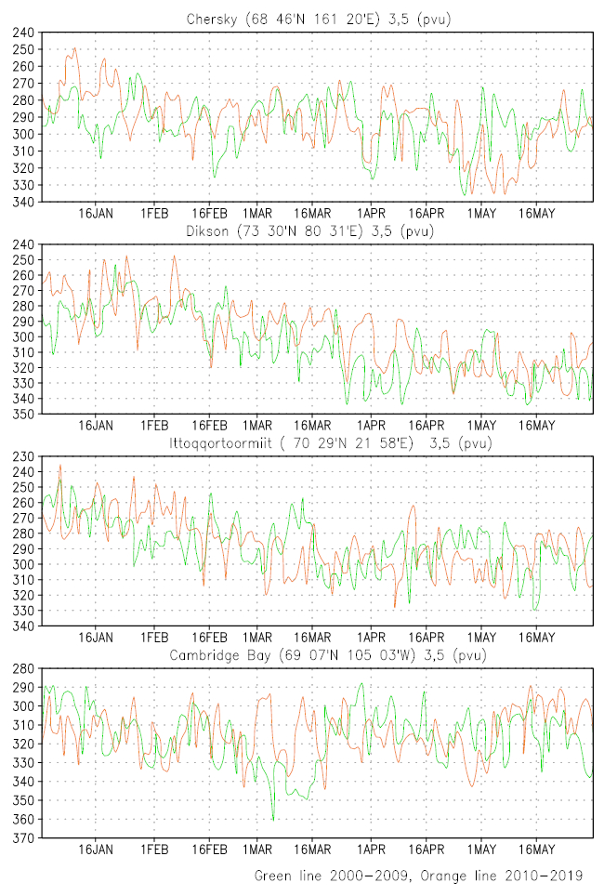

Slide 10
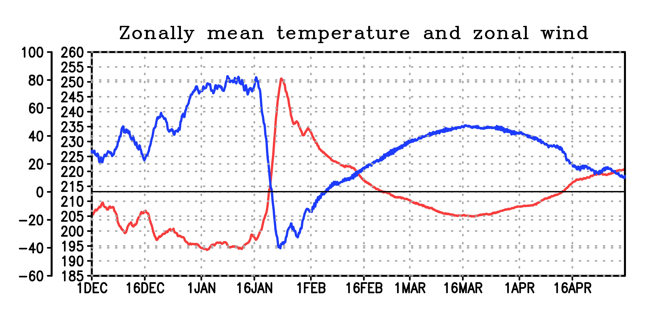
The temperature averaged between 77.5 and 87.5 degrees north latitude
The wind averaged along 62.5 degrees north latitude
Averaged distributions of geopotential height in km, at the level of 10 hPa
Averaging for 10 days before the SSW
Averaging over 10 days during the SSW
Averaging for 10 days after the SSW

Slide 11
Time course of pressure at the tropopause level from radiosonde data
Averaging for 10 days before the SSW
Averaging over 10 days during the SSW
Averaging for 10 days after the SSW

Slide 12
Time course of pressure at the tropopause level from radiosonde data
Averaging for 10 days before the SSW
Averaging over 10 days during the SSW
Averaging for 10 days after the SSW

Slide 13
СПАСИБО ЗА ВНИМАНИЕ
Conclusion
The tropopause is sensitive to the event of sudden stratospheric warming, while a study of specific cases shows that there is a characteristic delay of about 10 days between the phenomenon of sudden stratospheric warming and the maximum decrease in the height of the tropopause.
The increase in the tropopause in January of the last decade at the Chersky and Dixon stations was caused by a decrease in the number of SSW during this period, nevertheless they took place, which is manifested in the behavior of the tropopause at the Cambridge Bay and Illocortoormiut stations in the form of its slight sagging and lack of difference from the first decade respectively.
In February, in the period 2010-2019, there were no significant differences from the period 2000-2009, which was probably caused by approximately the same number and intensity of SSW event in this month for both decades. Only a relatively high tropopause at the beginning of the month in the second decade at the points of Chersky, Dixon and Illocortoormiut should be caused by the influence of powerful and occurred on approximately the same dates of the SSW in the second half of January of the first decade.
As for March of the second decade, the influence of a large number of SSW compared to the first decade and their strength had a significant impact on the position of the tropopause. In the Chersky, the differences are not so noticeable, but nevertheless there is a drop in the middle of the month. At the Illocortoormiut station, it can be seen that the tropopause behaved in a “typical” way and sagged. However, it has become higher at Dixon and Cambridge Bay points, especially in the latter.
THANK YOU FOR YOUR ATTENTION

Slide 14
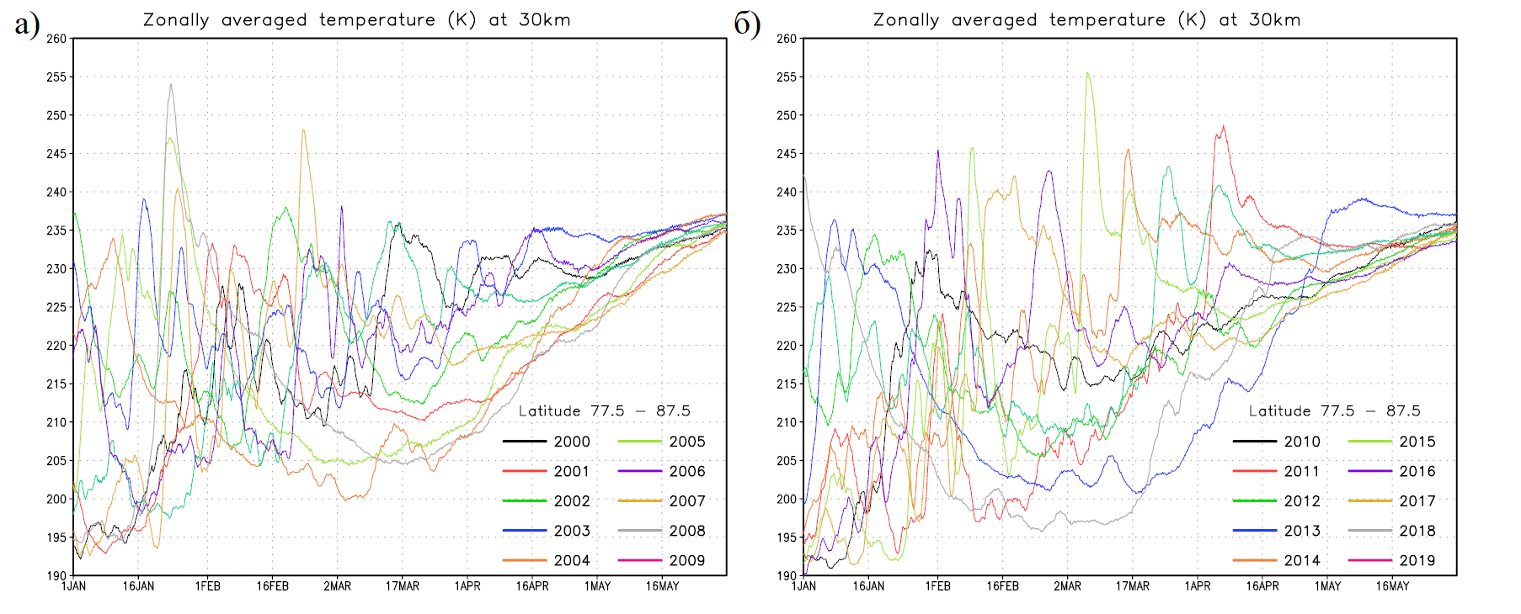
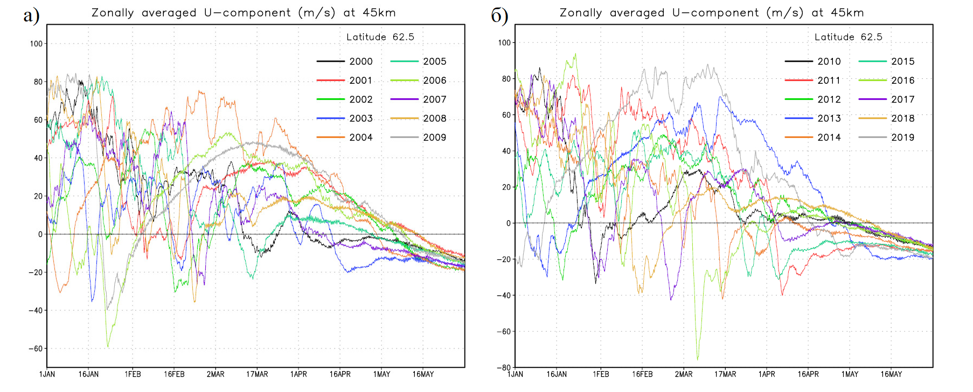
THANK YOU FOR YOUR ATTENTION
ЗАКЛЮЧЕНИЕ
РЕЗУЛЬТАТЫ
а)
Зонально усредненная температура (K) на 30 км
б)
Зонально усредненная температура (K) на 30 км
Подводя итог проделанной работы, можно сделать следующие выводы:
Тропопауза чувствительна к воздействиям внезапных стратосферных потеплений
Подъем тропопаузы в январе последнего десятилетия на станциях Черский и Диксон вызван уменьшением количества ВСП в этот период, тем не менее они имели место быть, что и проявляется в поведении тропопаузы на станциях Кеймбридж-Бей и Иллоккортоормиут в виде ее небольшого провисания и отсутствия разницы с первым десятилетием соотетственно.
В феврале в период 2010-2019 годов существенных различий замечено не было, что вероятно было вызвано примерно одинаковым по количеству и интенсивности явлений ВСП в этом месяце за оба десятилетия. Лишь относительно высокая тропопауза в начале месяца в пунктах Черский, Диксон и Иллоккортоормиут должна быть вызвана влиянием мощных и случившихся примерно в одинаковые даты ВСП во второй половине января.
Что касается марта второго десятилетия, то влияние большого, по сравнению с первым десятилетием, количества ВСП и их сила оказало существенное влияние на положение тропопаузы. В Черском различия не так заметны, но тем не менее наблюдается опускание в середине месяца. На станции Иллоккортоормиут видно, что тропопауза повела себя “типичным” образом и провисла. Однако в пунктах Диксон и Кеймбридж-Бей она стала выше, особенно в последнем. Что можно объяснить разрушением полярного вихря, последующим проникновением холодных арктических воздушных масс в более низкие широты и соответственным подъемом теплых воздушных масс в северные.
в)
Зонально усредненная U – компонента ветра (м/с) на 45 км
г)
Зонально усредненная U – компонента ветра (м/с) на 45 км

