Slide 1


Kinetic modeling of non-thermal atmospheric losses for the exoplanet pi Men c forced by the host star
Международная Байкальская молодежная научная школа по фундаментальной физике
"ФИЗИЧЕСКИЕ ПРОЦЕССЫ В КОСМОСЕ И ОКОЛОЗЕМНОЙ СРЕДЕ"
XVIII Конференция молодых ученых
"Взаимодействие полей и излучения с веществом" Иркутск, 1-7 сентября 2024 г.
Avtaeva A.A., Shematovich V.I.
Institute of astronomy RAS

Slide 2
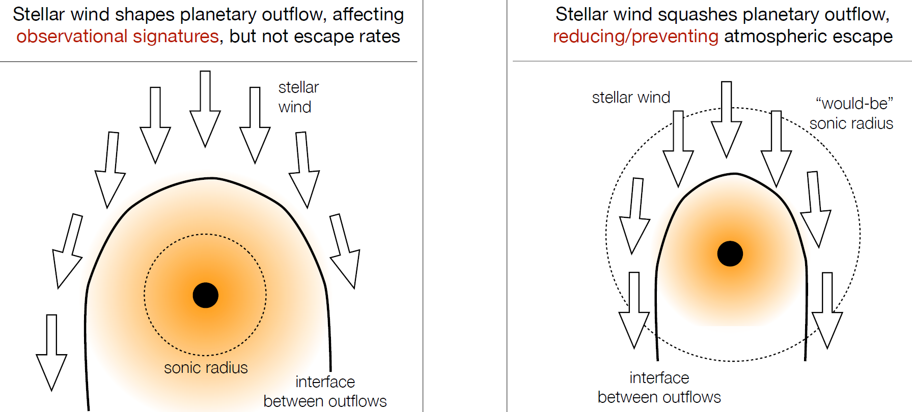
Influence of the host star
hydrodynamic compression of the atmosphere
Stellar wind
stellar wind proton charge exchange – ENA H
Hard UV flux
atmospheric escape due to exothermic photochemical reactions
Notes:
Исследование воздействия ЗВ на атмосферу экзопланет, что приводит к образованию протяженной газовой оболочки. Раннее расмотривалось только гидродинамическое приближение, а мы использовали кинетический подход, что бы учесть возможные кинетические воздействия.

Slide 3
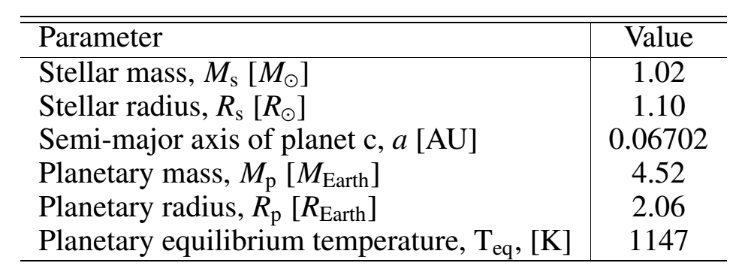
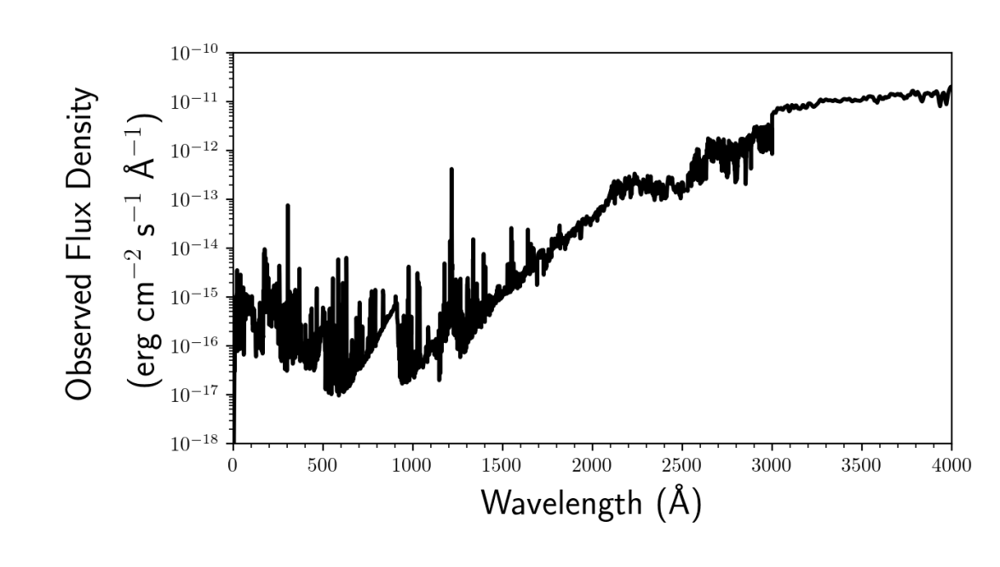
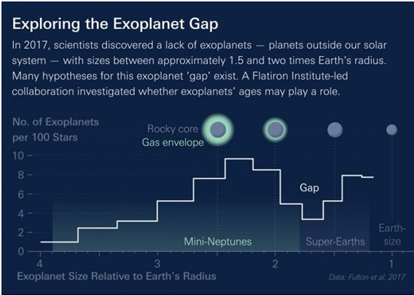
π Men c – sub-neptune
Parameters π Men and π Men c system (Gandolfi et al. (2018))
π Men spectrum is of solar type star (Garcia-Munoz et al., 2020). The age is 3 bln years
Hot sub-neptune (super-earth) π Men c is the first transit planet discovered by TESS space telescope (Gandolfi et al., 2018). Atmosphere of this exoplanet was studied by HST, but absorption in red or blue wings of Ly-α line wasn`t detected (García Muñoz et al., 2020).
Parameters of π Men atmosphere from aeronomic model were used (Shaikhislamov et al., 2020).

Slide 4
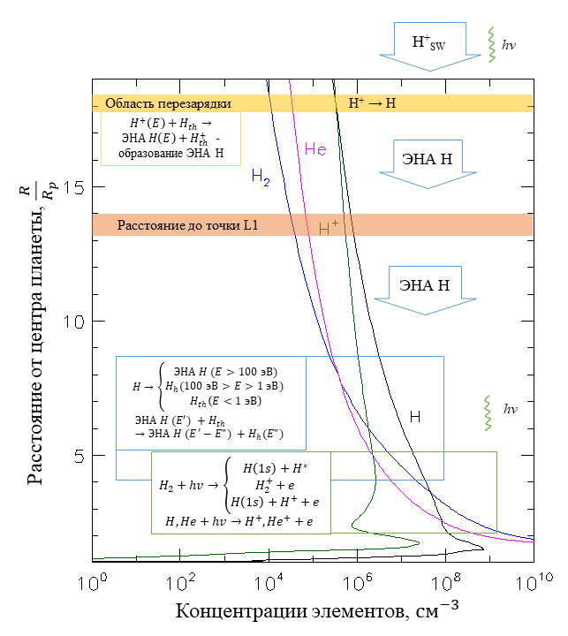
Influence of the host star on the exoplanet atmosphere
Yellow region (~ 18 R_{p}) – region of charge exchange between solar wind protons and neutral atoms of hydrogen crown, formation of ENA H.
Blue region (4.0 R_{p} – 8.6 R_{p}) – region of interaction between ENA H and atmospheric H, computational domain for formation of superthermal fraction.
Green region (2.5 R_{p} – 4.7 R_{p}) – region of interaction between XUV and H₂, also H→H₂ reaction, where exothermal photochemistry starts dominating.
Orange region (~ 13.6 R_{p}) – Lagrange point position.

Slide 5
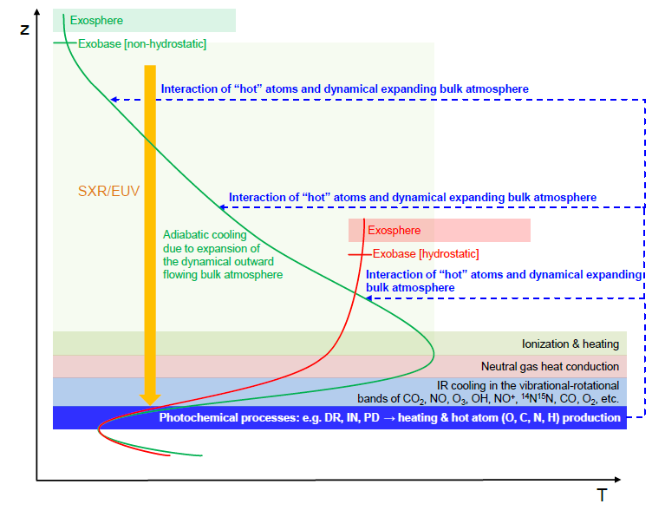
Kinetic model: formation, kinetics and transfer of suprathermal atoms
H-H₂ region
J_{α} ~ Q_{α}
Boltzmann kinetic equation
Boltzmann kinetic equation for suprathermal hydrogen atoms in the transition region of the upper atmosphere of an exoplanet:
The following codes were used to calculate the distribution functions of suprathermal hydrogen in the transition region of the upper atmosphere of a hot exoplanet:
a) Monte Carlo code for calculating source functions – rates of formation and energy spectra of suprathermal hydrogen atoms formed during the dissociation of H₂ by stellar UV radiation and the accompanying flux of photoelectrons (Shematovich, 2010);
b) Stochastic model (DSMC) for calculating the kinetics and transport of suprathermal hydrogen atoms in the transition region (Shematovich, 2004).
The thermosphere is the region where collisions dominate.
J_{α} >> Q_{α}
Hydrodynamic equations

Slide 6
Energy spectra of the upward flux of suprathermal hydrogen due to exothermic photochemistry
The host star nonthermal flux is 2,2×10¹³ cm⁻² s⁻¹ for the average level of stellar activity.
This is close to value calculated by the Jeans formula - 5,6 × 10¹² сm⁻² s⁻¹ for thermal hydrogen atoms.
Upper limit on non-thermal average flux is 9.7 × 10⁹ g/s. Close to estimate of thermal atmosphere loss (up to ~ 10¹⁰ g/s).
6

Slide 7
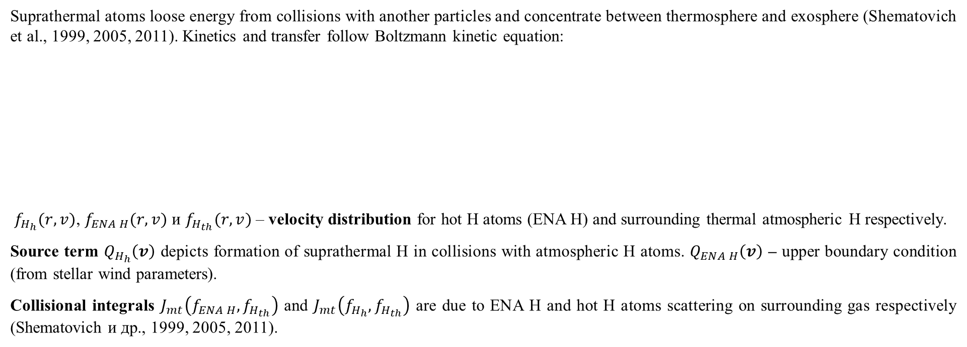
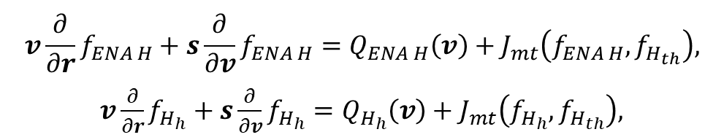
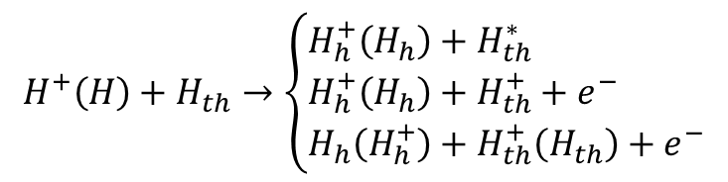

Kinetic model
$$H^{+}\left(H\right)+H_{th}→\left\{\begin{aligned}&H_{h}^{+}\left(H_{h}\right)+H_{th}^{∗} \\ &H_{h}^{+}\left(H_{h}\right)+H_{th}^{+}+e^{−} \\ &H_{h}\left(H_{h}^{+}\right)+H_{th}^{+}\left(H_{th}\right)+e^{−}\end{aligned}\right.$$
$H^{+}\left(E\right)+H_{th}→ЭНА H\left(E\right)+H_{th}^{+}$
$ЭНА H (E′>100 eV) +H_{th}→ ЭНА H (E^{′}−E">100 eV) +H_{h}(E">1 eV)$
Suprathermal atoms loose energy from collisions with another particles and concentrate between thermosphere and exosphere (Shematovich et al., 1999, 2005, 2011). Kinetics and transfer follow Boltzmann kinetic equation:
$f_{H_{h}}(r,v)$, $f_{ENA H}(r,v)$ и $f_{H_{th}}(r,v)$ – velocity distribution for hot H atoms (ENA Н) and surrounding thermal atmospheric H respectively.
Source term $Q_{H_{h}}\left(v\right)$ depicts formation of suprathermal H in collisions with atmospheric H atoms. $Q_{ENA H}\left(v\right)$ – upper boundary condition (from stellar wind parameters).
Collisional integrals $J_{mt}\left(f_{ENA H},f_{H_{th}}\right)$ and $J_{mt}\left(f_{H_{h}},f_{H_{th}}\right)$ are due to ENA Н and hot H atoms scattering on surrounding gas respectively (Shematovich и др., 1999, 2005, 2011).
$$v\frac{∂}{∂r}f_{ENA H}+s\frac{∂}{∂v}f_{ENA H}=Q_{ENA H}\left(v\right)+J_{mt}\left(f_{ENA H},f_{H_{th}}\right),$$
$v\frac{∂}{∂r}f_{H_{h}}+s\frac{∂}{∂v}f_{H_{h}}=Q_{H_{h}}\left(v\right)+J_{mt}\left(f_{H_{h}},f_{H_{th}}\right),$
Notes:
Исследование воздействия ЗВ на атмосферу экзопланет, что приводит к образованию протяженной газовой оболочки. Раннее расмотривалось только гидродинамическое приближение, а мы использовали кинетический подход, что бы учесть возможные кинетические воздействия.

Slide 8
Synthetic high energy H atoms spectra
We used stellar wind spectra from solar observations of SWIA (MAVEN spacecraft). 20% energy transformation to ENA H flux is assumed;
Synthetic spectra for 8.0R_{p} distance are presented;
327 (budget) - 131 (downward) - 2 (upward) = 194 erg cm⁻² s⁻¹ heats an atmosphere.
Notes:
В качестве энергетического спектра ЗВ мы использовали измеренный прибором SWIA на борту КА MAVEN на орбите Марса, данный поток был перешкалирован на орбиту исследуемой экзопланеты. Этот поток измерен для умереного низкого уровня солнечной активности. ЗВ у других звезд не меряются. Данных о звездных ветрах у других звезд отсутствуют

Slide 9
Downward and upward fluxes spectra
Downward
Upward
Energy
Spectra are strongly non-equilibrium.
Integration gives height profiles of H Ly-α line.
Particles
Notes:
Проинтегрировать под кривой, то мы найдем светимость в линии Лайман а.

Slide 10
Height profiles of high energy atoms fluxes
Fluxes through:
Upper bound – 1.6×10¹⁰ cm⁻² s⁻¹ atoms, equivalent energy 7.8 erg cm⁻² s⁻¹;
Lower bound – 1.8×10⁸ cm⁻² s⁻¹ atoms, equivalent energy 0.19 erg cm⁻² s⁻¹;

Slide 11


High energy H fractions
H⁺_{SW}
hv
Область перезарядки
Расстояние до точки L1
Расстояние от центра планеты, $\frac{R}{R_{p}}$
Концентрации элементов, $см^{−3}$

Slide 12
Conclusion:
Study of π Men c atmosphere loss is important, because planet is on bound between sub-neptunes and super-Earths;
Interaction of atmosphere with stellar wind and extrim UV causes heating. Exothermic photochemistry leads to atmosphere mass loss and cooling;
We performed calculations for medium stellar activity. With UV flares, strong wind or coronal mass ejections influence of parent star would be stronger.
The work was carried out with the support of the RNF project 22-12-00384.
Thank you for your attention!

